Slide 1
Information Technology Project Management – Fifth Edition
By Jack T. Marchewka
Northern Illinois University
4-<number>
Copyright 2015 John Wiley & Sons, Inc.

Slide 2
Project Planning: The Project Infrastructure
Chapter 4
4-<number>
Copyright 2015 John Wiley & Sons, Inc.

Slide 3
Learning Objectives
Describe the planning phase of the project life cycle (PLC)
Define the project’s infrastructure.
Describe project governance and its role.
Understand the roles of the project manager and how the project team is selected.
Understand how a project acquires both internal and external resources.
Understand and describe the project environment.
Describe three general categories for procurement-type contracts.
Develop a project charter and understand its relationship to the project plan.
4-<number>
Copyright 2015 John Wiley & Sons, Inc.

Slide 4
Introduction
The Project Planning Phase Attempts to Answer the Following Questions:
  What work needs to be done?
  Who will do the work?
  What resources will be needed to do the work?
  When will they do the work?
  How long will it take?
  How much will it cost?
  Does the time, money, and resources invested support the project’s MOV?
4-<number>
Copyright 2015 John Wiley & Sons, Inc.

Slide 5
Introduction (continued)
Project’s have…
  An Infrastructure
  A Governance structure
  Required Resources (must be obtained)
  A Project Charter
4-<number>
Copyright 2015 John Wiley & Sons, Inc.

Slide 6
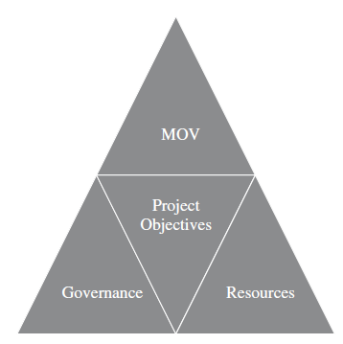
Figure 4.1 – The Project Infrastructure
4-<number>
Copyright 2015 John Wiley & Sons, Inc.

Slide 7
Project Governance
Should flow from organizational governance
Provides a framework to ensure that a project aligns with a chosen business strategy while ensuring that the time, money, and resources provide real value to the organization.
Projects governance must define:
  Structure
  Authorization
  Oversight and Accountability
  Decision Making
  Resources
4-<number>
Copyright 2015 John Wiley & Sons, Inc.

Slide 8
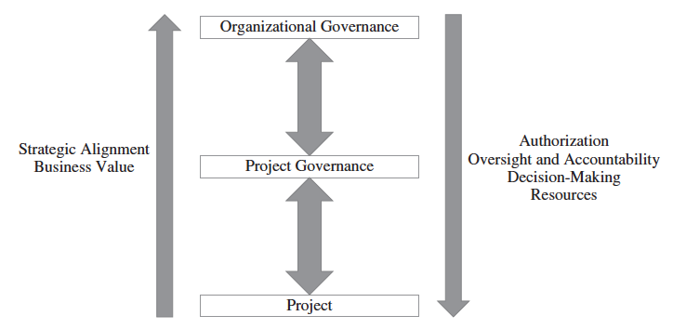
Figure 4.2 Project Governance
4-<number>
Copyright 2015 John Wiley & Sons, Inc.

Slide 9
The Project Team
The Roles of the Project Manager
  Managerial role
  Leadership role
Attributes of a successful project manager
  ability to communicate with people
  ability to deal with people
  ability to create and sustain relationships
  ability to organize
The Project Team
  Technology Skills
  Business/organization knowledge
  Interpersonal skills
4-<number>
Copyright 2015 John Wiley & Sons, Inc.

Slide 10
The Formal Organization
Formal groupings & specializations
Published Lines of
  Authority
  Responsibilities
  Reporting Relationships
  Communication
  Decision-Making
4-<number>
Copyright 2015 John Wiley & Sons, Inc.

Slide 11
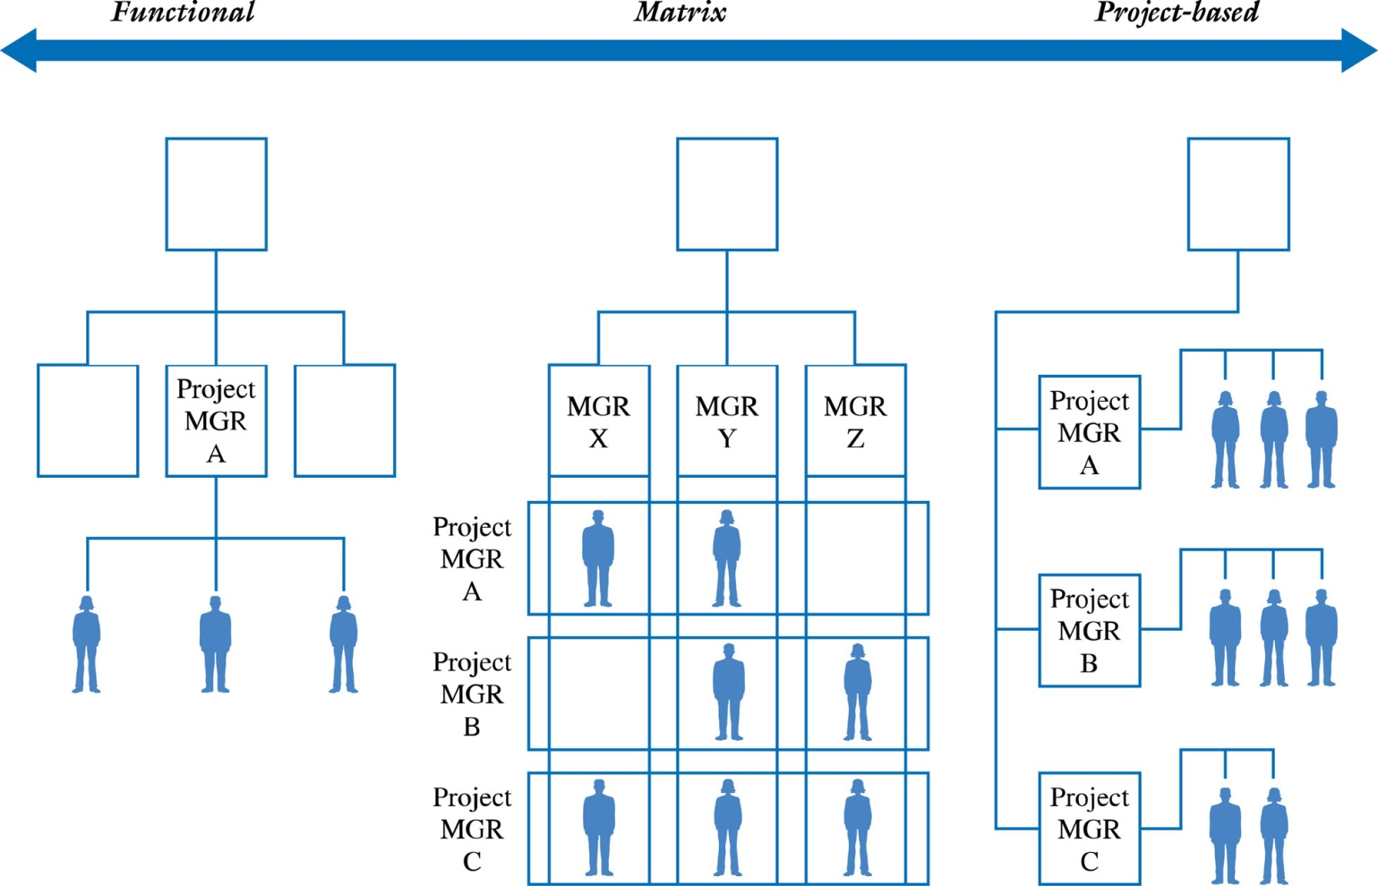
Figure 4.3 – The Organization and Project Resources
4-<number>
Copyright 2015 John Wiley & Sons, Inc.

Slide 12
The Functional Organization
Advantages
  Increased Flexibility
  Breadth & Depth of Knowledge & Experience
  Less Duplication
Disadvantages
  Determining Authority & Responsibility
  Poor Response Time
  Poor Integration
4-<number>
Copyright 2015 John Wiley & Sons, Inc.

Slide 13
The Project-Based Organization
Advantages
  Clear Authority & Responsibility
  Improved Communication
  High Level of Integration
Disadvantages
  Project Isolation
  Duplication of Effort
  “Projectitis”
4-<number>
Copyright 2015 John Wiley & Sons, Inc.

Slide 14
The Matrix Organization
Advantages
  High Level of Integration
  Improved Communication
  Increased Project Focus
Disadvantages
  Higher potential for conflict
    Team members may wonder “Who’s my boss?”
  Poorer Response Time
4-<number>
Copyright 2015 John Wiley & Sons, Inc.

Slide 15
Procuring External Project Resources
Project resources can be internal or externally acquired.
The decision depends on
  The project scope
  Availability of the products and services in the marketplace
  Cost
  Quality
  Terms and Conditions
  Experience and skills of the project team
Similar to a “make” or “buy” decision
Business process outsourcing, including offshoring, is one option for acquiring external resources
4-<number>
Copyright 2015 John Wiley & Sons, Inc.

Slide 16
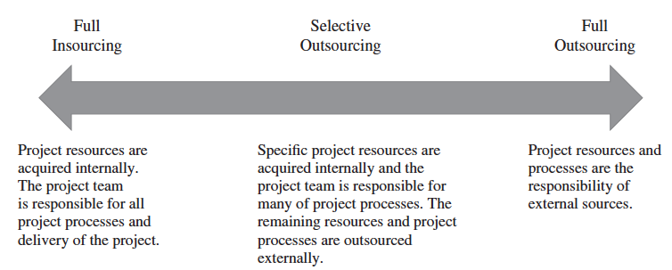
Figure 4.4 – The Project Outsourcing Model
4-<number>
Copyright 2015 John Wiley & Sons, Inc.

Slide 17
Procurement Planning
Begins by determining which project needs can be fulfilled internally or externally by the project team
Focuses on not only what can best be filled internally or externally, but
  How
  When
  How Many
  And Where these products or services will be acquired
A Request for Proposal (RFP) may be developed and used to solicit bids, quotes, or proposals for services or goods from prospective sellers.
4-<number>
Copyright 2015 John Wiley & Sons, Inc.

Slide 18
Contracts Between Sellers and Buyers
Once a seller is selected, the buyer may enter into contract negotiations so that a mutual agreement can be reached
A contract is a document signed by the buyer and seller that defines the terms and conditions of the buyer-seller relationship. IT serves as a legally binding agreement that obligates seller to provide specific products, services, or even results, while obligating the buyer to provide specific monetary or other consideration.
4-<number>
Copyright 2015 John Wiley & Sons, Inc.

Slide 19
General Categories of Procurement-type Contracts
Fixed-Price or Lump-Sum Contracts
  A total or fixed price is negotiated or set as the final price for a product or service
  May include incentives for meeting certain performance objectives or penalties if those objectives are not met
4-<number>
Copyright 2015 John Wiley & Sons, Inc.

Slide 20
Categories for Procurement-Type Contracts
Cost-Reimbursable Contracts
  Payment or reimbursement is made to the seller to cover the seller’s actual direct costs (i.e., labor, materials, etc.) and indirect costs (i.e., admin. salaries, rent, utilities, etc.)
  May include incentives for meeting certain objectives or penalties if those objectives are not met
  Types
    Cost-Plus- Fee (CPF) or Cost-Plus-Percentage (CPPC)
    Cost-Plus-Fixed-Fee (CPFF)
    Cost-Plus-Incentive-Fee (CPIF)
4-<number>
Copyright 2015 John Wiley & Sons, Inc.

Slide 21
Types of Cost-Reimbursable Contracts
Cost-Plus-Fee (CPF) or Cost-Plus-Percentage Cost (CPPC)
  The seller is paid for the costs incurred in performing the work as well as a fee based upon an agreed on percentage of the costs
Cost-Plus-Fixed-Fee (CPFF)
  The seller is reimbursed for the total direct and indirect costs of doing the work, but receives a fixed amount that does not change unless the project’s scope changes
Cost-Plus-Incentive-Fee (CPIF)
  The seller is reimbursed for the costs incurred in doing the work and receives a predetermined fee plus an incentive bonus for meeting certain objectives
4-<number>
Copyright 2015 John Wiley & Sons, Inc.

Slide 22
Categories for Procurement-Type Contracts
Time and Materials (T&M) Contracts
  A hybrid of cost-reimbursable and fixed-price contracts
  The buyer pays the seller for both the time and materials required to complete the work
    Resembles a cost-reimbursable contract because it is open-ended and full cost of project is not predetermined
    But can resemble a fixed-price contract if unit rates are set
4-<number>
Copyright 2015 John Wiley & Sons, Inc.

Slide 23
The Project Environment
A place to call home
Technology
Office supplies
Culture
  What is expected from each team member?
  What role will each team member play?
  How will conflicts be resolved?
4-<number>
Copyright 2015 John Wiley & Sons, Inc.

Slide 24
The Project Charter
Serves as an agreement and as a communication tool for all of the project stakeholders
Documents the project’s MOV
Defines the project’s infrastructure
Summarizes the details of the project plan
Defines the project’s governance structure
Shows explicit commitment to the project
See Figure 4-5 (next slide) for the typical areas of a project charter
4-<number>
Copyright 2015 John Wiley & Sons, Inc.

Slide 25
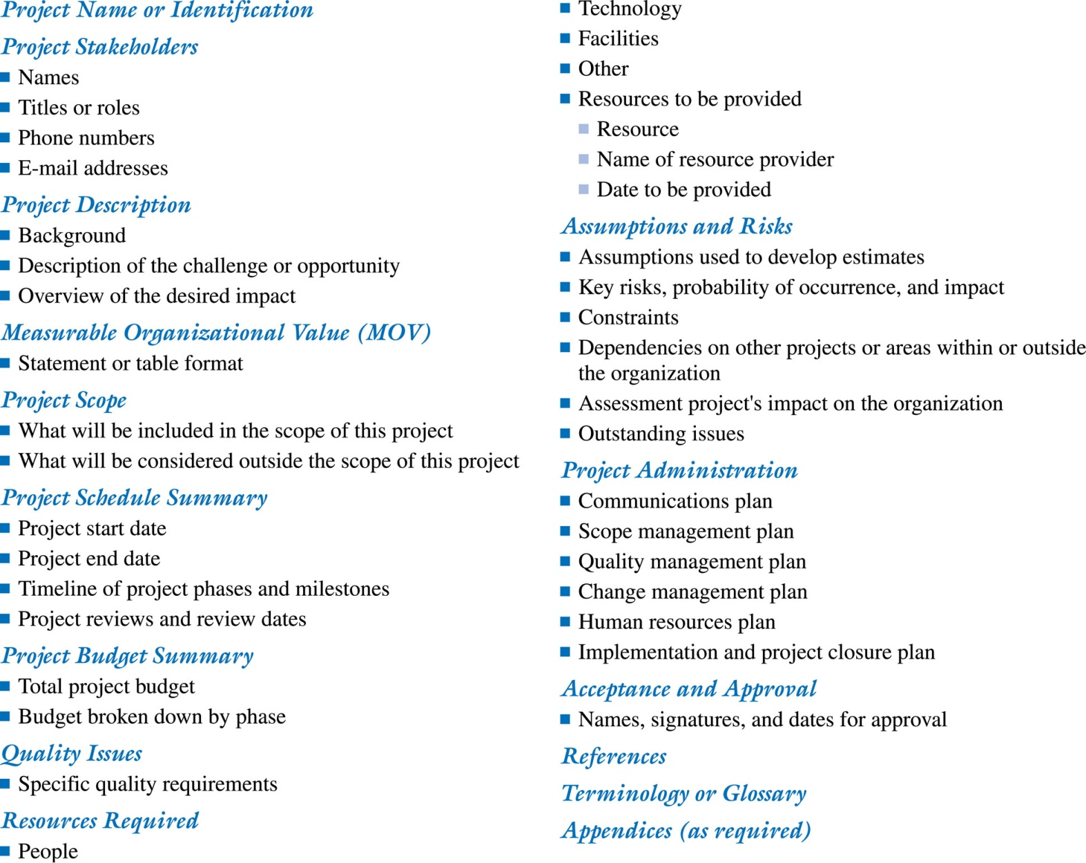
Figure 4.5 A Project Charter Template
4-<number>
Copyright 2015 John Wiley & Sons, Inc.

