Slide 1
LaunchPad Website
Preparing for Success:
A Timeline and Tracking
Tool for Young Adults

Slide 2
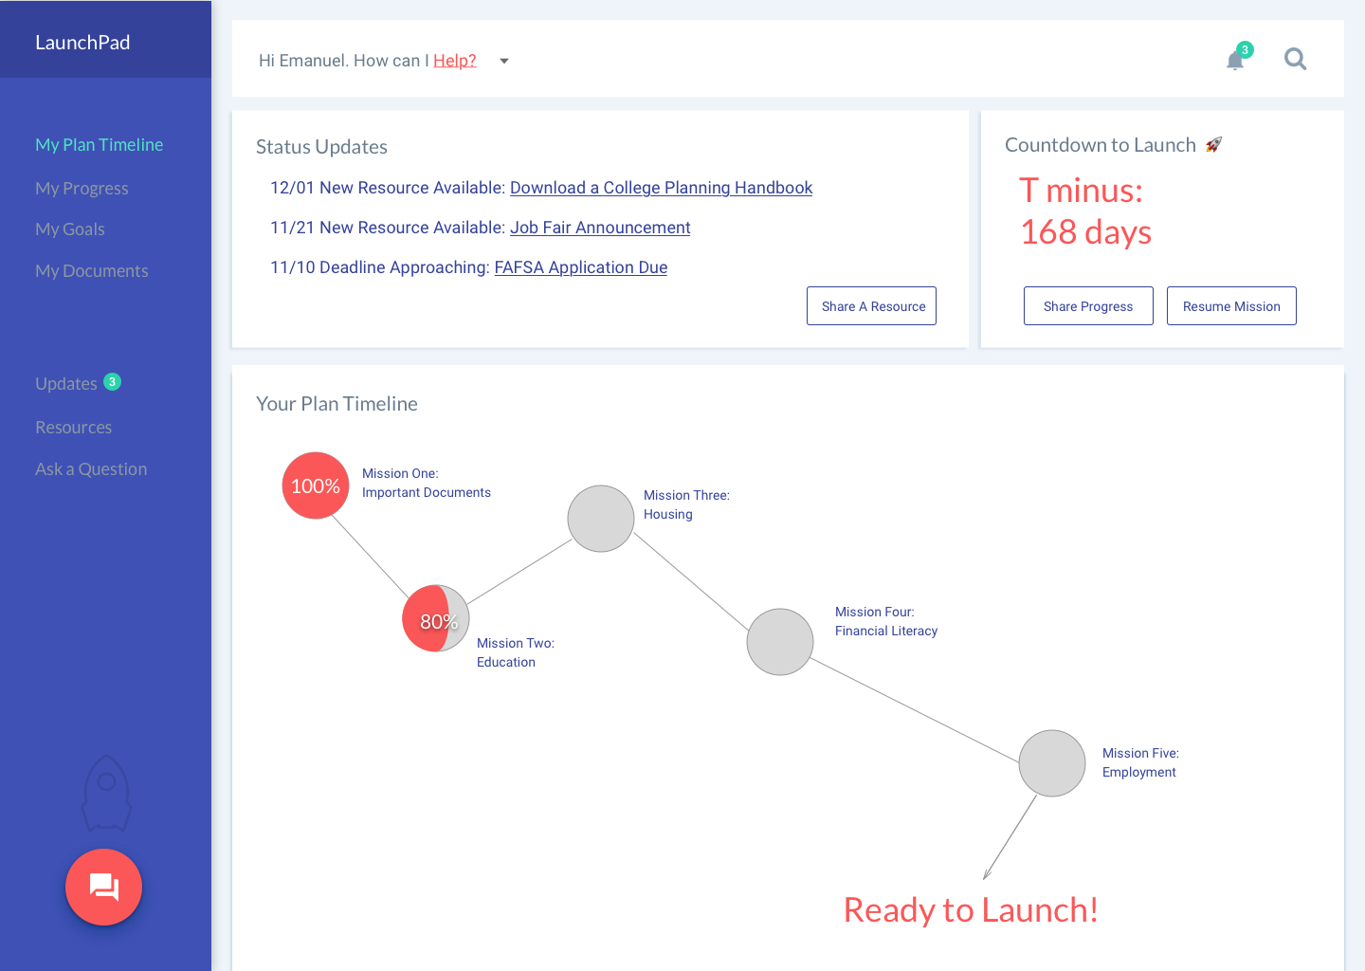
LaunchPad
Timeline View
See an overview of where you are with your plan timeline
See a countdown clock to remind of you of time left
Resources and status updates shown so you have important info first
Pick up where you left off last time or share your progress

Slide 3
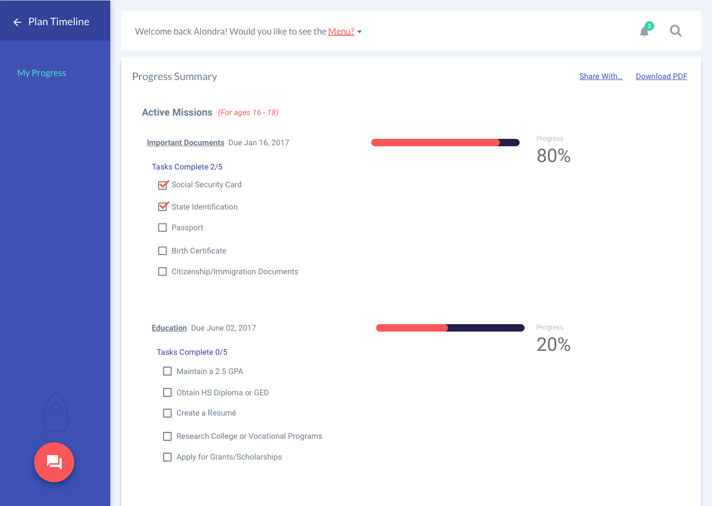
LaunchPad
Progress View
View progress on all your active missions
Share the summary with your caseworkers
Download a detailed PDF to reference during 6-month check-ins
Chat with your caseworkers to supply more detail

Slide 4
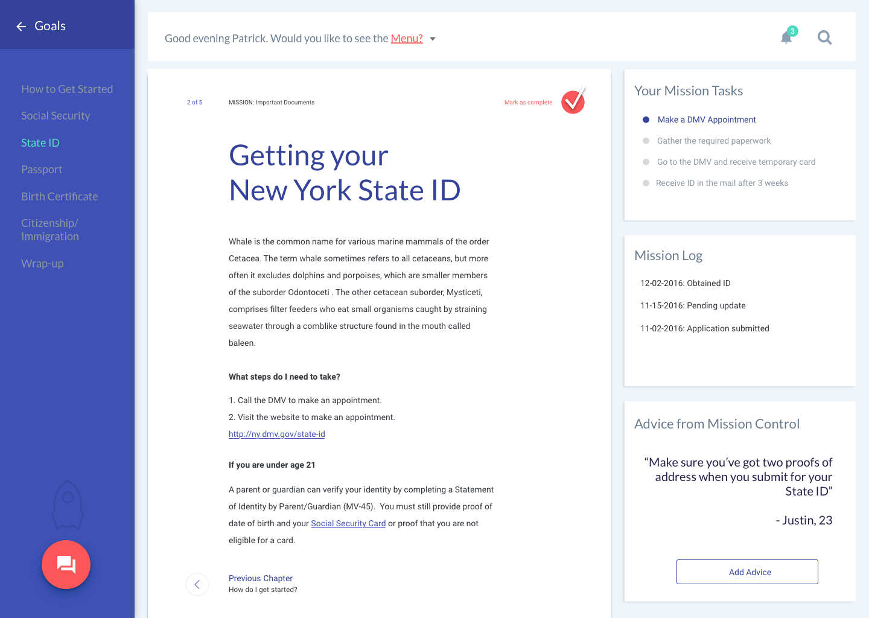
LaunchPad
Mission View
Read information about steps required to prepare
Access links to resources such as NY DMV website and documents
Complete a list of tasks for the mission
Share your advice for others

Slide 5
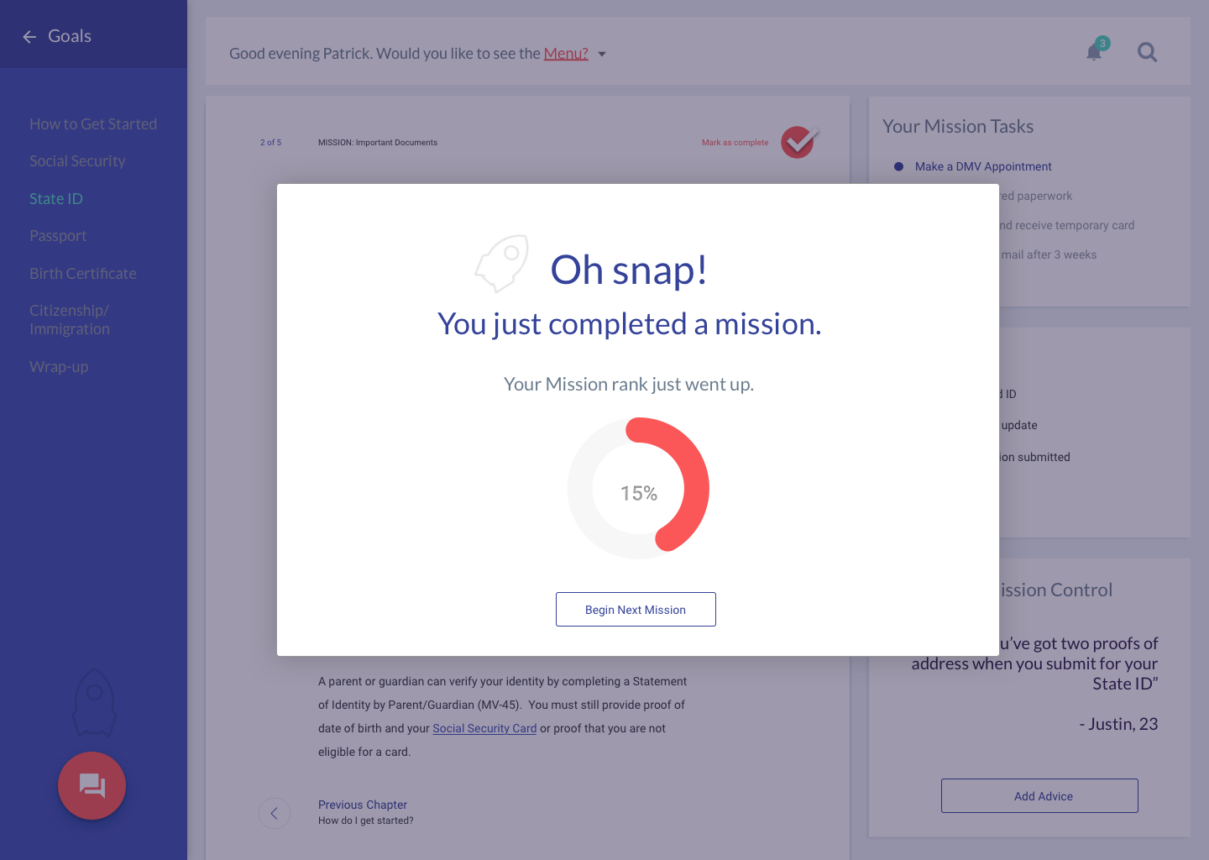
LaunchPad
Mission Complete
View your overall plan progress
Move on to your next mission
Automatically notify the caseworkers who you have shared this mission with

Slide 6
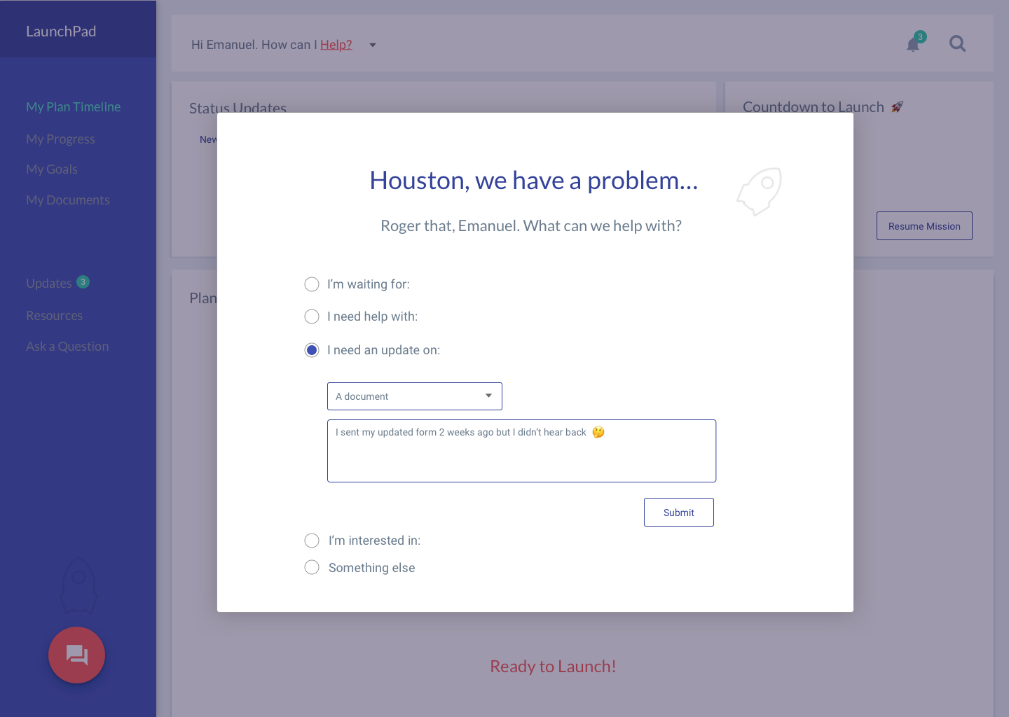
LaunchPad
Contact View
Ask your caseworker a general question
Let your caseworker know that you’re waiting for assistance
Ask for updates from your caseworker

Slide 7
Search & view nearby ACS Community Partners
See important dates & deadlines in an embedded calendar
See goal & mission suggestions based on similar peers
Securely store important PDFs and files
LaunchPad
Future Plans

Slide 8
Questions?

