Slide 1

Re-architecting for the ‘green’ cloud and lower costs Justin Cormack
1. build a cloud from lots of underpants mobile phone CPUs
2. ?
3. Profit
Notes:
There has been a lot of talk about low power “green” cloud computing, using ARM and similar CPUs.
Is this really cost effective?
Will we all be shifting away from x86 architectures in a few years?

Slide 2

What would change the status quo?
Slower processors more power efficient
But require many more of them
Much more parallelism, hard
Notes:
Processors are much more power efficient when run slow.
But we all know about Amdahl's law
And we all know that getting developers to write parallel code is not easy.
Is there a big enough gain to make this shift worthwhile?

Slide 3

Some numbers
 | RAM | power | cost | SHA1 speed
dual core 1GHz ARM | 1 GB | 4 W | $50 | 120 MB/s
dual core Pentium | 8 GB | 40 W | $500 | 720 MB/s
12 core Xeon | 64 GB | 400 W | $5000 | 3000 MB/s
Almost linear performance, not compelling. Amdahl's Law.
Notes:
If we actually look at the price, power and performance of cheap computers, we do not really see a huge benefit.
Using a rough benchmark, you seem to get what you pay for.
This is not going to change anything.

Slide 4

RAM based world
The applications we are building are very RAM hungry.
RAM based data storage: Memcache, Redis, Membase, VoltDB, Gigaspaces, TimesTen ...
EC2 offers 68GB high memory instances. Intel releasing machines that can take 1TB RAM.
ARM servers are 32 bit. 4GB is enough for anybody?
Notes:
One characteristic of modern applications is that the use a lot of RAM.
Facebook last year had 200TB of data in memcache.
We cannot replicate that on low power computers. First RAM uses a fair amount of power, also the cheap CPUs are only 32 bit, and cannot generally address as much memory as x86 servers.

Slide 5
Why are we so RAM obsessed?
Reads per second
L1 cache reference | 2,000,000,000
Branch mispredict | 200,000,000
L2 cache reference | 140,000,000
Mutex lock/unlock | 10,000,000
RAM reference | 10,000,000
datacentre round trip | 2000
hard drive seek | 100
Intercontinental round trip | 10
Notes:
Why have we built everything in RAM?
There is a huge performance gap between RAM performance and disk.
Disk is too slow for web applications to read from.

Slide 6
Hold on, something happened...
Reads per second
L1 cache reference | 2,000,000,000
Branch mispredict | 200,000,000
L2 cache reference | 140,000,000
Mutex lock/unlock | 10,000,000
RAM reference | 10,000,000
SLC flash SSD, PCIe | 180,000
MLC flash SSD, SATA | 35,000
datacentre round trip | 2000
hard drive seek | 100
Intercontinental round trip | 10
Notes:
But we have suddenly got a technology to fill that gap, flash memory.
Over the last few years it has started to turn into a mainstream commodity storage medium.

Slide 7
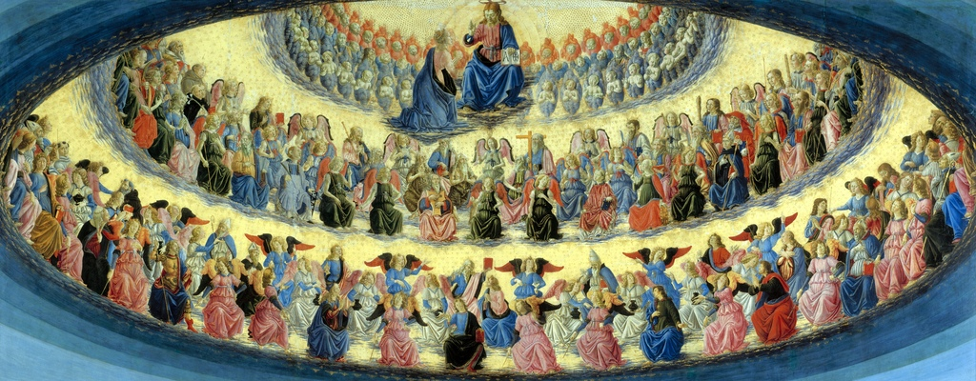
Marriage made in heaven?
RAM | $75 / GB | 250 W / TB
SSD | $2 / GB | 2 W / TB
Notes:
And flash is cheap compared to RAM, and very low power.
Because it fits in that gap between fast RAM and slow hard drives it gives us a new option.

Slide 8
Cheapest Space / Transactions
1000
Hard Disk
100
SSD
10
RAM
1
Notes:
There is a middle ground
Hard drives are great if you have lots of data and very few accesses to it.
RAM is great if you need to access a small amount of data very fast.
In the middle flash gives you a middle ground of fast enough access to quite big data.
And as its price falls, this slice increases.

Slide 9
Which workloads?
Middle ground of performance
Read dominated
Up to 1k requests per second per CPU
Medium latency 10–100ms per request
eg web serving SAAS, 1GB data per customer
12 core xeon | 64 GB RAM | $5,000 | 64 customers | $78 each | 400 W
2 core ARM | 512 GB SSD | $1,000 | 512 customers | $2 each | 4 W
Notes:
This middle ground covers a fair amount of useful web workloads.
Not for high speed trading, or for backups.
But responsive web applications. The kind of stuff clouds are used a lot for.

Slide 10
Business case for low power cloud?
Not just more slower processors
Not a replacement for all workloads
low cost commodity middle ground
Use SSD not RAM or hard drive
Needs optimised software
Upside is potentially 10-100x cheaper
Notes:
So it does look like there is a real opportunity for low power cloud if we change the architecture enough.
Flash is becoming a new commodity technology, and matches up well with low power CPUs.
Like most cloud applications, you can't just take old code and run it.
But it can be substantially cheaper for commodity workloads.

Slide 11





Questions?
@justincormack
justin@specialbusservice.com
http://blog.technologyofcontent.com/
http://google.com/profiles/justincormack

