Slide 1
Wine Quality Predictors
Areej, Courtney, Isaac, Justin, and Sandra

Slide 2
Project scope
Use machine learning models to analyze existing data to predict and classify wine quality (as judged by experts) based on traits like acidity, residual sugar, and alcohol concentration
Train and tune support-vector machines, a random forest, a neural network, xgboost, kmeans, k-nearest neighbor, and a logistic regression

Slide 3
Can we predict the quality of a wine?
Publicly accessible wine data intended for research
P. Cortez, A. Cerdeira, F. Almeida, T. Matos and J. Reis. Modeling wine preferences by data mining from physicochemical properties. In Decision Support Systems, Elsevier, 47(4):547-553, 2009.

Slide 4
Libraries and modules used
Sci-Kit Learn
RandomForestRegressor
Matplotlib, NumPy
Pandas ML
Tableau
R

Slide 5
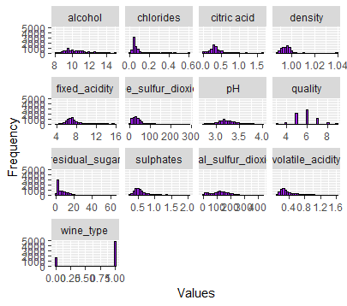
A quick look
Twelve factors to judge quality of red and white wines
Data irregularities
significantly more red wines than white wines
Quality score ranges from 1 – 10 yet we have significantly more mid-tier wines

Slide 6
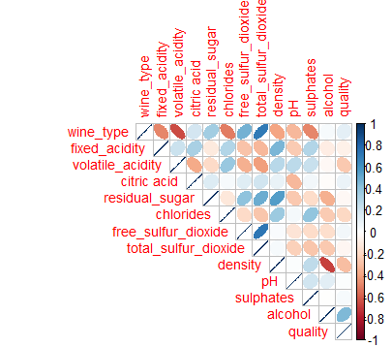
Correlations
Strong positive correlation between wine type and sulfur dioxide
Semi-strong positive correlation between alcohol level and quality
Strong negative correlation between wine type and fixe acidity
Strong negative correlation between density and sulphates

Slide 7
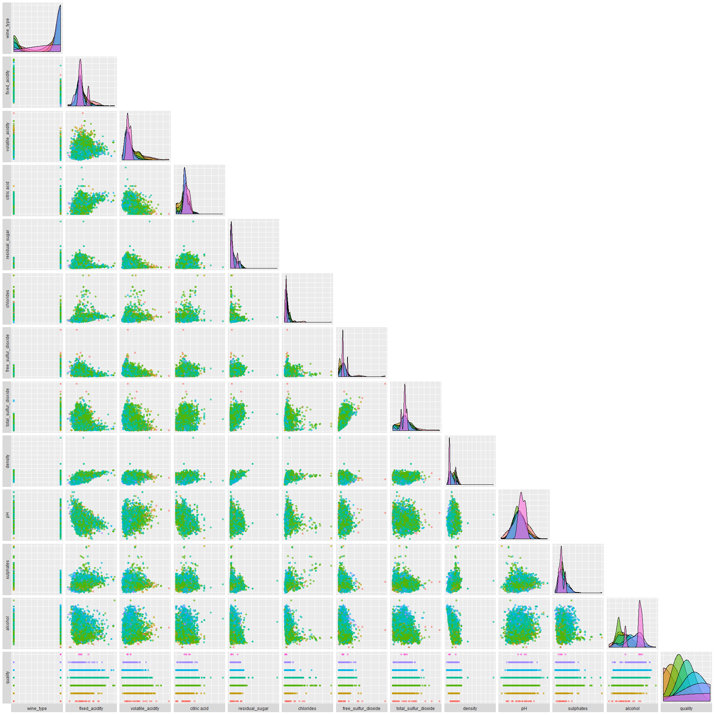
A Pairwise correlation chart for ants

Slide 8
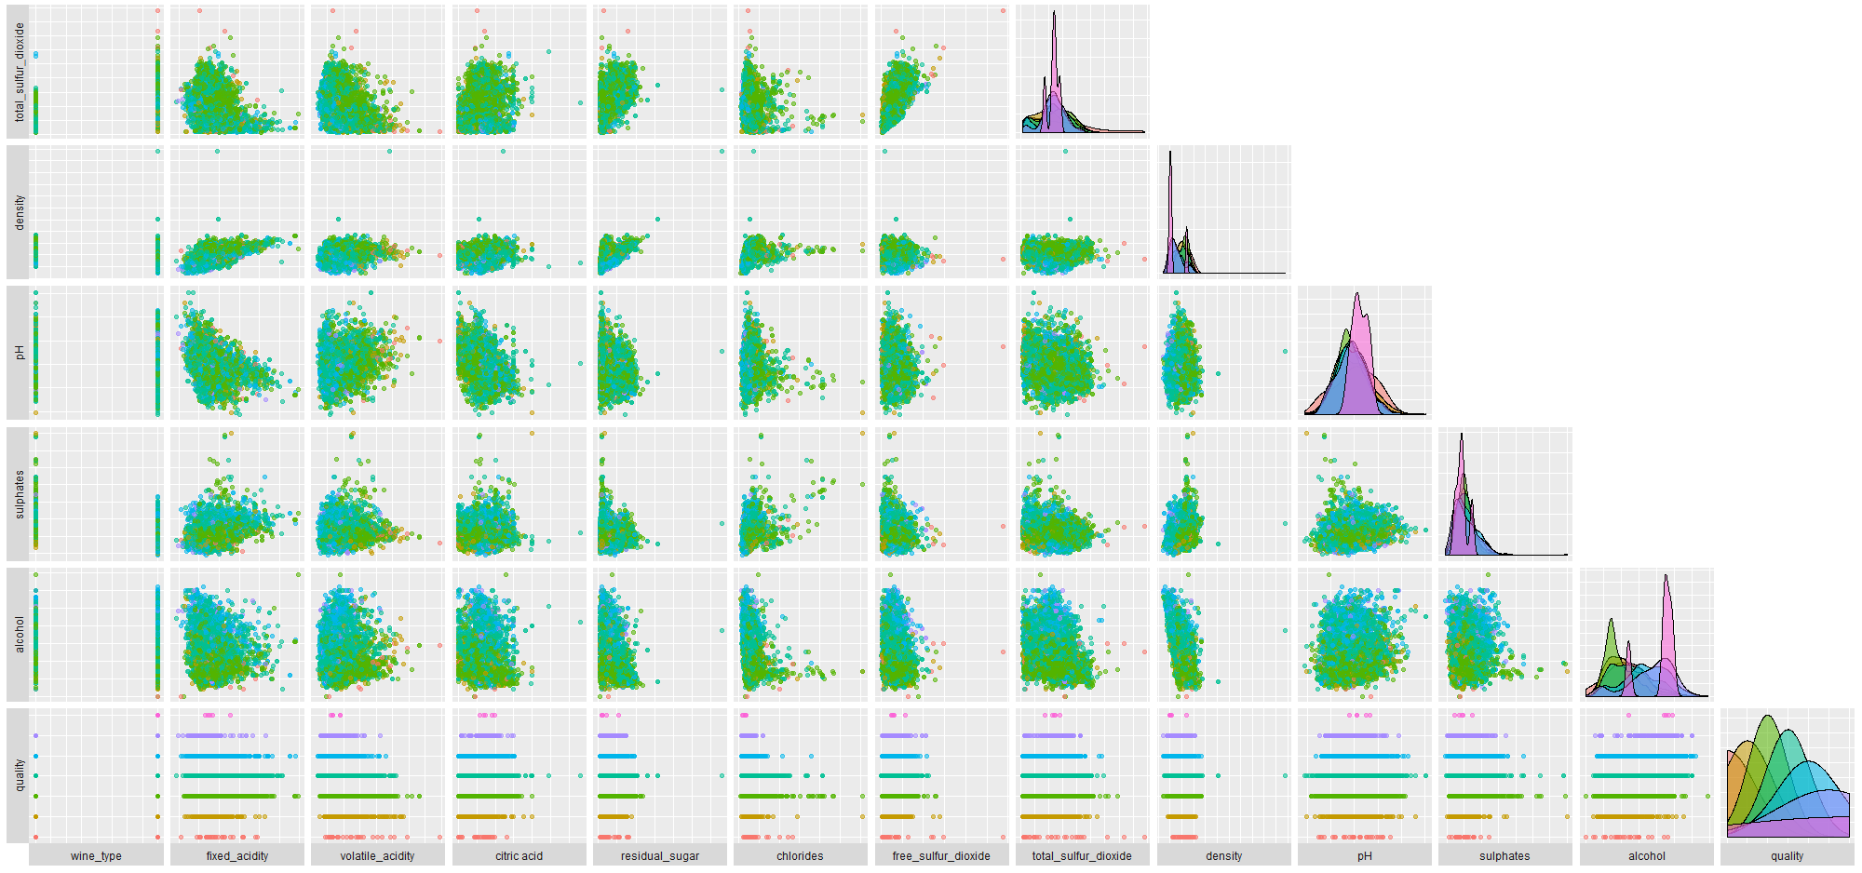
A better look

Slide 9
Machine learning modules

Slide 10
Classification models
other models
Linear regression
kmeans
Random Forest
Logistic regression
Source vector machine
K-nearest neighbor
XG Boost
Neural Network

Slide 11
Random forest

Slide 12
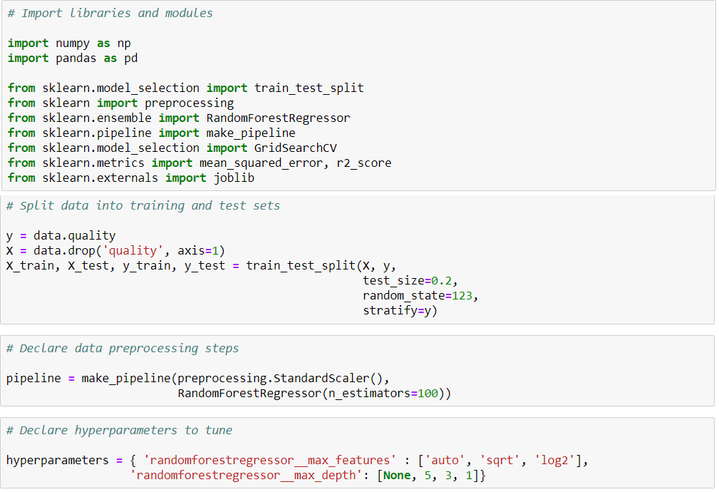
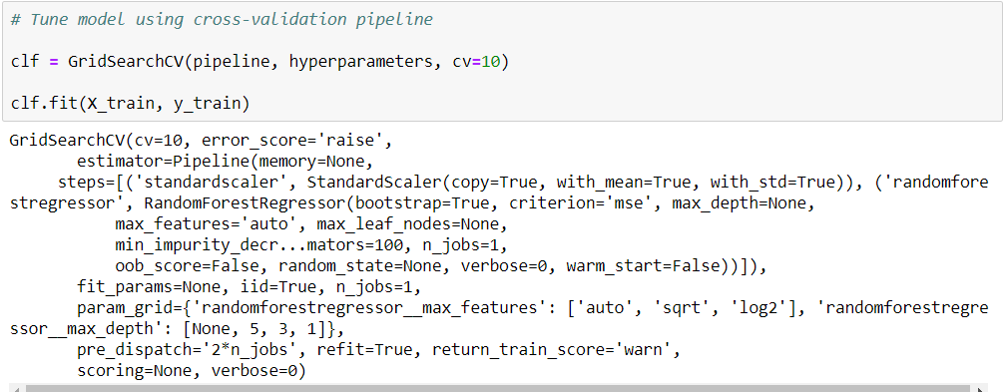
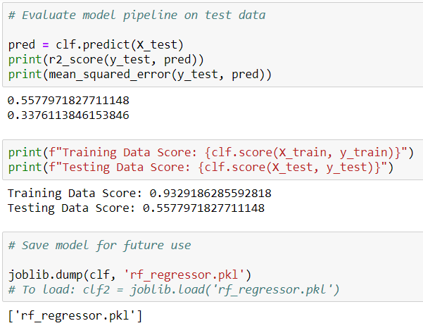
Code and measurements

Slide 13
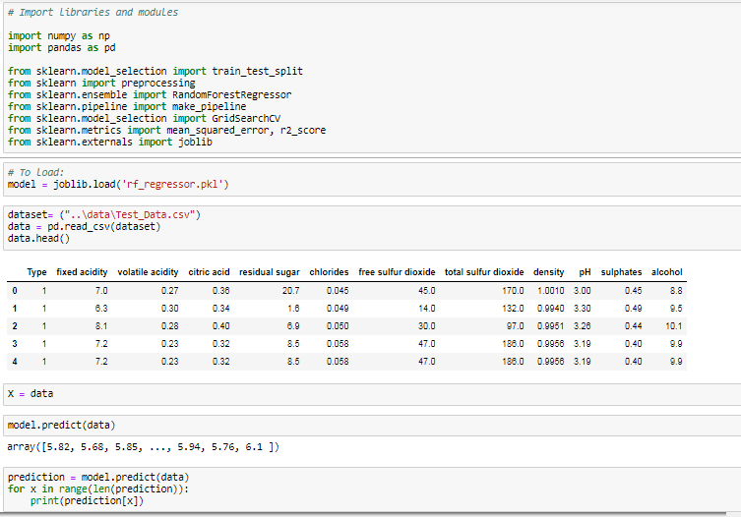
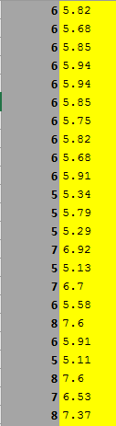
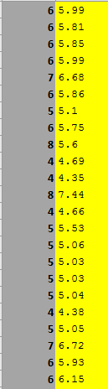
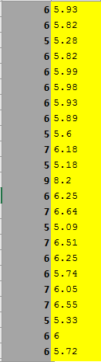
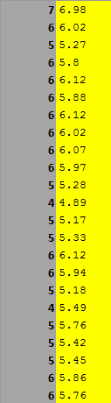
analysis

Slide 14
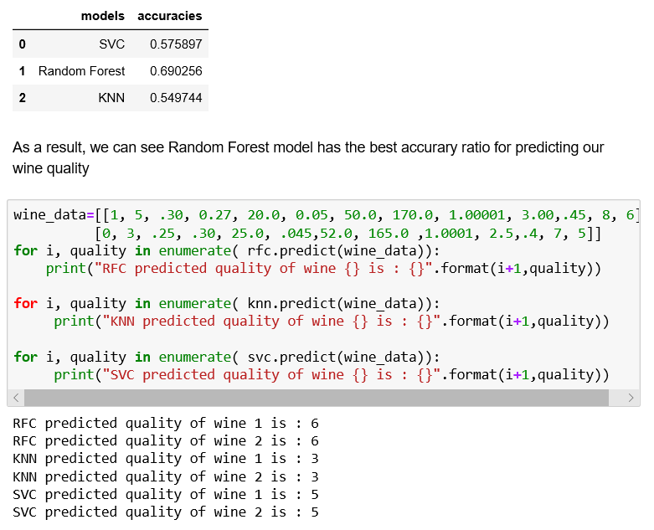
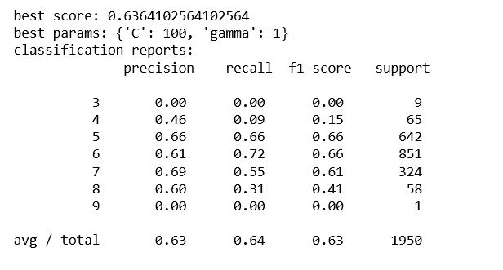
Classifications

Slide 15
Classifications

Slide 16
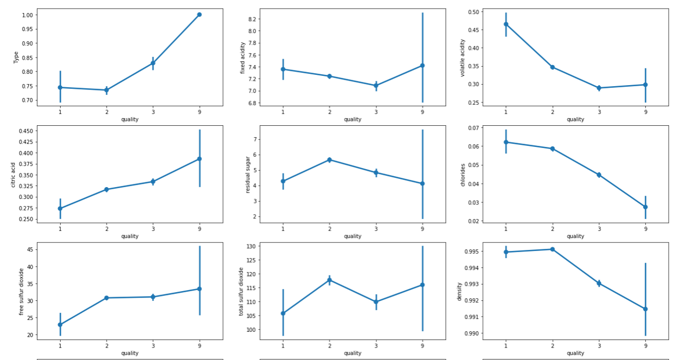
analysis

Slide 17
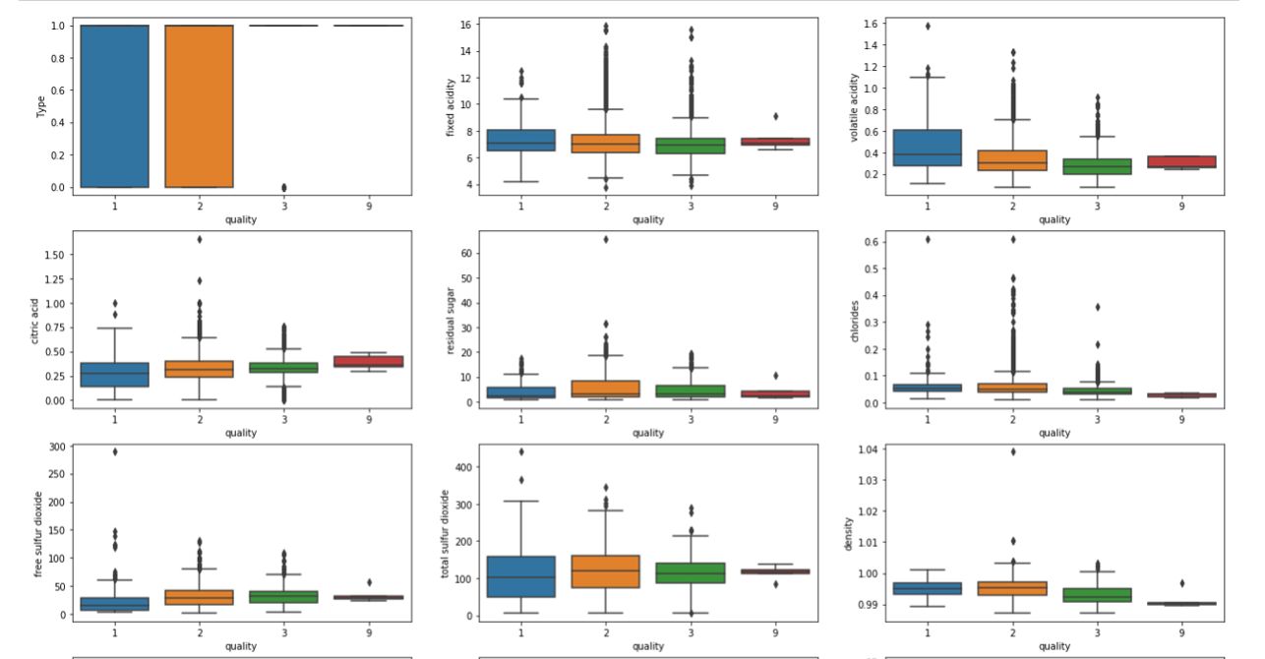

Slide 18
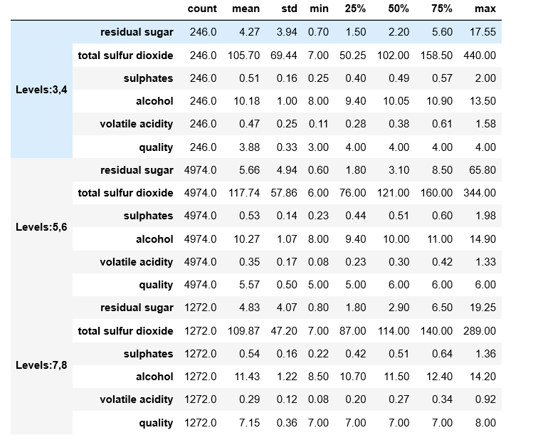
Statistical analysis

Slide 19
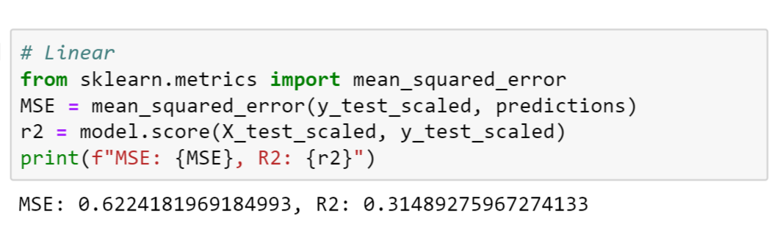
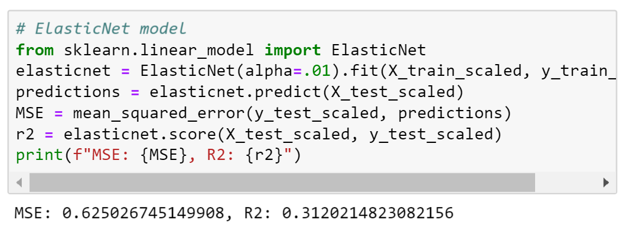
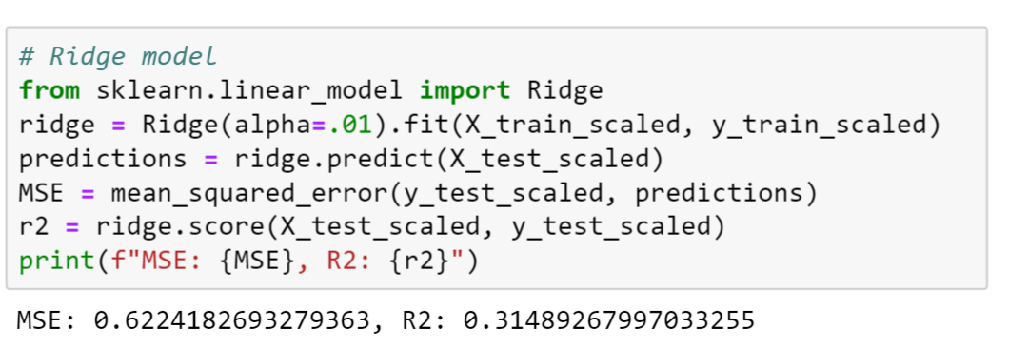
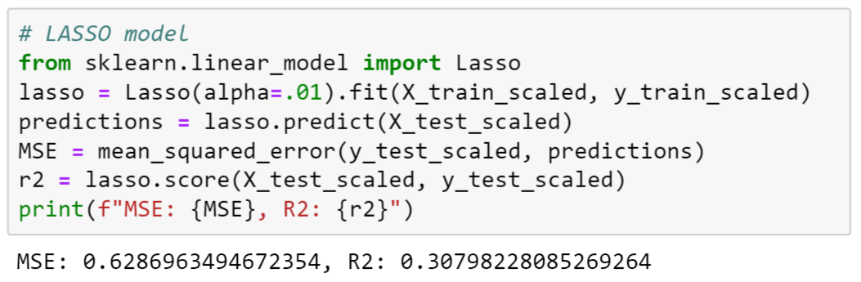
Linear Regression - Code and measurements
Data is non linear
MSE describes the avG error
R2 percent is low
Linear regression is not suitable for this data set

Slide 20
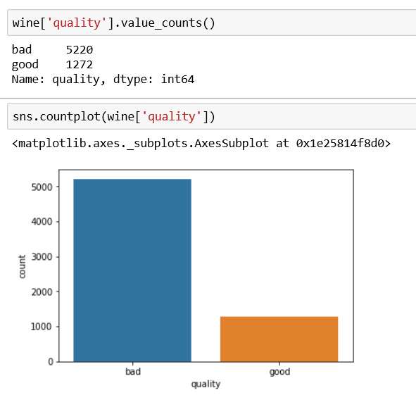
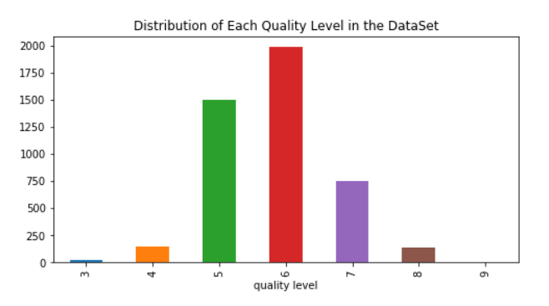
Distribution and Classification

Slide 21
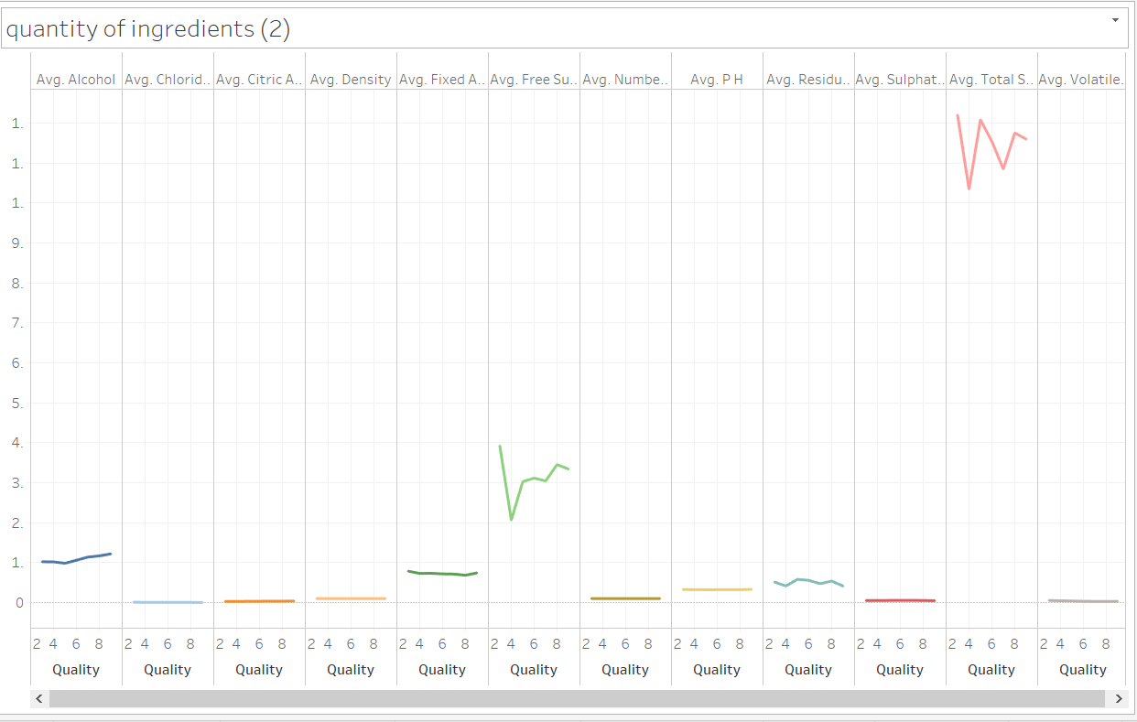
Quality correlation to ingredients

Slide 22
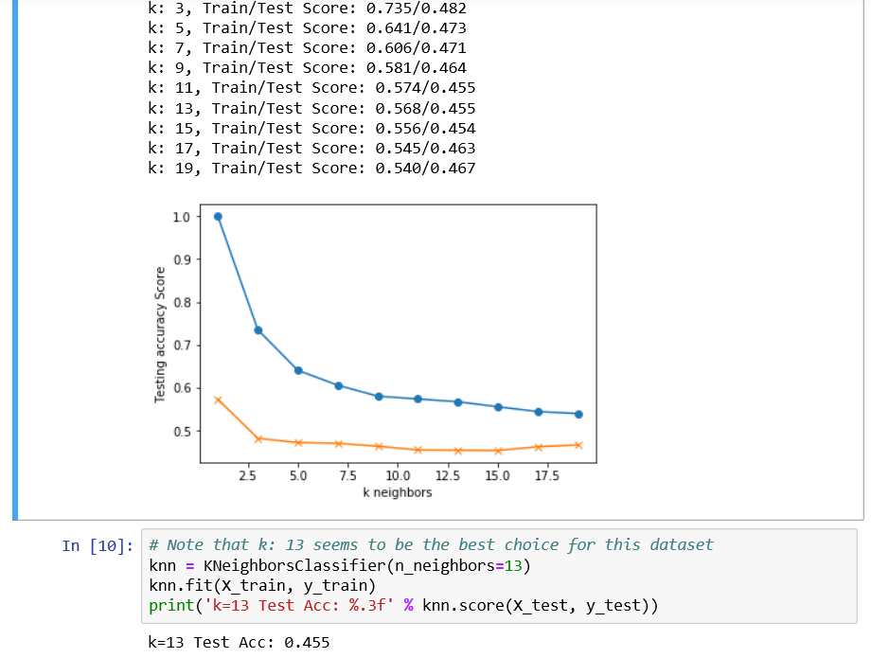
K-nearest neighbor
Accuracy 45%
Leveled out at K 13

Slide 23
analysis

Slide 24
Source vector machine

Slide 25
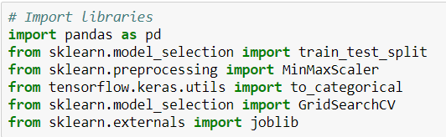
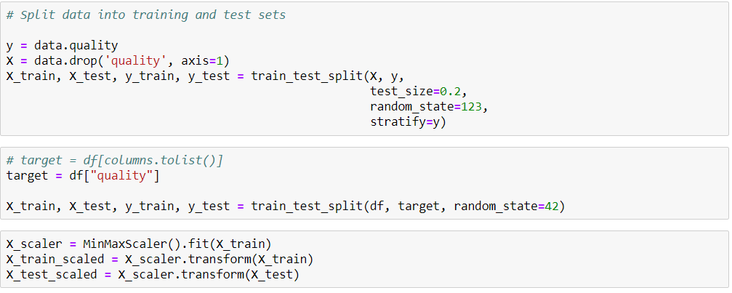
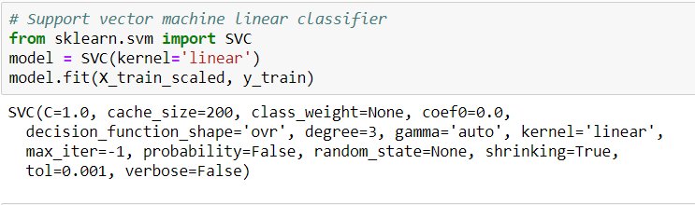
Code and measurements

Slide 26
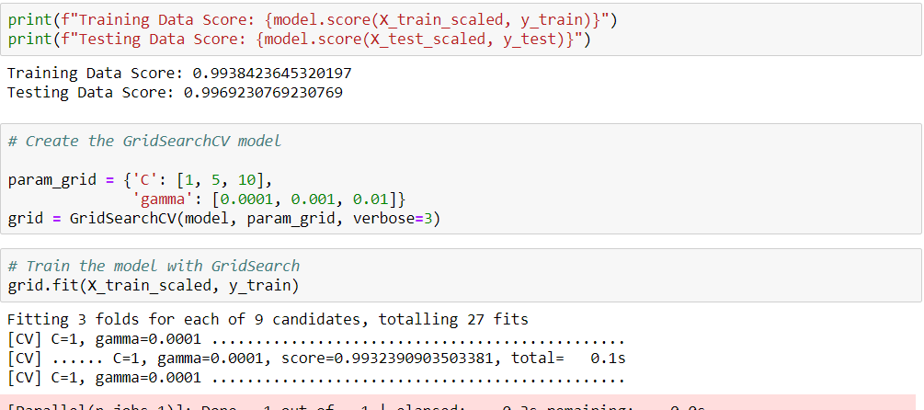

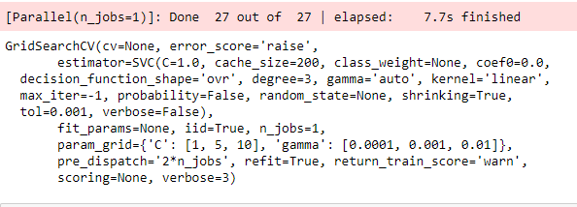

Slide 27
analysis

Slide 28
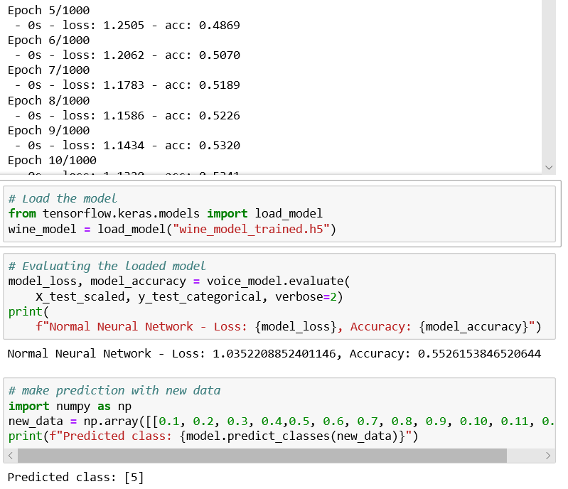

Neural network
Predicted 5
Accuracy 55%
Ran 1000 Epoch

Slide 29
Xg boost

Slide 30
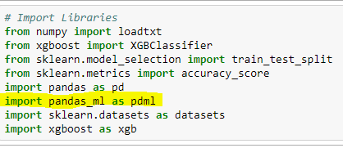
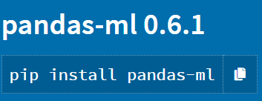
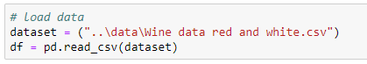
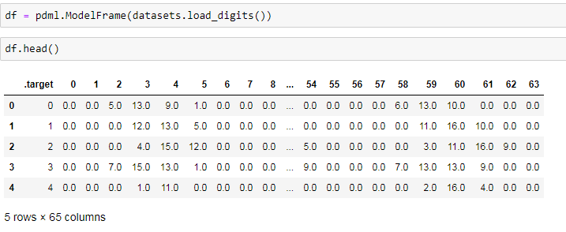
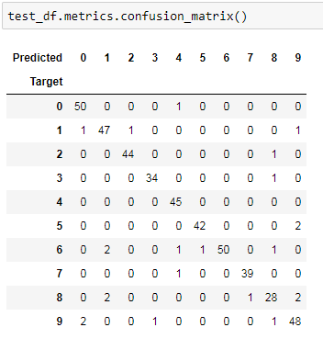
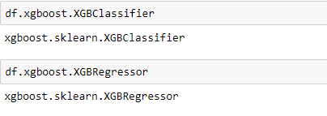
Code and measurements

Slide 31
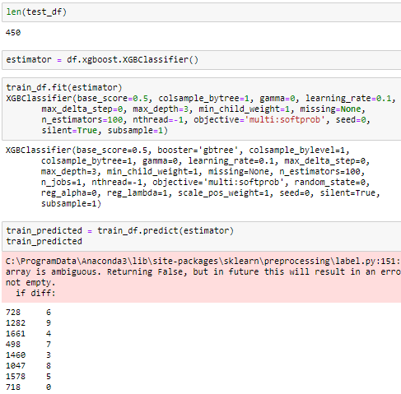

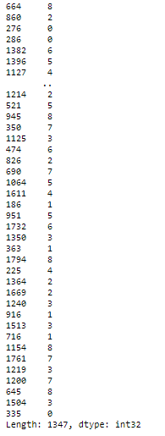

Slide 32
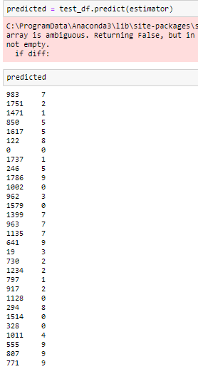
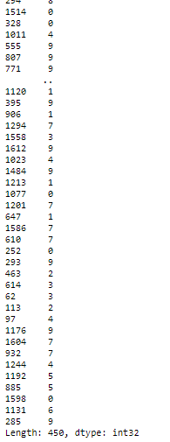
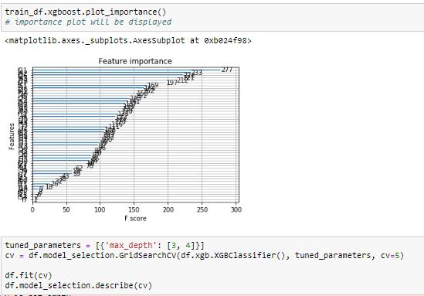
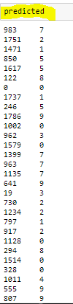
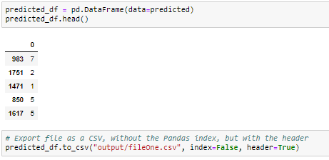

Slide 33
analysis

Slide 34
conclusions
* Discuss your findings. Did you find what you expected to find? If not, why not? What inferences or general conclusions can you draw from your analysis?
* Summarize your conclusions. This should include a numerical summary (i.e., what data did your analysis yield), as well as visualizations of that summary (plots of the final analysis data)
* Discuss the implications of your findings. This is where you get to have an open-ended discussion about what your findings mean

Slide 35
Post mortem
* Discuss any difficulties that arose, and how you dealt with them
* Discuss any additional questions that came up, but which you didn't have time to answer: What would you research next, if you had two more weeks?

Slide 36
Any questions?

