Slide 1
Wine Quality Predictors
Areej, Courtney, Isaac, Justin, and Sandra

Slide 2
Project scope
Use machine learning models to analyze existing data to predict and classify wine quality (as judged by experts) based on traits like acidity, residual sugar, and alcohol concentration
Train and tune support-vector machines, a random forest, a neural network, xgboost, kmeans, k-nearest neighbor, and a logistic regression

Slide 3
Libraries and modules used
Sci-Kit Learn
RandomForestRegressor
Matplotlib, NumPy
Pandas ML
Tableau
R

Slide 4
The data

Slide 5
Can we predict the quality of a wine?
Publicly accessible wine data intended for research
P. Cortez, A. Cerdeira, F. Almeida, T. Matos and J. Reis. Modeling wine preferences by data mining from physicochemical properties. In Decision Support Systems, Elsevier, 47(4):547-553, 2009.

Slide 6
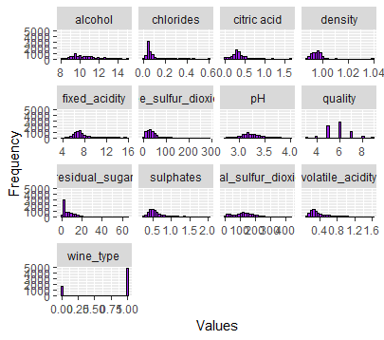
A quick look
Twelve factors to judge quality of red and white wines
Data irregularities
significantly more red wines than white wines
Quality score ranges from 1 – 10 yet we have significantly more mid-tier wines

Slide 7
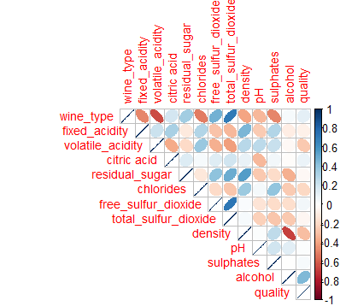
Correlations
Strong positive correlation between wine type and sulfur dioxide
Semi-strong positive correlation between alcohol level and quality
Strong negative correlation between wine type and fixe acidity
Strong negative correlation between density and sulphates

Slide 8
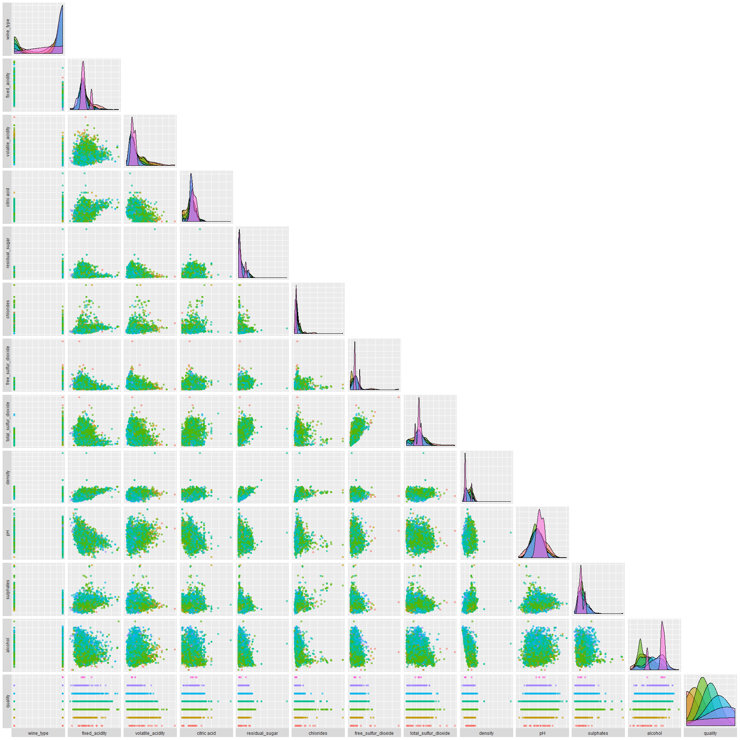
A Pairwise correlation chart for ants

Slide 9
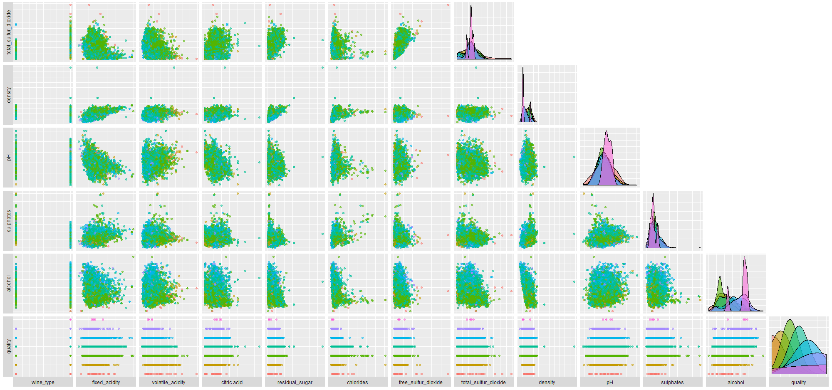
A better look

Slide 10
Machine learning modules

Slide 11
Classification models
other models
Linear regression
kmeans
Random Forest
Logistic regression
Source vector machine
K-nearest neighbor
XG Boost
Neural Network

Slide 12
Linear regression

Slide 13
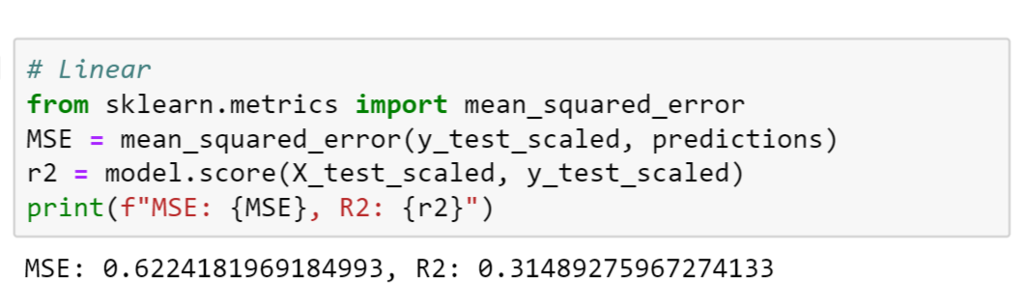
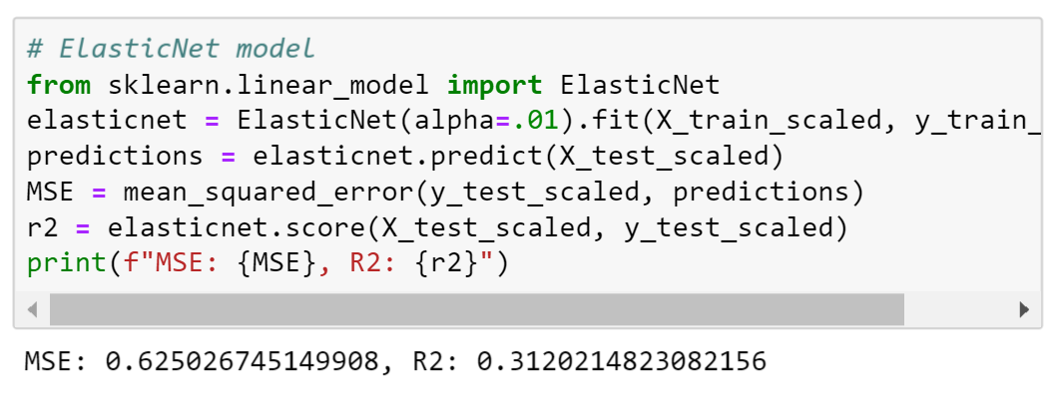
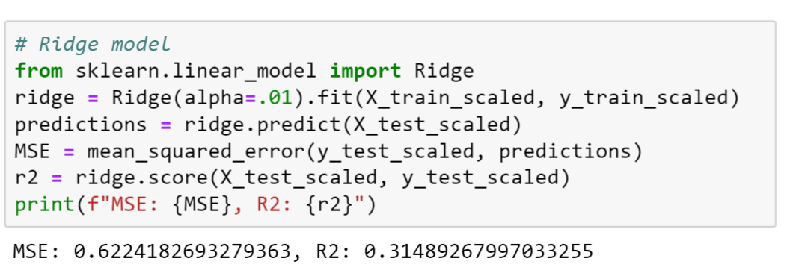
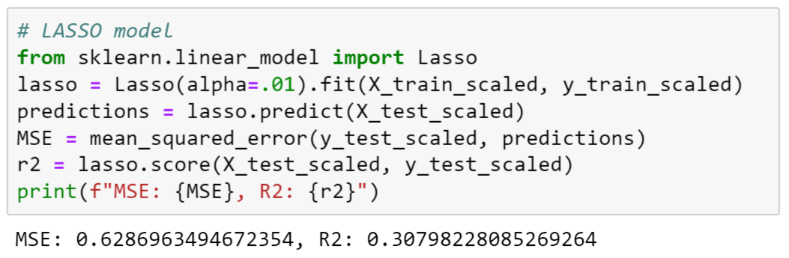
Code and measurements

Slide 14
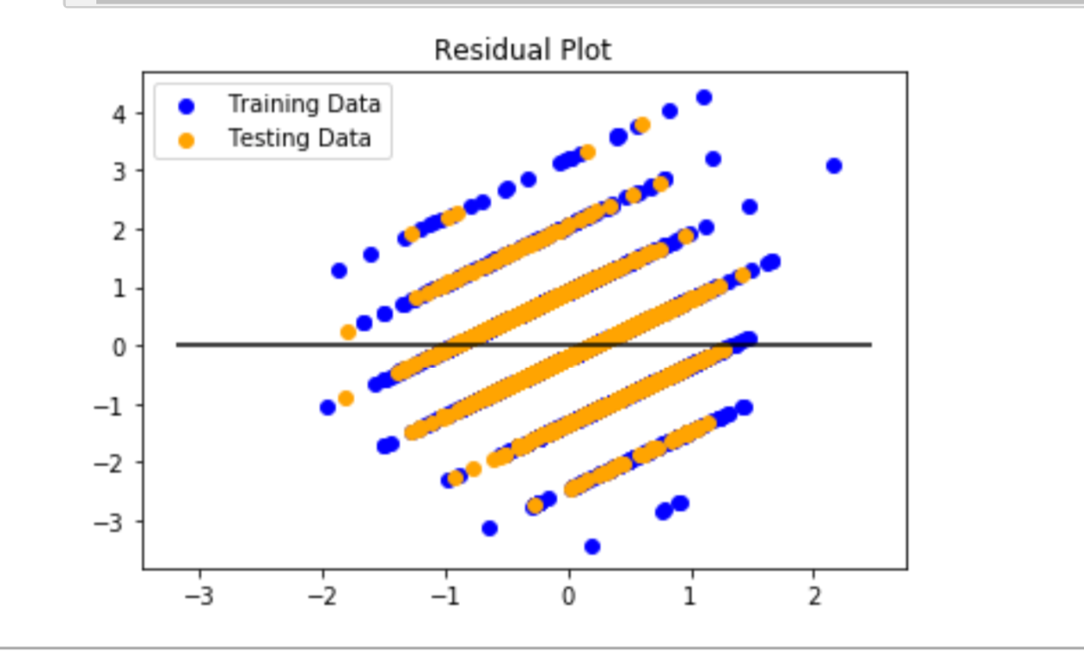
analysis

Slide 15
Random forest

Slide 16
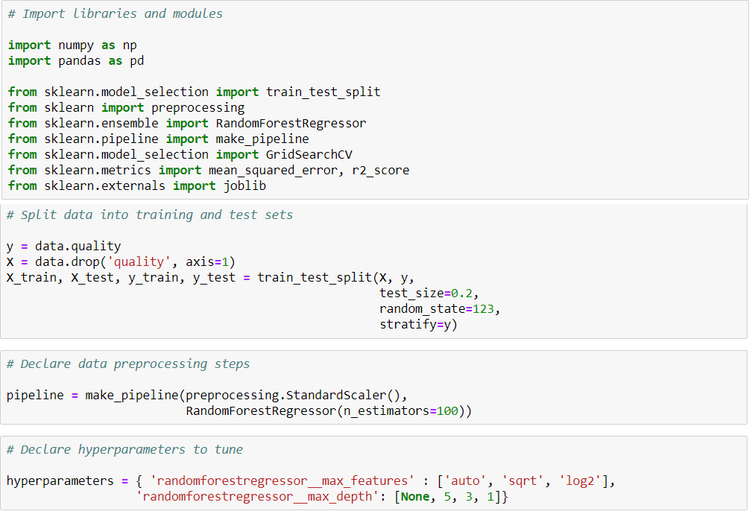
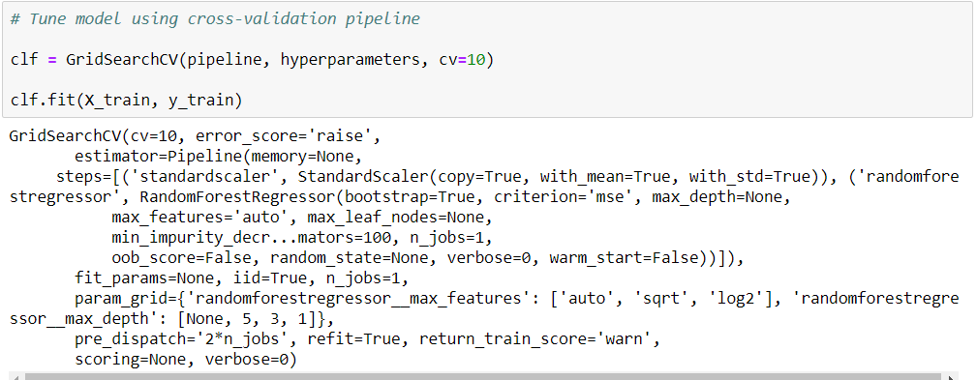
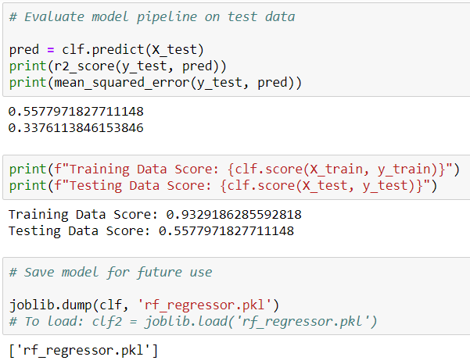
Code and measurements

Slide 17
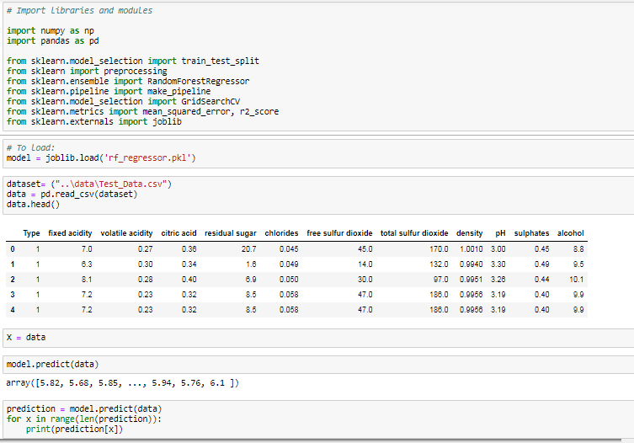
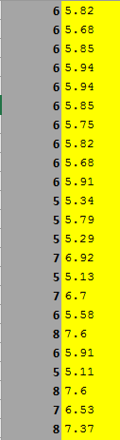
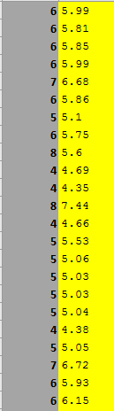
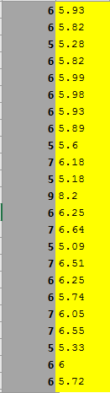
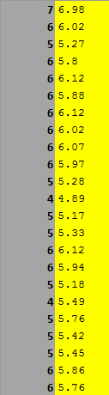
analysis

Slide 18
K-nearest neighbor

Slide 19
Code and measurements

Slide 20
analysis

Slide 21
Logistic regression

Slide 22
Code and measurements

Slide 23
analysis

Slide 24
K-means

Slide 25
Code and measurements

Slide 26
analysis

Slide 27
Source vector machine

Slide 28
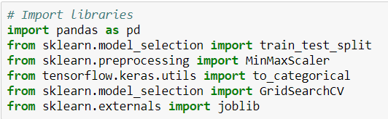
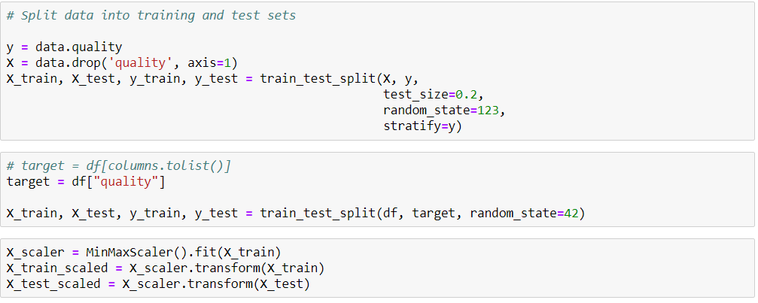
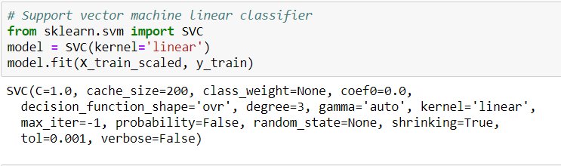
Code and measurements

Slide 29
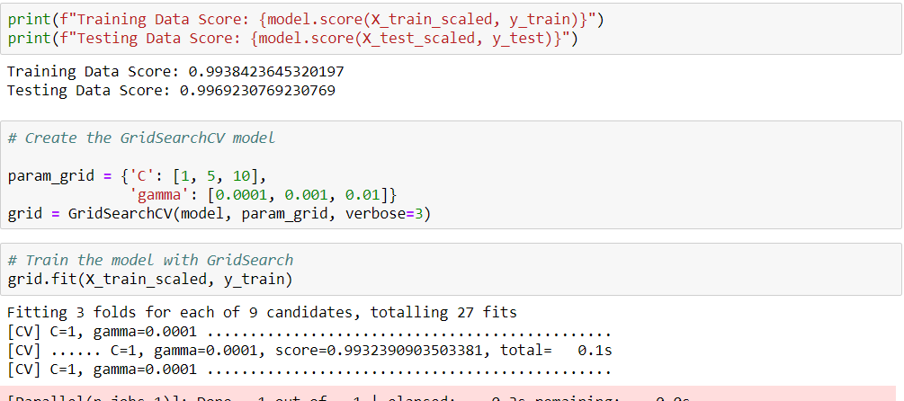

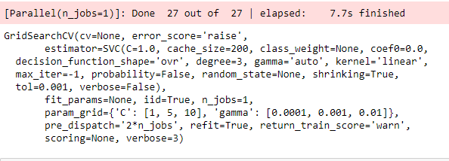

Slide 30
analysis

Slide 31
Neural network

Slide 32
Code and measurements

Slide 33
analysis

Slide 34
Xg boost

Slide 35
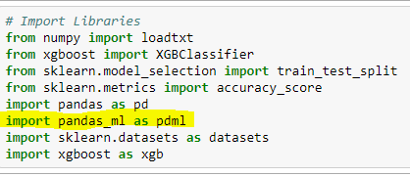
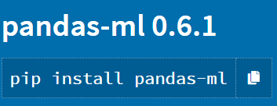
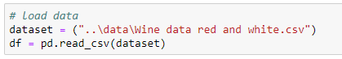
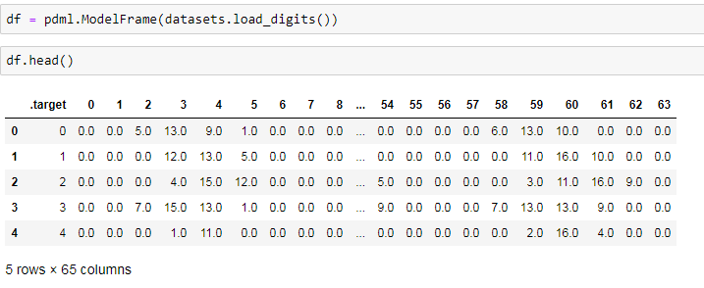
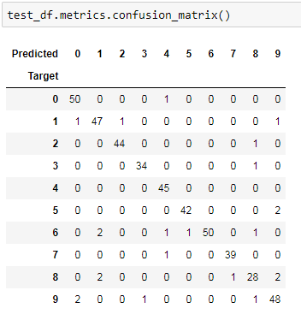
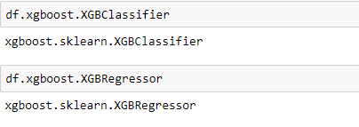
Code and measurements

Slide 36
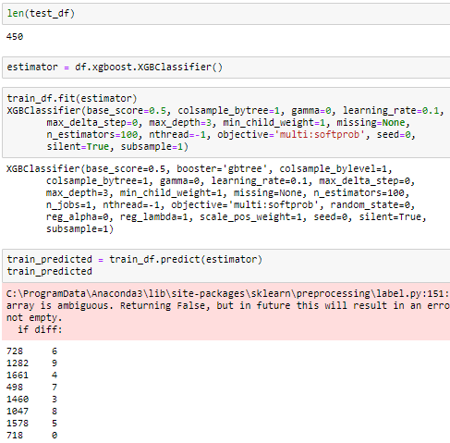

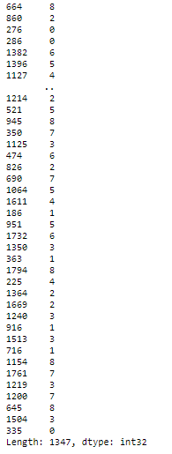

Slide 37
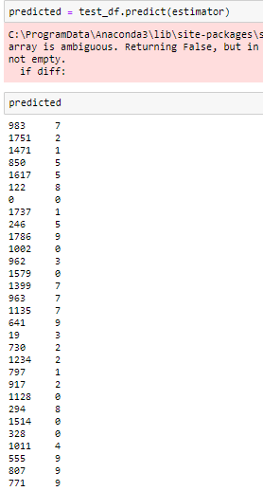
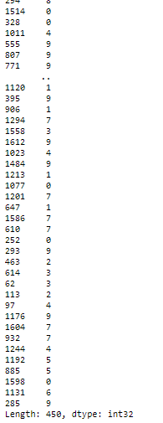
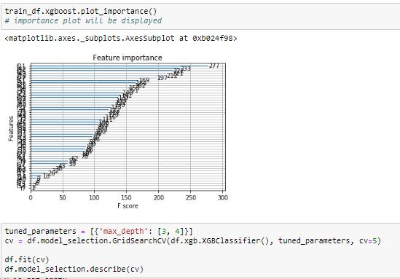
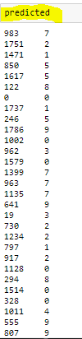
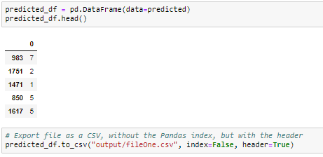

Slide 38
analysis

Slide 39
conclusions
* Discuss your findings. Did you find what you expected to find? If not, why not? What inferences or general conclusions can you draw from your analysis?
* Summarize your conclusions. This should include a numerical summary (i.e., what data did your analysis yield), as well as visualizations of that summary (plots of the final analysis data)
* Discuss the implications of your findings. This is where you get to have an open-ended discussion about what your findings mean

Slide 40
Post mortem
* Discuss any difficulties that arose, and how you dealt with them
* Discuss any additional questions that came up, but which you didn't have time to answer: What would you research next, if you had two more weeks?

Slide 41
Any questions?

