Slide 1

Personal Cloud Provider Model
Founder: Justine Longla T-Lane (JLT)

Slide 2
Vision
Build a governed multi-service platform ecosystem
01
Operate digital systems like a cloud provider
02
Ensure consistency, scalability, and long-term sustainability
03

Slide 3
The Problem
Fragmented digital systems across organizations
Duplicated effort and inconsistent experiences
Lack of governance and long-term architectural direction

Slide 4
The Solution
A Personal Cloud Provider Model
Unified governance through MeshHub (Control Plane)
Independent services operating within a cohesive ecosystem

Slide 5
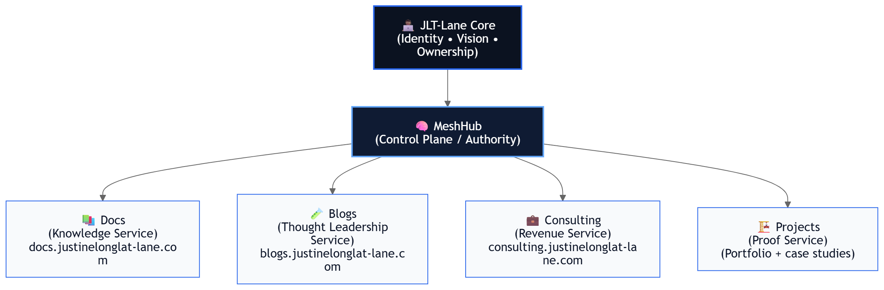
Three-Plane Architecture
Control Plane — Authority and governance
Knowledge Plane — Documentation and guidance
Execution Plane — Operational services and applications

Slide 6
Platform Services
Docs — Knowledge Service
Blogs — Thought Leadership Service
Consulting — Revenue Service
Projects — Proof Service

Slide 7
Value Proposition
Consistent platform experience across services
Scalable architecture designed for growth
Reduced fragmentation and improved maintainability

Slide 8
Founder Story
Built incrementally through personal investment and discipline
Simulates the scope of a multi-engineer platform initiative
Demonstrates platform leadership and systems thinking

Slide 9
Future Vision
Expand into a full internal developer platform
Enable team collaboration and service onboarding
Evolve into a scalable platform product

Slide 10
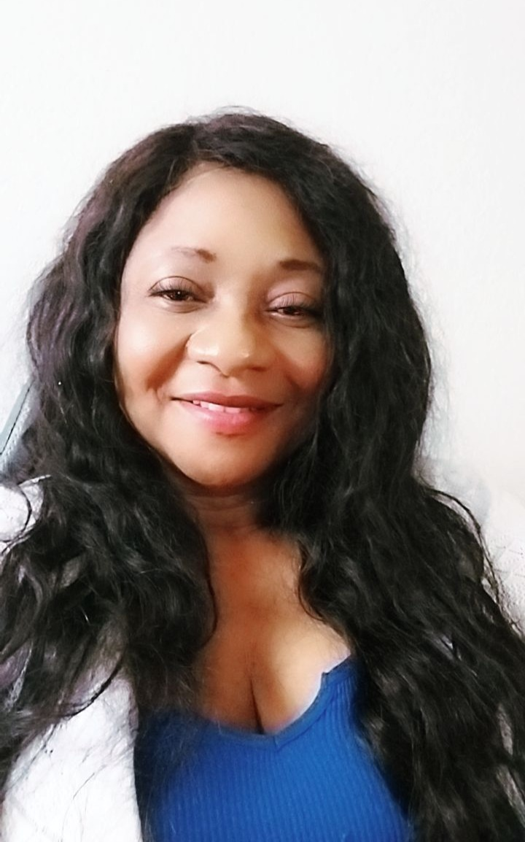
Personal Cloud Provider Model
Founder: Justine Longla T-Lane

Slide 11
Thank You

