Slide 1

CHEERDANCE

Slide 2
CHEERDANCE
Is coined from the words cheer and dance
- To Cheer is to shout out words or phrases that may well motivate team and perform better during the Game
- Dance, on the other hand, is a physical activity where one expresses emotions or gestures while performing bodily movement usually In Time with rhythm.

Slide 3
CHEERLEADING
 is an activity in which the participants (called "cheerleaders") cheer for their team as a form of encouragement. It can range from chanting slogans to intense physical activity.
 It can be performed to motivate sports teams, to entertain the audience, or for competition.
 Competitive routines typically range anywhere from one to three minutes, and contain components of tumbling, dance, jumps, cheers, and stunting.

Slide 4
Difference of Cheerleading and Cheer dancing

Slide 5
Cheerdancing is rooted from cheerleading.
 Cheerleading as we all know developed in the United States of America. But did you know that the Philippines has had developed Cheerdancing?
 -Cheerdancing in the Elementary, High School and College levels has always been the opening salvo for intramurals in campuses in the Philippines. The difference between Cheerleading and Cheerdancing is that cheerleading has its foundation in Gymnastics. And as for Cheerdance, it's foundation lies in the Choreography where Ballet seems to be its foundation.

Slide 6
Elements of Cheerdance routine
-Cheer dance contains dance techniques, basic elements of cheer and basic gymnastics skills

Slide 7
1. DANCE TECHNIQUES
 Depending on the competitions requirement, various dance techniques may be used in a cheer dance competition
 Some squads prefer contemporary dance techniques while others incorporate several technique such as jazz, hip-hop , modern dance , contemporary ballet and ethnic or folk dance however, cheerleading style dance tends to be more rigid and sharper compared to contemporary or pop culture dance styles ( Carrier and Mckay,2006).

Slide 8
2. ELEMENTS OF CHEER
 Cheers are coordination of organized words and movements relating to an athletic event.
 These used during a sport event when plays has been stopped on the field or court.
 The purpose is to draw a unified response of the crowd to highlight their support for the playing team.

Slide 9
3. BASIC GYMNASTICS SKILLS
 Cheerdance incorporates simple gymnastic skills such as jumps and tumbling to add to the thrill of the game and the effect of a routine. Also , these help cheerleaders to develop a higher spirit level and enhance crowd motivation.
Jumps- jumping requires stamina, strength and flexibility and they greatly improves every areas in cheerdance routine (Carrier and Mckay,2006). Every jump has important elements namely;
-Approach- the first stage of a jump
-Lift- Occurs after a cheerleader leaves the ground
-Execution- is hitting a jump at its peak or maximum weight.
-Landing- this involves whipping of the legs and feet together to end with a small rebound.

Slide 10
B. Tumbling- very dynamic and excellent way to shake a crowd up quickly.
- Properly incorporated tumbling can be a real attention getter and crowd pleaser.
-Tumbling may be executed simultaneously by several tumblers or the entire squad.
-Thus it is imperative that cheerleaders in a squad should have an identical techniques in tumbling to strengthen the uniformnity of the routine.

Slide 11
BASIC FORMATION OF CHEERDANCE
1.) Bowling Pin- The formation is set up like bowling pins in a bowling
alley.
- This woks great when highlighting a few members on a squad/ team
2.) Staggered Line- A simple line where the back is positioned in the windows (space in between individuals) of the front line. Vertical lines in formations highlight differences in levels rather than suggest squad uniformity

Slide 12
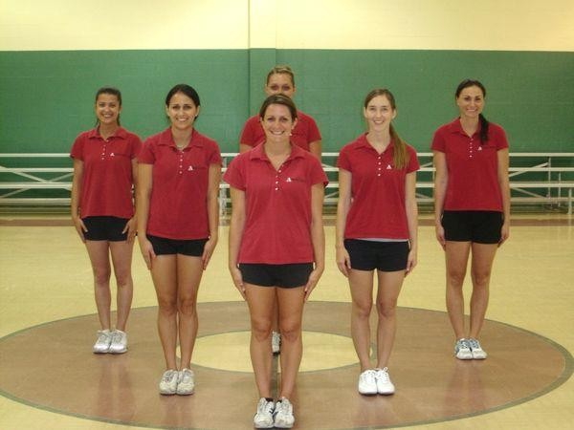
BOWLING PIN

Slide 13
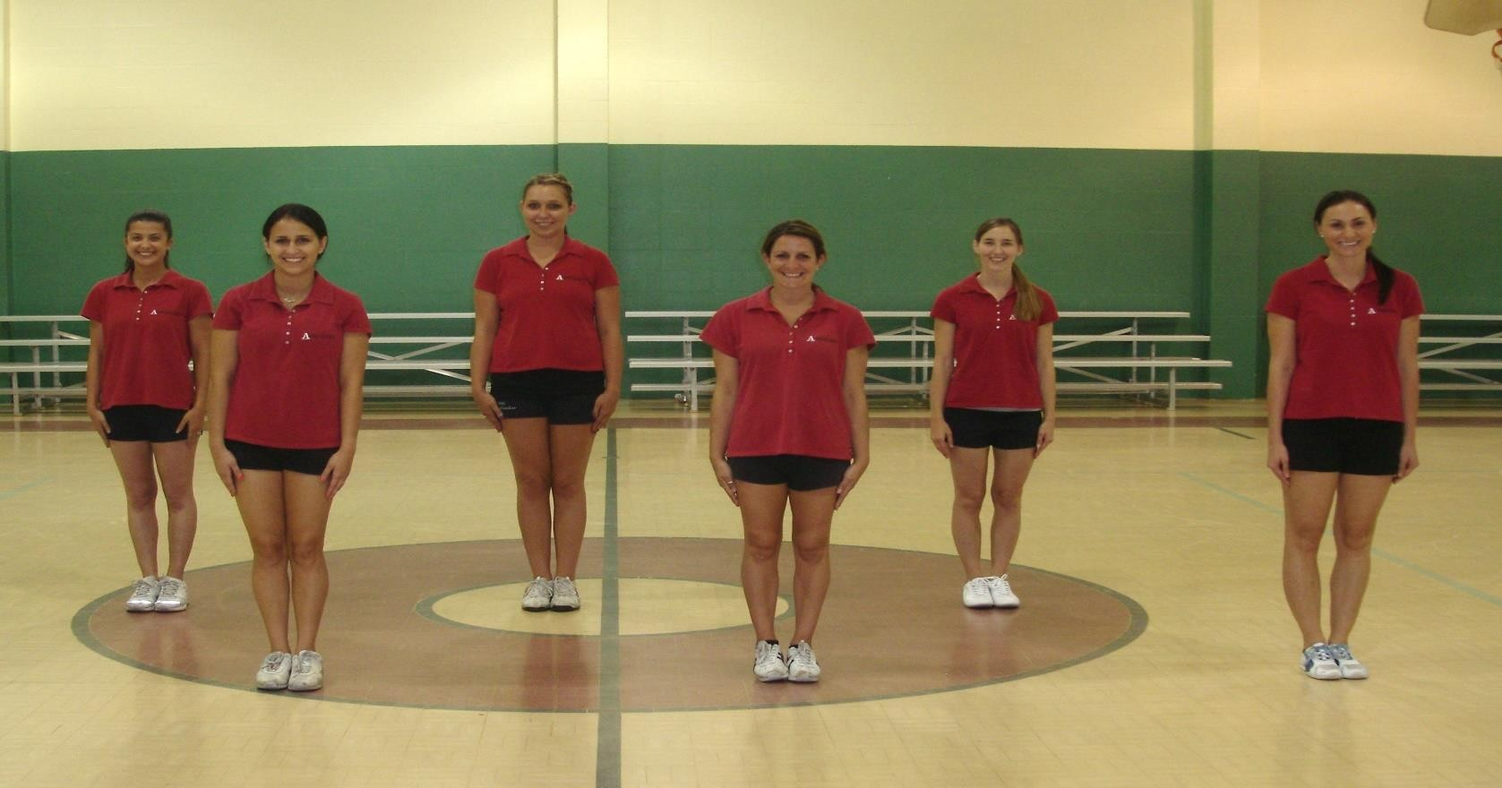
STAGGERED LINE

Slide 14
SEGMENTS OF A CHEERDANCE ROUTINE
 Music Section- Music plays a vital role in cheerdance routine as it sets the one and pace as well as adds to the creativity of the choreography.
-It also motivates both the cheerleader and the spectators.
 Cheer Section- This section shows supports for the school or
program that the cheerleaders represent.

Slide 15
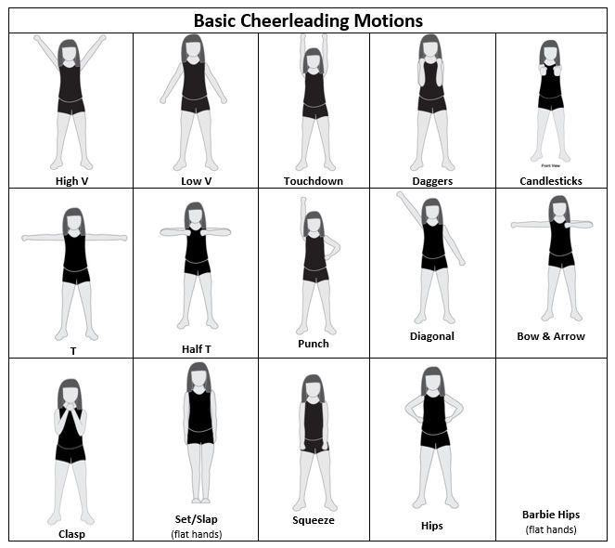

Slide 16
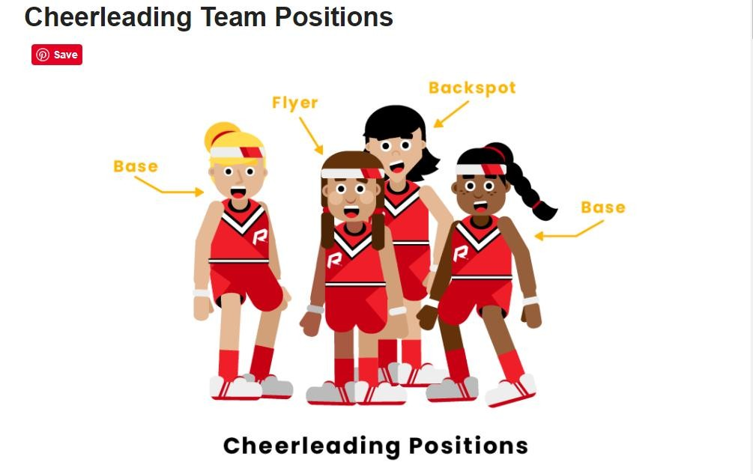

Slide 17
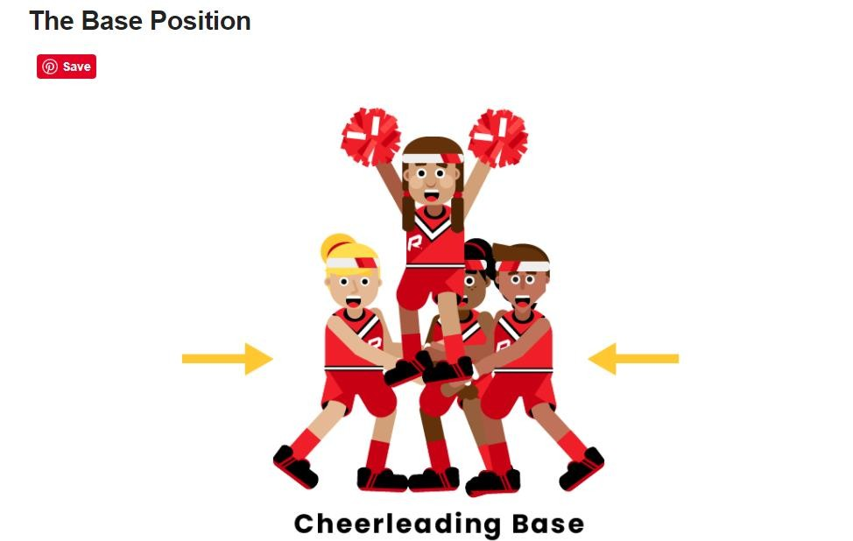

Slide 18
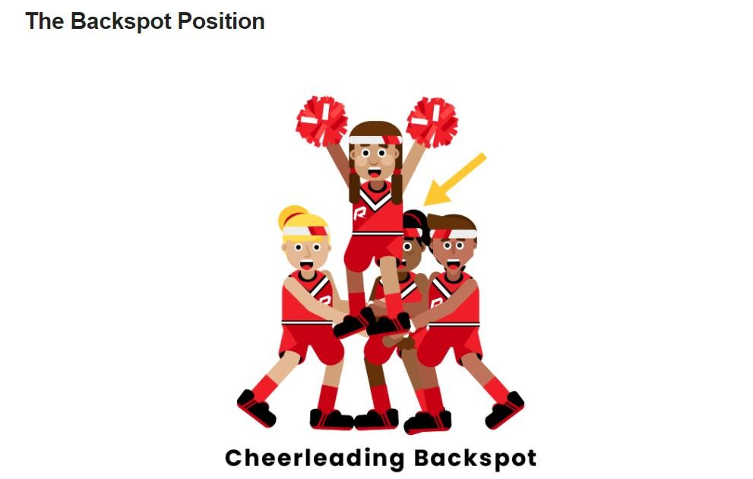

Slide 19
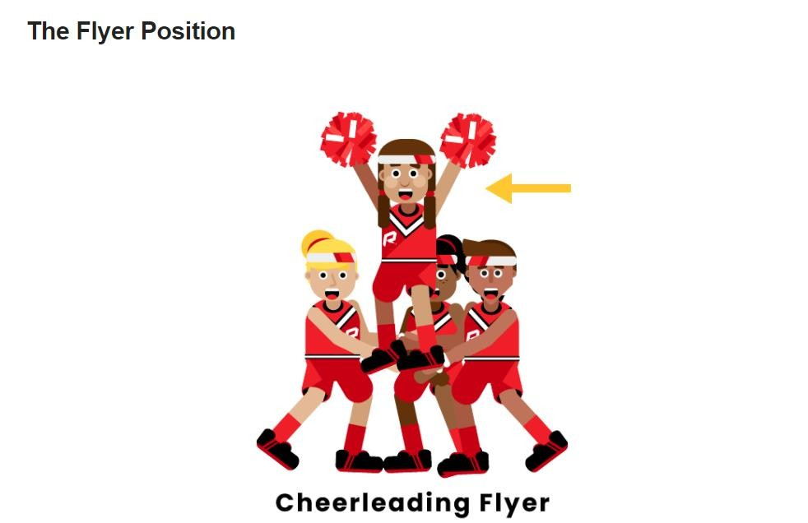

Slide 20
Thank You for Listening
Keep Safe!
Prepared by:
Ms. Kio Mae D. Marvida

