Slide 1

DANCESPORT

Slide 2
DANCESPORT
❖ Is a combination of art and sport
❖ It was called ballroom dancing in the past.
❖ This goes with partners (male and lady) competing against other partners dancing on the floor at one time
❖ Dancesport provide avenue to gain discipline of the body and mind of the dance athletes.
❖ Governing bodies of Dancesport, World Danceport Council (WDC) and World DanceSport Federation (WDSF)

Slide 3
WHAT ARE THE CHARACTERISTICS OF DANCESPORT?

Slide 4
❖ Posture- enables a dancers to stand out on the floor, which shows sophistication and confidence.
❖ Timing- dancing on time with the music.
❖ Line- the stretching of the body
❖ Hold- the correct position of the body.
❖ Poise- stretch of the woman’s body upwards and outwards and leftwards into the man’s right arm to achieve balance and connection with his frame, as well as to project outwards to the audience.

Slide 5
❖ Togetherness- dancing of two people as one on the dance floor.
❖ Musicality and expression- basic characterization of the dance with particular music being played and the choreographic adherence to musical phrasings and accents.
❖ Presentation- how the people presents their dancing to the audience as well as the proper costuming and grooming.
❖ Power- the energy that is controlled and not wild.
❖ Foot and leg action- the use of lower extremities that creates balance, beauty and strength.

Slide 6
❖ Shape- the combination of turn and sway to create a look or a position.
❖ Lead and follow- the non- verbal communication of the man and lady through shape, visual an body weight.
❖ Floor craft- ability to avoid bumping into other couples and continue dancing without pause when boxed in.
❖ Intangibles- how a couple “look’’ together in performing their dances

Slide 7
WHAT ARE THE TWO DIFFERENT DANCESPORT STYLES?

Slide 8
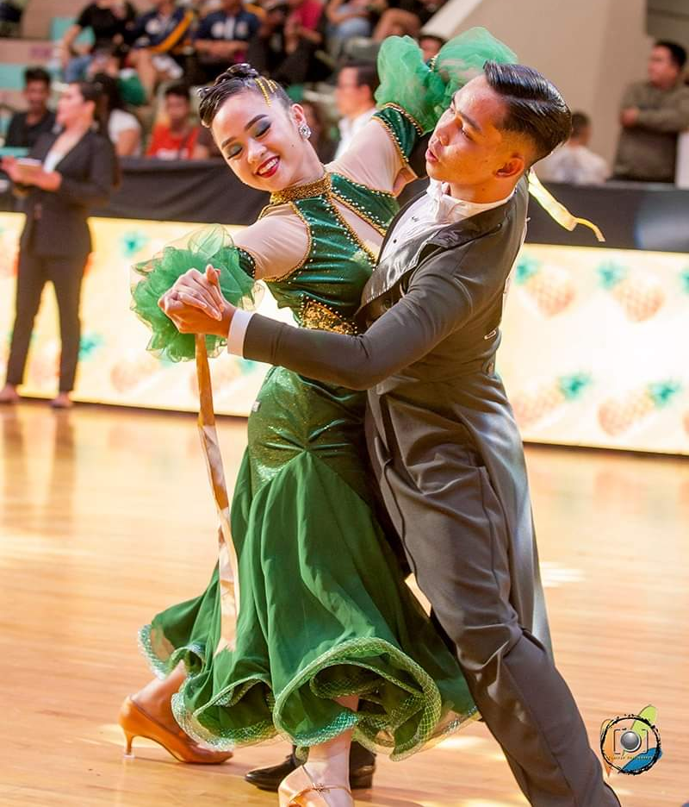
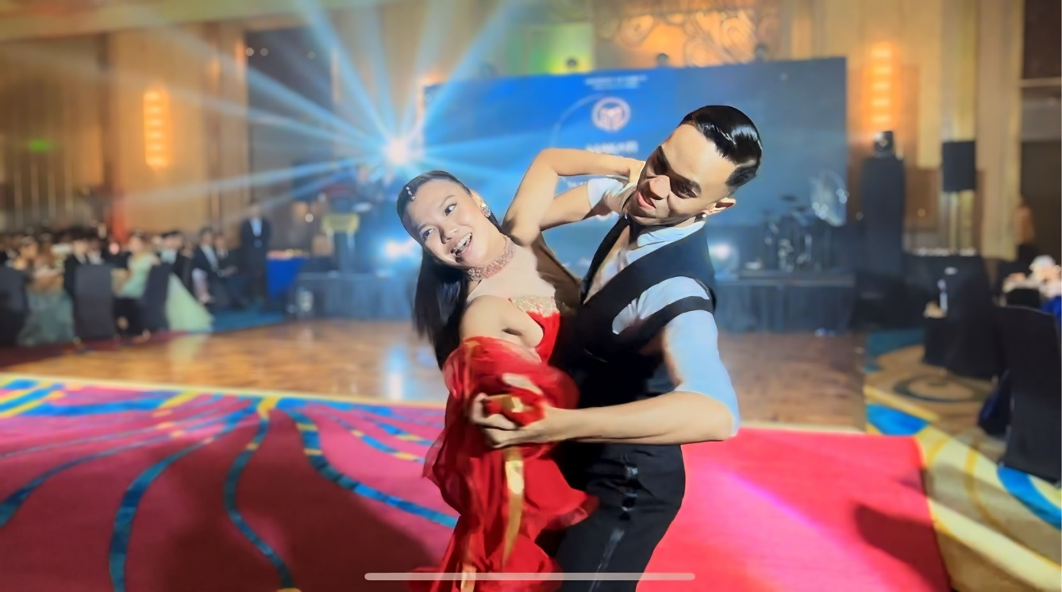
A.INTERNATIONALSTANDARD

Slide 9
Waltz- is one of the smoothest ballroom dance. It is a progressive dance marked by long, flowing movements, continuous turns, and "rise and fall."
-The dance is so graceful and elegant; Waltz dancers appear to glide around the floor with almost no effort.
-Time signature -3/4 with the 1st beat accented -Each step 1 beat -Counting in beats and bars 1 2 3, 2 2 3, 3 2 3, etc.

Slide 10
2. Tango- was first danced in Europe before WW I
❖ It is one of the most fascinating of all ballroom dance.
❖ This sensual ballroom dance originated in South America in the early twentieth century.
-Time signature -2/4 with both best accented. -’slow ‘’ count= 1 beat ‘’quick’’=1/2 beat -Counting in beats and bars: 1&2, 2&2, 3&2 etc..

Slide 11
3. Viennese Waltz- is a controversial dance with so many claims about its origin but known to be born in the modest outskirts of Austria and Bavaria.
-Time Signature – 6/8 with the first beat accented
-Counting in beats and bars- 1 2 3, 2 2 3, 3 2 3 etc.

Slide 12
4. Foxtrot- was named after an American performer Harry Fox, which was premiered in 1914.
Is a smooth dance in which dancers make long, flowing movements across the floor.
Foxtrot has lots of fun and simple to learn an excellent dance for beginners.
Time signature 4/4 with the first and third beats accented -Slow Count= 2 beats. ‘quick’’ count= 1 beat -Counting in beats and bars: 1 2 3 4. 2 2 3 4, 3 2 3 4 etc.

Slide 13
5. Quickstep- is a quick version of the Foxtrot. It is a ballroom dance comprised of extremely quick stepping, syncopated feet rhythms, and runs of quick steps.
- The Quickstep is exciting to watch, but among the most difficult of all the ballroom dance.
- Time Signature- 4/4 with the first and third beats accented -‘’Slow’’ count = beats. ‘’Quick’’ count =1 beat -Counting beats and bars: 1 2 3 4, 2 2 3 4, 3 2 3 4 etc..

Slide 14
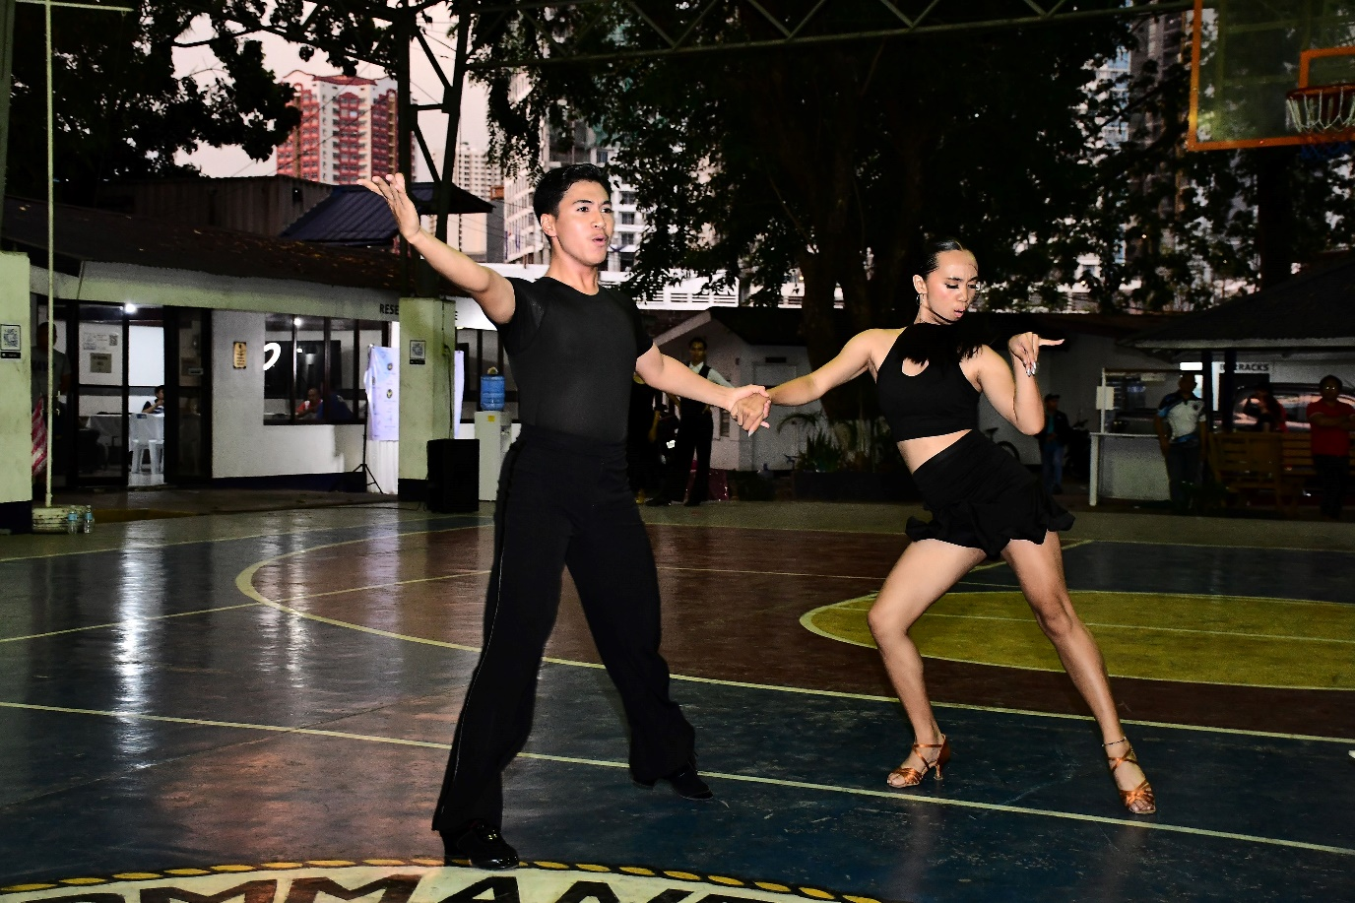
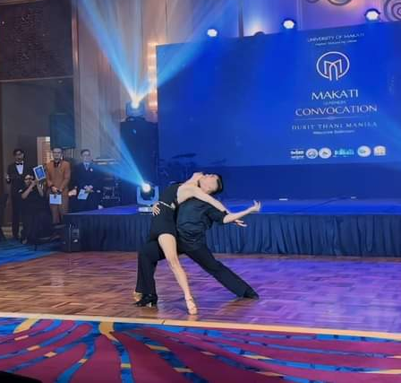
B. INTERNATIONAL LATIN

Slide 15
1. Samba- is popular with young people as well as older generations. Samba can be performed solo or with a partner.
-Possibly the most popular of all Brazilian ballroom dance.
-Time signature -2/4

Slide 16
2.Chachacha- is a lively, flirtatious ballroom dance full of passion and energy.
-The classic "Cuban motion" gives the Cha cha cha its unique style.
-Partners work together to synchronize each movement in perfect alignment.
-Chasing Dance Time Signature- 4/4 with accented beat on the first and fourth of each bar

Slide 17
3. Rumba- is considered by many to be the most romantic and sensual of all Latin ballroom dance.
-It is often referred to as the "Grandfather of the Latin dances." A moderately slow Latin dance with plenty of wraps, under arm turns and a truck load of flirtation.
It is often called as the “Dance of Love’’
-Time Signature- 4/4

Slide 18
4. Paso Doble- means ‘’double steps’’, which originated from spain and is inspired by bullfighting.
❖ Paso doble is the one of the most dramatic of all latin dances.
❖ Time signature- 2/4
5. Jive- is an American dance that evolved from a dance called the Jitterbug by removing the lifts and acrobatic elements.
-Dancers use a more bouncy type movement using the balls of the feet.
-A lot of kicks are used in jive.
-Jive is a very fast, energy-consuming dance.
-Time Signature- 4/4

Slide 19
Thank You for Listening
Keep Safe!
Prepared by:
Ms. Kio Mae D. Marvida

