Slide 1

Formalizing the pragmatics of metaphor understanding
Justine Kao
Leon Bergen, Noah Goodman
Lab meeting 05202014
Notes:
Hi everyone, welcome to Frisem. My name is Justine Kao, and I am a 3rd year PhD student in Professor Noah Goodman’s Computation and Cognition Lab. Today I’m going to talk to you about my work on modeling nonliteral language understanding for number words.

Slide 2
Formalizing the pragmatics of metaphor understanding
Multiple attempts at
Justine Kao
Leon Bergen, Noah Goodman
Lab meeting 05202014
Notes:
Hi everyone, welcome to Frisem. My name is Justine Kao, and I am a 3rd year PhD student in Professor Noah Goodman’s Computation and Cognition Lab. Today I’m going to talk to you about my work on modeling nonliteral language understanding for number words.

Slide 3
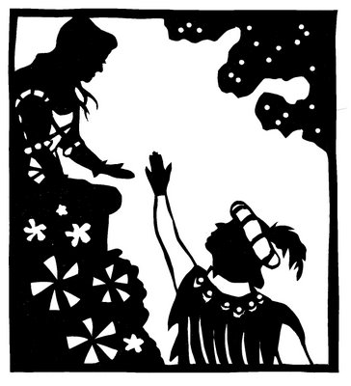
How are metaphors understood?
Notes:
Here is an example of a metaphor you probably had to analyze in high school, and so it should be familiar to most of you. In a classic scene in Romeo and Juliet, Romeo is about to find Juliet at her balcony. To profess his love for her, he utters these timeless words.

Slide 4
How are metaphors understood?
But soft! What light through yonder window breaks? It is the east, and Juliet is the sun.
Notes:
I won’t hazard a dramatic reading of this. I will instead focus on the last part of Romeo’s speech: Juliet is the sun. How does Juliet interpret this utterance?

Slide 5
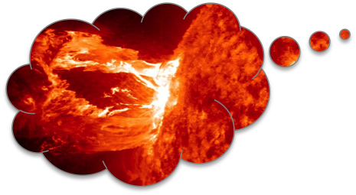
How are metaphors understood?
But soft! What light through yonder window breaks? It is the east, and Juliet is the sun.
He wants to tell me I am made of hot plasma.
Notes:
She could think, “Romeo wants to tell me I am made of hot plasma.” Not the most romantic message.

Slide 6
How are metaphors understood?
But soft! What light through yonder window breaks? It is the east, and Juliet is the sun.
He wants to tell me I am beautiful.
Notes:
Or she could think, “Romeo wants to tell me I am beautiful.” This is much more likely and is in fact the textbook interpretation of the metaphor.

Slide 7
How are metaphors understood?
But soft! What light through yonder window breaks? It is the east, and Juliet is the sun.
He wants to tell me I am hot.
Notes:
Or, of course, Juliet could simply infer that Romeo wants to tell her she is hot.
In both of the last two interpretations, Juliet needs to go beyond the literal meaning of the utterance to infer Romeo’s true message.

Slide 8
Communication as social reasoning
Rational Speech Act models (Frank & Goodman, 2012; Goodman & Stuhlmuller, 2013)
A speaker chooses an utterance that will effectively communicate her message to a listener
A pragmatic listener reasons about a speaker in order to infer the meaning of an utterance
Explains scalar implicature, Horn’s implicature, etc
Does not handle cases where the literal meaning of an utterance directly contradicts the intended meaning
Notes:
Given an utterance, a pragmatic listener will then reason about a speaker to infer its meaning. This is given by the following equation, which uses bayes rule to infer the meaning given an utterance. By modeling language understanding as recursive reasoning between speaker and listener, these models can explain a range of phenomena in pragmatics, such as scalar implicature, which is the tendency for listeners to infer that less specific utterances imply the negation of more specific utterances, and Horn’s implicatures, which is the tendency for listeners to assign more complex utterances to less likely meanings. However, this basic framework is not able to handle cases where the literal meaning of an utterance directly contradicts the intended meaning. As a result, the model cannot capture the effects of metaphor, hyperbole, and pragmatic halo that we described and know to be an important part of language use.

Slide 9
Extending to nonliteral language
Multiple communicative goals
Given a communicative goal, the speaker may wish to maximize informativeness for one kind of information (e.g. Juliet’s attractiveness) but not others (e.g. Juliet’s temperature)
The listener reasons about multiple dimensions of information from a single utterance and jointly infers the speaker’s goal as well as the meaning
A statement that is literally false can be optimal as long as it conveys information along the target dimension
Notes:
To extend this model to explain nonliteral language, our insight was that a speaker may have multiple communicative goals for producing an utterance. Given a goal, the speaker may wish to maximize informativeness for one kind of information (such as how she feels about the wait time) but not others (e.g. her exact wait time). The listener reasons about multiple dimensions of information from a single utterance and jointly infers the speaker’s goal as well as the meaning of the utterance. Given this formulation, a statement that is literally false can be optimal as long as it conveys information along the target dimension. So a listener who reasons about the goals of the speaker can make sense of a statement that is false under its literal interpretation.

Slide 10
Metaphors, like most utterances, are understood using pragmatic reasoning
But soft! What light through yonder window breaks? It is the east, and Juliet is the sun.
Notes:
Returning to the Juliet example,

Slide 11
Metaphors, like most utterances, are understood using pragmatic reasoning
But soft! What light through yonder window breaks? It is the east, and Juliet is the sun.
What are features of the sun?
P(hot plasma | sun)
P(beautiful | sun)
Notes:
We can model metaphor interpretation in similar ways. Instead of the probability of affect given a price, the listener now considers the probability of a feature given a category. For example, what is the probability that the sun is made of hot plasma? What is the probability that the sun is beautiful?

Slide 12
Metaphors, like most utterances, are understood using pragmatic reasoning
But soft! What light through yonder window breaks? It is the east, and Juliet is the sun.
What are features of me?
P(hot plasma | Juliet)
P(beautiful | Juliet)
Notes:
Also, what is the probability of Juliet being made of hot plasma, and the probability that Juliet is beautiful?

Slide 13
Metaphors, like most utterances, are understood using pragmatic reasoning
But soft! What light through yonder window breaks? It is the east, and Juliet is the sun.
What might Romeo want to say about me?
P(topic = hot plasma)
P(topic = beautiful)
Notes:
What are Romeo’s possible communicative goals? Is he likely to want to talk about hot plasma? Or is he likely to want to talk about Juliet’s beauty?

Slide 14

Metaphors, like most utterances, are understood using pragmatic reasoning
But soft! What light through yonder window breaks? It is the east, and Juliet is the sun.
Notes:
Using this information, the listener can infer the features of a metaphorical target.

Slide 15
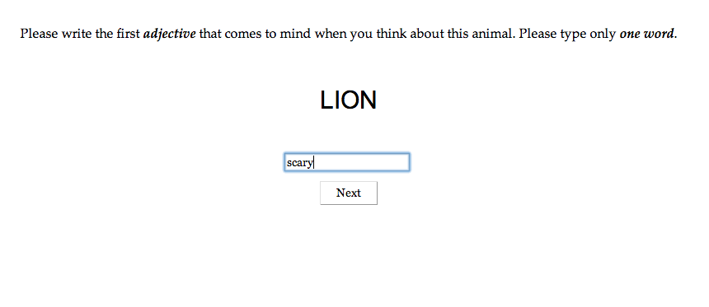
Experiment 1a: features
Notes:
We used the following paradigm to examine people’s interpretation of a range of animal metaphors in context.

Slide 16
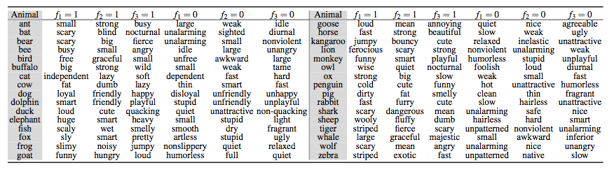
Experiment 1a: features

Slide 17
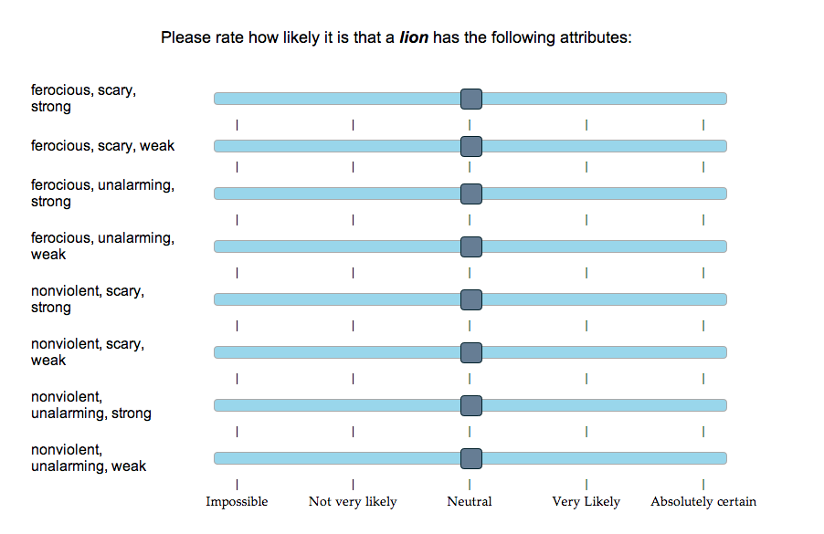
Experiment 1b: feature priors
Notes:
We used the following paradigm to examine people’s interpretation of a range of animal metaphors in context.

Slide 18
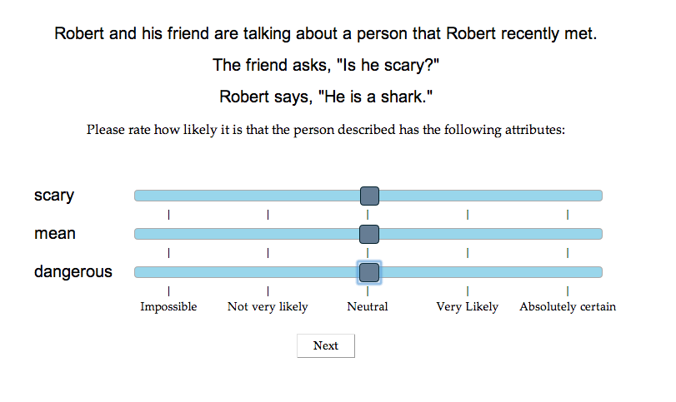
Experiment 2: interpretation
Notes:
We used the following paradigm to examine people’s interpretation of a range of animal metaphors in context.

Slide 19
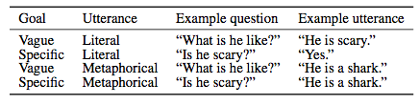
Experiment 2: interpretation
Notes:
We used the following paradigm to examine people’s interpretation of a range of animal metaphors in context.

Slide 20
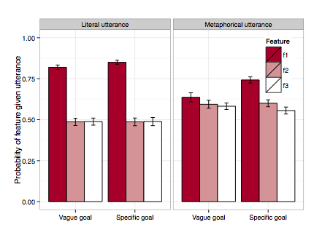
Experiment 2: interpretation
Notes:
We used the following paradigm to examine people’s interpretation of a range of animal metaphors in context.

Slide 21
Model v1
Notes:
We used the following paradigm to examine people’s interpretation of a range of animal metaphors in context.

Slide 22
Model predictions
r = 0.6
Notes:
Our model achieved decent correlation with people’s interpretation of these metaphorical utterances. Work is still ongoing, but we believe it is quite promising and are excited to see where it goes.

Slide 23
Flaws
Inconsistent dependent measures
Prior elicitation experiment was done on sets of features (joint probability); interpretation experiment was done on individual features (marginal probability); model produces joint posterior probability
Prior probabilities too conservative
Zebras are only rated as “striped” with 0.7 probability
No consideration of alternative utterances
Alternative metaphors? “He is a whale” vs “He is a swan”
Alternative literal statements? “He is a lion” vs “He is ferocious”
Notes:
Our model achieved decent correlation with people’s interpretation of these metaphorical utterances. Work is still ongoing, but we believe it is quite promising and are excited to see where it goes.

Slide 24
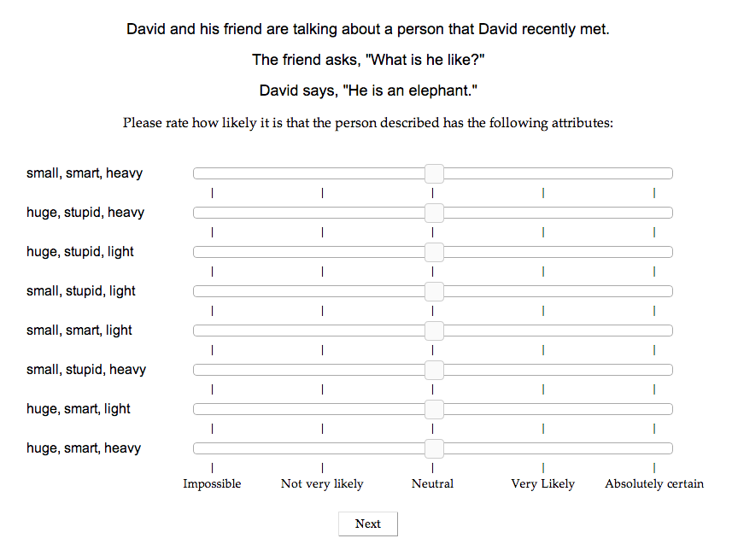
Dependent measures
Marginal vs joint?
Notes:
Our model achieved decent correlation with people’s interpretation of these metaphorical utterances. Work is still ongoing, but we believe it is quite promising and are excited to see where it goes.

Slide 25
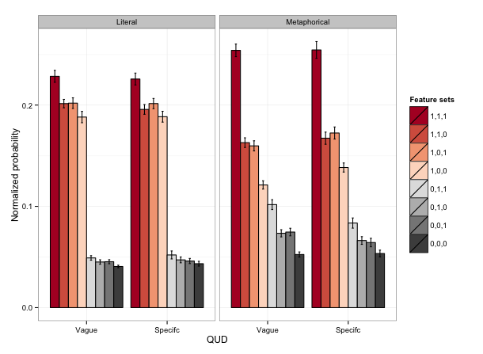
Dependent measures
Marginal vs joint?
Notes:
Our model achieved decent correlation with people’s interpretation of these metaphorical utterances. Work is still ongoing, but we believe it is quite promising and are excited to see where it goes.

Slide 26
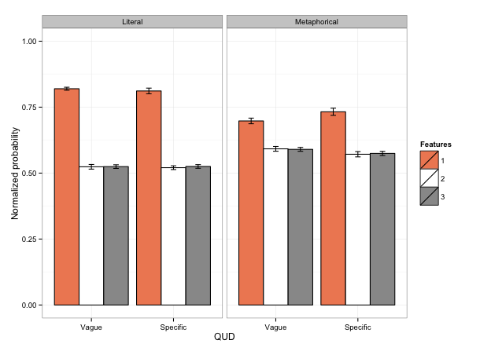
Dependent measures
Marginal vs joint?
Notes:
Our model achieved decent correlation with people’s interpretation of these metaphorical utterances. Work is still ongoing, but we believe it is quite promising and are excited to see where it goes.

Slide 27
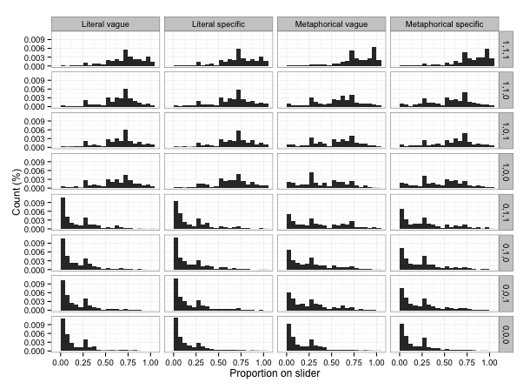
Dependent measures
Linking function from slider to probability?
Notes:
Our model achieved decent correlation with people’s interpretation of these metaphorical utterances. Work is still ongoing, but we believe it is quite promising and are excited to see where it goes.

Slide 28
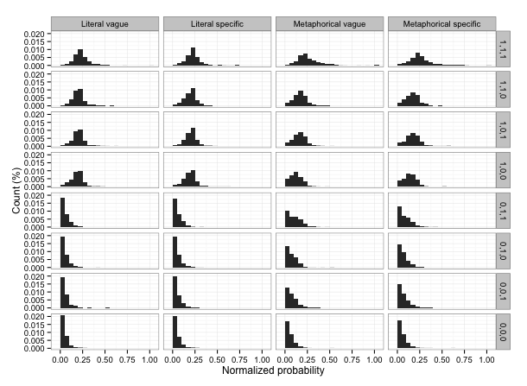
Dependent measures
Linking function from slider to probability?
Notes:
Our model achieved decent correlation with people’s interpretation of these metaphorical utterances. Work is still ongoing, but we believe it is quite promising and are excited to see where it goes.

Slide 29
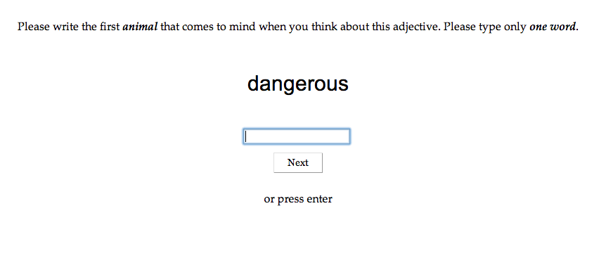
Alternative utterances
Alternative metaphors
Notes:
Our model achieved decent correlation with people’s interpretation of these metaphorical utterances. Work is still ongoing, but we believe it is quite promising and are excited to see where it goes.

Slide 30
Model v2
Notes:
We used the following paradigm to examine people’s interpretation of a range of animal metaphors in context.

Slide 31
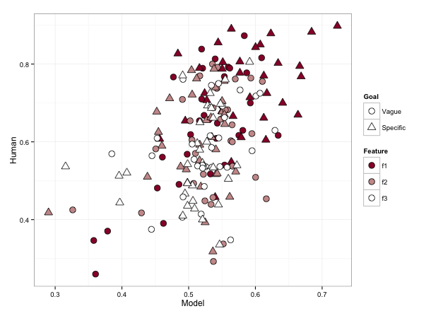
Results
r = 0.48

Slide 32
Alternative utterances
Alternative literal utterances
“He is a lion.” vs “He is ferocious.”
Notes:
Our model achieved decent correlation with people’s interpretation of these metaphorical utterances. Work is still ongoing, but we believe it is quite promising and are excited to see where it goes.

Slide 33
Model v3
Notes:
Our model achieved decent correlation with people’s interpretation of these metaphorical utterances. Work is still ongoing, but we believe it is quite promising and are excited to see where it goes.

Slide 34
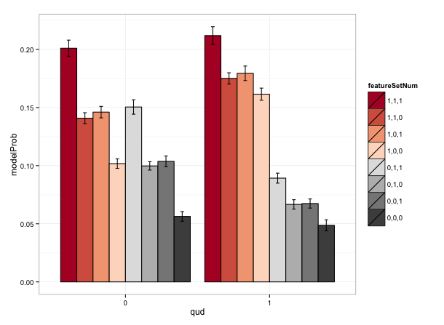
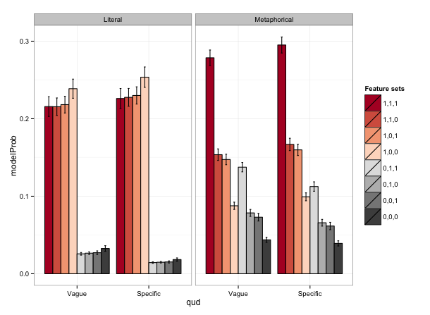
Results
Model: no alternatives
Alternative literal utterances
Model
Human
Notes:
Our model achieved decent correlation with people’s interpretation of these metaphorical utterances. Work is still ongoing, but we believe it is quite promising and are excited to see where it goes.

Slide 35
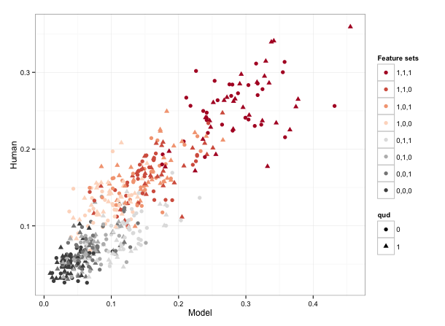
Results
Alternative literal utterances: metaphorical utterances
r = 0.89
Notes:
Our model achieved decent correlation with people’s interpretation of these metaphorical utterances. Work is still ongoing, but we believe it is quite promising and are excited to see where it goes.

Slide 36
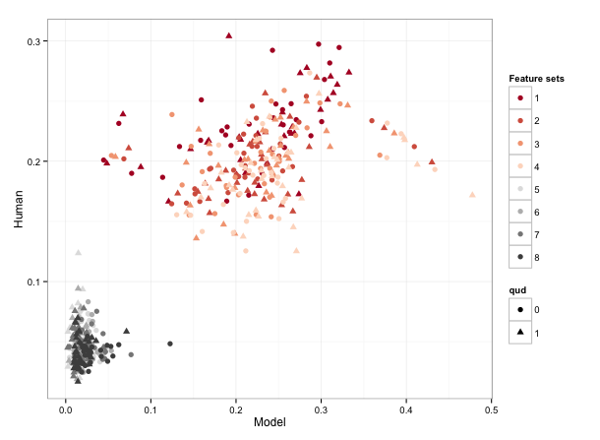
Results
Alternative literal utterances: literal utterances
r = 0.9
Notes:
Our model achieved decent correlation with people’s interpretation of these metaphorical utterances. Work is still ongoing, but we believe it is quite promising and are excited to see where it goes.

Slide 37
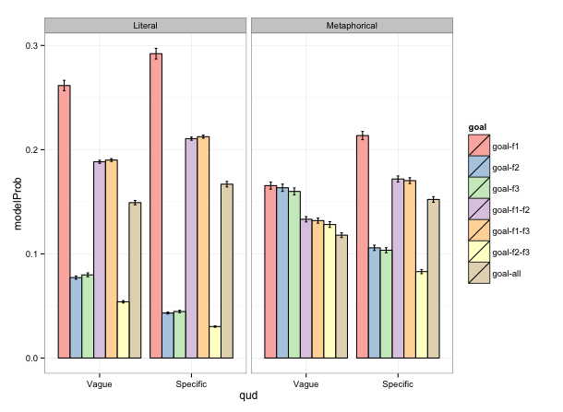
Results
Alternative literal utterances: goals
Notes:
Our model achieved decent correlation with people’s interpretation of these metaphorical utterances. Work is still ongoing, but we believe it is quite promising and are excited to see where it goes.

