Slide 1
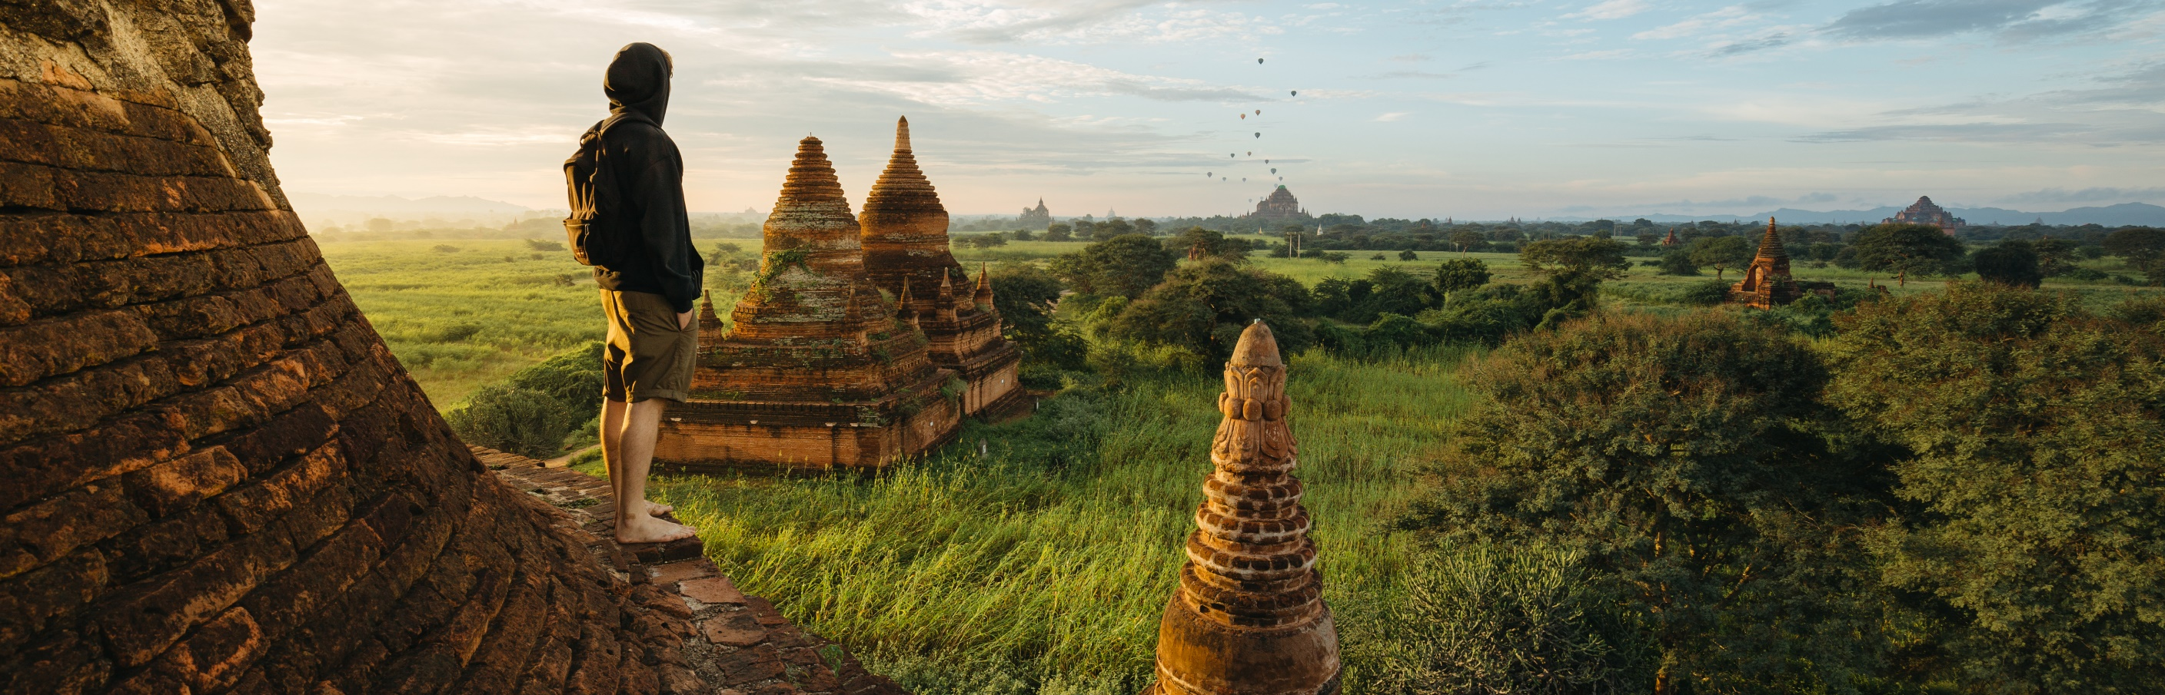
MY DREAM DESTINATION
Student Name: Justine Kyle A. Necesario

Slide 2
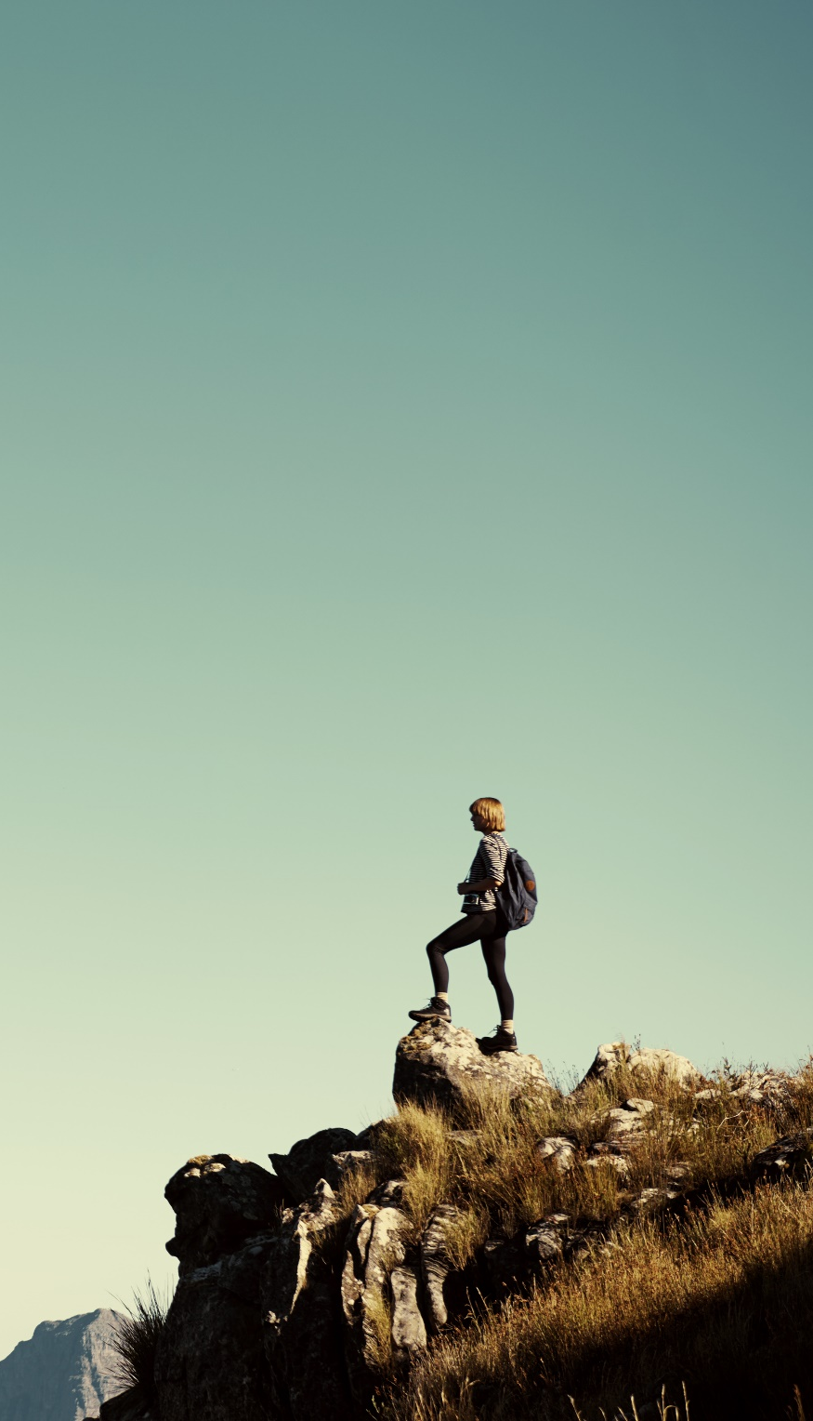
MY GOALS
Adventure
Enthusiasm
Discovery

Slide 3
Travel Budget

Slide 4
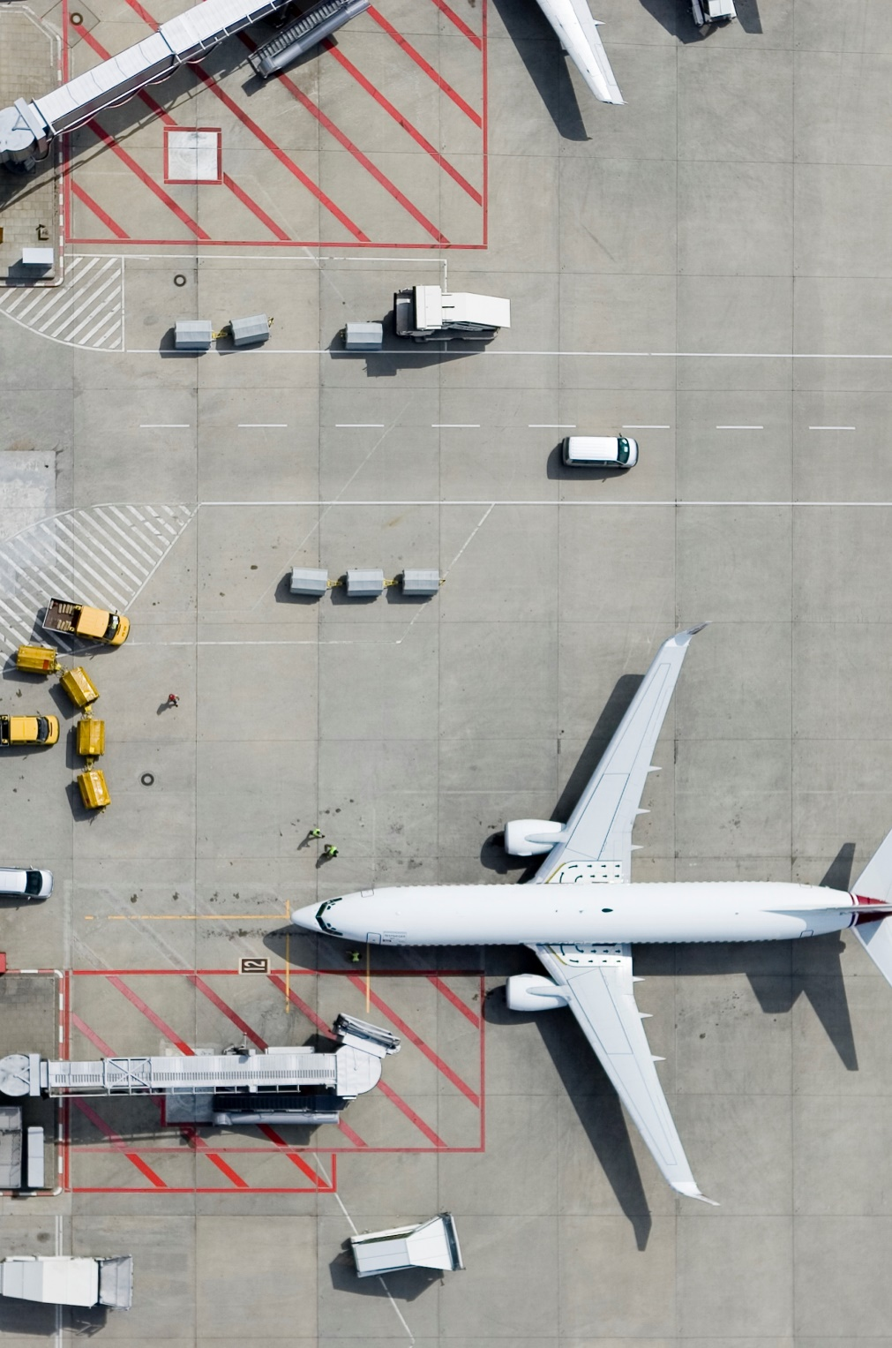
Transportation
Whenever I travel , I would choose to ride in plane because

Slide 5
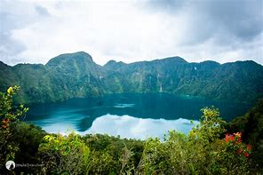
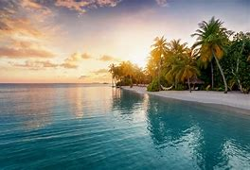
MY FAVORITE DESTINATION
LAKE HOLON
MALDIVES

Slide 6
MY FIRST TRAVEL
- I like to travel here because……………………………………………………………………..

Slide 7
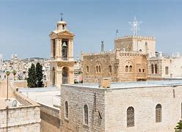
MY TARGET DESTINATION

Slide 8
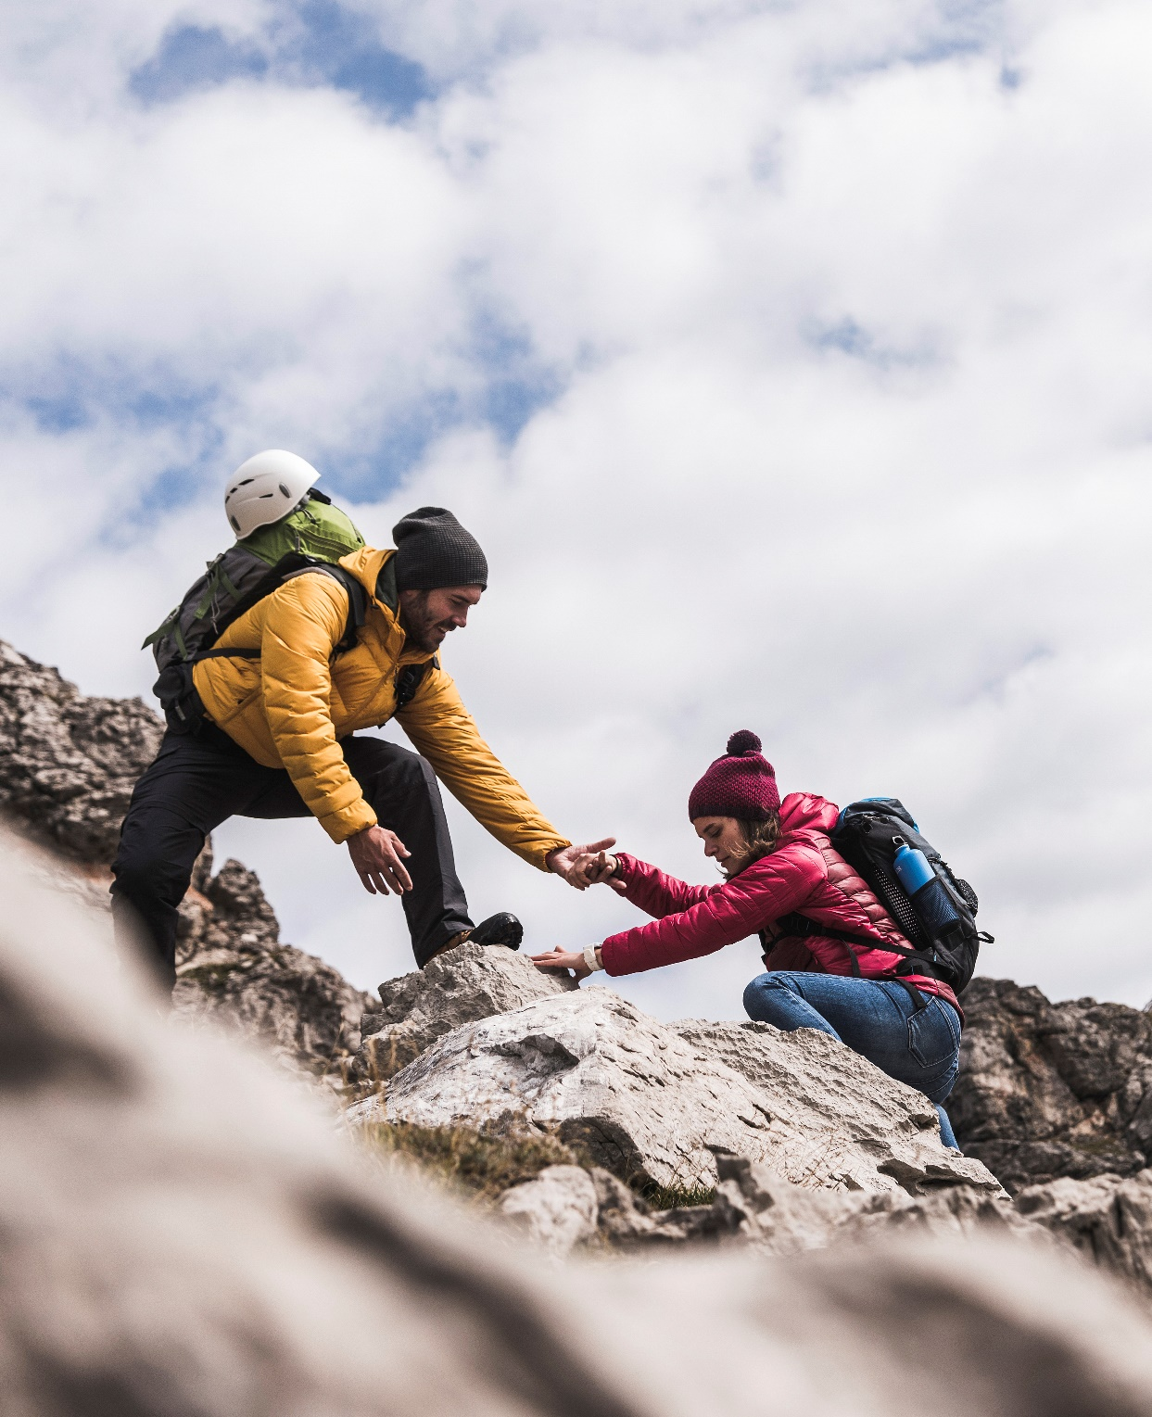
Thank You
Justinekyle@yahoo.com

