Slide 1
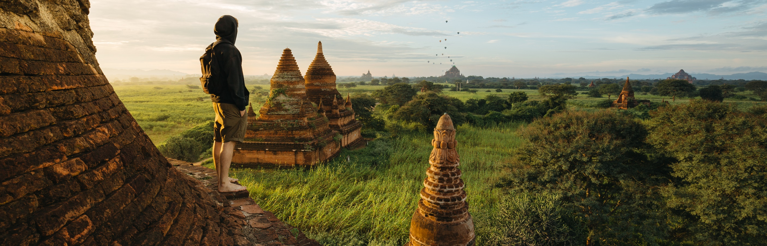
MY DREAM DESTINATION
Studen name: Justine Kyle A. Necesario

Slide 2
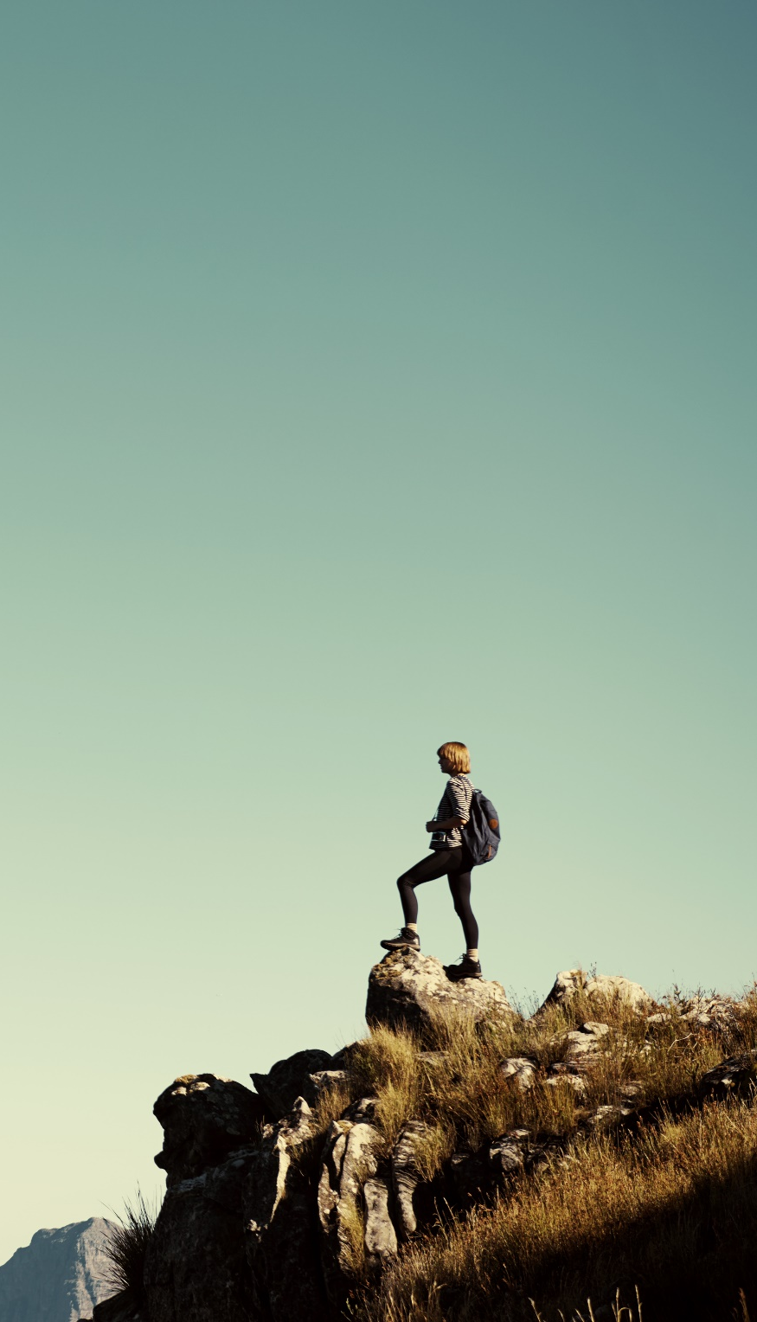
MY GOALS
Adventure
Enthusiasm
Discovery

Slide 3
Travel Budget

Slide 4
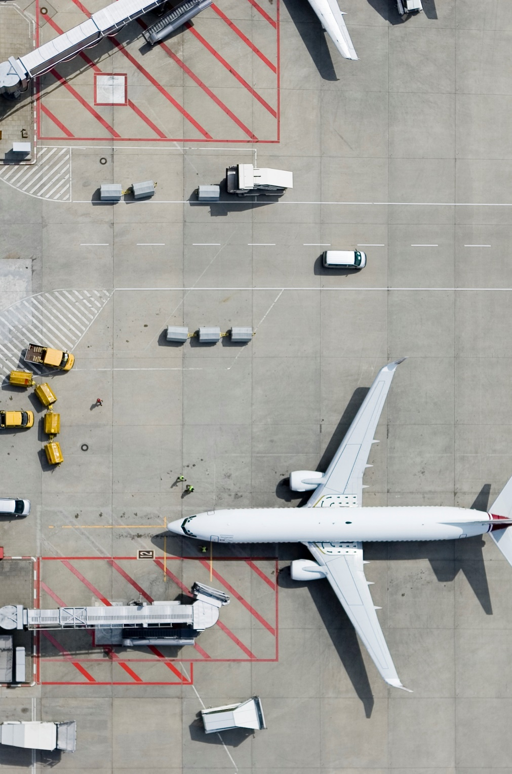
Transportation
Whenever I travel , I would choose to ride in plane because

Slide 5
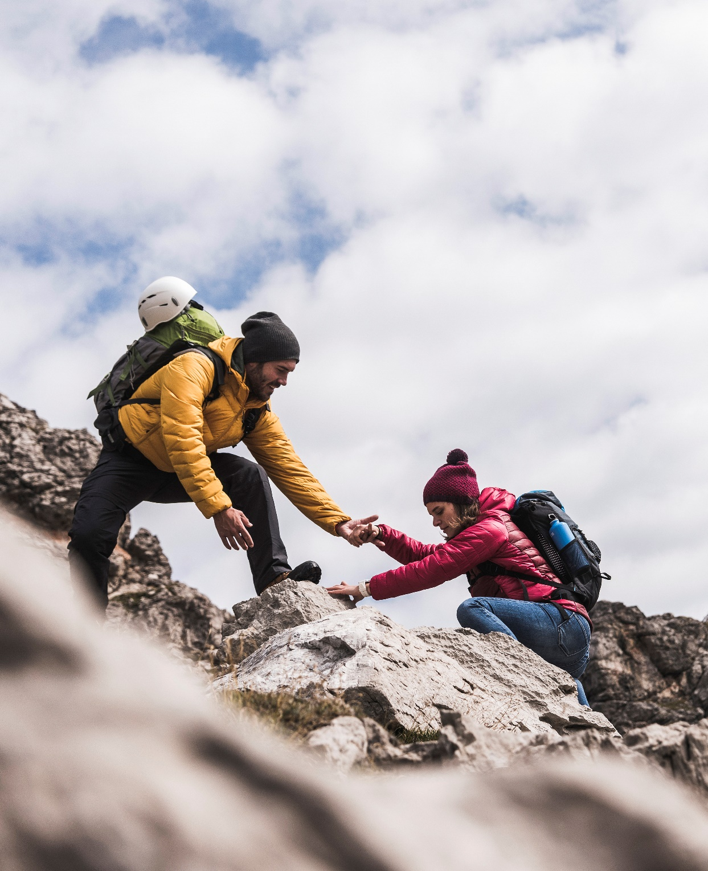
Thank You
Justinekyle@yahoo.com

