Slide 1
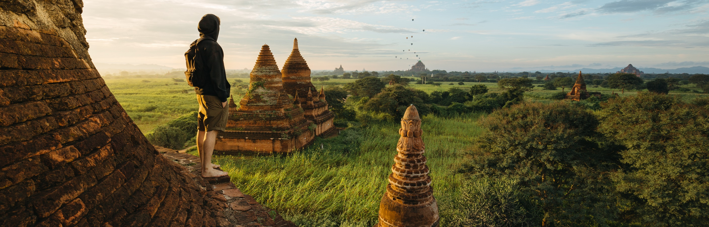
MY DREAM DESTINATION
Studen name: Justine Kyle A. Necesario

Slide 2
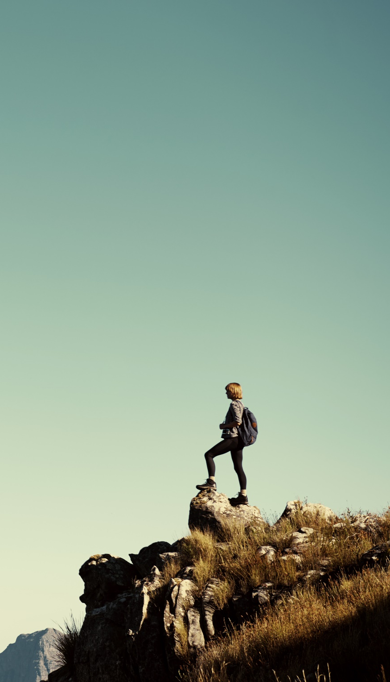
MY GOALS
Adventure
Enthusiasm
Discovery

Slide 3
Travel Budget

Slide 4
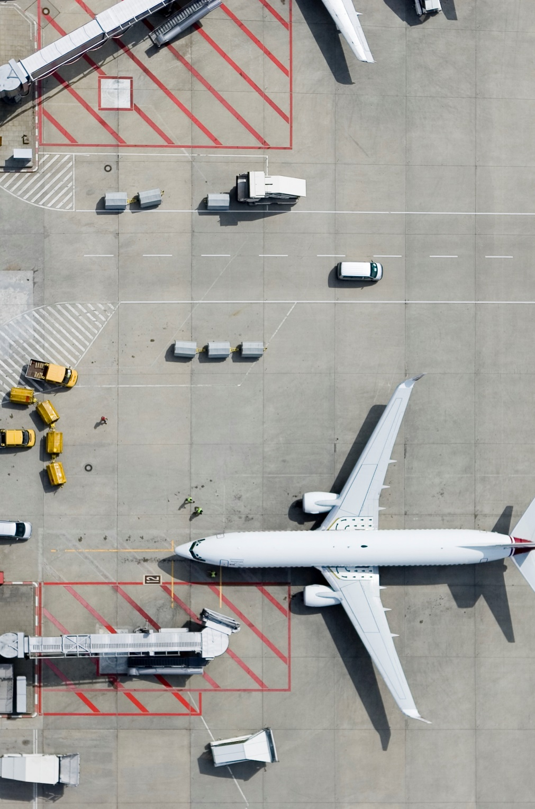
Transportation

Slide 5
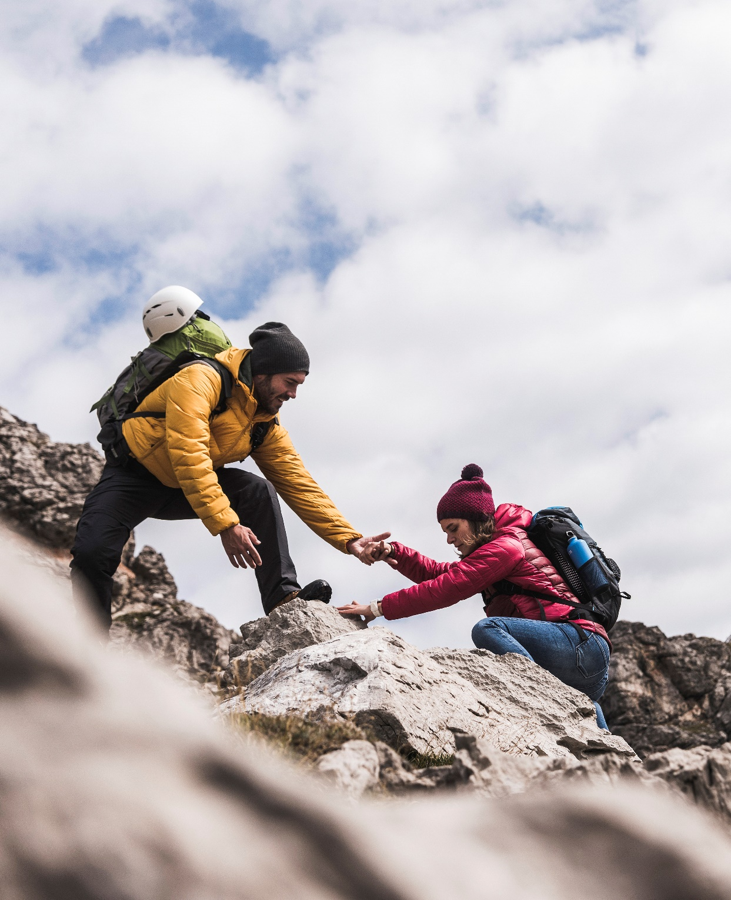
Thank You
someone@example.com

