Slide 1
MY DREAM DESTINATION

Slide 2
INTRODUCTION
“Welcome to my presentation on Maldives, a place that has captured my imagination and inspired my travel dreams. Nestled in the heart of Maldives, this destination offers a unique blend of breathtaking landscapes, rich cultural heritage, and unforgettable experiences. Join me as we embark on a journey to discover what makes Maldives so special and why it should be on everyone’s travel bucket list.”

Slide 3
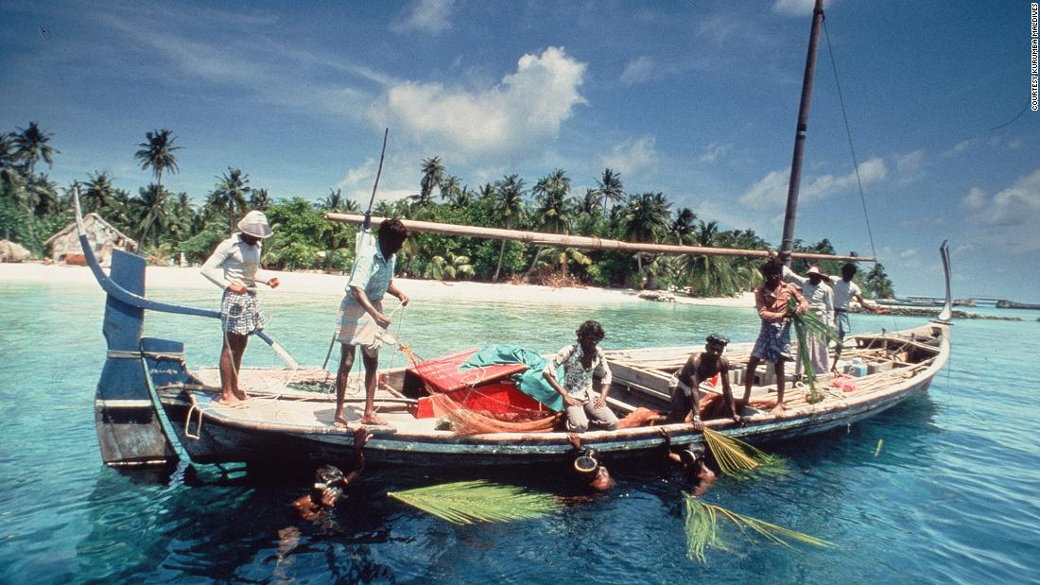
HISTORY
history of the Maldives ,a survey of the important events and people in the history of the Maldives. Located in the north-central Indian Ocean, the Maldives is an independent island country that consists of a chain of about 1,200 small coral islands and sandbanks (some 200 of which are inhabited), grouped in clusters, or atolls. The population of the Maldives belongs almost entirely to the Maldivian ethnic group, which is the result of various peoples’ settling in the islands successively during the country’s history.

Slide 4
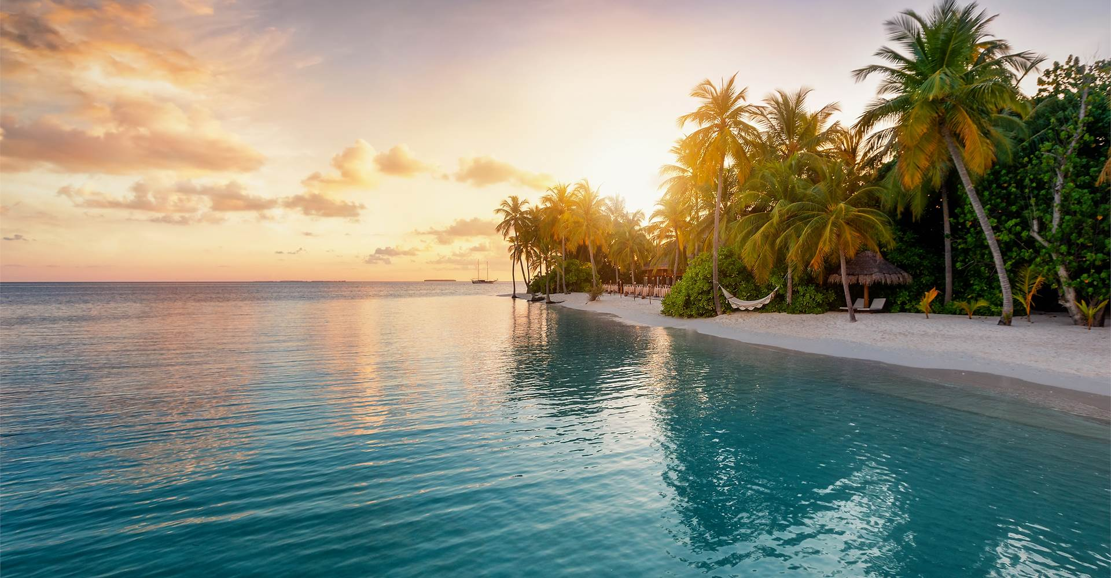
MALDIVES ATTRACTIONS
Beaches
The Maldives is famous for its stunning white-sand beaches and crystal-clear turquoise waters. Each resort island typically has its own beautiful beach.

Slide 5
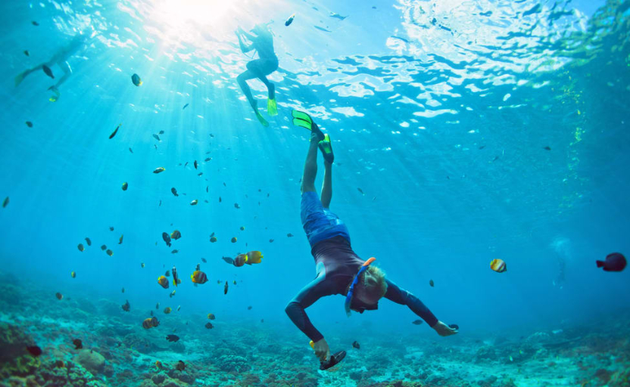
SNORKELING AND SCUBA DIVING
MALDIVES ATTRACTIONS
The Maldives offers some of the best snorkeling and diving experiences in the world.

Slide 6
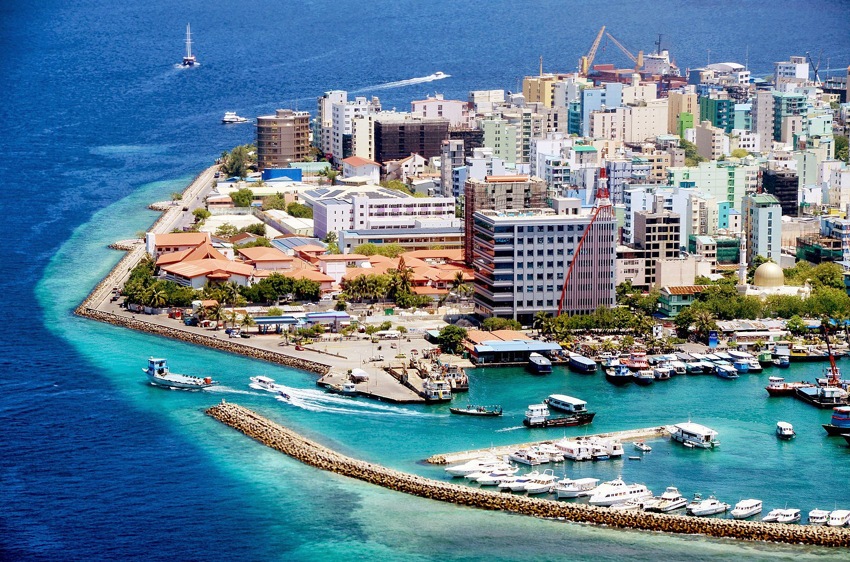
MALDIVES ATTRACTIONS
MALE CITY
Male City: The capital city offers a mix of modernity and tradition. Key attractions include the Maldives National Museum, the Grand Friday Mosque, and the bustling local markets.

Slide 7
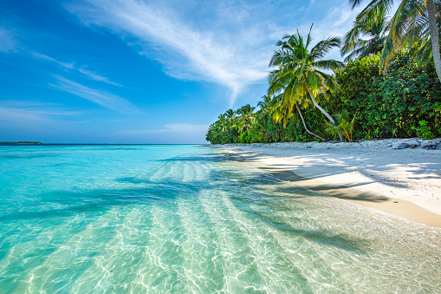
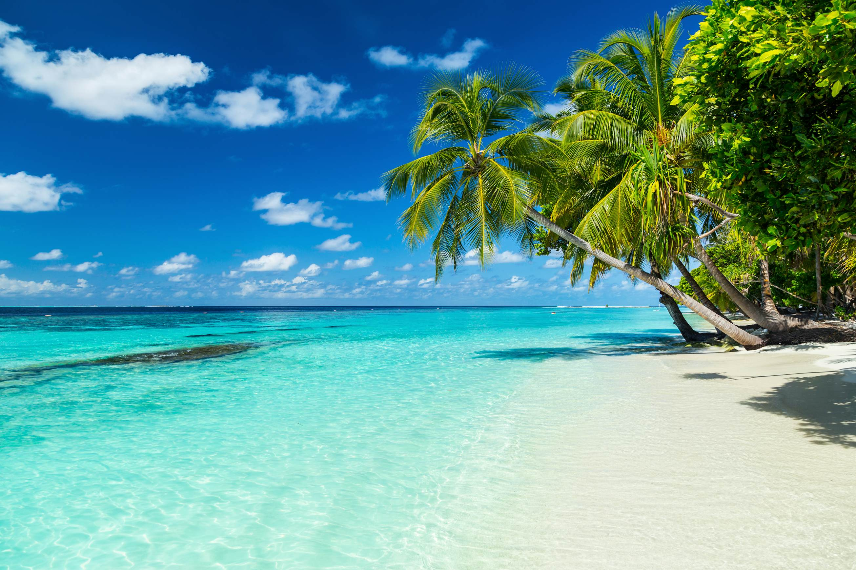
WHY I WOULD LIKE TO TRAVEL IN MALDIVES?
Stunning Beaches : The Maldives is renowned for its pristine white-sand beaches and crystal-clear turquoise waters. It’s the perfect place to relax and soak up.

Slide 8
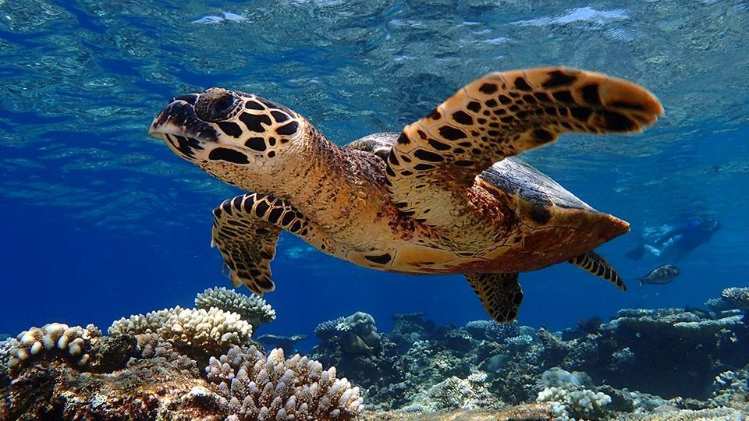
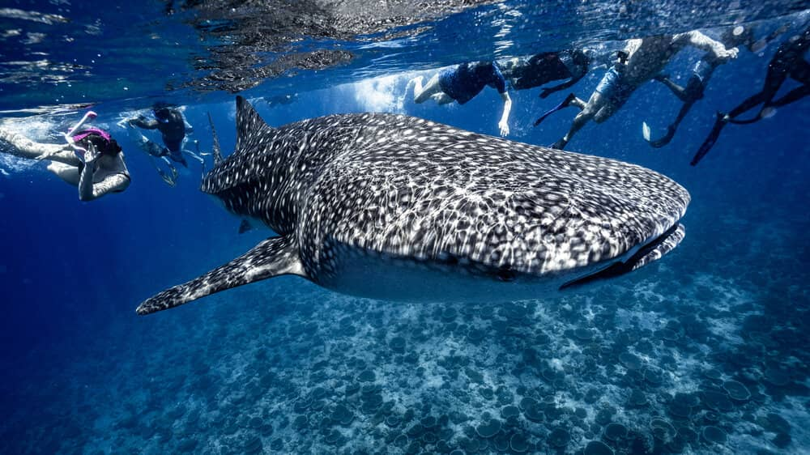
WHY I WOULD LIKE TO TRAVEL IN MALDIVES?
Incredible Marine Life : The Maldives offers some of the best snorkeling and diving experiences in the world. You can swim with vibrant coral reefs, manta rays, and even whale sharks

Slide 9
THANK YOU!

