Slide 1
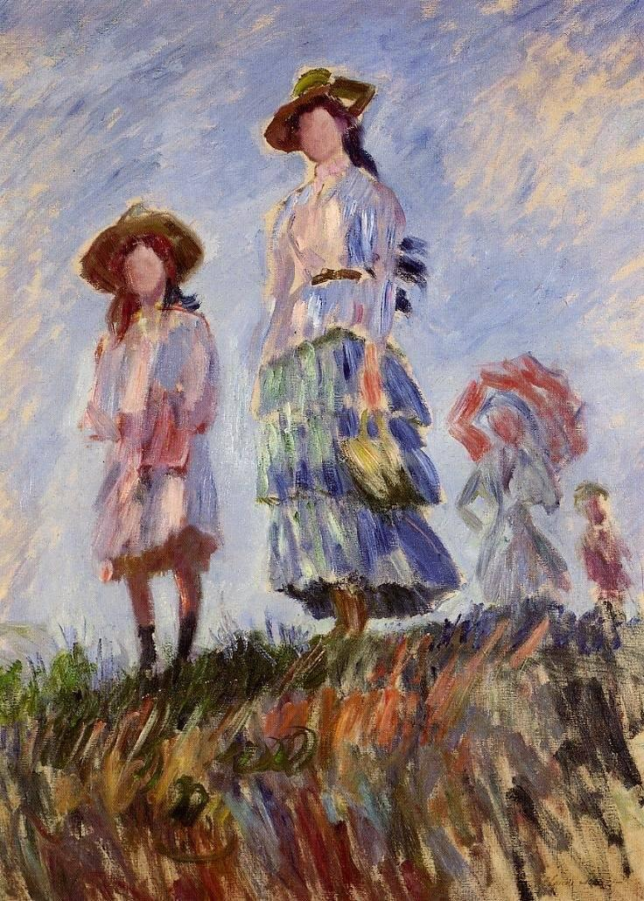
ART CLASSIFICATION WITH DEEP LEARNING
JUSTINE PICAR, JULY 2021

Slide 2
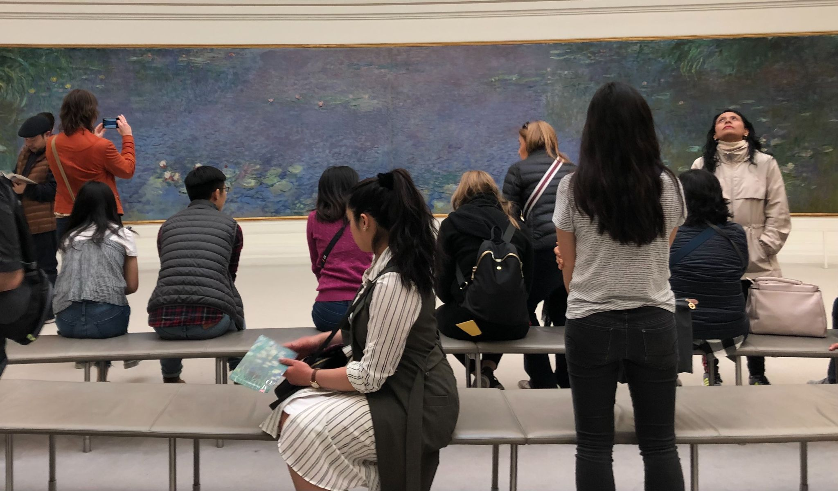
ART MUSEUMS: A BACKGROUND
Important public institutions
Hold a lot of cultural history
A popular experience shared by many people with the help of the internet
Opportunities exist to reach a broader, diverse group of people

Slide 3
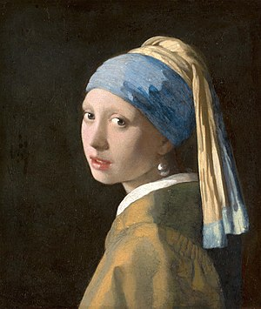
PROBLEM
Rely on increased audience engagement and patrons
Lesser known museums cannot afford engaging programs and activities
Museums are must index the genre of a painting before displaying it, which can be time consuming (source)
New art enthusiasts can be intimidated by art without background knowledge
An online poll by art start-up, Meural, shows that from a group of 1,000 people, only 18% of all ages in the US could identify who painted The Girl with the Pearl Earring (source)
However, 20% of people would appreciate art if there was more accessibility

Slide 4
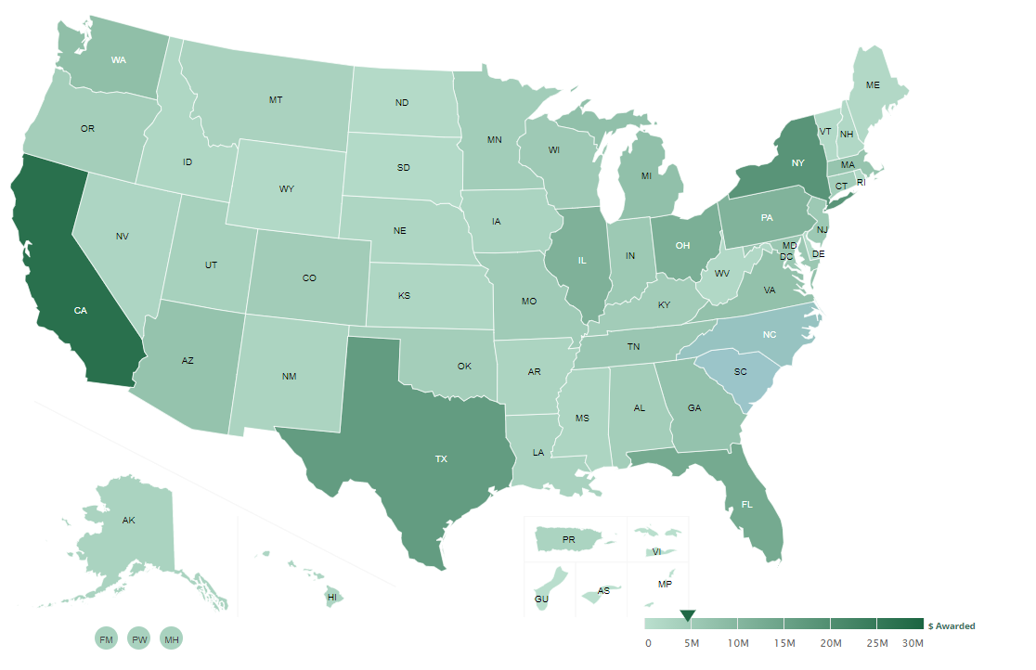
PROBLEM
A map of funding for the 9k libraries and 35k museums in the U.S. during the fiscal year 2020 from the Institute of Museum and Library Services (IMLS)

Slide 5
PROJECT OBJECTIVE:
Classify the art style of a painting to use as an interactive tool for patrons and for museum curators to label new paintings before an exhibition

Slide 6
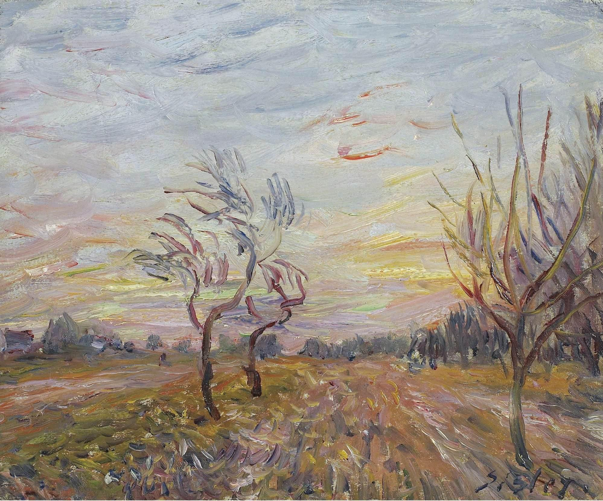
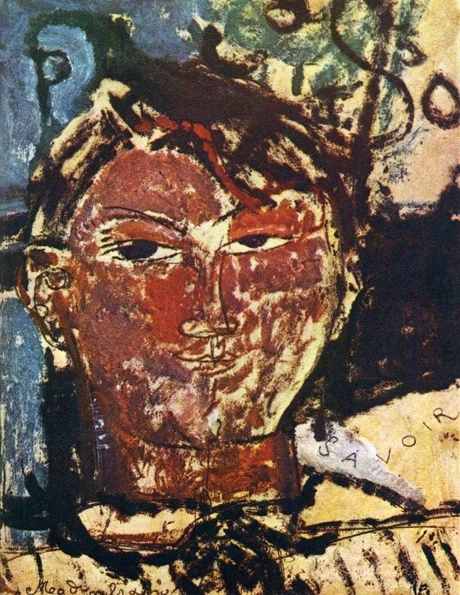
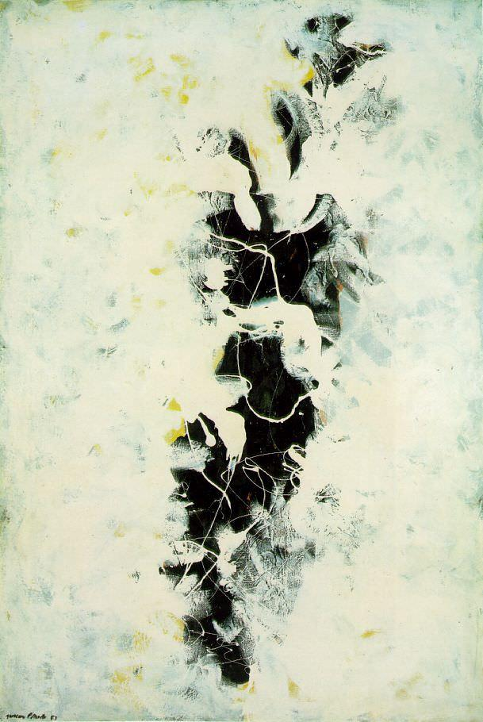
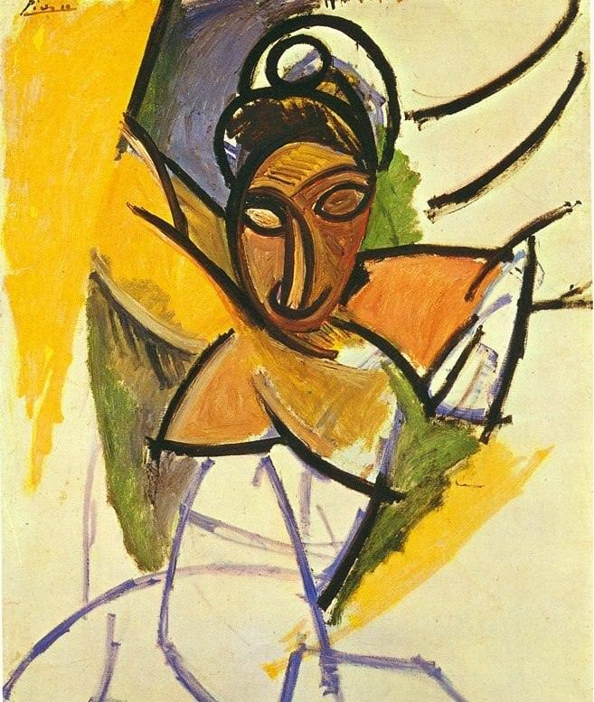
DATA: KAGGLE’S BEST ARTWORKS OF ALL TIME
8,446 PAINTINGS
FROM TOP 50 RENOWNED ARTISTS (Warhol, Monet, Degas, etc)
20 UNIQUE ART STYLES

Slide 7
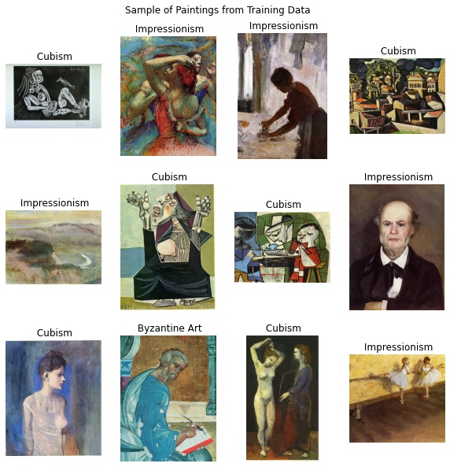
DATA WRANGLING
Classified by artists; relabeled by genre
20/31 art styles are unique; drop columns with multiple genres
Focus on 6 particular classes:
Impressionism
Cubism
Expressionism
Pop Art
Byzantine Art
Abstract Expressionism
Total of 2,206 images
81% training, 9% validation, 10% testing*
* There is a separate testing set independent of the and validation set so the model will not “cheat” or “learn” training

Slide 8
BREAKDOWN OF DATA
DATA
TRAIN SET (81%)
VALIDATION SET (9%)
TEST SET (10%)
class a
class a
class a
class b
class c
class d
class e
class f
class b
class c
class d
class e
class f
class b
class c
class d
class e
class f

Slide 9
PACKAGES
For training and modeling the data
keras
For visualizing the raw data, the pre-processed images, and metrics
skimage
matplotlib.pyplot
seaborn
For visualizing neural network architectures
graphviz
pydot

Slide 10
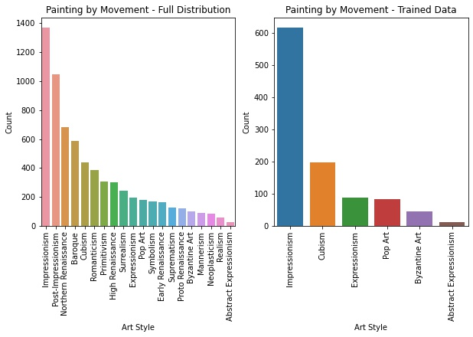
EDA: PAINTING DISTRIBUTION

Slide 11
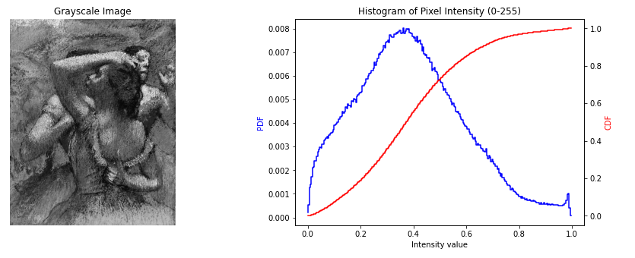
EDA: PIXEL INTENSITY

Slide 12
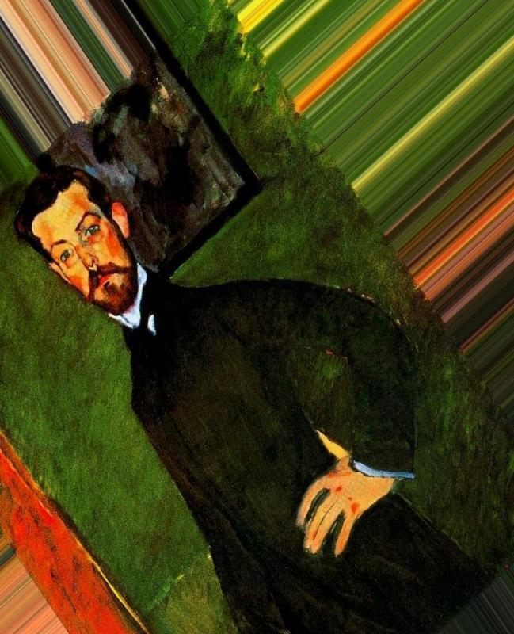
METHODOLOGY: DATA AUGMENTATION & PRE-PROCESSING
Increase robustness of models and ability to generalize data
Maintain distribution
Apply distortions randomly
Rotations
Nearest ‘fill’ method
Horizontal flip
Zoom
Stretch (width and height)

Slide 13
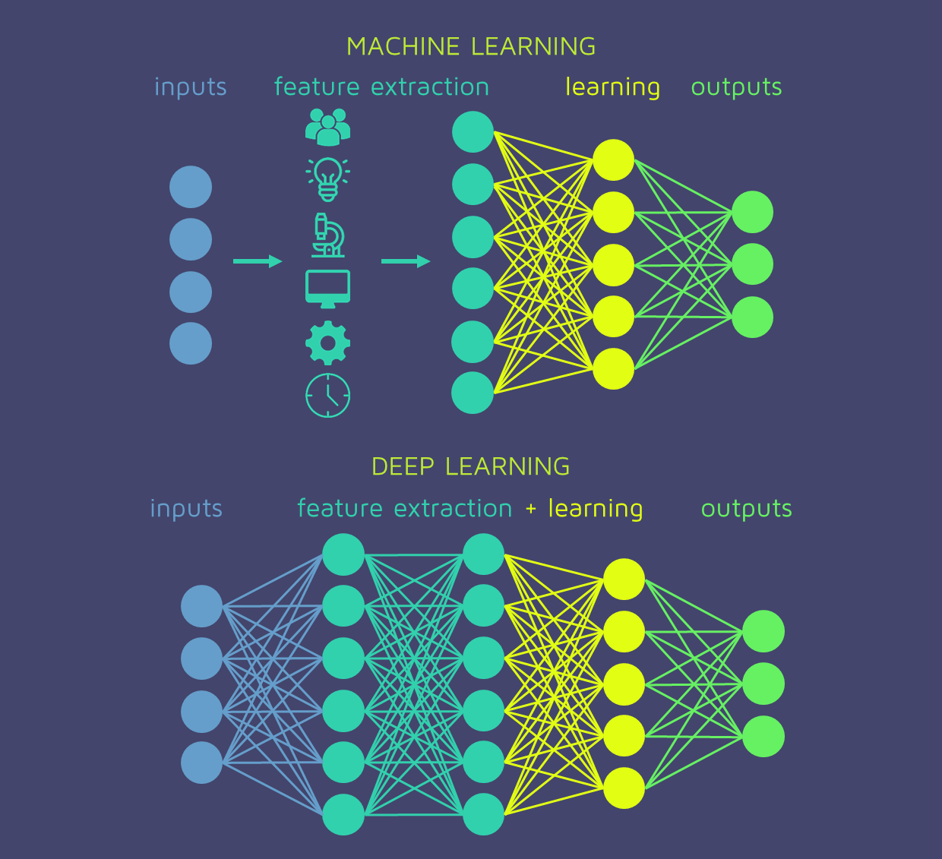
METHODOLOGY: USING DEEP LEARNING
DEEP LEARNING: a subset of machine learning that is more complex and uses neural networks
NEURAL NETWORKS: computing system inspired by the brain; receives, processes and “signals” other neurons to output a sum of its inputs with input, hidden, and output layers
WEIGHT INITIALIZATION: sets the weights of a neural network to adjust the learning of the model
PRE-TRAINING/TRANSFER LEARNING: Uses a pre-trained model trained on a large benchmark dataset (ex. ImageNet) to solve a similar problem to the one we want to solve
FINE-TUNING: process of adjusting or tuning parameters in a model to perform a similar task or to perform better

Slide 14
METHODOLOGY
WEIGHT INITIALIZATION
class_weights from sklearn.utils
balance the distribution between art styles in the training data
PRE-TRAINING
Transfer learning with the ImageNet database
Train on top of a RESNET50 model
FINE TUNING
Re-train last 20% of layers
Freeze all other layers
Slower learning rate
Use Stochastic Gradient Descent (SGD) Optimizer

Slide 15
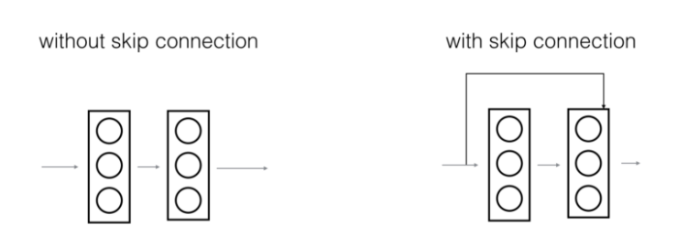
SIMPLE CNN VS. RESNET50
Simple Convolutional Neural Network (CNN)
Specializes in processing data that has a grid-like topology, such as an image
Each layer is fully connected to all neurons in the layer
As more layers are added, the performance of the model degrades rapidly due to vanishing gradients
Residual Neural Network (RESNET50)
A type of convolutional neural network
Uses skip connections to train the model at deeper layers and mitigates the issue of gradient descent
Skip connections ensure the higher layers will perform at least as good the lower layers
Skip connection adds the original input to the output of a convolutional block

Slide 16
NEURAL NETWORK ARCHITECTURES
Simple Convolutional Neural Network (CNN)
Input shape: 200 x 200 x 3
3 stages with structure:
Conv2D
RELU Activation
MaxPooling2D
Filters at each stage: 32, 64,128 respectively
Final Stage:
Flatten
Dense Layer with 128 feature maps
Dropout ~40% of the parameters to prevent overfitting
Dense layer = the number of classes (6)
Softmax activation for multi-classification
Click Here for Visual
Residual Neural Network (RESNET50)
Input shape: 200 x 200 x 3
Identity Block with skip connection
Conv2D -> BatchNormalization
Convolutional Block with skip connection
Conv2D -> BatchNormalization
Residual Neural Network
Conv2D
BatchNormalization
MaxPooling2D
4 stages of convolutional and identity block
AveragePooling
Dense layer = the number of classes (6)
Softmax activation for multi-classification
Total: 53 layers
Click Here for Visual

Slide 17
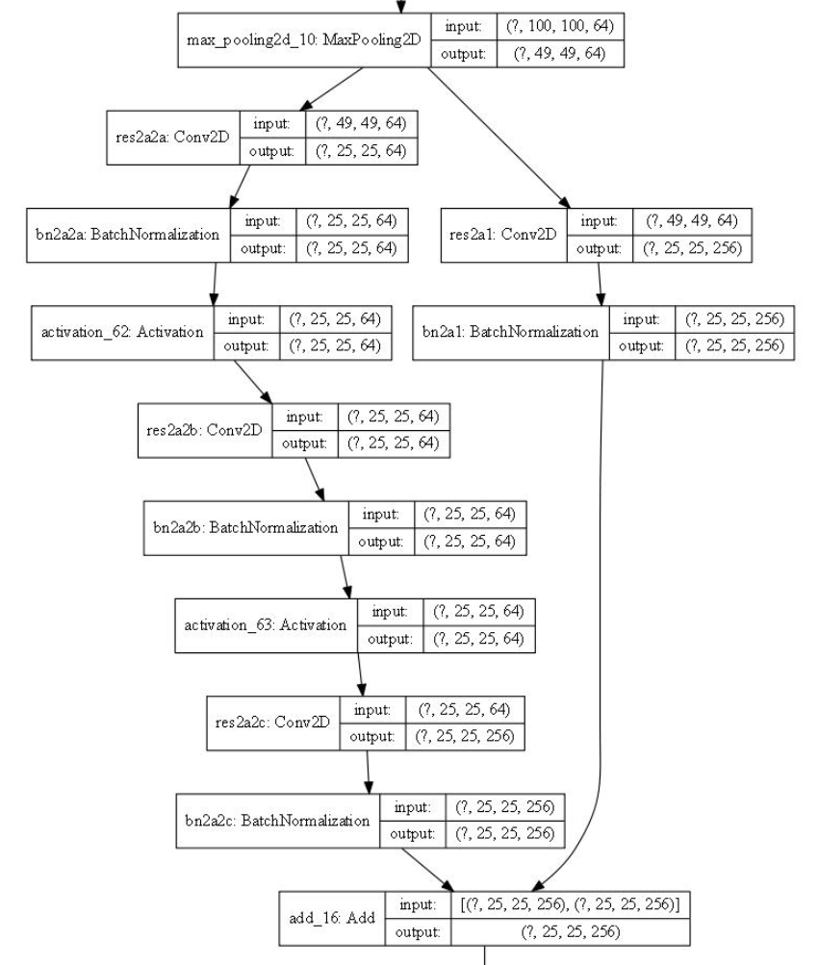
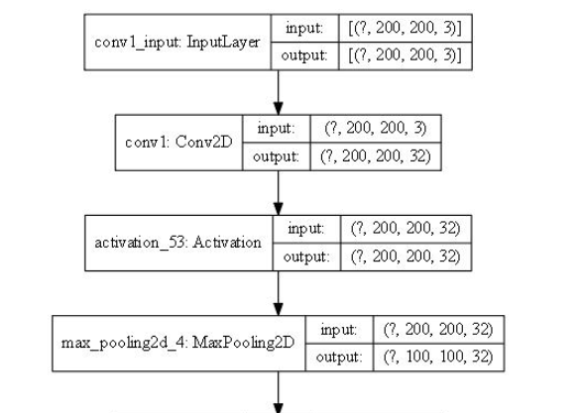
NEURAL NETWORK ARCHITECTURES
Residual Neural Network (RESNET50)
Convolutional Neural Network (CNN)

Slide 18
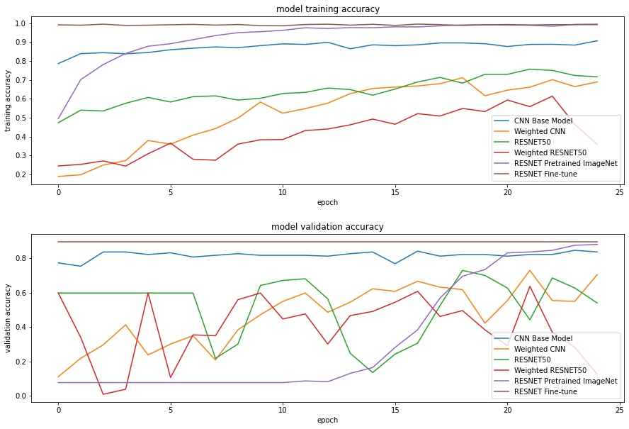
MODEL RESULTS AND ANALYSIS
We use accuracy as the main metric when comparing the models because the goal is to predict a specific label for each class

Slide 19
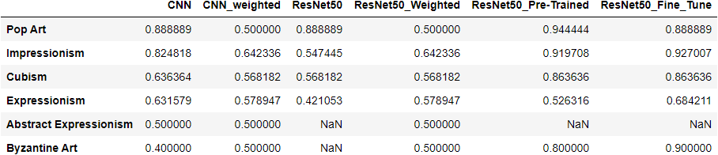
MODEL RESULTS AND ANALYSIS
PRE-TRAINED RESNET50 WAS THE BEST MODEL
WEIGHTED RESNET50 WAS THE WORST MODEL

Slide 20
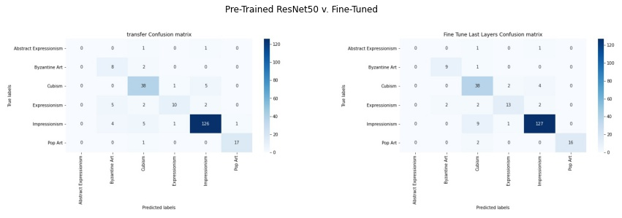
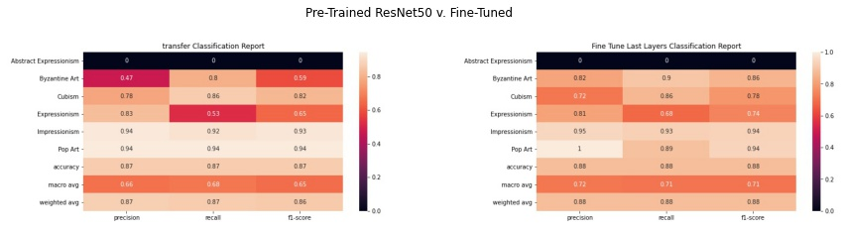
MODEL RESULTS AND ANALYSIS

Slide 21
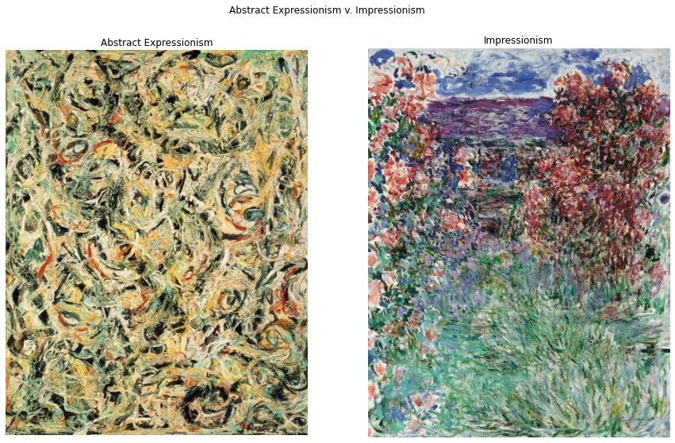
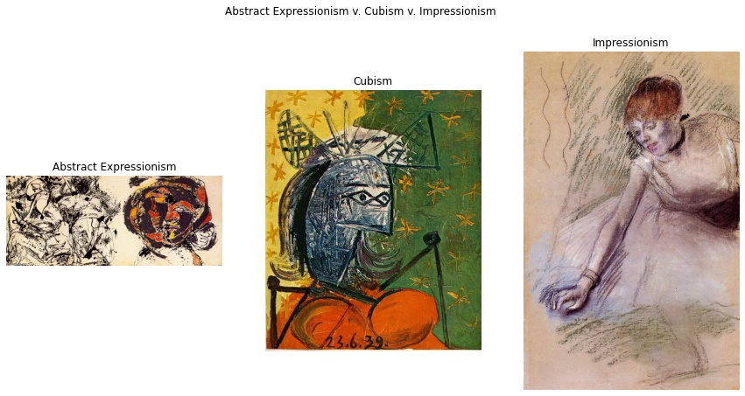
Key Findings
Abstract Expressionism labels misclassified as Cubism and Impressionism
Impressionism has a very open composition that appears abstract up close
Cubism is specific, yet abstract form of art

Slide 22
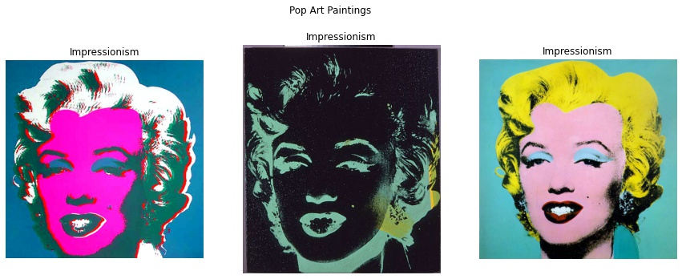
Key Findings
Pop Art highly recognizable due to unique style (repeating patterns)
Model detects styles with distinct repeating patterns
Struggles with styles closer to one another, much like a person

Slide 23
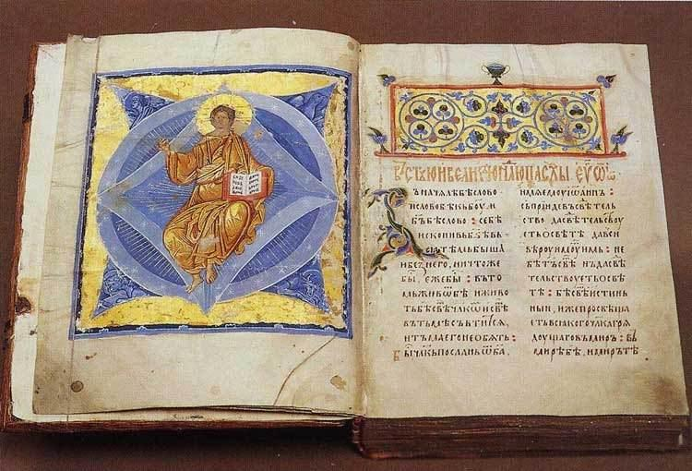
CONCLUSION & LESSONS LEARNED
87% ACCURACY ON PRE-TRAINED RESNET50
PRE-TRAIN OTHER MODELS:
VGG-16
INCEPTIONV3
EFFICIENT NET
METHODOLOGY:
COMBINING CLASSES
BAGGING
CROSS-VALIDATION
DIVERSE DATASET

Slide 24
THANK YOU!
Thank you to my patient and wonderful mentor Nik Skhirtladze, Francois Chollet and Priya Dwivedi on their helpful tutorials, and Stack Overflow for all my troubleshooting needs.

Slide 25
SOURCES
Image Classification Using Very Little Data by Francois Chollet
Kaggle Best Artworks of All Time
Keras API
Map of All 35,000 Museums in the United States Reveals Empty Region
MOMA Contemporary Challenges
Stack Overflow
Understanding ResNet in Keras by Priya Dwivedi

