Slide 1
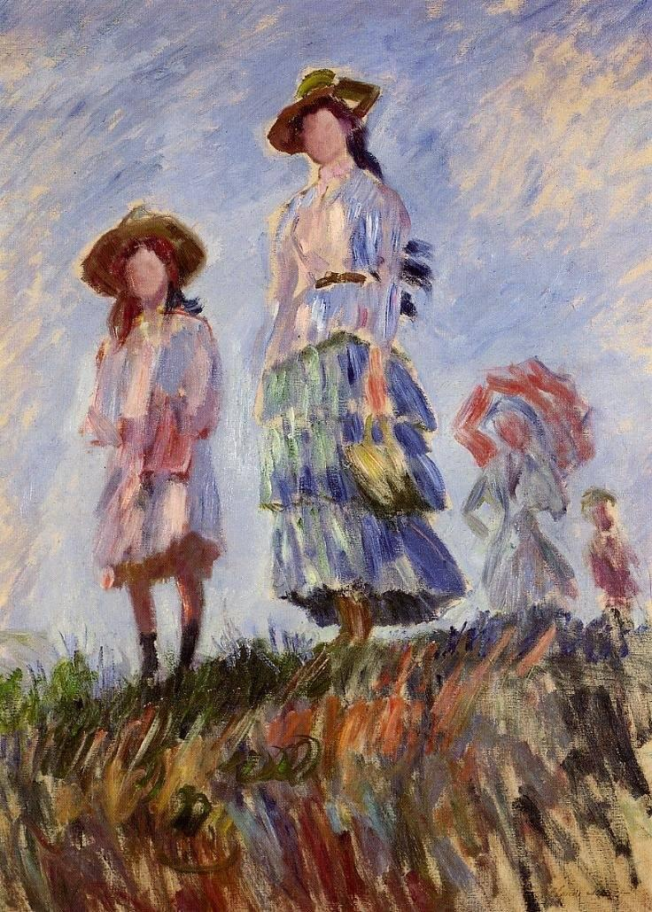
ART CLASSIFICATION WITH DEEP LEARNING
JUSTINE PICAR, JULY 2021

Slide 2
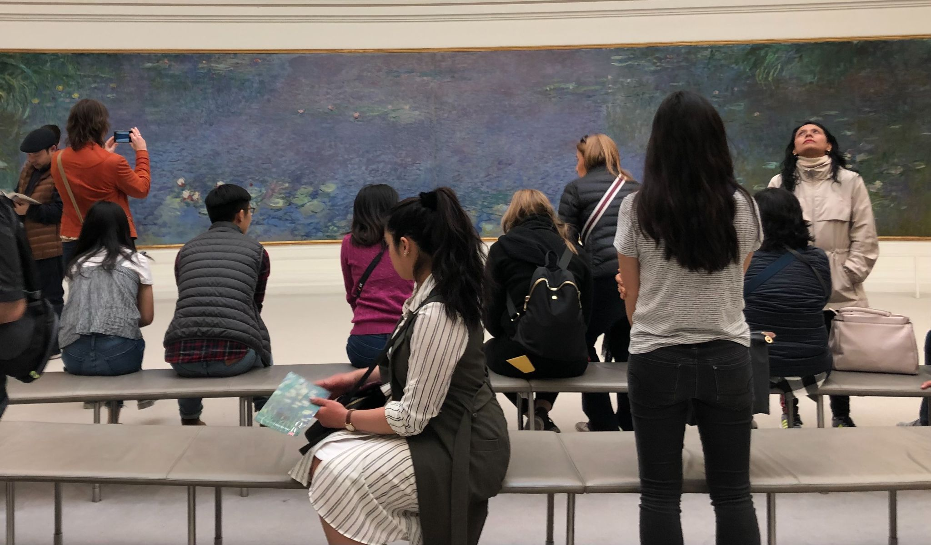
ART MUSEUMS: A BACKGROUND
Important public institutions
Hold a lot of cultural history
A popular experience shared by many people with the help of the internet
Opportunities exist to reach a broader, diverse group of people

Slide 3
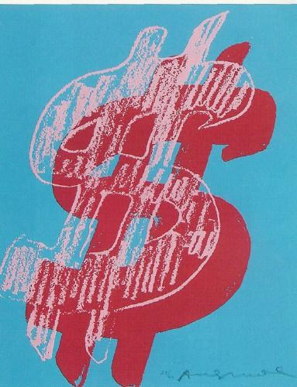
PROBLEM
Struggle with budget cuts
Rely on increased audience engagement and patrons
Lesser known museums cannot afford engaging programs and activities
New art enthusiasts can be intimidated by art without background with knowledge
Museums are required to label the genre of a painting before displaying it, which can be time consuming

Slide 4
PROJECT OBJECTIVE:
Classify the art style of a painting to use as an interactive tool for patrons and for museum curators to label new paintings before an exhibition

Slide 5
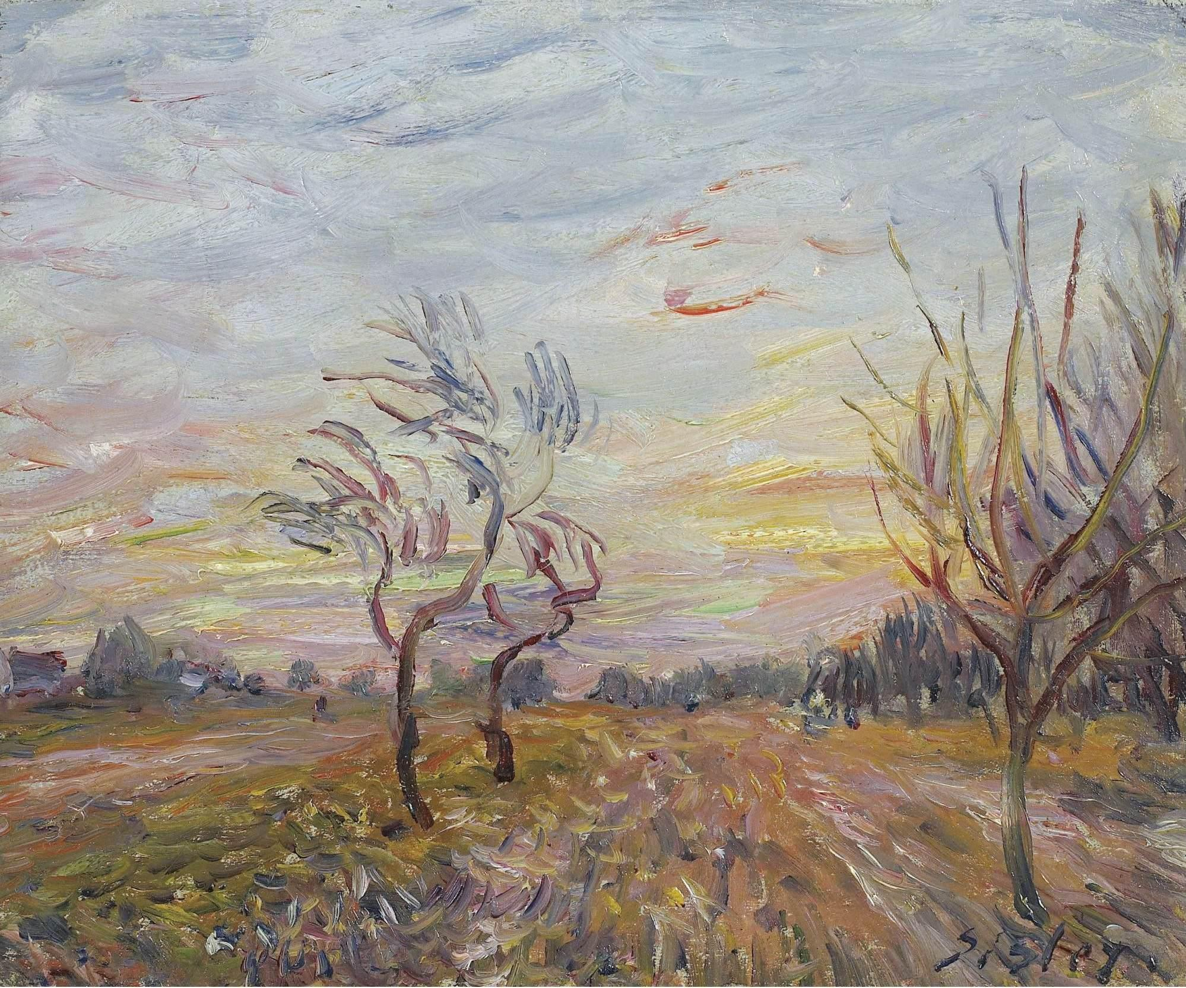
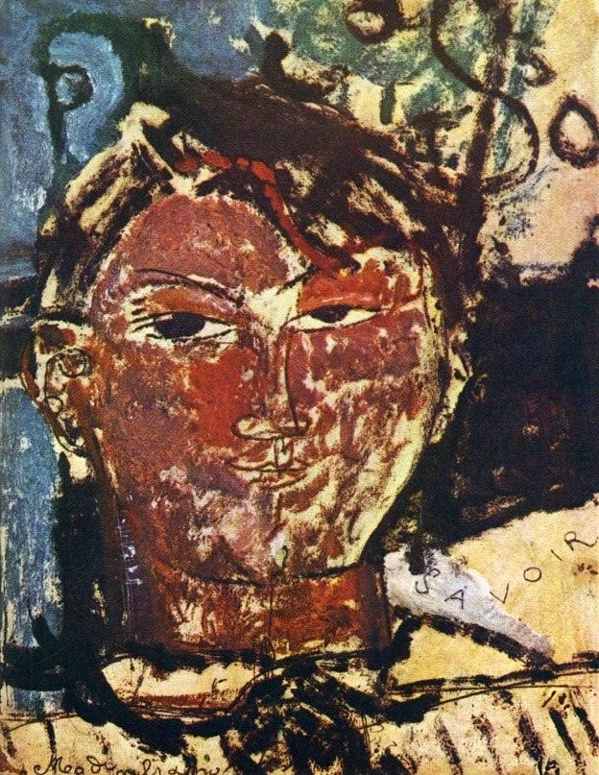
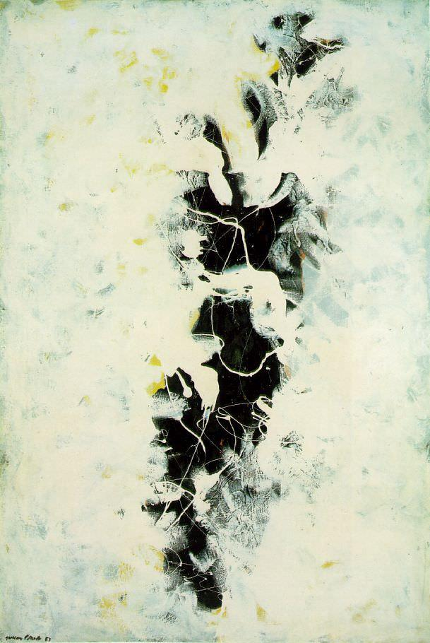
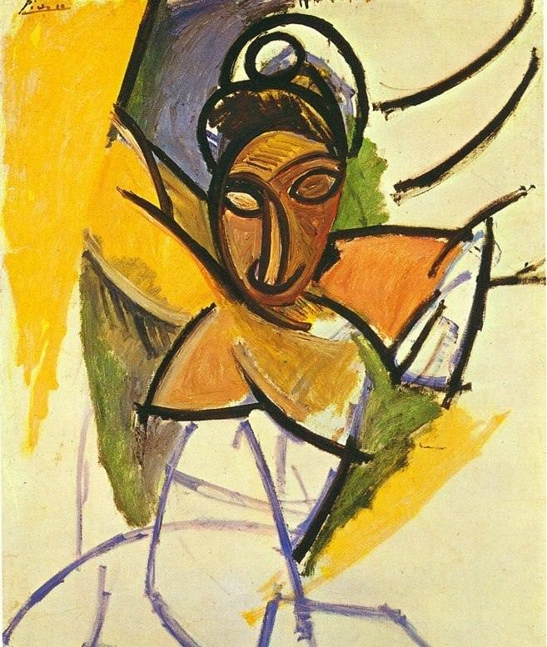
DATA: KAGGLE’S BEST ARTWORKS OF ALL TIME
8,446 PAINTINGS
FROM TOP 50 RENOWNED ARTISTS
20 UNIQUE ART STYLES

Slide 6
PACKAGES
Training and modeling the data
KERAS API
EDA and Metrics Visualization
skimage
matplotlib.pyplot
seaborn
Neural Network Visualization
graphviz
pydot

Slide 7
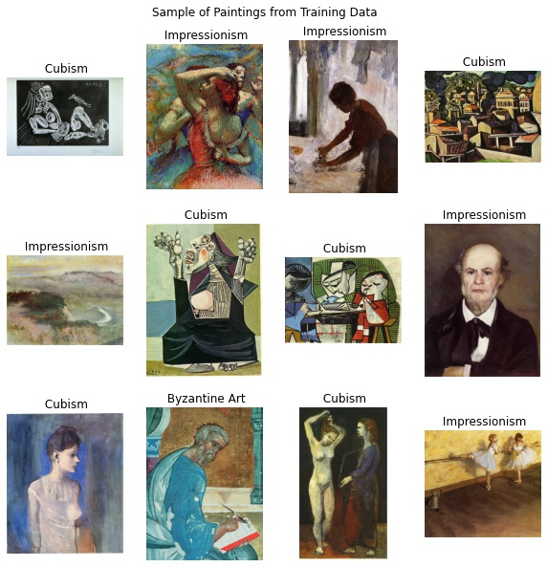
DATA WRANGLING
Reclassified data to genre then dropped all other columns
20/31 art styles are unique; drop columns with multiple genres
Focus on 6 particular classes:
Impressionism
Cubism
Expressionism
Pop Art
Byzantine Art
Abstract Expressionism
Total of 2,206 images
60% training, 9% validation, 10% testing

Slide 8
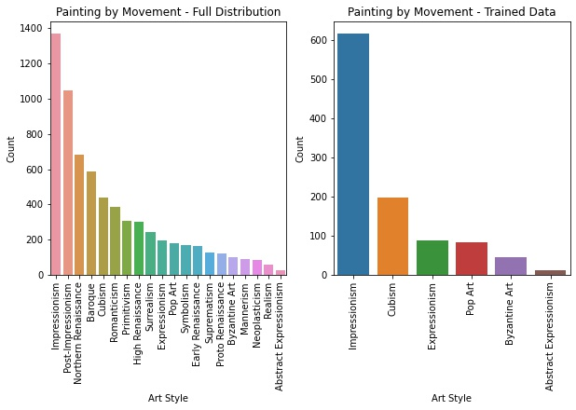
EDA: PAINTING DISTRIBUTION

Slide 9
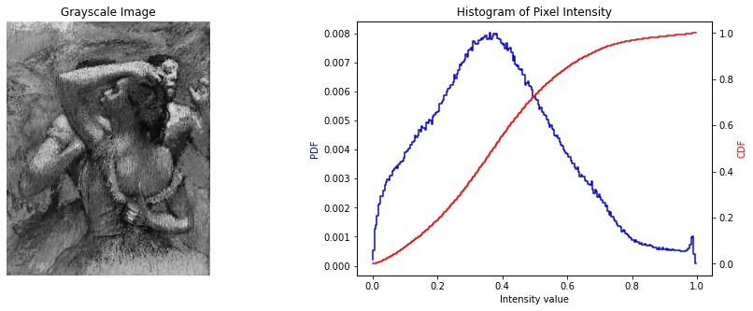
EDA: PIXEL INTENSITY

Slide 10
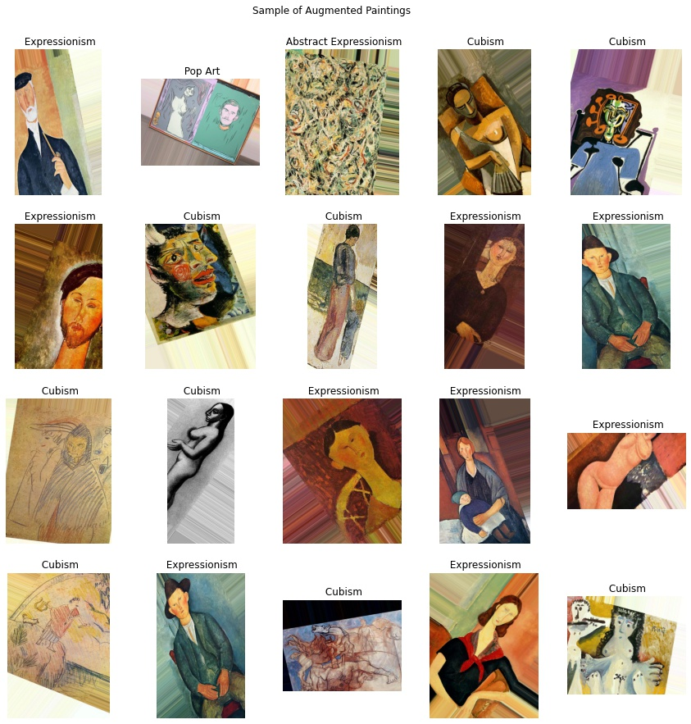
METHODOLOGY: DATA AUGMENTATION & PRE-PROCESSING
Increase robustness of models and ability to generalize data
Maintain distribution
Apply distortions randomly
Rotations
Nearest ‘fill’ method
Horizontal flip
Zoom
Stretch (width and height)
Shear
Brightness
Normalization

Slide 11
METHODOLOGY
WEIGHT INITIALIZATION
class_weights from sklearn.utils
balance the distribution between art styles in the training data
PRE-TRAINING
Transfer learning with the ImageNet database
Train on top of a RESNET50 model
FINE TUNING
Re-train last 20% of layers
Freeze all other layers
Slower learning rate
Use Stochastic Gradient Descent (SGD) Optimizer

Slide 12
NEURAL NETWORK ARCHITECTURES
Convolutional Neural Network
Input shape: 200 x 200 x 3
3 stages with structure:
Conv2D
RELU Activation
MaxPooling2D
Filters at each stage: 32, 64,128 respectively
Final Stage:
Flatten
Dense Layer with 128 feature maps
Dropout ~40% of the parameters to prevent overfitting
Dense layer = the number of classes (6)
Softmax activation for multi-classification
Click Here for Visual
Residual Neural Network
Input shape: 200 x 200 x 3
Identity Block with skip connection
Conv2D -> BatchNormalization
Convolutional Block with skip connection
Conv2D -> BatchNormalization
Residual Neural Network
Conv2D
BatchNormalization
MaxPooling2D
4 stages of convolutional and identity block
AveragePooling
Dense layer = the number of classes (6)
Softmax activation for multi-classification
Total: 53 layers
Click Here for Visual

Slide 13
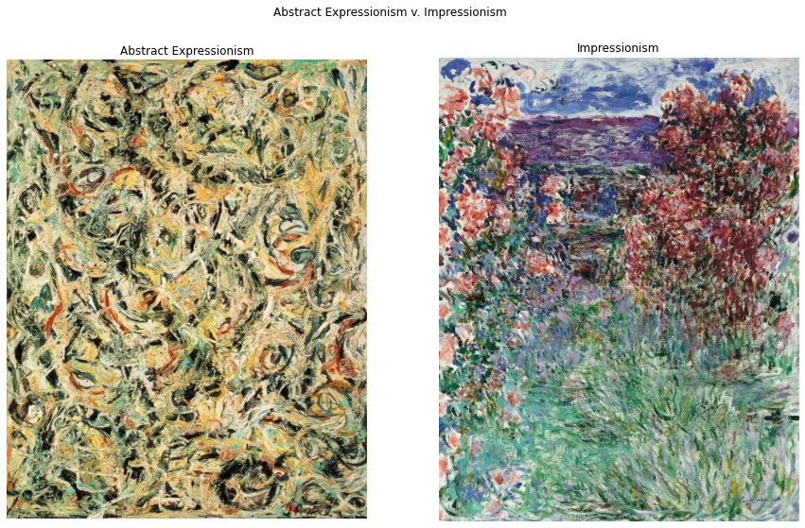
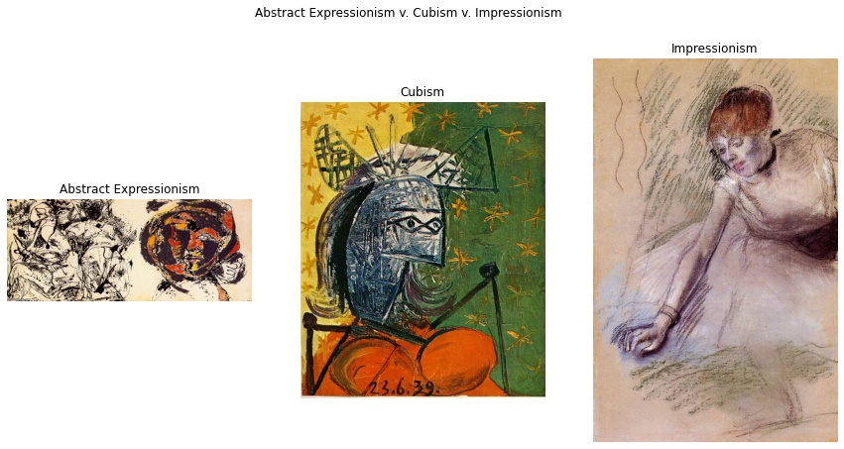
Key Findings
Abstract Expressionism labels misclassified as Cubism and Impressionism
Impressionism has a very open composition that appears abstract up close
Cubism is specific, yet abstract form of art

Slide 14
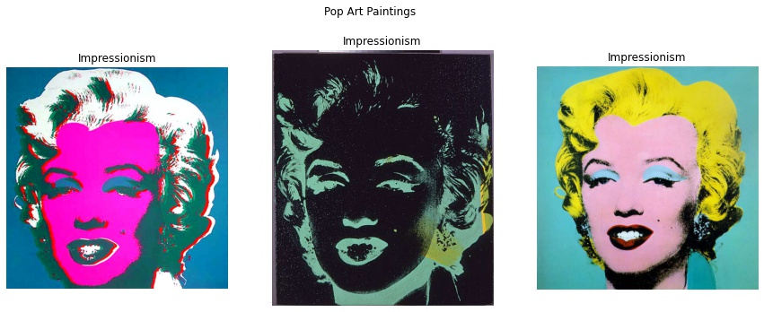
Key Findings
Pop Art highly recognizable due to unique style (repeating patterns)
Model detects styles with distinct repeating patterns
Struggles with styles closer to one another, much like a person

Slide 15
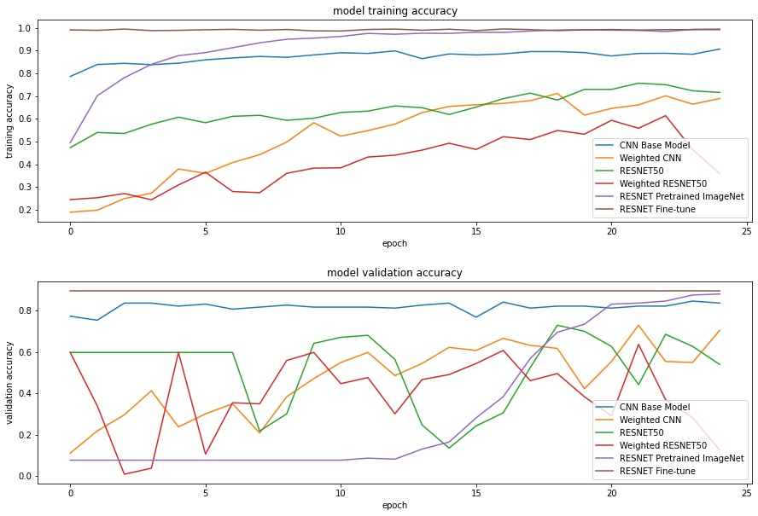
MODEL RESULTS AND ANALYSIS

Slide 16
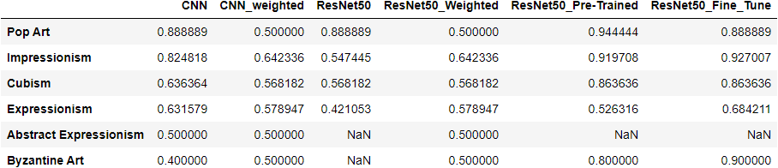
MODEL RESULTS AND ANALYSIS
PRE-TRAINED RESNET50 WAS THE BEST MODEL
WEIGHTED RESNET50 WAS THE WORST MODEL

Slide 17
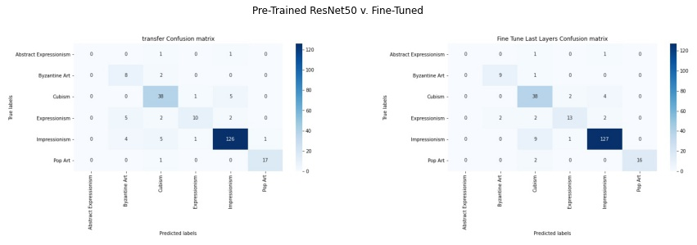
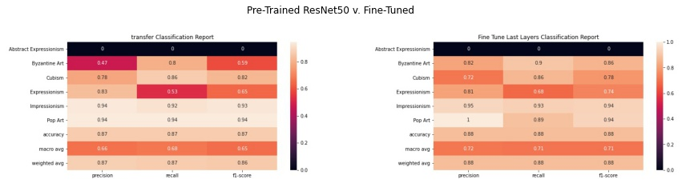
MODEL RESULTS AND ANALYSIS

Slide 18
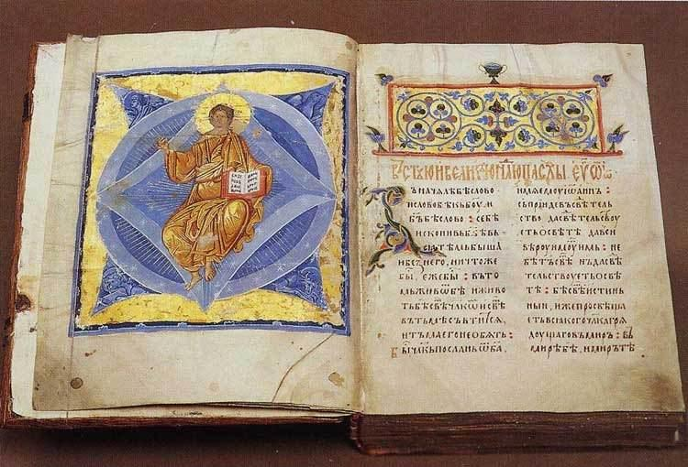
CONCLUSION & LESSONS LEARNED
87% ACCURACY ON PRE-TRAINED RESNET50
PRE-TRAIN OTHER MODELS:
VGG-16
INCEPTIONV3
EFFICIENT NET
METHODOLOGY:
COMBINING CLASSES
BAGGING
CROSS-VALIDATION
DIVERSE DATASET

Slide 19
THANK YOU!
Thank you to my patient and wonderful mentor Nik Skhirtladze, Francois Chollet and Priya Dwivedi on their helpful tutorials, and Stack Overflow for all my troubleshooting needs.

Slide 20
SOURCES
Image Classification Using Very Little Data by Francois Chollet
Kaggle Best Artworks of All Time
Keras API
MOMA Contemporary Challenges
Stack Overflow
Understanding ResNet in Keras by Priya Dwivedi

