Slide 1
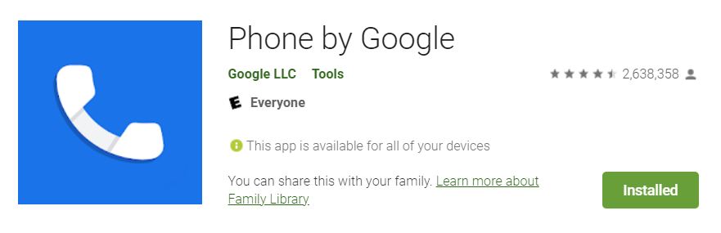
GMS Apps Investigations
Part 2: GMS Google Phone Dialer App

Slide 2
Phone Dialer App?

Slide 3
What is Phone Dialer App?
It's the default phone app on many Android devices
especially Google Pixel phones and some other OEM devices running stock or near-stock Android.
can sometimes be downloaded from the Google Play Store on compatible devices.
Key features: handles phone calls, call history, contacts
Other features: spam call filtering, visual voicemail, and call screening on supported devices.
Package ID: com.google.android.dialer

Slide 4
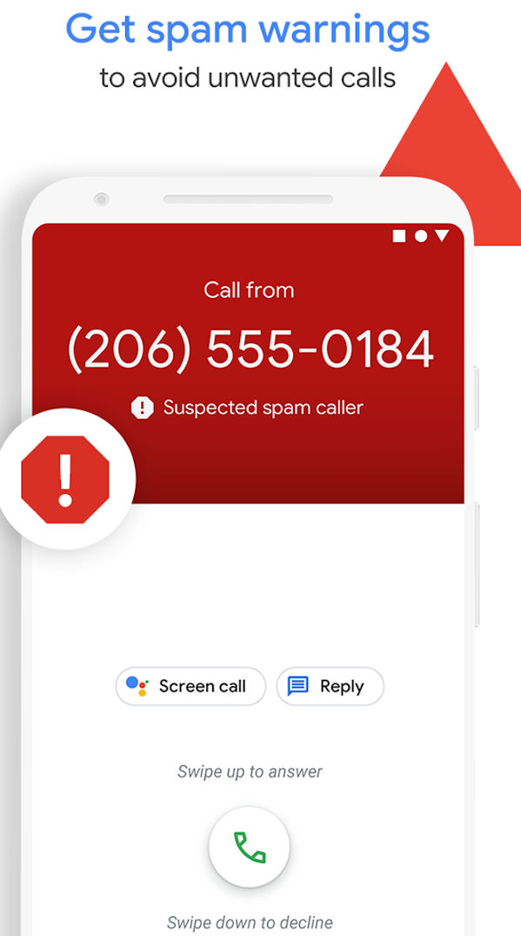
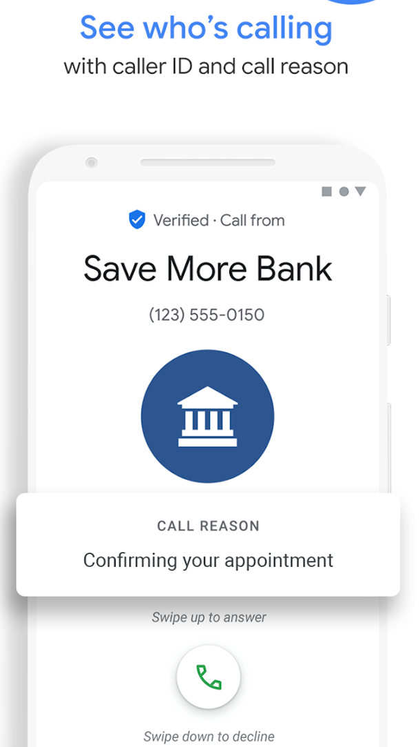
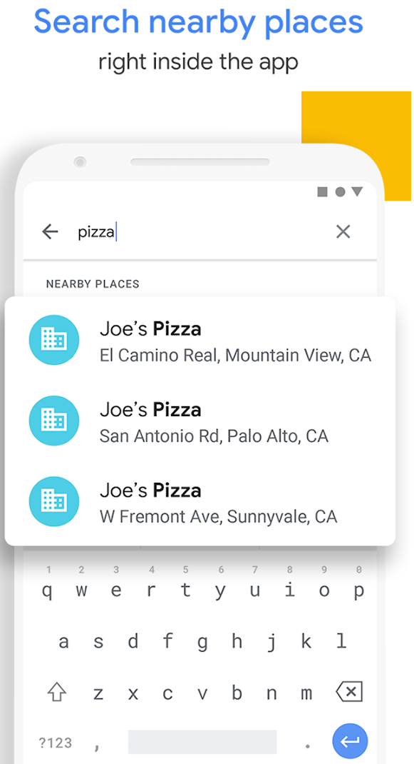
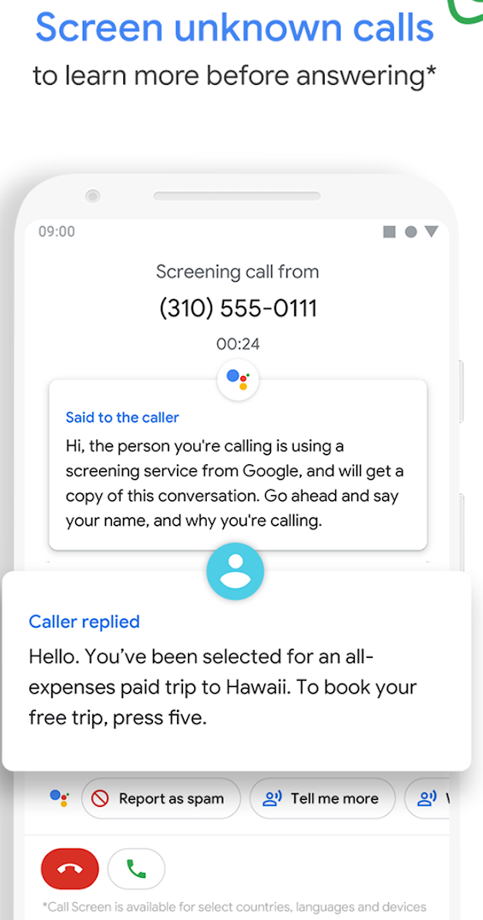

Slide 5
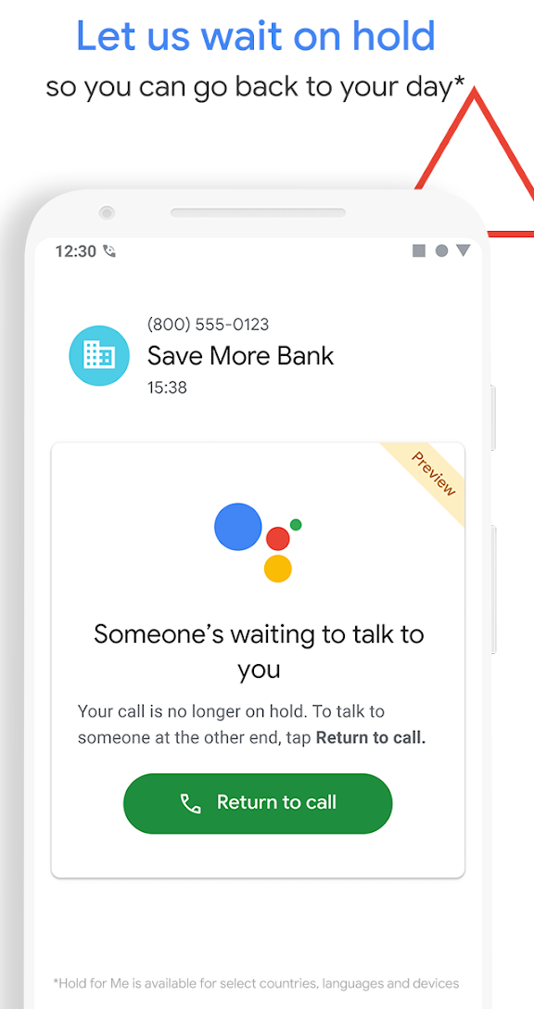
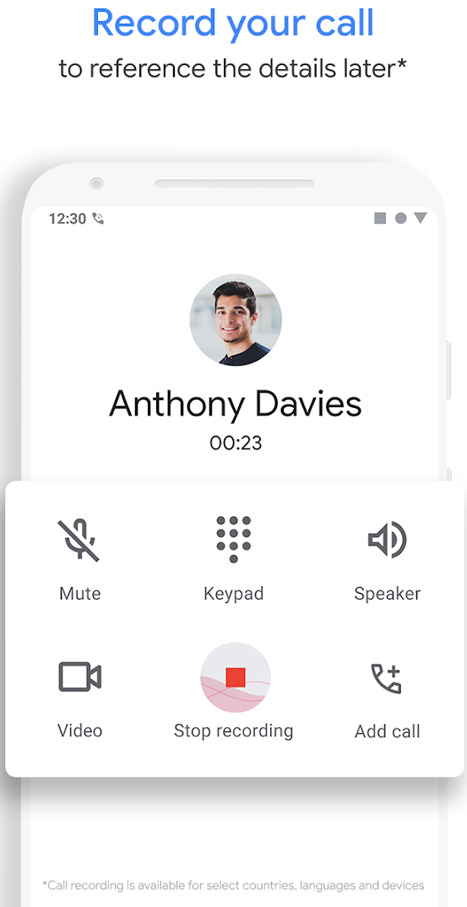
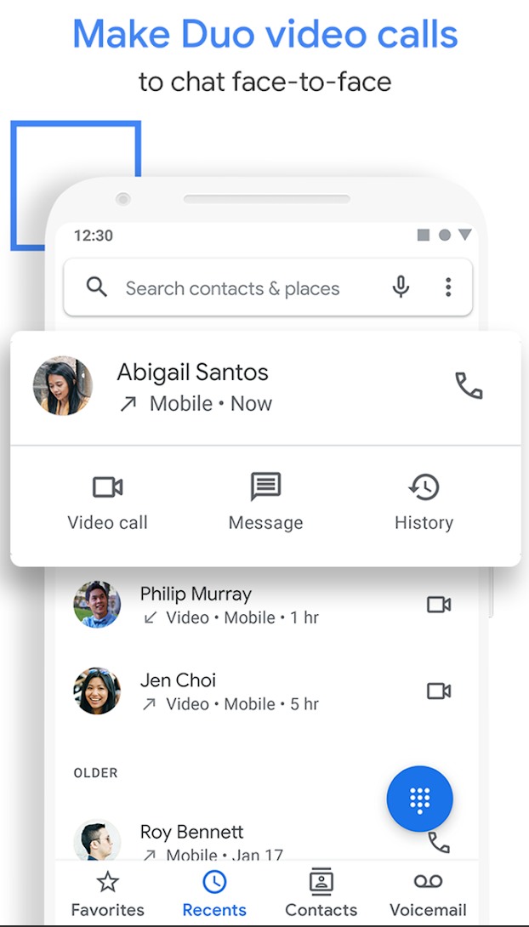
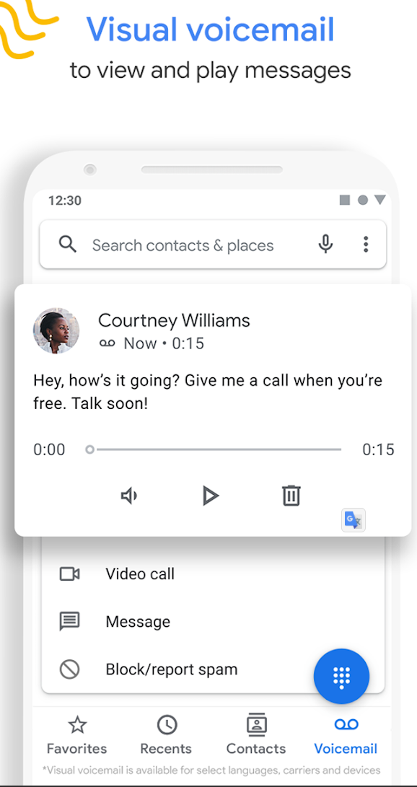

Slide 6
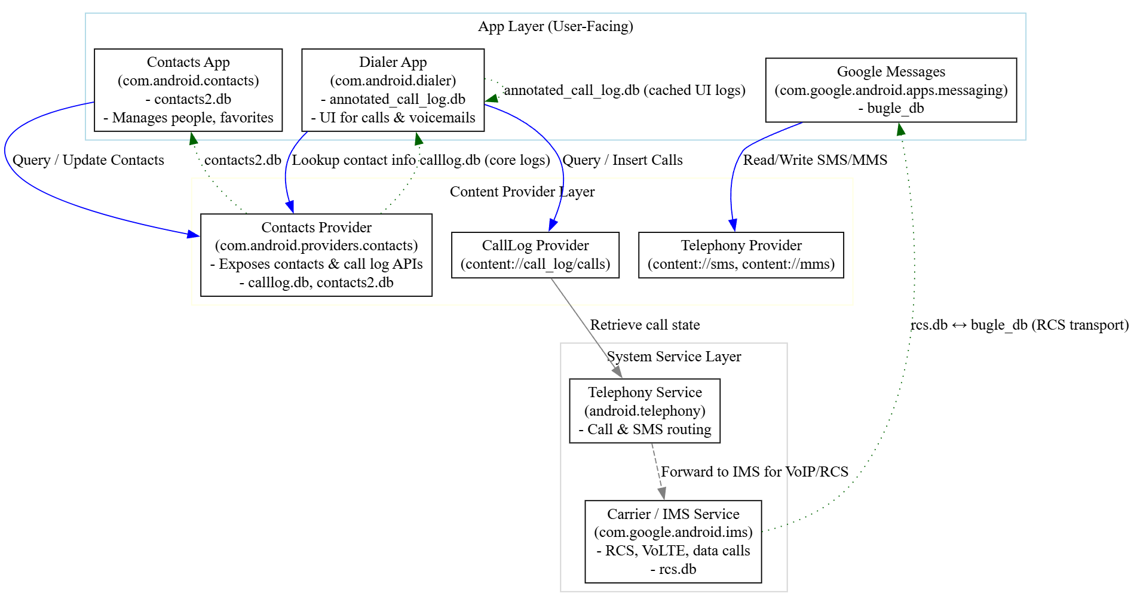



Notes:
digraph AndroidContactArchitecture {
rankdir=TB;
node [shape=box, style=filled, fillcolor=white];
subgraph cluster_app {
label="App Layer (User-Facing)";
color=lightblue;
Dialer [label="Dialer App\n(com.android.dialer)\n- annotated_call_log.db\n- UI for calls & voicemails"];
ContactsApp [label="Contacts App\n(com.android.contacts)\n- contacts2.db\n- Manages people, favorites"];
Messaging [label="Google Messages\n(com.google.android.apps.messaging)\n- bugle_db"];
}
subgraph cluster_provider {
label="Content Provider Layer";
color=lightyellow;
ContactsProvider [label="Contacts Provider\n(com.android.providers.contacts)\n- Exposes contacts & call log APIs\n- calllog.db, contacts2.db"];
CallLogProvider [label="CallLog Provider\n(content://call_log/calls)"];
TelephonyProvider [label="Telephony Provider\n(content://sms, content://mms)"];
}
subgraph cluster_system {
label="System Service Layer";
color=lightgray;
TelephonyService [label="Telephony Service\n(android.telephony)\n- Call & SMS routing"];
IMSService [label="Carrier / IMS Service\n(com.google.android.ims)\n- RCS, VoLTE, data calls\n- rcs.db"];
}
// Relationships between layers
Dialer -> CallLogProvider [label="Query / Insert Calls", color=blue];
ContactsApp -> ContactsProvider [label="Query / Update Contacts", color=blue];
Dialer -> ContactsProvider [label="Lookup contact info", color=blue];
Messaging -> TelephonyProvider [label="Read/Write SMS/MMS", color=blue];
CallLogProvider -> TelephonyService [label="Retrieve call state", color=gray];
TelephonyService -> IMSService [label="Forward to IMS for VoIP/RCS", color=gray, style=dashed];
// Databases linkage
ContactsProvider -> ContactsApp [label="contacts2.db", color=darkgreen, style=dotted];
ContactsProvider -> Dialer [label="calllog.db (core logs)", color=darkgreen, style=dotted];
Dialer -> Dialer [label="annotated_call_log.db (cached UI logs)", color=darkgreen, style=dotted];
IMSService -> Messaging [label="rcs.db ↔ bugle_db (RCS transport)", color=darkgreen, style=dotted];
}

Slide 7
Concept | calllog.db.calls (📁 com.android.providers.contacts) | annotated_call_log.db.annotated_call_log (📁 com.android.dialer)
Origin | Contacts Provider (system-level) - authoritative call log maintained by com.android.providers.contacts | Dialer app - synced and enriched for UI display
Link key | _id | call_id (foreign key referencing calls._id)
Data type | Raw call event (date, number, type, duration, SIM info) | Enriched record (spam flags, labels, caller categories, transcriptions)
Sync direction | Contacts Provider → Dialer (read-only copy) | Updates on app refresh or content observer triggers
Persistence | System-persistent (survives app resets) | Ephemeral (lost if Dialer app data cleared)
Extra fields | — | is_spam, label, business_name, call_screening_status, transcription

Slide 8
Sample questions
List all incoming calls
Did any callers leave voice mails?

Slide 9
Dialer Databases

Slide 10
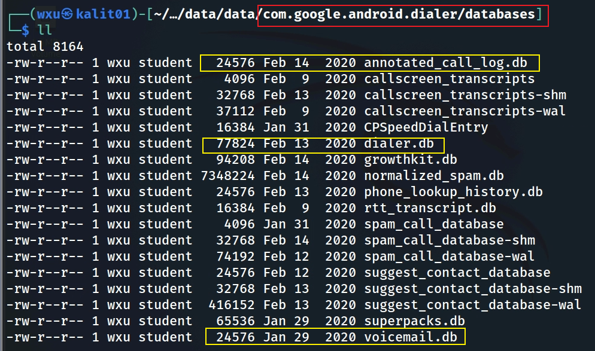
Notes:
tree 'Pixel 3/data/data/com.google.android.dialer/databases/'

Slide 11
Most Valuable Tables for Investigation (1)
annotated_call_log.db
Why? includes enriched call log data, such as whether a call was flagged as spam, marked as a favorite, or associated with a specific contact. It might also include user annotations or app-generated labels.
Use Case: Identifying suspicious calls (e.g., flagged as spam) or understanding user interactions with specific numbers.
dialer.db
Why? containing contact information, smart dial data, and filtered number data. It’s a primary source for understanding contact associations and some usage patterns but does not contain detailed call logs.
Use Case: Investigating frequently contacted numbers, mapping phone numbers to contacts, and identifying blocked or filtered numbers.

Slide 12
Most Valuable Tables for Investigation (2)
suggest_contact_database
Why? store data for suggesting contacts, likely across a broader range of interactions beyond just dialing.
Suggesting contacts to call based on recent interactions (calls, messages, emails).
Suggesting contacts for sharing content (e.g., via the share sheet).
Suggesting contacts in other contexts, like when composing a message or email.
Use Case:
Useful for understanding a broader range of the user’s interactions with contacts, not just dialing.
Could reveal contacts the user frequently interacts with across different apps or contexts (e.g., messaging, email), which might not show up in smartdial_table if they weren’t dialed.

Slide 13
Most Valuable Tables for Investigation (3)
voicemail.db
Why? Voicemails can contain critical information, such as audio recordings, transcriptions, and metadata about the caller. This could reveal important conversations or evidence.
Use Case: Extracting voicemail content for evidence of threats, plans, or other relevant communications.
phone_lookup_history.db
Why? This database tracks phone number lookups, which could reveal attempts to identify unknown callers, reverse lookups, or spam detection queries. It might also show if the user or app queried a number against a known database.
Use Case: Investigating whether the user was dealing with unknown or suspicious numbers.

Slide 14
Most Valuable Tables for Investigation (4)
rtt_transcript.db
Why? If the user used RTT (Real-Time Text) for communication, this database could contain transcripts of text-based conversations during calls, which might be relevant for accessibility users or specific investigations.
Use Case: Extracting text communications that occurred during calls.
callscreen_transcripts
Why? contains transcriptions of call screening interactions (e.g., Google’s Call Screen feature, which answers calls and transcribes responses). It could reveal interactions with unknown callers.
Use Case: Investigating interactions with unknown or suspicious callers through call screening.

Slide 15
annotated_call_log.db

Slide 16
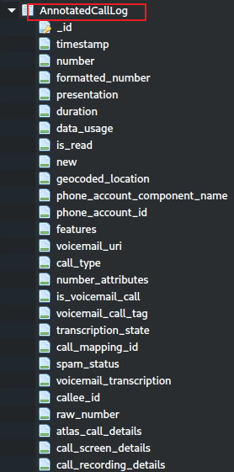
AnnotatedCallLog table schema
_id: unique identifier for each call log entry, essential for referencing specific calls.
timestamp: records when the call occurred
number: phone number involved in the call, a core piece of data for identifying callers.
formatted_number: A user-friendly version of the phone number, useful for display purposes.
duration: length of the call in seconds
call_type: Indicates the type of call (e.g., incoming, outgoing, missed),
is_read: if the call log entry has been viewed, useful for notifying users of new calls.
new: Flags new call entries, helping the app highlight unread or unacknowledged calls.
phone_account_component_name: Identifies the account or SIM used for the call, valuable for multi-SIM devices.
phone_account_id: Further specifies the account for the call, useful for managing multiple accounts.
spam_status: Indicates if the call is marked as spam, critical for user safety and filtering.
voicemail_uri: Links to voicemail audio, important for voicemail-enabled apps.
transcription: Provides a text version of the voicemail, enhancing accessibility and searchability.

Slide 17
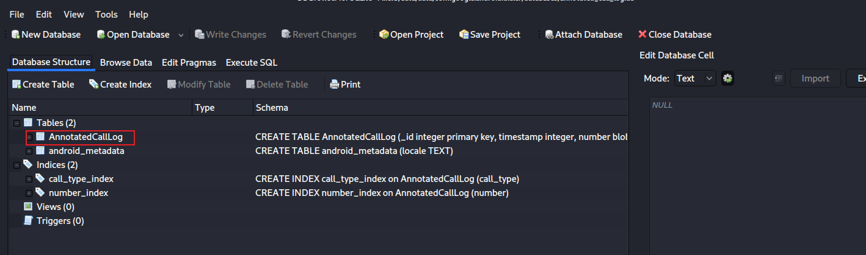
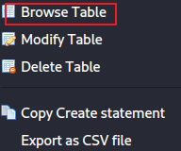
AnnotatedCallLog table content
Notes:
sqlitebrowser 'Pixel 3/data/data/com.google.android.dialer/databases/annotated_call_log.db'

Slide 18
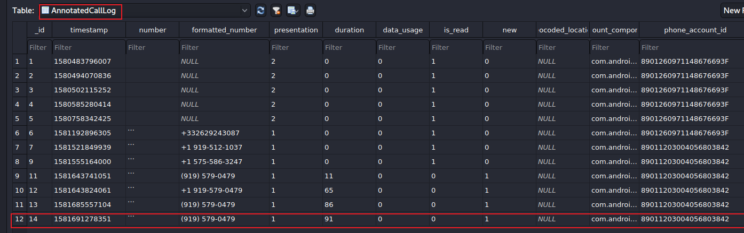

phone_account_component_name
com.android.phone/com.android.services.telephony.TelephonyConnectionService
calling/
received number
91 seconds
0: took the call
1: missed
The identifier for the account used to place or receive the call.
The phone has two accounts
calling/received time
Number is allowed to display for caller id.
1: number # showed
2: private #
The component name of the account used to place or receive the call
Notes:
date -d '@1581691278’ –u
https://developer.android.com/reference/android/provider/CallLog.Calls

Slide 19
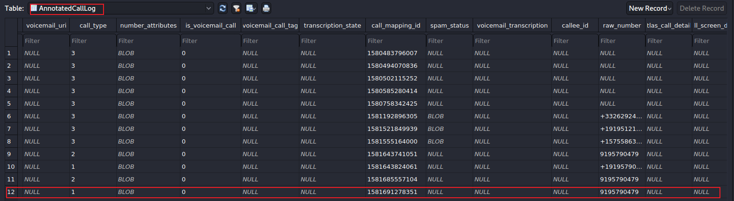
url to voicemail
1: incoming
2: outgoing
3: missed
left voice mail?
Voicemail transcription state, ie. in-progress, failed
Notes:
https://developer.android.com/reference/android/provider/CallLog.Calls.html#TYPE
https://android.googlesource.com/platform/packages/apps/Dialer/+/5d01ebb84a25c097a58ea8a3e1b4a521456e6f17/java/com/android/dialer/calllogutils/PhoneCallDetails.java

Slide 20

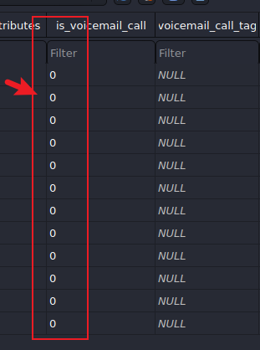
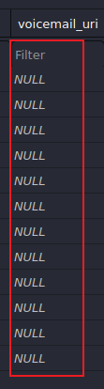
Sample Questions
List all incoming calls
2
Did any callers leave voice mails?
none

Slide 21
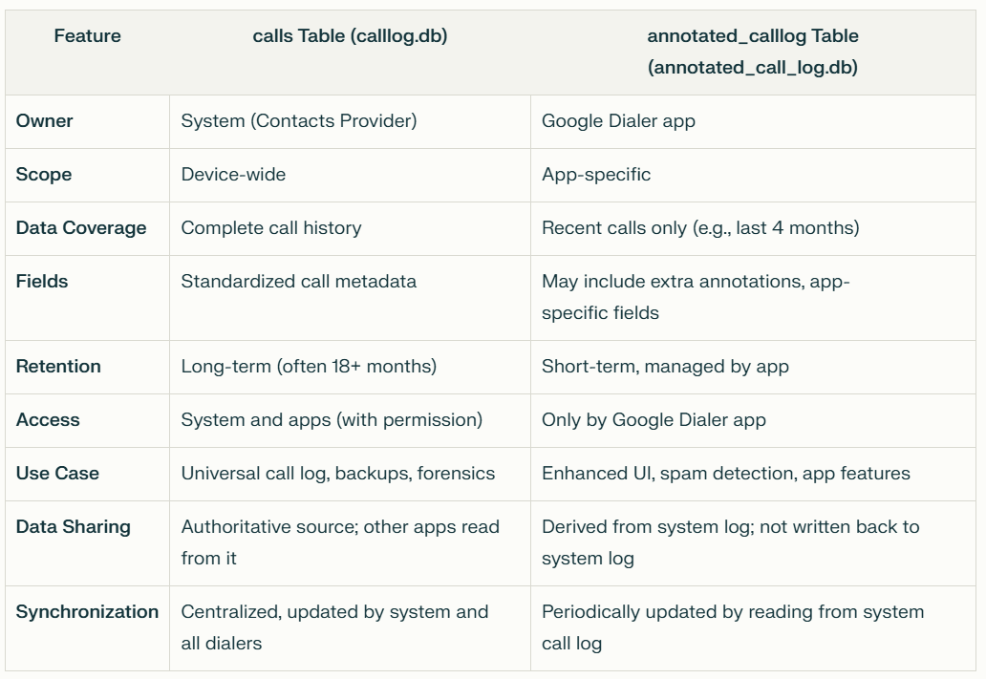

Slide 22
Data sharing between calllog.db and annotated_call_log.db
Data Sharing:
The calls table is the authoritative source. The Google Dialer and other apps read from it, but do not write data from their own databases back to it.
The annotated_calllog table is a copy/subset of recent entries from the system call log, enhanced with app-specific annotations.
Synchronization:
There is no automatic, two-way synchronization between the two databases.
The Google Dialer app periodically reads new entries from the system call log and updates its own annotated_calllog table as needed.
No foreign key in either table that references the other table’s primary key.
The annotated_calllog table is populated by the Google Dialer app reading data from the system calls table and copying relevant fields, but this is done at the application logic level, not via database-enforced foreign key constraints.

Slide 23
dialer.db

Slide 24
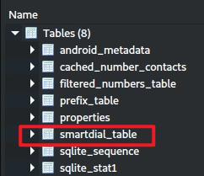
smart_dial_table
"smart dial" functionality
allows users to quickly find contacts by typing a portion of a name or number, with the app suggesting matches as they type.
Provides detailed information about frequently dialed or interacted-with contacts
including usage patterns (last_time_used, times_used).
contact_id and lookup_key can link to the Android Contacts database,
starred or is_primary can indicate important contacts.

Slide 25
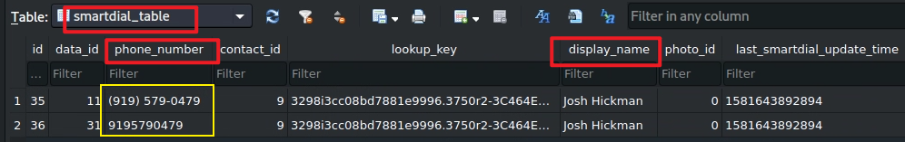
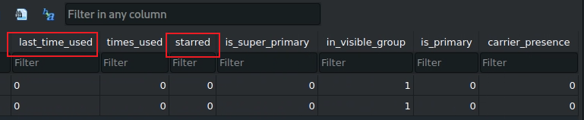
Two phone numbers are found

Slide 26
suggest_contact_database

Slide 27
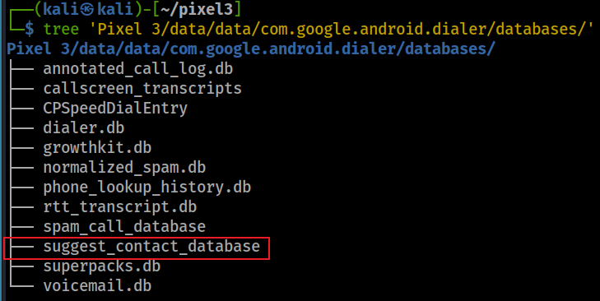
Understand user’s interactions with contacts, not just dialing
When you try and share photos or anything from Google pixel, you will see suggested contacts pops up with several frequently contacted people in the phone

Slide 28
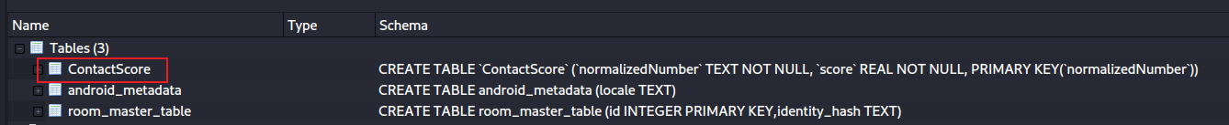
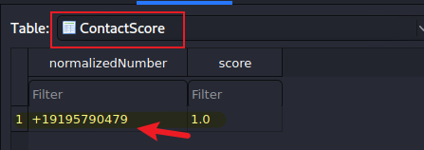
Open suggest_contact_database
Find thefrequently contacted phone numbers

Slide 29
phone_lookup_history.db

Slide 30
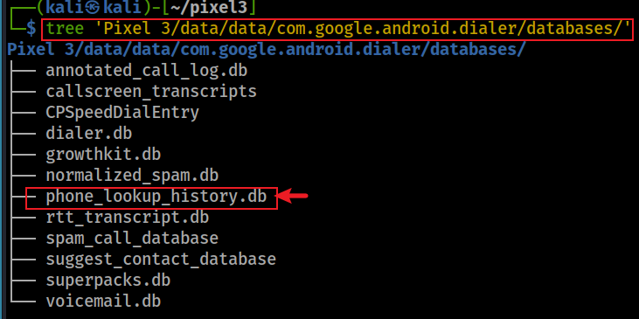
What is the phone lookup function?
Identify the caller (caller ID)
It needs to query Google’s servers or another external database
Cached these results locally in phone_lookup_history.db
Allows the app to quickly retrieve the same information if the same number calls again
Reducing the need for repeated server queries and improving performance.

Slide 31
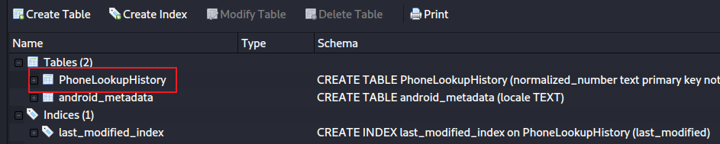
Open phone_lookup_history.db

Slide 32
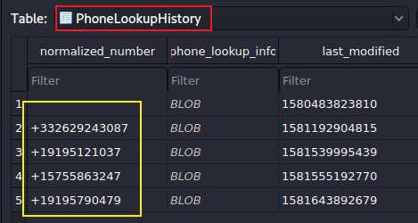
PhoneLookupHistory table
normalized_number: stores the phone number in a standardized (normalized) format
phone_lookup_info: stores the lookup information associated with the phone number.
Stored as a Binary Large Object (BLOB)
Structured data in a format like Protocol Buffers, JSON, or a custom binary format, which is then deserialized by the application.
The actual content could include:
Caller details (e.g., name, carrier, location).
Metadata about the lookup (e.g., source of the data, confidence score).

Slide 33
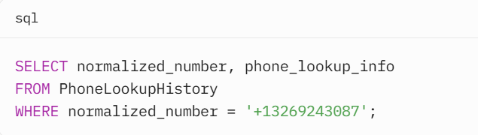
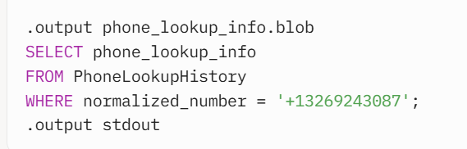
Access the BLOB
Notes:
import sqlite3
# Connect to the database
conn = sqlite3.connect('phone_lookup_history.db')
cursor = conn.cursor()
# Query the BLOB data
cursor.execute("SELECT normalized_number, phone_lookup_info FROM PhoneLookupHistory WHERE normalized_number = '+13269243087'")
row = cursor.fetchone()
if row:
normalized_number, blob_data = row
print(f"Phone Number: {normalized_number}")
# Save the BLOB to a file for further processing
with open('phone_lookup_info.blob', 'wb') as f:
f.write(blob_data)
# Close the connection
conn.close()

Slide 34
voicemail.db

Slide 35
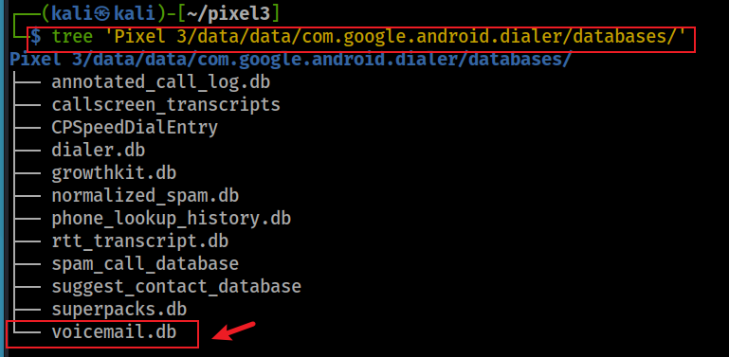
What is the greeting message?
The owner often provides greeting message. Did the owner use a greeting message?

Slide 36
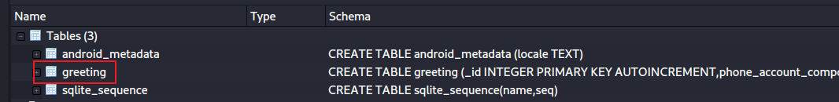
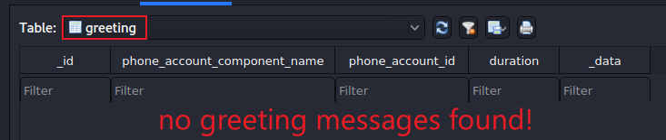
Open voicemail.db
Find thefrequently contacted phone numbers

Slide 37
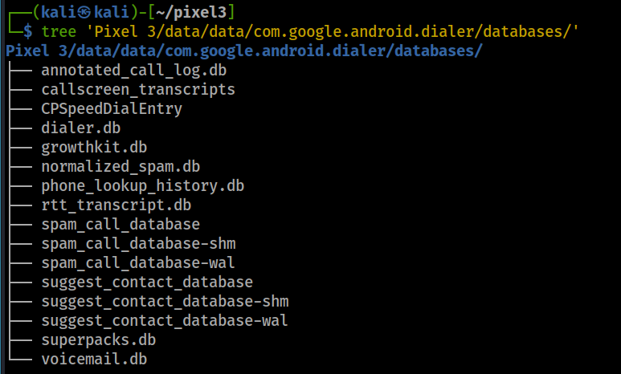
Other valuable information in databases
speed dial entry
spam call database

