Slide 1
ExplainShell for Chrome
Justin Gallagher, ted li, Howard Chen and Jake Zimmerman

Slide 2
Outline
Outline Team Project Approach Results Demo Summary
Outline
Team
Project
Approach
Results
Demo
Summary

Slide 3
Team
Outline Team Project Approach Results Demo Summary

Slide 4
Project
Outline Team Project Approach Results Demo Summary

Slide 5
Reasons for this Project
Outline Team Project Approach Results Demo Summary

Slide 6
Goals
Outline Team Project Approach Results Demo Summary

Slide 7
Technologies
Outline Team Project Approach Results Demo Summary

Slide 8
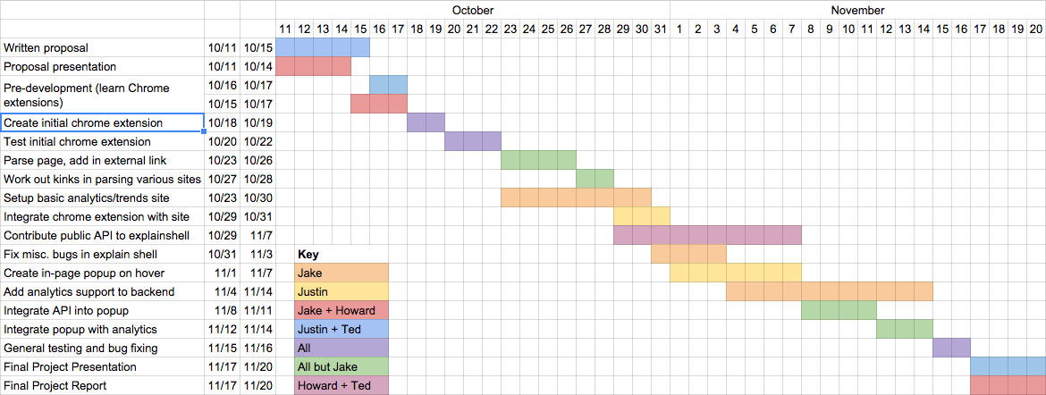
Original Schedule
Outline Team Project Approach Results Demo Summary

Slide 9
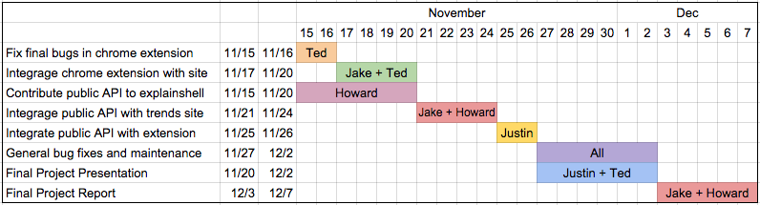
Revised Schedule
Outline Team Project Approach Results Demo Summary

Slide 10
Results
Outline Team Project Approach Results Demo Summary
Chrome extension supporting embedded links and popups
Still no public API for explainshell.com
Popups pull up the full explainshell website in a window rather than intelligently using that data
Some limitations – no HTTPS
Reports usage correctly to the trend website
Fully functional trends website
Track number of uses of extension
View clicks by time, source page, domain, and command
Pretty insecure right now: no authentication, API call in plain text Javascript

Slide 11
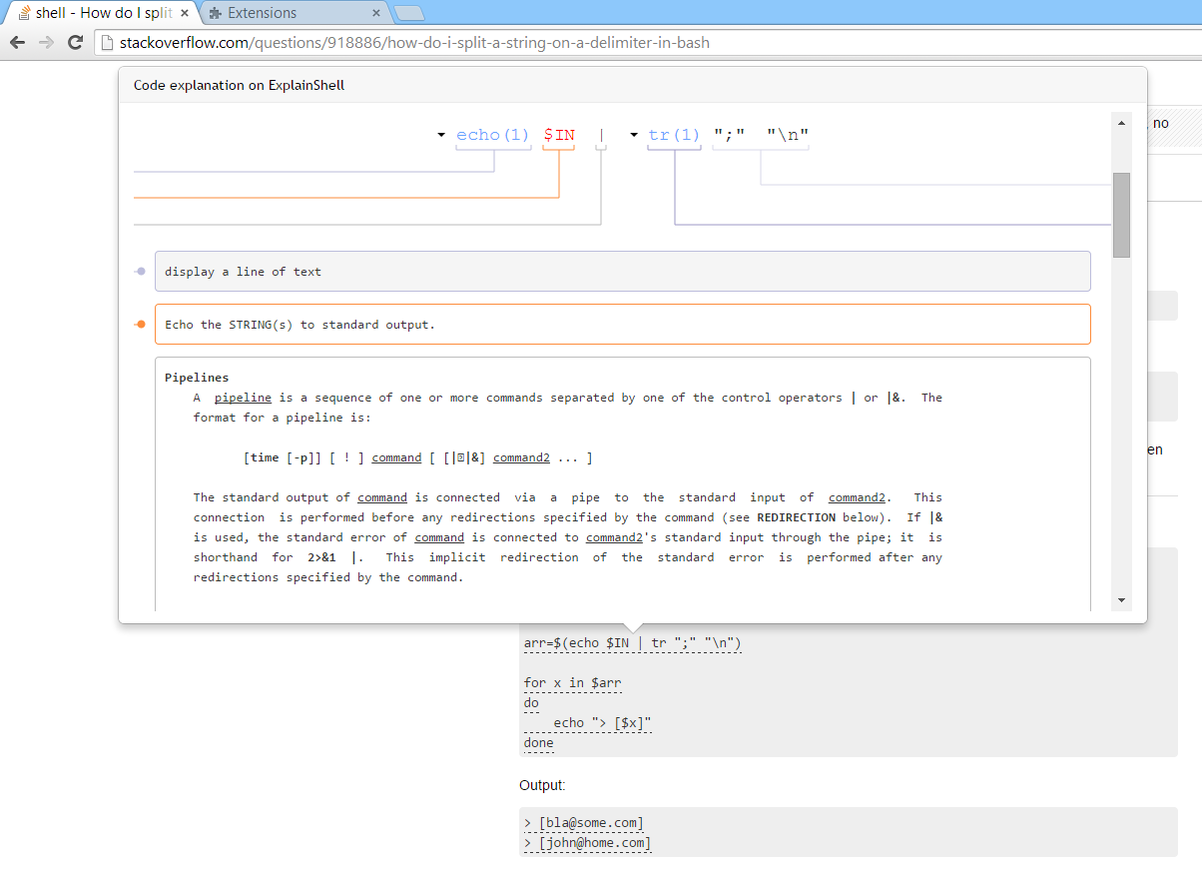
Demo
Outline Team Project Approach Results Demo Summary

Slide 12
Summary
Outline Team Project Approach Results Demo Summary

Slide 13
Lessons Learned
Outline Team Project Approach Results Demo Summary
Plan lots of extra time to accommodate for changing schedules
We were often behind deadlines, causing others to be held up by bottlenecks
Keep people accountable to their promises
Contributing to open source software is a large undertaking
Need to read lots of documentation and unfamiliar code
Pull requests take time
A lot more time is needed to do it properly
Documenting your code is essential
We often had problems running each others’ code
Time is wasted trying to decipher what code is doing rather than adding to it

Slide 14
Thank you!

