Slide 1
ExplainShell for Chrome
Justin Gallagher, ted li, Howard Chen and Jake Zimmerman

Slide 2
Outline
Outline Team Project Approach Results Demo Summary
Outline
Team
Project
Approach
Results
Demo
Summary

Slide 3
Team
Outline Team Project Approach Results Demo Summary

Slide 4
Project
Outline Team Project Approach Results Demo Summary

Slide 5
Reasons for this Project
Outline Team Project Approach Results Demo Summary

Slide 6
Goals
Outline Team Project Approach Results Demo Summary

Slide 7
Technologies
Outline Team Project Approach Results Demo Summary

Slide 8
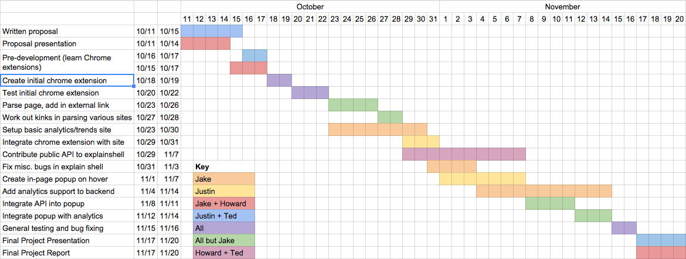
Original Schedule
Outline Team Project Approach Results Demo Summary

Slide 9
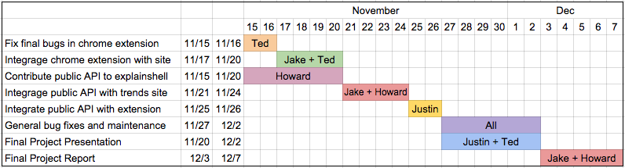
Revised Schedule
Outline Team Project Approach Results Demo Summary

Slide 10
Results
Outline Team Project Approach Results Demo Summary

Slide 11
Demo
Outline Team Project Approach Results Demo Summary

Slide 12
Summary
Outline Team Project Approach Results Demo Summary

Slide 13
Lessons Learned
Outline Team Project Approach Results Demo Summary

Slide 14
Thank you!

