Slide 1
C@CM: Courses at Carnegie Mellon
James
Bryce
David
Jeffrey
Today’s
Dynamic Presenters

Slide 2
Where are we?
Outline
Problem Addressed
Proposed Approach
Intermission
Literature Review
Qualifications
Benefits
Bryce Speaks
James Speaks

Slide 3
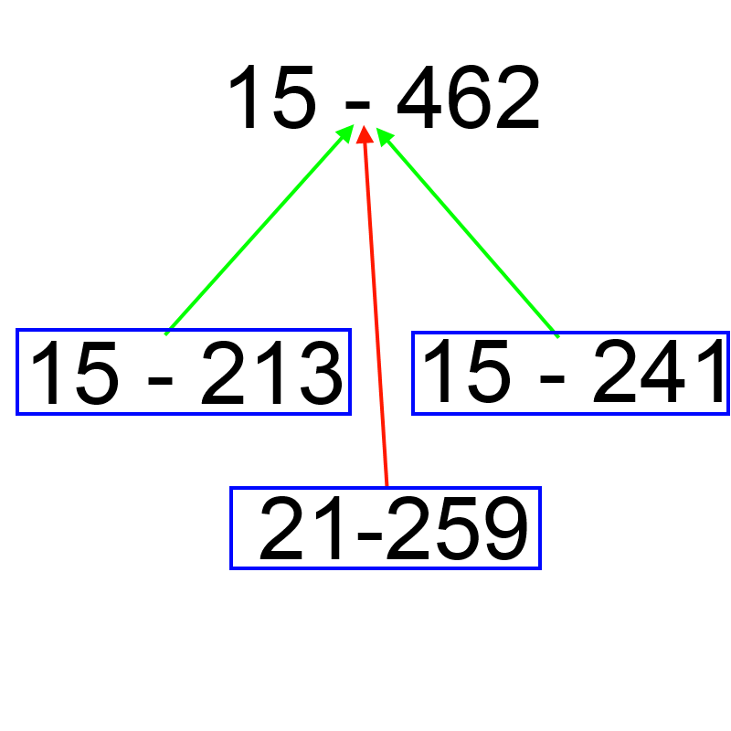
Problem Addressed
Students need help with their course selections
Prerequisites
Planning
Spring / Fall only
Outline
Problem
Approach
Qualifications
Literature Review
Benefits
Notes:
Why did we choose this topic!!!!

Slide 4
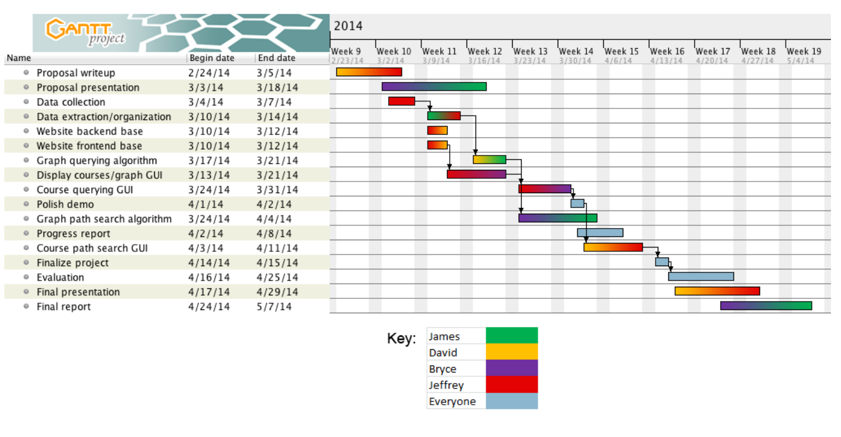
Problem Approach
Figure 1: Gantt chart
Outline
Problem
Approach
Qualifications
Literature Review
Benefits
Notes:
Startup writing the presentations.
Gather the Data.
Start Backends and Front ends.
Build the course graph Graphic User interface.
Query GUI
Algorithms
Testing.

Slide 5
Methodology
HTML parser → data Scraping
SQLite database → data management
JavaScript with d3.js → frontend
Python + Bottle.py → backend
Git → Version Control
Outline
Problem
Approach
Qualifications
Literature Review
Benefits

Slide 6
Where are we?
Outline
Problem Addressed
Proposed Approach
Intermission
Literature Review
Qualifications
Benefits
Bryce Speaks
James Speaks

Slide 7

Literature Review
Official CMU Tools
CMU Student Projects
Student Information Online (SIO)
Academic Audit
Course Catalog
ScheduleMan
Schedule+
WhichCourse
CourseReqr
APIs@CMU
External Tools
Hxhl95 Course Dependency Visualizer on GitHub
Graph Libraries:
Dracula Graph Library
Outline
Problem
Approach
Qualifications
Literature Review
Benefits

Slide 8
Qualifications
James
4 years of Java programming
Graduate Level coursework in Algorithms
Bryce
6 years of Java programming
4 years of Python programming
Implemented many algorithmic programs
David
6 years of Java programming
2 years of Python programming
10 years of art/design experience
Jeffrey
4 years of web development
3+ years of Java, Python, and JavaScript Programming
Outline
Problem
Approach
Qualifications
Literature Review
Benefits

Slide 9

Benefits
Them
Easier Course Selection for the community
Fewer wasted semesters
Long Term Planning
Us
learning Web Development
Practicing applied graph algorithms
The warm and fuzzy feeling that comes from helping others
Outline
Problem
Approach
Qualifications
Literature Review
Benefits

Slide 10

Conclusion
We wish to help the Carnegie Mellon Community.
Courses @ Carnegie Mellon will help the short term planners.

Slide 11
Sources
1. https://scheduleman.org/
2. http://scheduleplus.org/
3. http://whichcourse.herokuapp.com/
4. https://apis.scottylabs.org/
5. http://www.graphdracula.net/
6. http://tartanhacks.com/
7. http://upload.wikimedia.org/wikipedia/commons/8/8c/Buffer_stop_at_Leamington_Spa_railway_station_-_geograph.org.uk_-_1519251.jpg

