Slide 1
ExplainShell for Chrome
Justin Gallagher, ted li, Howard Chen and Jake Zimmerman

Slide 2
Outline
Outline Team Project Approach Results Summary Demo
Outline
Team
Project
Approach
Results
Summary
Demo

Slide 3
Team
Outline Team Project Approach Results Summary Demo
Jake Zimmerman
Justin Gallagher
Ted Li
Howard Chen

Slide 4
Project
Outline Team Project Approach Results Summary Demo
Chrome extension to provide easy lookup of bash commands using explainshell.com
Backend analytics site to show trending commands, referring sites, popular pages, etc.

Slide 5
Reasons for this Project
Outline Team Project Approach Results Summary Demo
Bash commands found online pose a threat to unsuspecting users
People have a risk of running malicious or insecure commands
Often difficult to look through man pages for bash command usage
Helps users discover and explore more bash commands

Slide 6
Goals
Outline Team Project Approach Results Summary Demo
Develop Chrome Extension that identifies and extracts bash commands from web pages
Add a link to each bash command that redirects users to the usage explanation on explainshell.com
Display friendly in-page popup of command usage when users click on a bash command
Develop backend analytics site to keep track of bash commands that users lookup
Eventually publish on Chrome Web Store for people to use

Slide 7
Technologies
Outline Team Project Approach Results Summary Demo
Chrome Extension: HTML/CSS/Javascript
Backend analytics site: Node.js/Express/MongoDB
Version control with Git on Github

Slide 8
Approach
Outline Team Project Approach Results Summary Demo
Rudimentary version of Chrome extension: Allow users to select text and lookup selected command
Develop heuristics to identify and extract bash commands automatically from a web page
In-page link to jump to explainshell.com
Insert in-page summary on hover
Develop backend analytics site
Integrate analytics site with Chrome extension

Slide 9
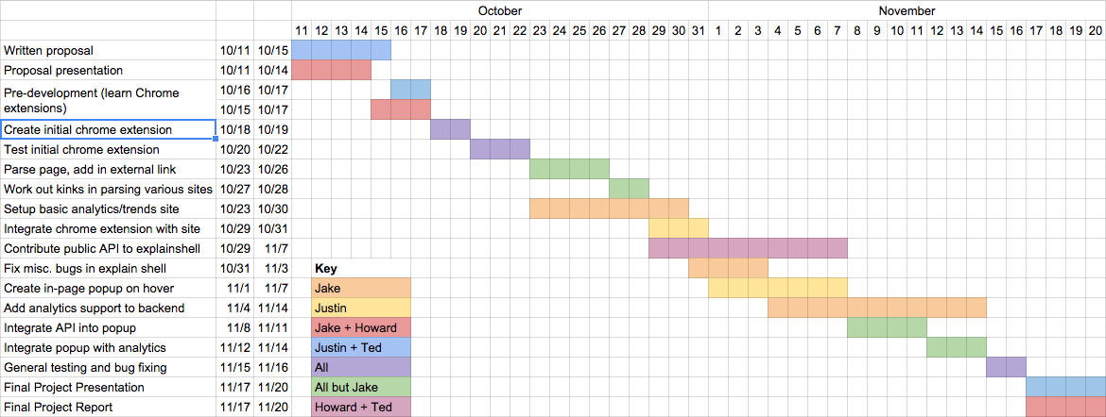
Original Schedule
Outline Team Project Approach Results Summary Demo

Slide 10
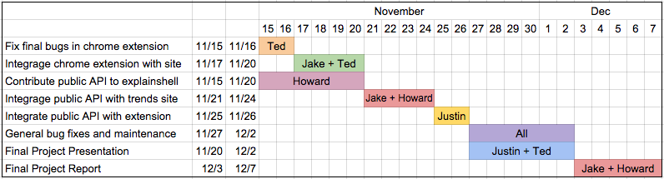
Revised Schedule
Outline Team Project Approach Results Summary Demo

Slide 11
Results
Outline Team Project Approach Results Summary Demo
Chrome extension supporting embedded links and popups
Still no public API for explainshell.com
Popups pull up the full explainshell website in a window rather than intelligently using that data
Some limitations – no HTTPS
Reports usage correctly to the trend website
Fully functional trends website
Track number of uses of extension
View clicks by time, source page, domain, and command
Pretty insecure right now: no authentication, API call in plain text Javascript

Slide 12
Lessons Learned
Outline Team Project Approach Results Summary Demo
Plan lots of extra time to accommodate for changing schedules
We were often behind deadlines, causing others be held up by bottlenecks
Keep people accountable to deadlines
Contributing to open source software is a large undertaking
Need to read lots of documentation and unfamiliar code
Pull requests take time
A lot of work is necessary to do it properly
Documenting your code is essential
We often had problems running each others’ code
Time is wasted trying to decipher what code is doing rather than adding to it

Slide 13
Lessons Learned
Outline Team Project Approach Results Summary Demo
Plan lots of extra time to accommodate for changing schedules
We were often behind deadlines, causing others to be held up by bottlenecks
Keep people accountable to their promises
Contributing to open source software is a large undertaking
Need to read lots of documentation and unfamiliar code
Pull requests take time
A lot more time is needed to do it properly
Documenting your code is essential
We often had problems running each others’ code
Time is wasted trying to decipher what code is doing rather than adding to it

Slide 14
Summary
Outline Team Project Approach Results Summary Demo
Outline
Team
Project
Approach
Results
Summary
Demo

Slide 15
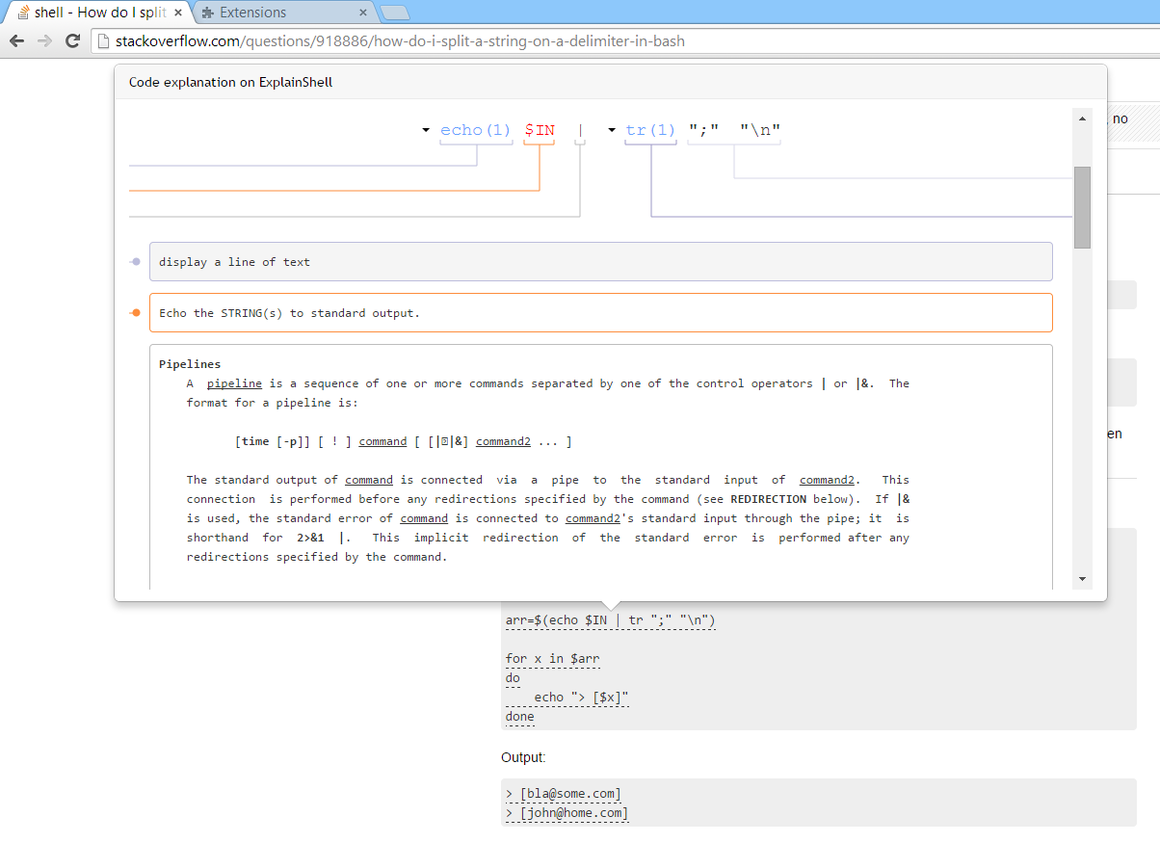
Demo
Outline Team Project Approach Results Summary Demo

