Slide 1
FPGA Accelerated Ray Tracing
Justin Gallagher
May 8, 2016

Slide 2
Summary
I implemented a parallel ray tracer, using FPGA hardware to accelerate computation.
The ray tracer supports CPU operation, multithreading, and SIMD as well, for comparison
This method is very competitive for large payloads, and offers improvements on energy efficiency
Memory bandwidth limits the performance gain, but this problem can be fixed

Slide 3
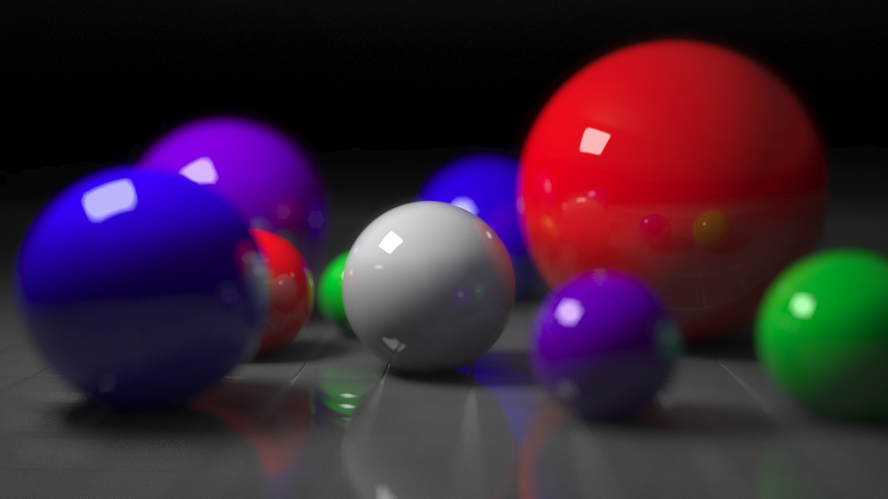
What is Ray Tracing?
Ray Tracing is a image rendering technique that simulates the travel of light through an image.
Photo Credit: Mimigu, Creative Commons Attribution License 3.0
Notes:
Allows effects to be easily simulated with little programmatic effort:
Soft Shadows
Reflections
Refraction

Slide 4
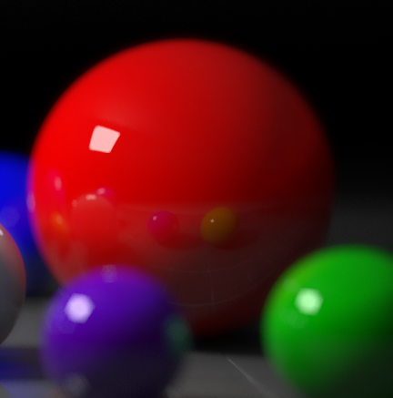
Demonstration
We trace light backwards from each pixel through the scene
Light source
Subject
Ray
Notes:
Here, we create a ray extending out from the viewer.
Test it for intersections with the scene’s objects (in our case, triangles).
Trace a path from collisions to light
If material is reflective/refractive, create a new ray travelling in the appropriate direction
Note that this method is highly parallel -> each ray/tri independent
My idea: use FPGA to encode many circuits that can do this calculation – more than we have in cores!

Slide 5
Hardware & Tools
Xilinx Zynq-7000 System on Chip (“Zedboard”)
Dual-core ARM Cortex-A9 CPU (@667 MHz) with ARM NEON SIMD
1GB on board RAM
On board FPGA in communication with the ARM processor at 266 Mb/s through Direct Memory Access
Xilinx Vivado High Level Synthesis (HLS)
Interface for compiling C-like code to hardware that can be implemented in the FPGA
C++ Ray Tracer running on ARM
Heavily based on the 15-462 Computer Graphics ray tracer
Processes each ray independently, calculating its intersection with triangles in the scene in sequence
Support for SIMD and FPGA acceleration was added

Slide 6
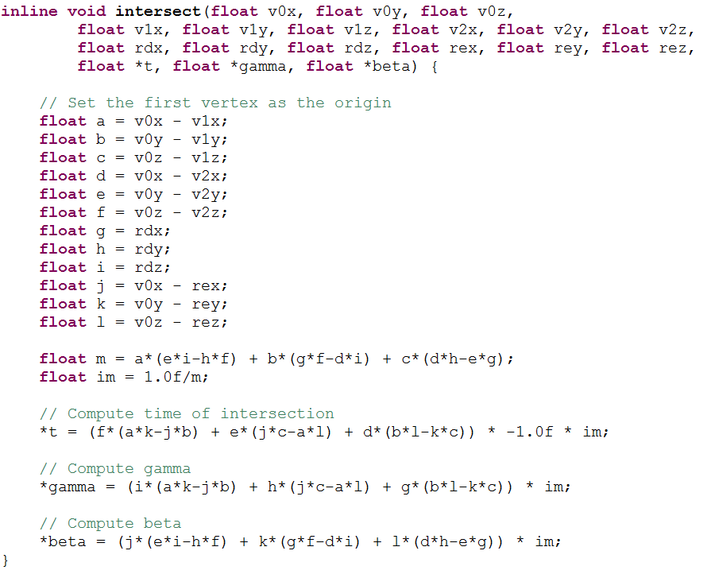
The Triangle/Ray intersection algorithm
Each block dependent on the last
Also known as the “Möller-Trumbore” algorithm
Trivial to implement with SIMD – just vectorize the inputs and the operations
This division takes more than 1/3 of the processing time!
Notes:
Inherent sequential operation makes this algorithm hard to parallelize internally

Slide 7
FPGA Parallelism
Problem: The streaming interconnect I use only allows one data read and write at a time
Solution: Create multiple circuits, and stagger their operation so many are calculating while the next is reading and the last is writing
Question: How many circuits should I make?
read | read | read | calc | calc | calc | calc
write | write | write | read | read | read | calc
calc | calc | calc | write | write | write | read

Slide 8
Memory Limitations
Turns out, 16-20 simultaneous intersections is the best we can do
Notes:
More than that, and you’re using valuable power + board space for diminishing returns

Slide 9
Testing Configurations
CPU
Single-threaded CPU implementation
CPUx4
4-threaded CPU implementation, running on the dual-core processor
CPU SIMD
Single-threaded CPU with SIMD vector operations
CPUx4 SIMD
4-threaded CPU implementation with SIMD vector operations
FPGA
Single CPU thread sends data to FPGA, which implements 20 simultaneous triangle intersection tests

Slide 10
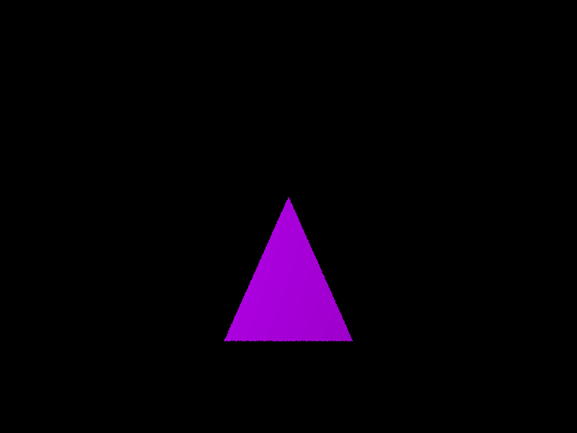
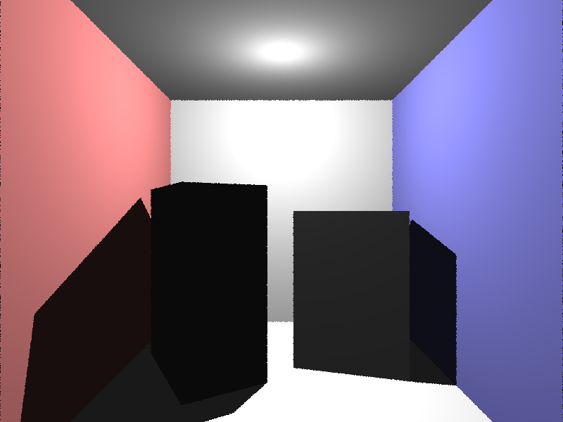
Four Testing Scenes
Triangle (1 triangle)
Cubes (34 triangles)

Slide 11
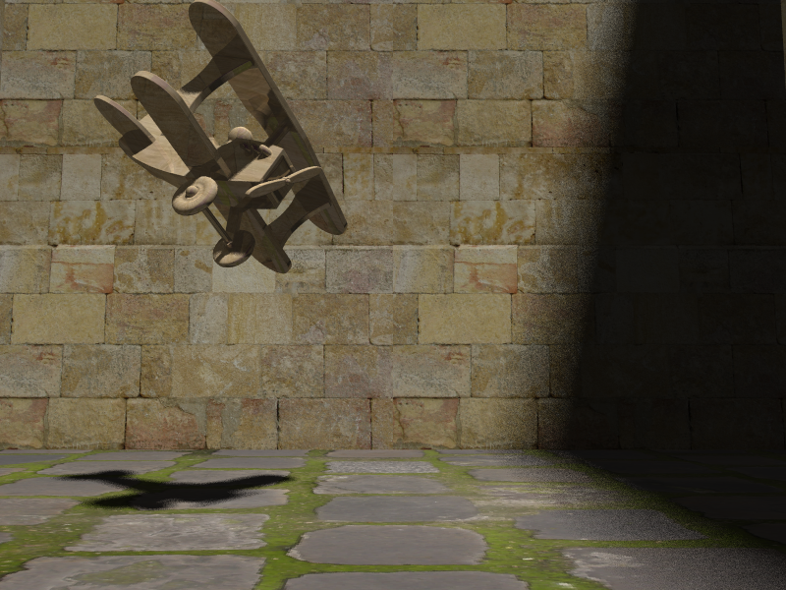
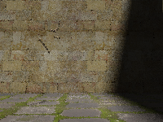
Four Testing Scenes
Small plane (1084 Triangles)
Large plane (138K Triangles)

Slide 12
Questions to Ask
Is the FPGA implementation competitive with the others in terms of throughput?
What about in terms of energy efficiency?
What workloads are best suited to each implementation?

Slide 13
FPGA Becomes More Competitive with Scale

Slide 14
FPGA is Competitive when Adjusted for Clock Speeds
Notes:
FPGA is significantly slower: 100 MHz vs 667 MHz
FPGA requires only half as many clock steps!

Slide 15
FPGA is More Power Efficient With High Loads

Slide 16
Conclusion
FPGAs are well suited for very high loads with little synchronization requirements
Communication overhead becomes irrelevant
Natural parallelism makes FPGAs extremely flexible, once the programmer overcomes the learning curve
FPGAs can be used to compute simple operations with high energy efficiency
Memory bandwidth is key – and a detail I should have paid attention to earlier

Slide 17
Future Work
Overcome the memory bandwidth barrier
Non-stream based memory interfaces
Reduce the amount of data that needs to be communicated between the FPGA and the processor
Take advantage of parallelism beyond the ray/triangle-level
“Bundle” data transfers to the FPGA to reduce communication overhead
Offload color calculations to the FPGA as well
Perform the “reduce step” on the FPGA, finding the closest triangle intersection rather than the time

Slide 18
Acknowledgements
Brandon Perez
Wrote the AXI Direct Memory Access driver for the Zedboard
Advice and support working with FPGAs
Prof. James Hoe
Provided Zedboard hardware, software and reading material
15-462 Course Staff
Built the core of the CPU ray tracer this project is based on
Prof. Kayvon, Prof. Bryant and the 15-418 Course Staff
Thank you for running a great course!

Slide 19
Questions
Thank yoU!

