Slide 1
Vocabulary: preparation and meetings
Full proposed vocabulary for review
TYPE | CURRENT WORDING / EXAMPLES | PROPOSED NAME
Workspace | Staff Deliberations | Staff Deliberations (keep)
Meeting | Deliberation session / Pre-discussion | Proposal discussion session
Meeting | Site visit / Presentation | Research presentation
Discussion | Staff discussion | Post-presentation discussion
Document | Pre-site briefing / Pre-RP Brief | Proposal discussion brief
Shared page | Deliberation briefing / Briefing page | Proposal review packet
Agenda | Deliberation session agenda | Discussion session agenda
Materials | Site visit materials | Presentation materials
Vocabulary review • Proposed wording • 5
Notes:
Current wording from source inventory in WMKF_Apps, October 19, 2026. Proposed names from user review in this chat. No app implementation is represented. The Scientific dossier label applies to the research product; collection naming remains available for later review.

Slide 2
Vocabulary: follow-up and summaries
Full proposed vocabulary for review
TYPE | CURRENT WORDING / EXAMPLES | PROPOSED NAME
Recording | Post-presentation materials | Recording and transcripts
Document | Working writeup / Word Draft | Post-presentation writeup
Document | Final Writeup | Final writeup
Summary | Presentation summary | Presentation summary
Summary | Staff discussion summary | Post-presentation discussion summary
Analysis | Discussion Sentiment | Post-presentation discussion sentiment
Collection | Program briefing | Discussion summaries
Research | Cycle Dossier / Scientific briefing | Scientific dossier
Vocabulary review • Proposed wording • 6
Notes:
Current wording from source inventory in WMKF_Apps, October 19, 2026. Proposed names from user review in this chat. No app implementation is represented. The Scientific dossier label applies to the research product; collection naming remains available for later review.

Slide 3
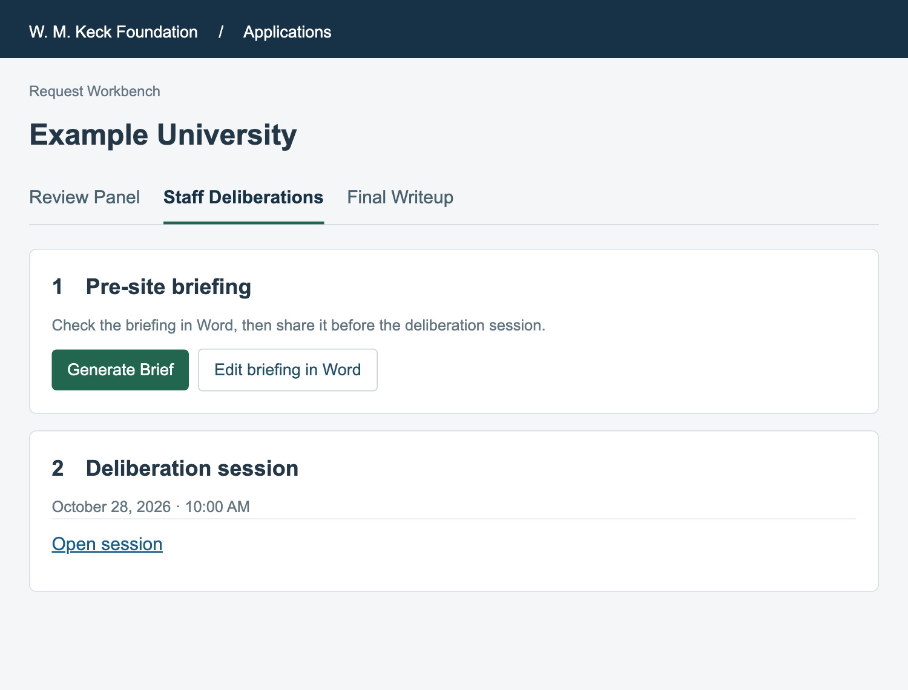
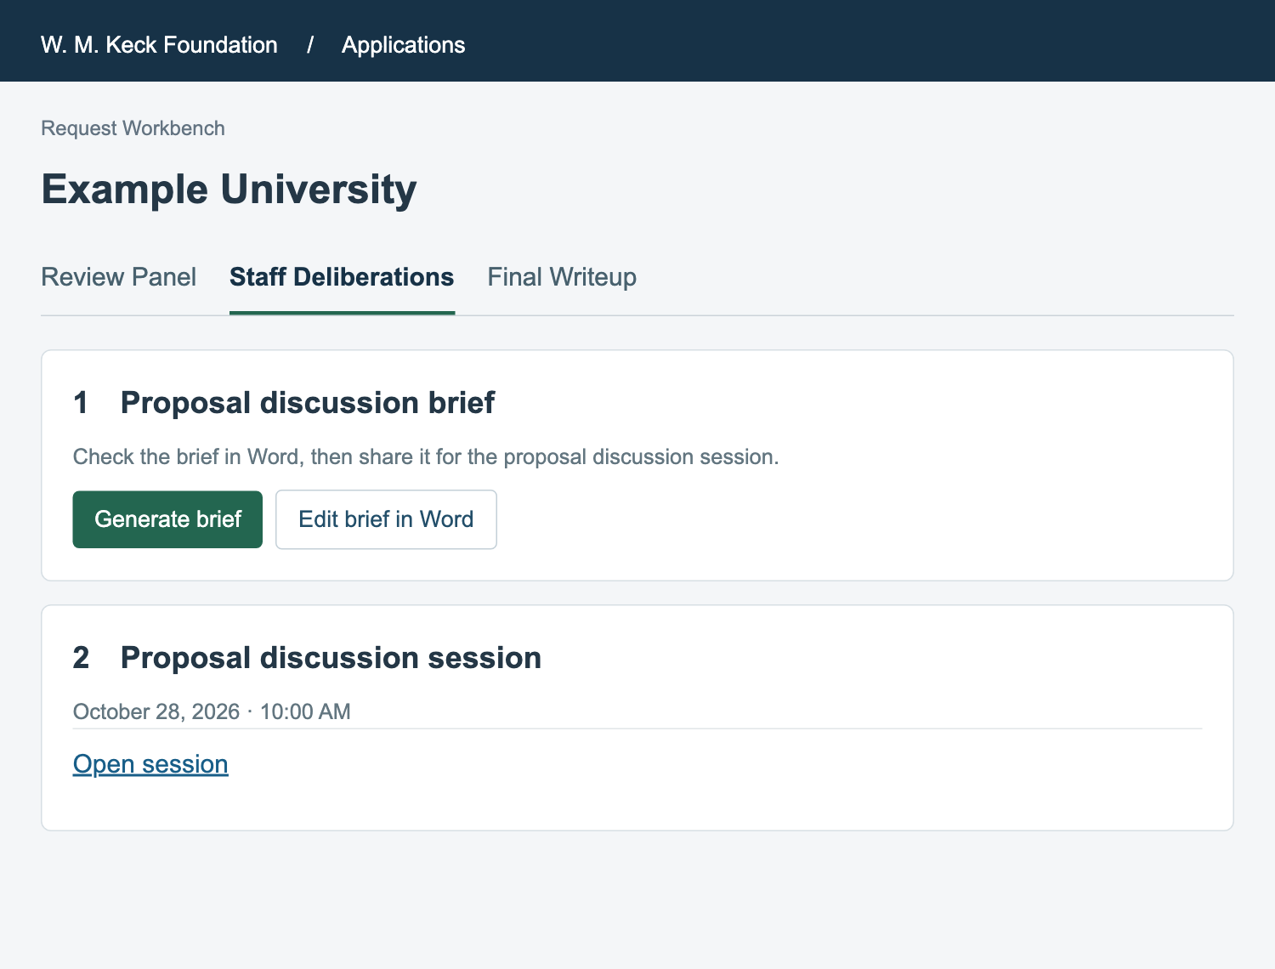
Workbench: a document and a meeting
Staff Deliberations remains the request tab
BEFORE · CURRENT WORDING
AFTER · PROPOSED
The brief is one authored document. The session covers multiple proposals.
Vocabulary review • Proposed wording • 2
Notes:
Schematic mockups, not production screenshots. Current labels verified from shared/components/workbench/StaffDeliberationsTab.js; pages/external/briefing/[token].js; shared/components/meeting-tracker/ProgramBriefingView.js; DiscussionSentimentView.js. Proposed labels reflect the vocabulary discussion with the user.

Slide 4
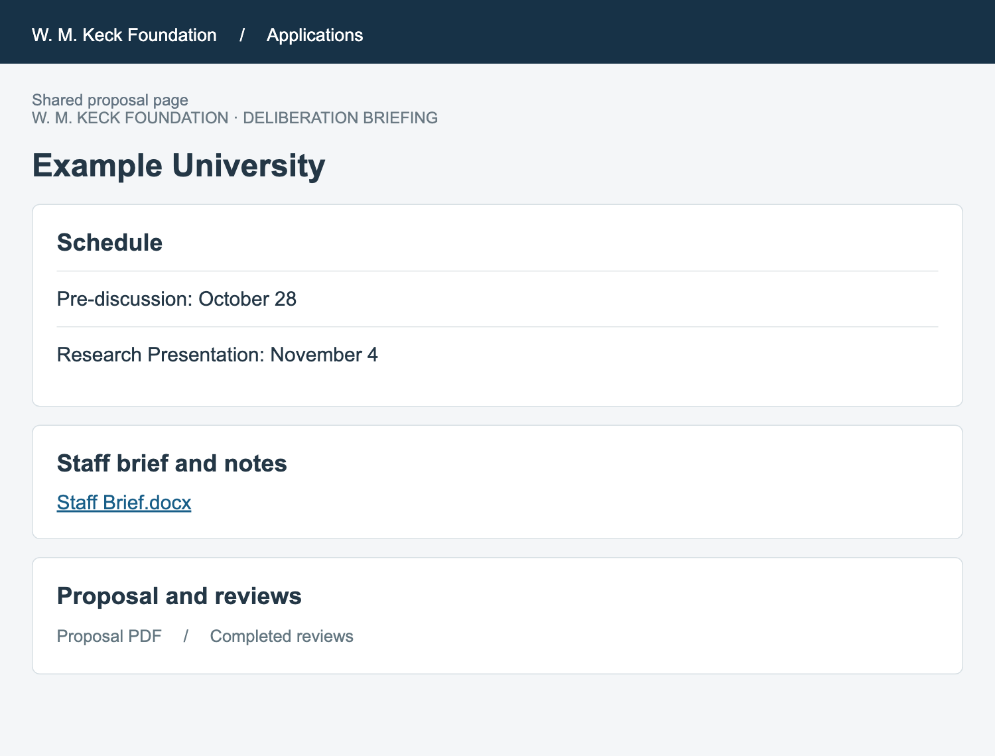
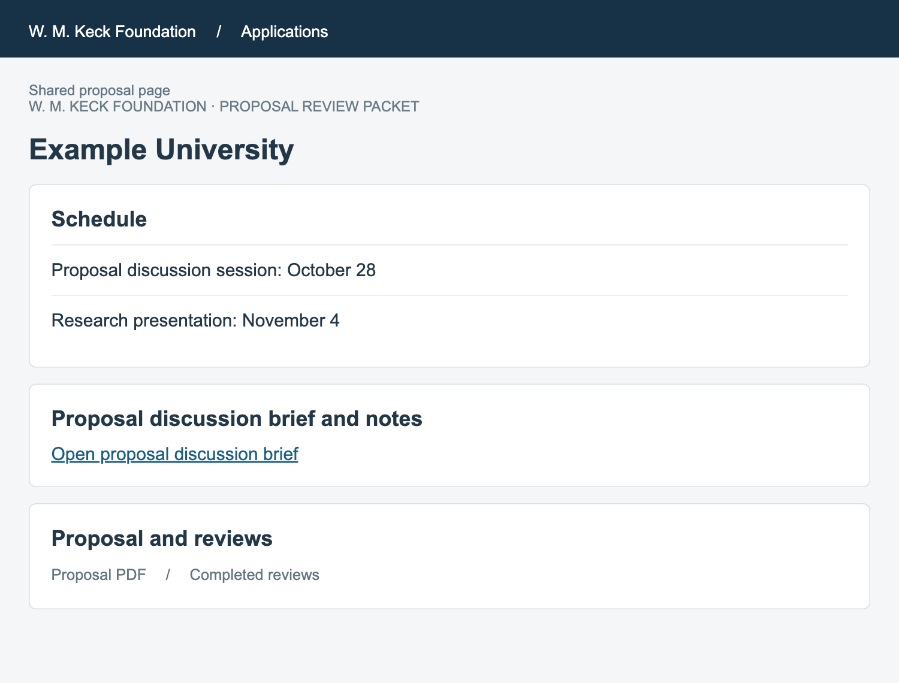
Shared page: the packet contains the brief
A distinct name for the collection of supporting materials
BEFORE · CURRENT WORDING
AFTER · PROPOSED
“Packet” names the shared page. “Brief” names the document within it.
Vocabulary review • Proposed wording • 3
Notes:
Schematic mockups, not production screenshots. Current labels verified from shared/components/workbench/StaffDeliberationsTab.js; pages/external/briefing/[token].js; shared/components/meeting-tracker/ProgramBriefingView.js; DiscussionSentimentView.js. Proposed labels reflect the vocabulary discussion with the user.

Slide 5
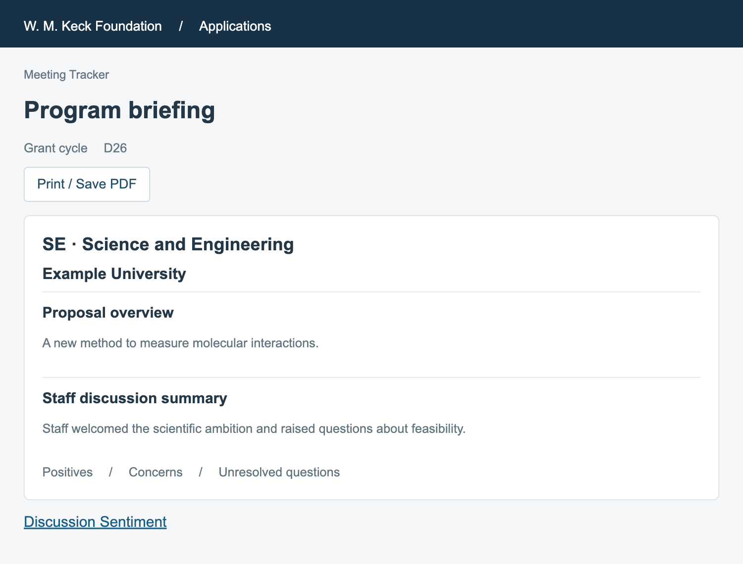
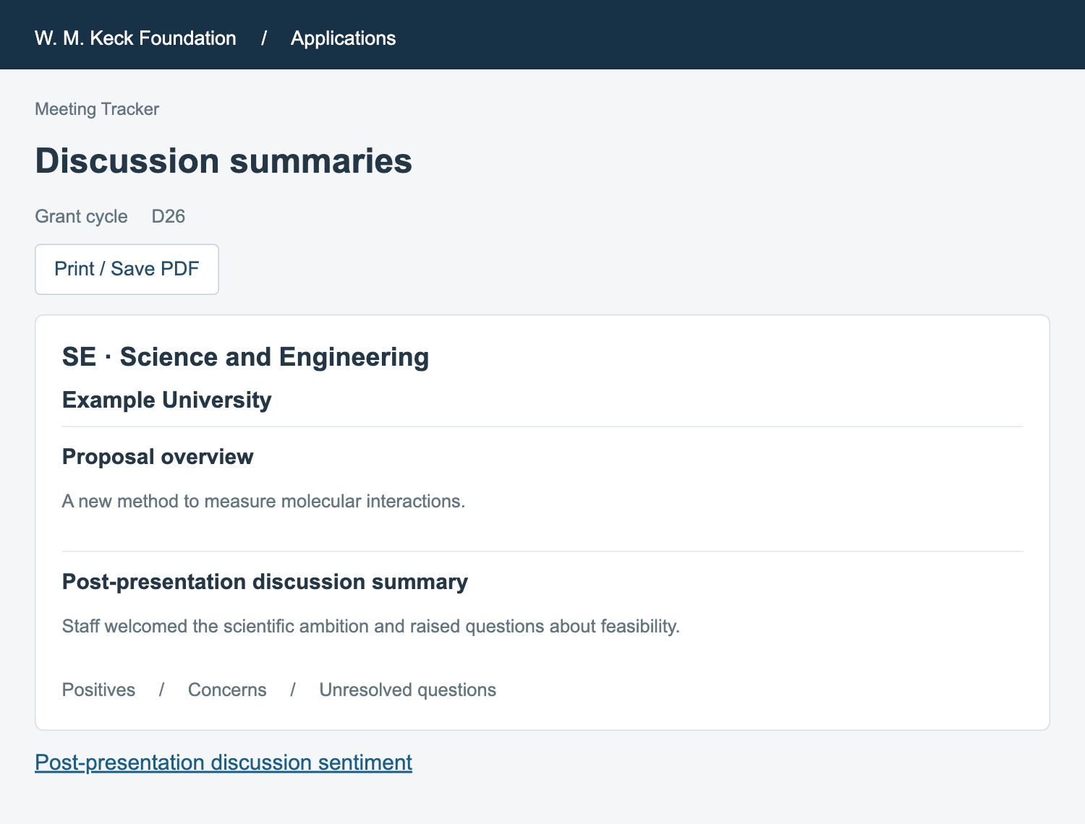
Meeting Tracker: summaries after the presentation
Consistent wording for the discussion and its program-wide summary
BEFORE · CURRENT WORDING
AFTER · PROPOSED
Discussion summaries are grouped by SE and MR. Each entry covers one proposal.
Vocabulary review • Proposed wording • 4
Notes:
Schematic mockups, not production screenshots. Current labels verified from shared/components/workbench/StaffDeliberationsTab.js; pages/external/briefing/[token].js; shared/components/meeting-tracker/ProgramBriefingView.js; DiscussionSentimentView.js. Proposed labels reflect the vocabulary discussion with the user.

Slide 6
Vocabulary: preparation and meetings
Full proposed vocabulary for review
TYPE | CURRENT WORDING / EXAMPLES | PROPOSED NAME
Workspace | Staff Deliberations | Staff Deliberations (keep)
Meeting | Deliberation session / Pre-discussion | Proposal discussion session
Meeting | Site visit / Presentation | Research presentation
Discussion | Staff discussion | Post-presentation discussion
Document | Pre-site briefing / Pre-RP Brief | Proposal discussion brief
Shared page | Deliberation briefing / Briefing page | Proposal review packet
Agenda | Deliberation session agenda | Discussion session agenda
Materials | Site visit materials | Presentation materials
Vocabulary review • Proposed wording • 5
Notes:
Current wording from source inventory in WMKF_Apps, October 19, 2026. Proposed names from user review in this chat. No app implementation is represented. The Scientific dossier label applies to the research product; collection naming remains available for later review.

Slide 7
Vocabulary: follow-up and summaries
Full proposed vocabulary for review
TYPE | CURRENT WORDING / EXAMPLES | PROPOSED NAME
Recording | Post-presentation materials | Recording and transcripts
Document | Working writeup / Word Draft | Post-presentation writeup
Document | Final Writeup | Final writeup
Summary | Presentation summary | Presentation summary
Summary | Staff discussion summary | Post-presentation discussion summary
Analysis | Discussion Sentiment | Post-presentation discussion sentiment
Collection | Program briefing | Discussion summaries
Research | Cycle Dossier / Scientific briefing | Scientific dossier
Vocabulary review • Proposed wording • 6
Notes:
Current wording from source inventory in WMKF_Apps, October 19, 2026. Proposed names from user review in this chat. No app implementation is represented. The Scientific dossier label applies to the research product; collection naming remains available for later review.

