Slide 1
ISP Overview
Architecture and tool
Marie-anne le menn
19 May 2017

Slide 2
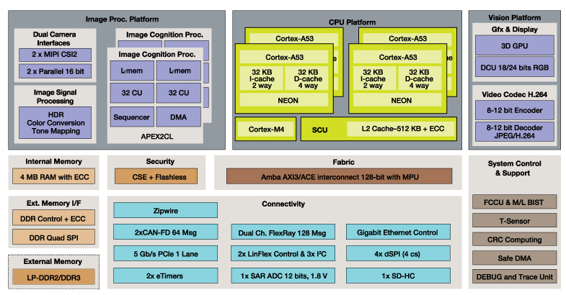
S32V234: Block Diagram

Slide 3
Image Sensor Processing
Black level correction
Exposure
White balancing
HDR
Vignetting
Debayering
RGB2YUV
Noise Filter
Format Conversion
Full processing for
up to 2x1Mpix @ 30fps!

Slide 4
AGENDA
ISP architecture
How to program it
Current software

Slide 5
AGENDA
Its architecture
Image processing and ISP kernels
ISP sub-system
ISP graph
Sequencer and processing pipeline
Memory management
IPU
How to program it
Current software

Slide 6
ISP Sub-system
IPU Modules
IPUS_0
IPUS
=
Scalar Image Processing Unit
(one result pixel at a time)
IPUS_1
…
IPUS_7

Slide 7
ISP Sub-system
IPU Modules
IPUS_0
IPUS_1
…
IPUS_7
IPUV_0
IPUV
=
Vector Image Processing Unit
(4 result pixels at a time)
…
IPUV_3

Slide 8
ISP Sub-system
IPU Modules
IPUS_0
Execute the Kernels
IPUS_1
…
IPUS_7
IPUV_0
…
IPUV_3

Slide 9
ISP Sub-system
SRAM
SRAM controller
IPU Modules
IPUS_0
IPUS_1
…
IPUS_7
Each input/output can fetch/output multiple data at the same time
IPUV_0
…
IPUV_3

Slide 10
ISP Sub-system
SRAM
SRAM controller
IPU Modules
IPUS_0
IPUS_1
…
The full SRAM is 4MB
=> 1MB is optimised for the ISP
IPUS_7
IPUV_0
…
IPUV_3

Slide 11
ISP Sub-system
SRAM
SRAM controller
IPU Modules
Sequencer
IPUS_0
IPUS_1
…
M0 Core
IPUS_7
IPUV_0
…
IPUV_3

Slide 12
ISP Sub-system
SRAM
SRAM controller
IPU Modules
Sequencer
IPUS_0
IPUS_1
…
M0 Core
IPUS_7
Data/ Instr. RAM
IPUV_0
…
IPUV_3

Slide 13
ISP Sub-system
SRAM
SRAM controller
IPU Modules
Sequencer
Crypto protected
IPUS_0
Kernel RAM
IPUS_1
…
M0 Core
IPUS_7
Data/ Instr. RAM
IPUV_0
…
IPUV_3

Slide 14
ISP Sub-system
SRAM
SRAM controller
IPU Modules
Sequencer
done
IPUS_0
start
Kernel RAM
IPUS_1
…
M0 Core
IPUS_7
Data/ Instr. RAM
IPUV_0
…
IPUV_3
Configuration and synchronization signals

Slide 15
ISP Sub-system
SRAM
SRAM controller
IPU Modules
Sequencer
done
IPUS_0
start
Kernel RAM
IPUS_1
…
M0 Core
IPUS_7
Data/ Instr. RAM
IPUV_0
…
IPUV_3
Fast DMA
DRAM

Slide 16
ISP Sub-system
SRAM
SRAM controller
IPU Modules
Sequencer
done
IPUS_0
start
Kernel RAM
IPUS_1
…
M0 Core
IPUS_7
Data/ Instr. RAM
IPUV_0
…
IPUV_3
done
Fast DMA
start
Configuration and synchronization signals
DRAM

Slide 17
ISP Sub-system
SRAM
SRAM controller
IPU Modules
Sequencer
done
IPUS_0
start
Kernel RAM
IPUS_1
…
M0 Core
IPUS_7
Data/ Instr. RAM
IPUV_0
…
IPUV_3
done
Fast DMA
Programmable Engines
start
DRAM

Slide 18

ISP Sub-system
SRAM
SRAM controller
MIPI-CSI
Camera
IPU Modules
Sequencer
done
IPUS_0
start
Kernel RAM
IPUS_1
…
M0 Core
IPUS_7
Data/ Instr. RAM
IPUV_0
…
IPUV_3
done
Fast DMA
start
DRAM

Slide 19
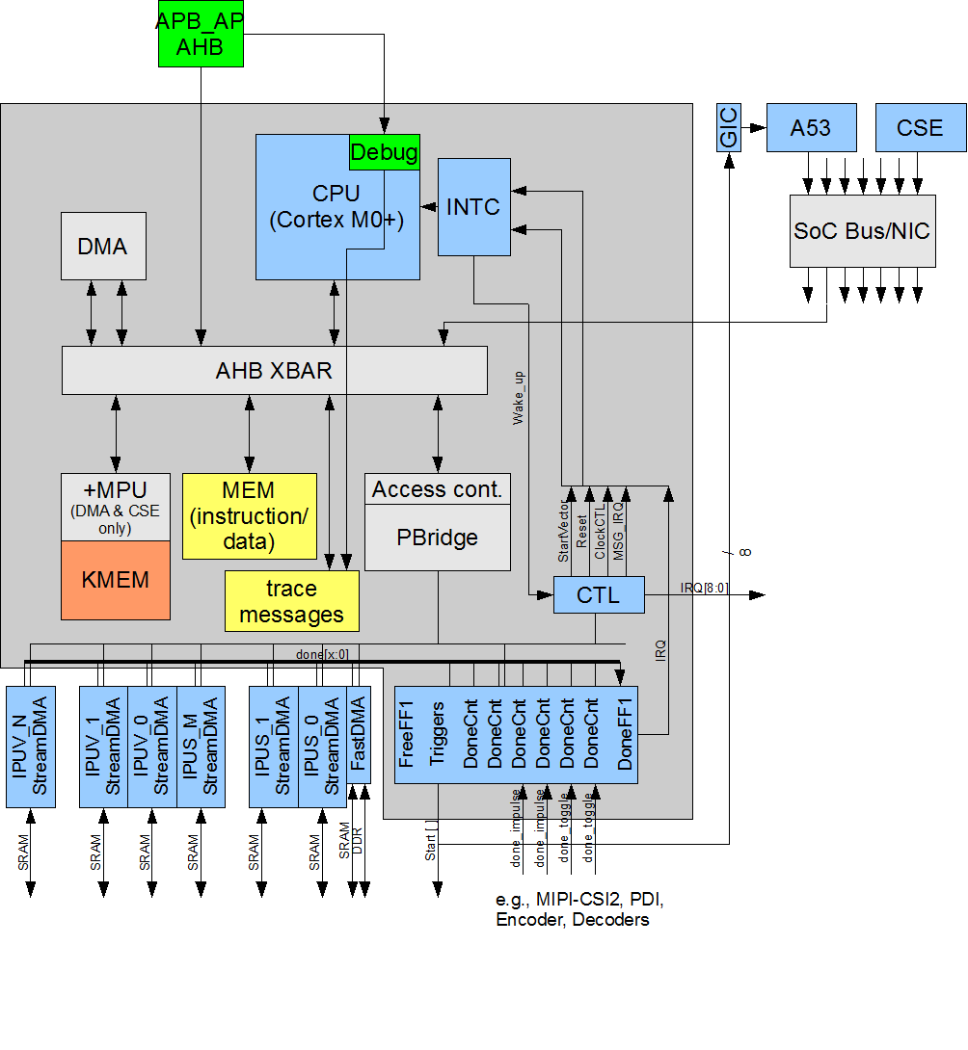
Sequencer: Block Diagram
Mapped into Host address space
Peripherals can also be controlled by Host CPU: IPUs and FastDMA
Servicing the Debug Unit for the IPUs
Sequencer code runs on the M0+ core
The sequencer executes/synchronises the ISP pipeline based on the graph description

Slide 20
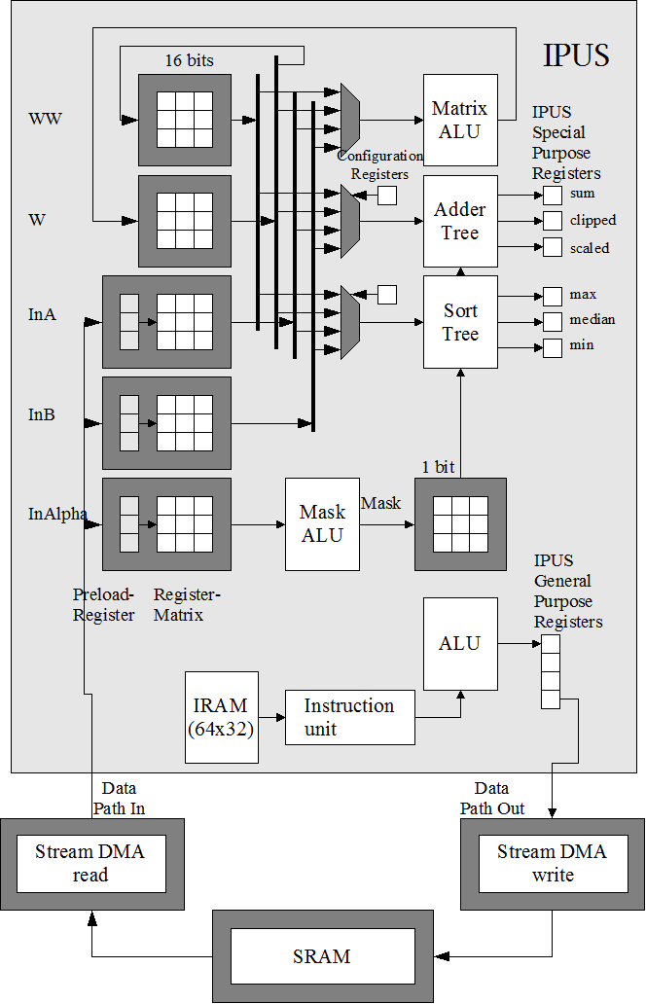
Scalar Engine (IPUS)

Slide 21
Scalar Engine (IPUS)
Input window: 3x3 or 9x1
Up to 3 Inputs:
Ex: R, G, B

Slide 22
Scalar Engine (IPUS)
No data memory (no load/store), only registers
Instruction memory
Decoding unit

Slide 23
Scalar Engine (IPUS)
Matrix ALU (3x3 -> 3x3)
Working matrix

Slide 24
Scalar Engine (IPUS)
3X3 Accelerators:
Sum, scaled, clipped
Max, median, min
Other accelerators:
Histogram
PRNG
Mask matrix: To select on which elements of the matrix the operation or accelerator should be applied to

Slide 25
Scalar Engine (IPUS)
Up to 2 output

Slide 26
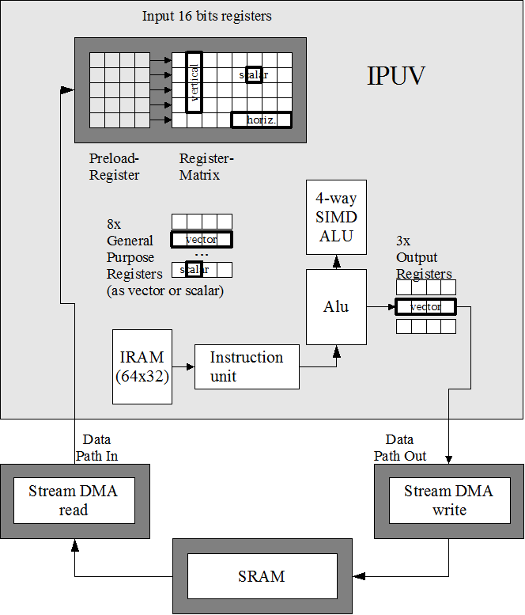
Vector Engine (IPUV)
5x5 input windows
Handles operation with:
Horizontal vectors
Vertical vectors
Scalars
4-way SIMD ALU

Slide 27
IPU Engines
8 x IPUS & 4 x IPUV
500MHz per Engine: 6000MHz total
Pixels are 16-bit fixed point data in signed or unsigned mode
Input and output managed by the StreamDMA engines

Slide 28
Input Matrix: IPUS
In2 | In1 | In0
In4 | In2 | In3
In7 | In6 | In5
3x3
In8 | In7 | In6 | In5 | In4 | In3 | In2 | In1 | In0
9x1

Slide 29
Input Matrix: IPUS
Pix 0 | Pix 1 | Pix 2 | Pix 3 | Pix 4 | Pix 5 | Pix 6 | Pix 7 | Pix 8
Pix 9 | Pix 10 | Pix 11 | Pix 12 | Pix 13 | Pix 14 | Pix 15 | Pix 16 | Pix 17
Pix 18 | Pix 19 | Pix 20 | Pix 21 | Pix 22 | Pix 23 | Pix 24 | Pix 25 | Pix 26
Pix 27 | Pix 28 | Pix 29 | Pix 30 | Pix 31 | Pix 32 | Pix 33 | Pix 34 | Pix 35
Pix 36 | Pix 37 | Pix 38 | Pix 39 | Pix 40 | Pix 41 | Pix 42 | Pix 43 | Pix 44
Pix 45 | Pix 46 | Pix 47 | Pix 48 | Pix 49 | Pix 50 | Pix 51 | Pix 52 | Pix 53
Input image
Input matrix

Slide 30
Input Matrix: IPUS
Pix 0 | Pix 1 | Pix 2 | Pix 3 | Pix 4 | Pix 5 | Pix 6 | Pix 7 | Pix 8
Pix 9 | Pix 10 | Pix 11 | Pix 12 | Pix 13 | Pix 14 | Pix 15 | Pix 16 | Pix 17
Pix 18 | Pix 19 | Pix 20 | Pix 21 | Pix 22 | Pix 23 | Pix 24 | Pix 25 | Pix 26
Pix 27 | Pix 28 | Pix 29 | Pix 30 | Pix 31 | Pix 32 | Pix 33 | Pix 34 | Pix 35
Pix 36 | Pix 37 | Pix 38 | Pix 39 | Pix 40 | Pix 41 | Pix 42 | Pix 43 | Pix 44
Pix 45 | Pix 46 | Pix 47 | Pix 48 | Pix 49 | Pix 50 | Pix 51 | Pix 52 | Pix 53
1st Input

Slide 31
Input Matrix: IPUS
Pix 0 | Pix 1 | Pix 2 | Pix 3 | Pix 4 | Pix 5 | Pix 6 | Pix 7 | Pix 8
Pix 9 | Pix 10 | Pix 11 | Pix 12 | Pix 13 | Pix 14 | Pix 15 | Pix 16 | Pix 17
Pix 18 | Pix 19 | Pix 20 | Pix 21 | Pix 22 | Pix 23 | Pix 24 | Pix 25 | Pix 26
Pix 27 | Pix 28 | Pix 29 | Pix 30 | Pix 31 | Pix 32 | Pix 33 | Pix 34 | Pix 35
Pix 36 | Pix 37 | Pix 38 | Pix 39 | Pix 40 | Pix 41 | Pix 42 | Pix 43 | Pix 44
Pix 45 | Pix 46 | Pix 47 | Pix 48 | Pix 49 | Pix 50 | Pix 51 | Pix 52 | Pix 53
2nd Input

Slide 32
Input Matrix: IPUS
Pix 0 | Pix 1 | Pix 2 | Pix 3 | Pix 4 | Pix 5 | Pix 6 | Pix 7 | Pix 8
Pix 9 | Pix 10 | Pix 11 | Pix 12 | Pix 13 | Pix 14 | Pix 15 | Pix 16 | Pix 17
Pix 18 | Pix 19 | Pix 20 | Pix 21 | Pix 22 | Pix 23 | Pix 24 | Pix 25 | Pix 26
Pix 27 | Pix 28 | Pix 29 | Pix 30 | Pix 31 | Pix 32 | Pix 33 | Pix 34 | Pix 35
Pix 36 | Pix 37 | Pix 38 | Pix 39 | Pix 40 | Pix 41 | Pix 42 | Pix 43 | Pix 44
Pix 45 | Pix 46 | Pix 47 | Pix 48 | Pix 49 | Pix 50 | Pix 51 | Pix 52 | Pix 53
… 5th input

Slide 33
Input Matrix: IPUS
Pix 0 | Pix 1 | Pix 2 | Pix 3 | Pix 4 | Pix 5 | Pix 6 | Pix 7 | Pix 8
Pix 9 | Pix 10 | Pix 11 | Pix 12 | Pix 13 | Pix 14 | Pix 15 | Pix 16 | Pix 17
Pix 18 | Pix 19 | Pix 20 | Pix 21 | Pix 22 | Pix 23 | Pix 24 | Pix 25 | Pix 26
Pix 27 | Pix 28 | Pix 29 | Pix 30 | Pix 31 | Pix 32 | Pix 33 | Pix 34 | Pix 35
Pix 36 | Pix 37 | Pix 38 | Pix 39 | Pix 40 | Pix 41 | Pix 42 | Pix 43 | Pix 44
Pix 45 | Pix 46 | Pix 47 | Pix 48 | Pix 49 | Pix 50 | Pix 51 | Pix 52 | Pix 53
1st Input of the 2nd line

Slide 34
Input Matrix: IPUS
Pix 0 | Pix 1 | Pix 2 | Pix 3 | Pix 4 | Pix 5
Pix 9 | Pix 10 | Pix 11 | Pix 12 | Pix 13 | Pix 14
Pix 18 | Pix 19 | Pix 20 | Pix 21 | Pix 22 | Pix 23
Pix 27 | Pix 28 | Pix 29 | Pix 30 | Pix 31 | Pix 32
Pix 36 | Pix 37 | Pix 38 | Pix 39 | Pix 40 | Pix 41
Pix 45 | Pix 46 | Pix 47 | Pix 48 | Pix 49 | Pix 50
9x1 mode 3rd Input

Slide 35
Memory management

Slide 36
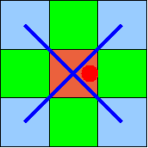
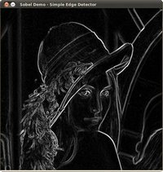
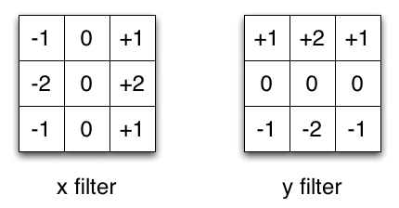
ISP Kernel
A lot of image processing steps (kernels) require multiple lines:
De-bayering
Sobel filtering
IPUs can fetch pixels from different lines

Slide 37



Image processing kernel
0 x 0 +
1 x -1 +
2 x 0 +
Result
12 x -1+
13 x 5 +
14 x -1+
13
24 x 0+
25 x -1+
26 x 0
Kernel
Image
13

Slide 38


Image processing kernel
Result
Kernel
Image

Slide 39
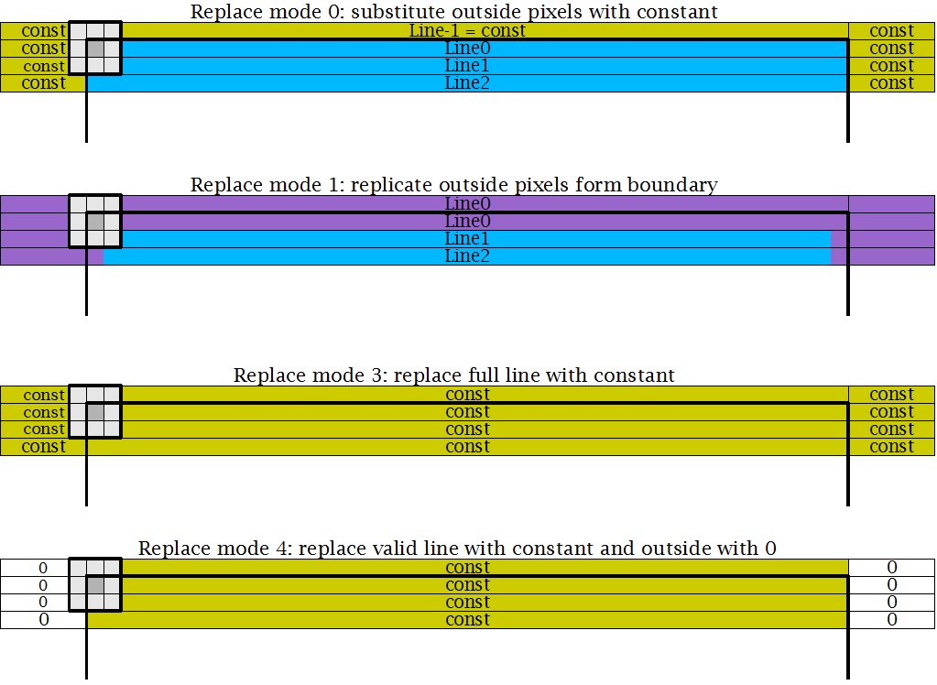
Hardware Replacement Modes
StreamDMA has a lot of additional features:
Scaling
Multiple data format support

Slide 40
AGENDA
Its architecture
How to program it
Current software

Slide 41
AGENDA
Its architecture
How to program it
Graph tool
Kernel example
Software Components
Build Process
Project structure
Optimisations
Current software

Slide 42
ISP Kernels
Functions
Black level measurement
Black level correction
Dead pixel processing
Channel Gain
L/S decompression
Input decompression
Exposure measurement
HDR
De-Bayer
Color Correction Matrix
RGB2Y
Compression
YRB to YUV
Denoise Y
Subsample UV and denoise
Edge Enhancement
Functions
Channel gain
3x3 filters
Vignetting
Global tone mapping
Histogram computation
…

