Slide 1
Lecture notes on shock reflection in steady flow
Justin Kin Jun Hew
Space Plasma Power & Propulsion (SP3) Lab, Department of Nuclear Physics & Accelerator Applications, Australian National University, ACT, 2601, Australia

Slide 2
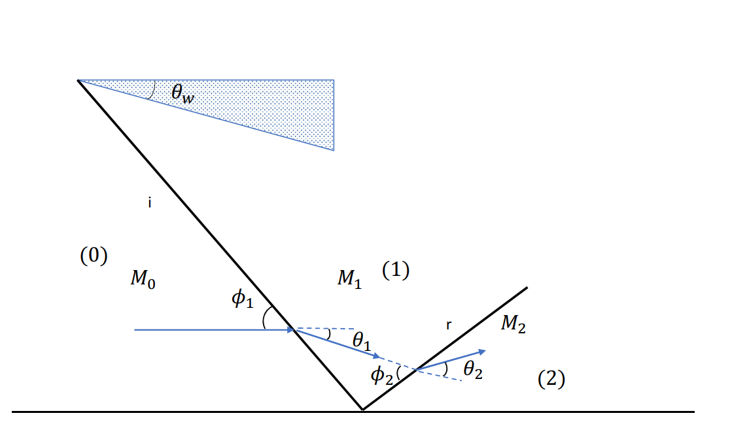
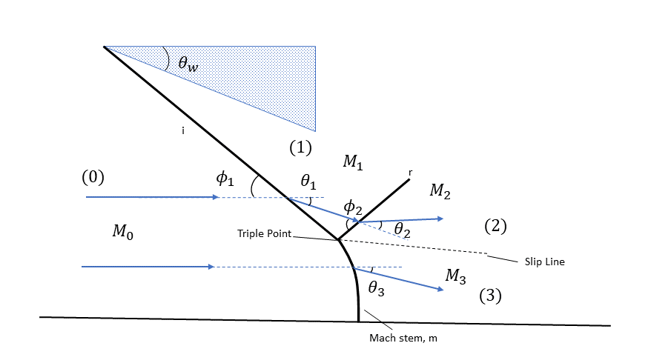
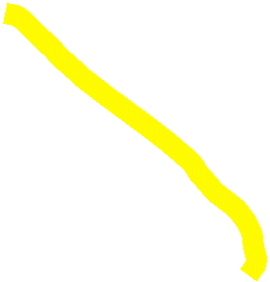


Shock reflection configurations in steady flow
Supersonic flow from LEFT to RIGHT, turned by a wedge with angle $θ_{w}$,
Regular reflection (similar to specular reflection for light waves)
Two-shock confluence
Mach reflection (more generally as irregular reflection)
Three-shock confluence

Slide 3
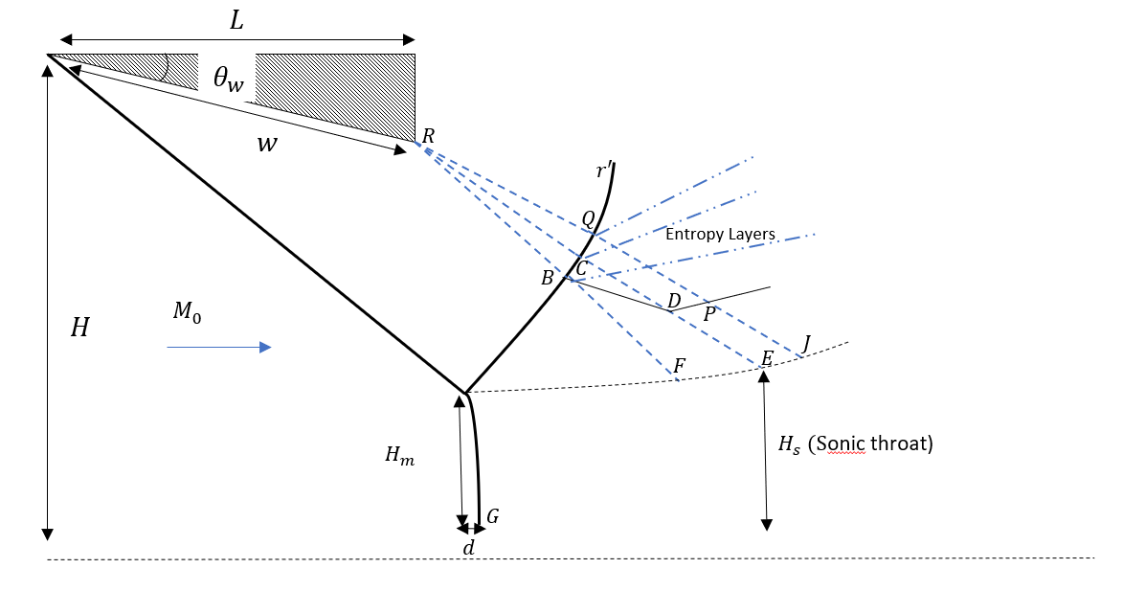
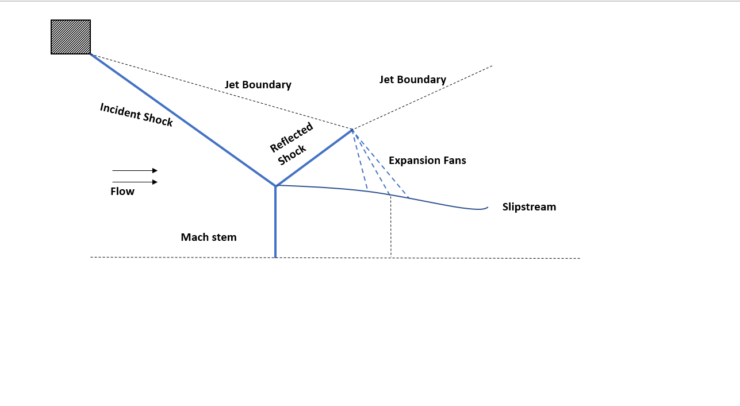
PLANAR MACH REFLECTION WITH FLOWS BETWEEN WEDGES
PLANAR MACH REFLECTION WITH FLOWS INSIDE NOZZLES/JETS
Model of Li & Ben-Dor (1997)
Hadjadj, Ivanov and Kudryatsev (2004)
Other planar models: Mouton & Hornung (2007,2008), Gao & Wu (2010), Bai & Wu (2017) ,Roy & Gopalapillai (2019)
Later models extended on earlier ones by incorporating prediction of asymmetric shocks, and secondary wave effects.

Slide 4
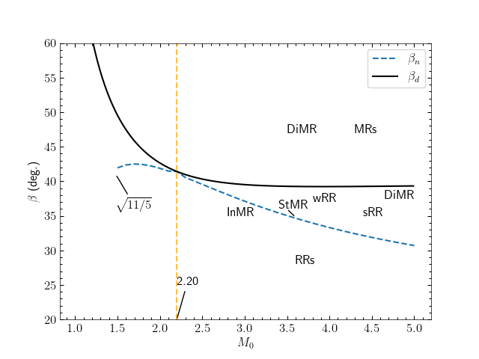







Theoretical transition boundaries between planar symmetric steady MR and RR
$β_{n}$ is the von Neumann criterion
$β_{d}$ is the detachment criterion
Region between the two criteria is called the dual-solution domain (DSD).
There are many other criterions, but these are the two most celebrated ones (see Mouton, 2009).
Standard shock theory regime
DiMR – Direct Mach Reflection (standard 3-ST)
StMR – Stationary Mach Reflection (standard 3-ST)
InMR – Inverse/Inverted Mach Reflection (standard 3-ST)
wRR - weak Regular reflection (2-ST)
sRR – strong Regular reflection (2-ST)
Von Neumann Paradox weak shock regime
GR – Guderley Reflection (4-WT)
VR – Vasilev Reflection (4-WT)
vNR – Von Neumann reflection (non-standard 3-ST)
GR, VR,
or vNR

Slide 5
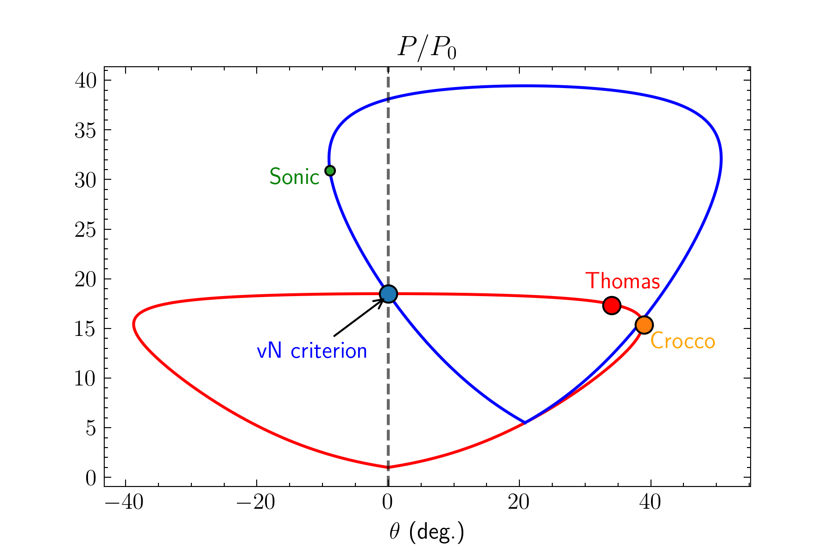
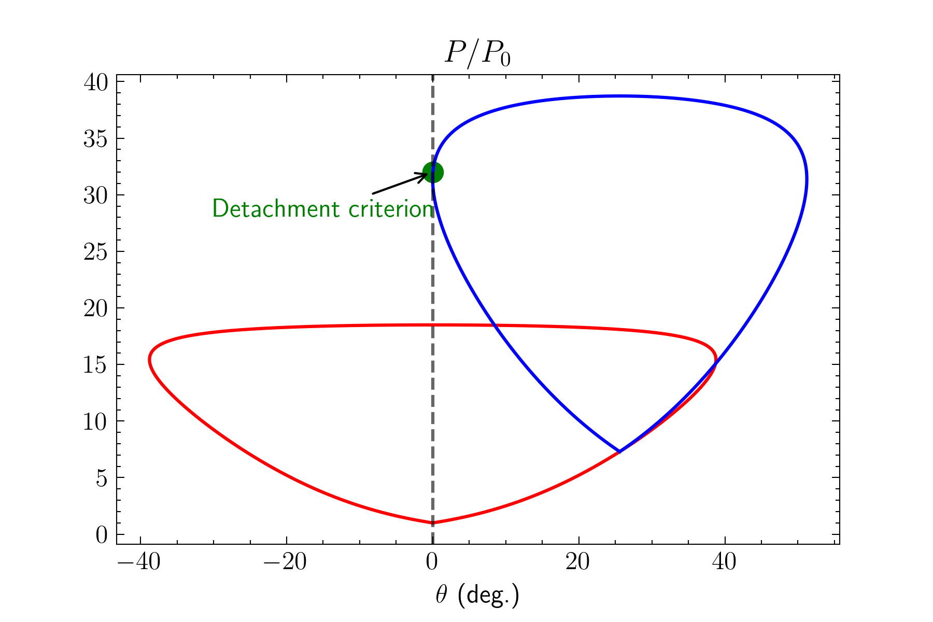

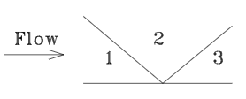


Oblique Shock Polar Theory In The Pressure-deflection $(\tilde{p,}θ)$ Plane
Representative polar for von Neumann criterion
Representative polar for detachment criterion
$$θ_{w}$$
$$θ_{w}$$
Flow deflection angle
Flow deflection angle
Expressions for Crocco and Thomas pt can be found in Mölder’s thesis (2012) and Silnikov & Chernyshov (2017)

Slide 6
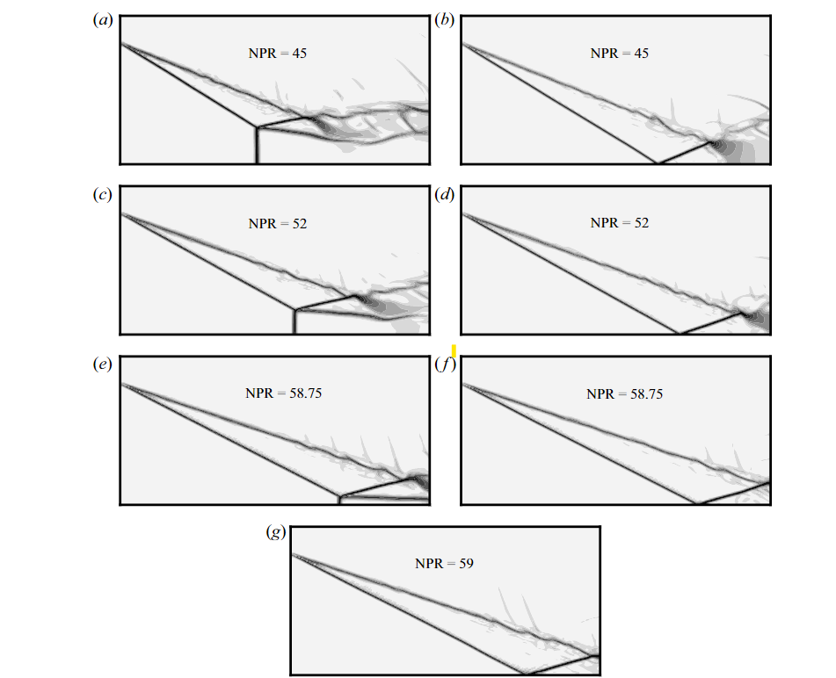
Dual solution domain hysteresis
In the DSD, both MR and RR are possible in theory (according to the vN and d criterion in 3-ST)
HLLC approximate Riemann solver, simulation from
from
Paramanantham, Janakiram, Gopalapillai (2022,JFM)

Slide 7
Dual solution domain hysteresis
Possibility of an MR <-> RR hysteresis pattern was first hypothesised by Hornung, Oertel & Sandeman (1979) based on results from the T3 Stalker Tunnel at ANU and experiments in Sydney by Henderson & Lozzi (1975), but they never observed RR above the vN condition
Experimental efforts followed (Henderson & Lozzi, 1979), (Hornung & Robinson, 1982), (Fomin et al., 1996), but could not detect the RR wave configuration in the DSD.
Chpoun et al. (1995) found hysteresis but results contaminated by 3-D edge effects according to Skews et al. (2000) and Fomin et al. (1996).
There were strong numerical evidence, Riemann solvers by Chpoun et al. (1995), Vuillon et al. (1996) & DSMC from Ivanov et al. (1997) with the early SMILE code.
Depending on who one asks, the DSD problem has either been “resolved” as summarised in Ben Dor et al. (2002) & more investigations by Mouton & Hornung (2007, 2008), or still remains to be solved.

Slide 8
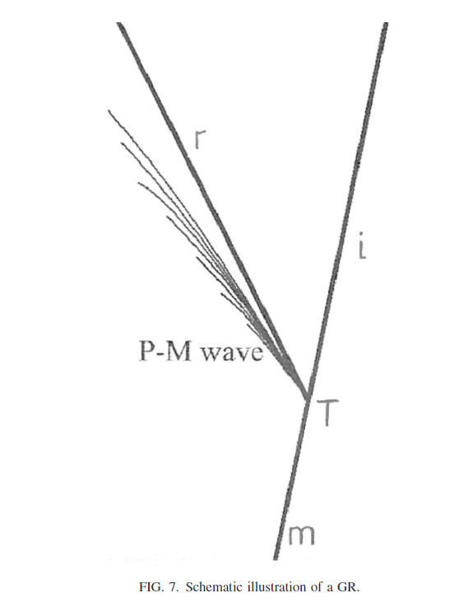
Resolving the Von neumann paradox in weak shock reflection: 2000s
There is a region in shock-polar theory, where von Neumann three shock theory yields no results but experimental evidence shows an MR configuration.
Here the shock structure can be either von Neumann reflection (vNR), Guderley reflection (GR) or Vasilev reflection (VR)
GR was first predicted by Guderley in the 50s. But he did not account for the fact that the flow behind the Mach stem can be subsonic, and used the hodograph form of the Tricomi equations.
First numerical observation made by Collela & Henderson and Henderson, Collela and Puckett in the early 90s, using experiments in Sydney and an adaptive unstructured Godunov flux code.
Followed by many observations of the Guderley reflection and Vasilev reflection and others in numerical codes (Vasi’lev & Kraiko, 1999) (Tesdall & Hunter, 2002) and experiments by Skews & Ashworth (2005)

Slide 9
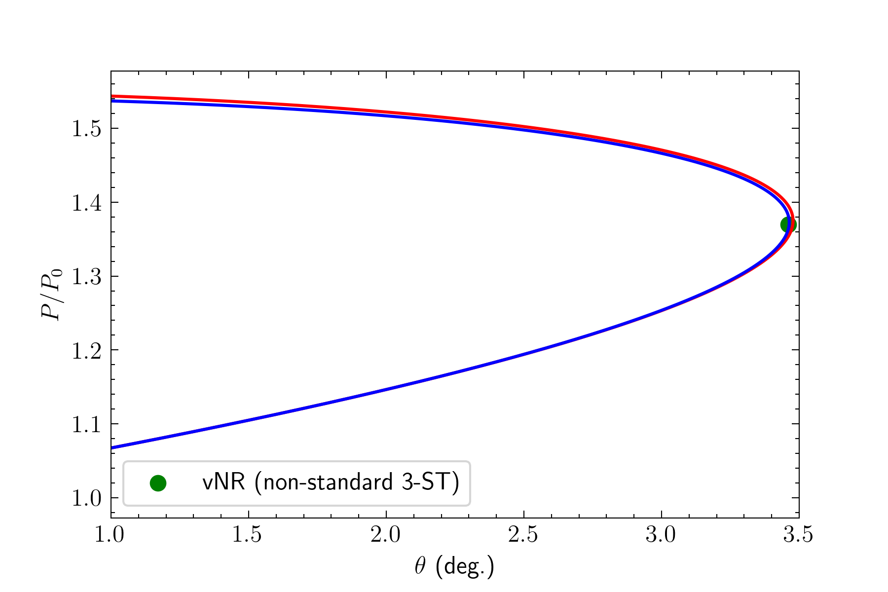
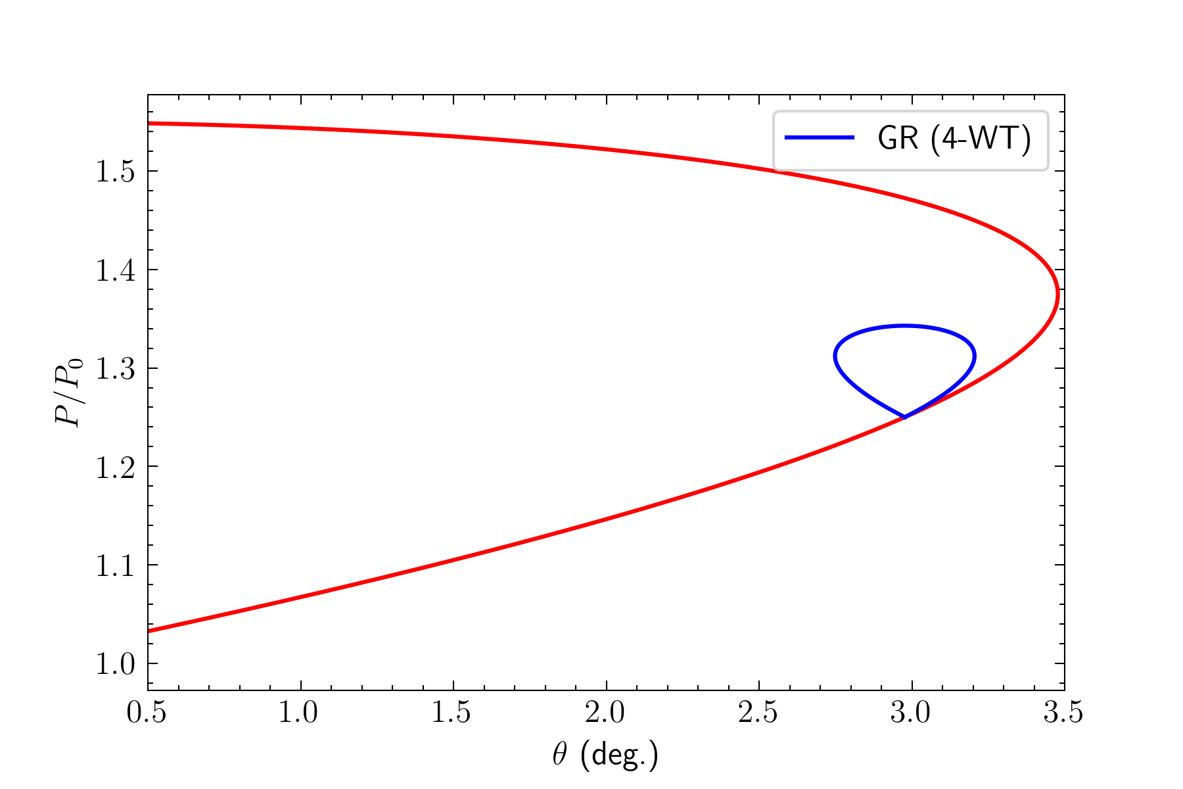
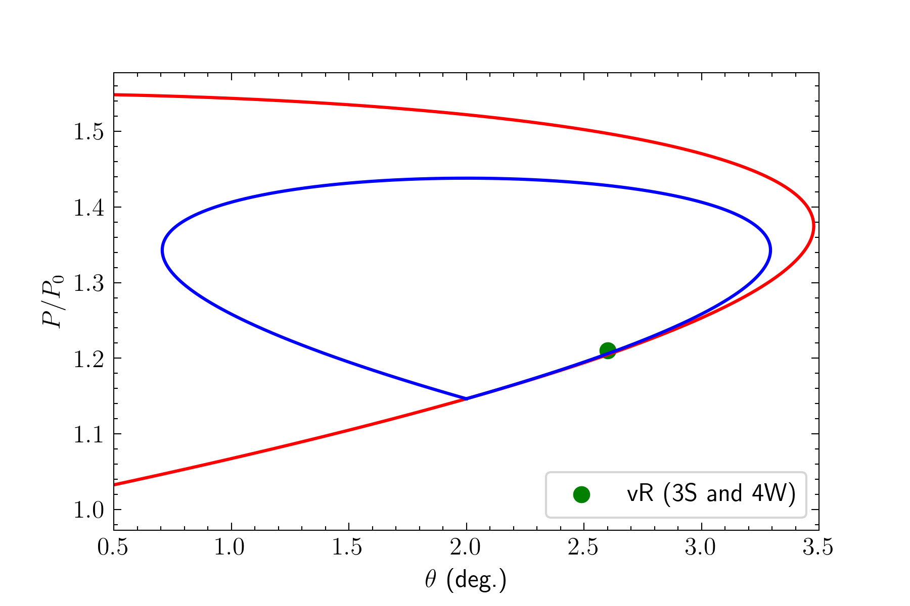
Resolving the Von neumann paradox in weak shock reflection
The R-polar either does not intersect the I-polar, or it intersects to the right of it, i.e., no standard solutions via von Neumann theory.
One can prove theoretically via shock polar theory that the vN paradox appears in this region ($M_{0}$ = 1.2,$γ$ = 5/3, $θ_{w}=2$)
This is the von Neumann reflection (vNR), Guderley reflection (GR), and Vasilev reflection (vR)

Slide 10
Other branches
Dynamic effects in steady MR <-> RR transition, Naidoo & Skews (2013, 2014)
Many extensive studies on pseudo-steady and unsteady shock reflection
Configurations such as single Mach reflection (SMR), transitioned Mach reflection (TMR) and Double Mach reflection (DMR).
M. Sun’s group SWR adaptive grid code from 2009
SMR -> TMR -> DMR w. increasing shock Mach number

