Slide 1

How to use git to streamline
your development Process
Notes:
Introduce git-scm

Slide 2
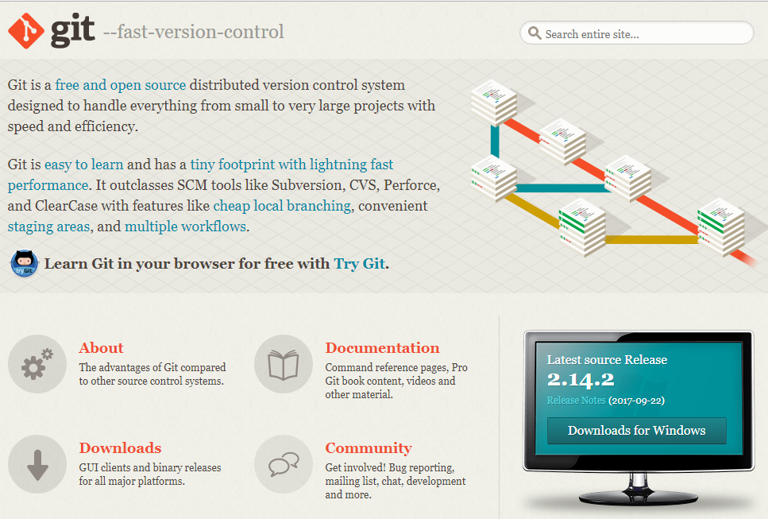
The first thing you will want to do is grab git from their website
Using a web browser go to git-scm.com
Click the “Download for windows button
Notes:
Describe how to download the git-scm

Slide 3
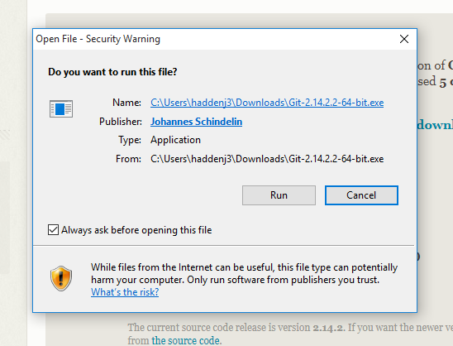
Once you have it downloaded you will be
prompted to run the file
Notes:
Show what the download process looks like

Slide 4

Once it has finished installing press the windows key
on your keyboard
After you have pressed the windows key type powershell and press enter
Move to your documents folder. Type: cd documents
Make a folder Type: mkdir fizzbuzz
Move to the folder. Type: cd fizzbuzz
Create the repository. Type: git init
Windows PowerShell
Copyright © 2015 Microsoft Corporation. All rights reserved
PS C:\Users\haddenj3> cd documents
PS C:\Users\haddenj3\documents> mkdir fizzbuzz
Directory: C:\Users\haddenj3\documents
Mode LastWriteTime Length Name
---- ------------- ------ ----
d----- 10/10/2017 6:49 PM fizzbuzz
PS C:\Users\haddenj3\documents> cd fizzbuzz
PS C:\Users\haddenj3\documents> git init
Initialized empty Git repository in C:\Users\haddenj3\documents\fizzbuzz/git
PS C:\Users\haddenj3\documents\fizzbuzz>
Notes:
Describe and show visuals of how to create the git repository

Slide 5
Once you have a repository we need some files to put into it.
Were’ going clone a simple web page from github
(A popular git repository hosting site)
Windows PowerShell
Copyright © 2015 Microsoft Corporation. All rights reserved
PS C:\Users\haddenj3\fizzbuzz>
Notes:
Describe and show visuals of how to create the git repository

Slide 6
Notes:
Describe how to stage files that you would like to commit

Slide 7
Once you have it downloaded you will be
prompted to run the file
Notes:
Describe how to commit staged files

Slide 8
Once you have it downloaded you will be
prompted to run the file
Notes:
Describe and show a merge conflict and how to resolve it

Slide 9
Once you have it downloaded you will be
prompted to run the file
Notes:
Talk about the benefits of using git to make development within a team a much better experience.

