Slide 1
Digital Record Player
Paul Bachinger, Maurer Florian, Kejda Domi, Hangoebl Justin

Slide 2
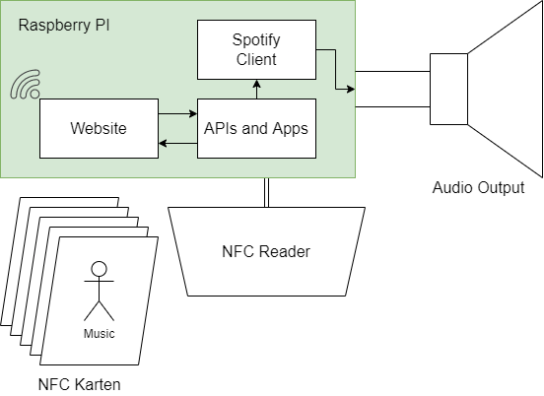
Project Idea
Raspberry PI
RFID
ExpressJS
React
Spotify API
Apache Kafka

Slide 3
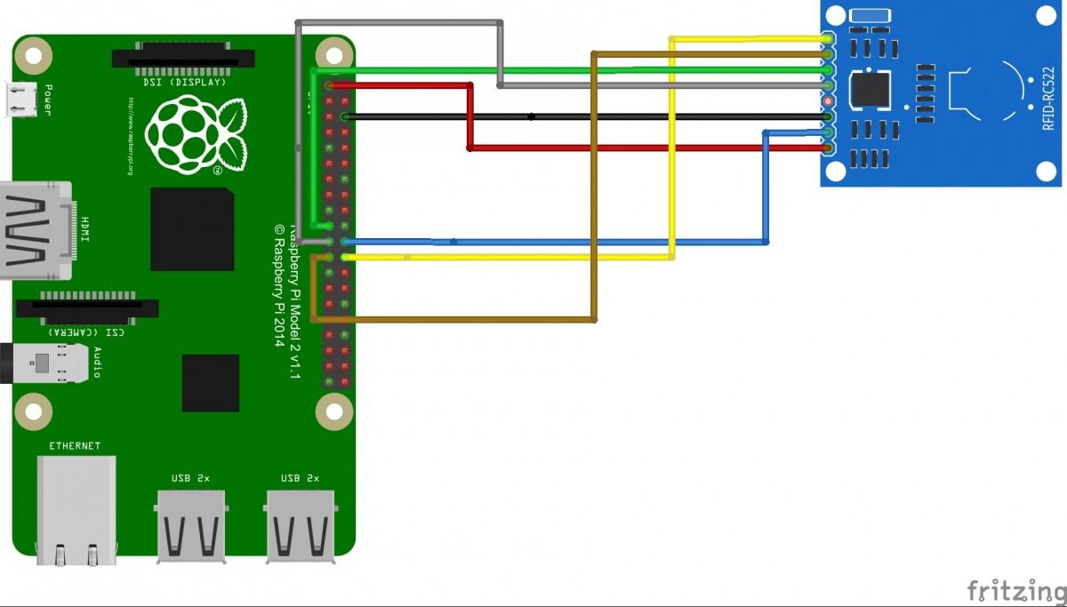
RaspberryPI and MFRC522
Input via NFC Cards
Python Script Reads the Song ID
HTTP request to ExpressJS server
Image source: www.fritzing.com/MFRC522

Slide 4
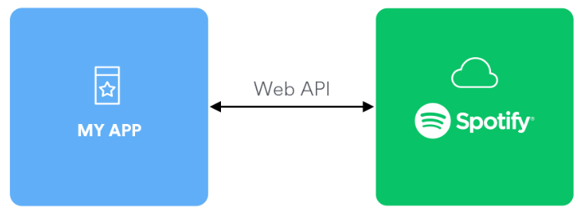
Spotify Web API
REST API principle
Gather public data from the Spotify database
Track-, Artist, Album information, …
Access private data from a specific Spotify account
Control playback, Edit Playlists, …
Requires authorization via OAuth 2.0
The base address of the API is “https://api.spotify.com/”

Slide 5
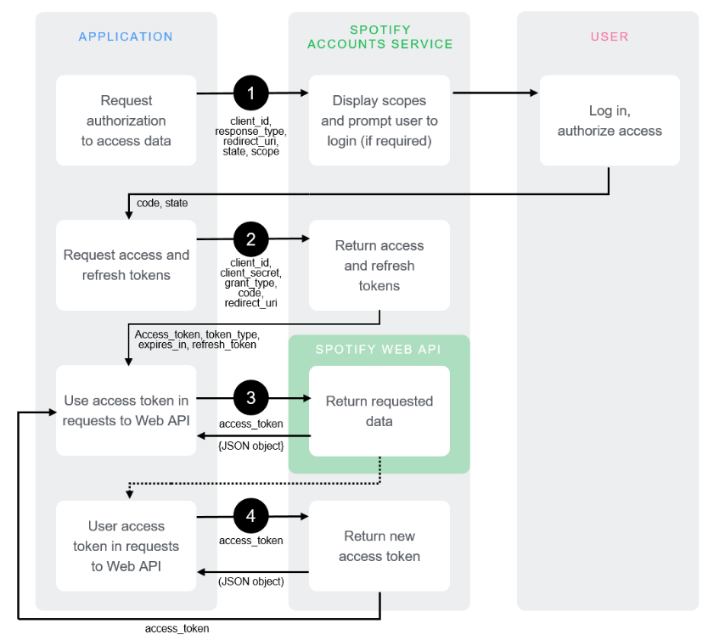
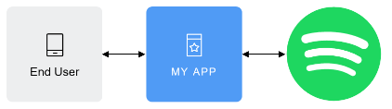
OAuth 2.0 - Authorization Flow
Granting applications a variety of permissions
Spotify Integration Module
Client credentials
Used to call specific API endpoints

Slide 6

ExpressJS
HTTP Server
GET & POST Request
Backend for Client and RFID Reader
Interface to the Spotify API, handles Client Authentication

Slide 7
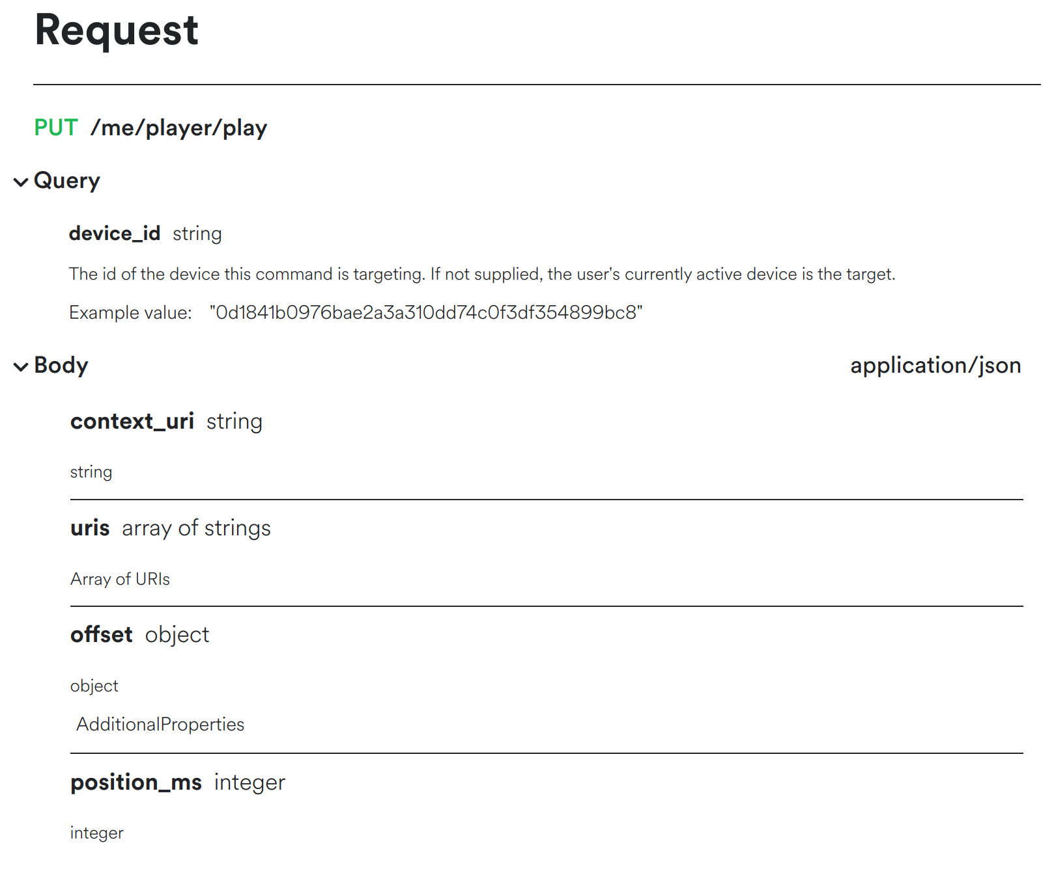
Request to Spotify API
PUT Requests to change Data with Body
GET Requests to access Data
POST Requests to change Data without a Body

Slide 8



Frontend

Slide 9
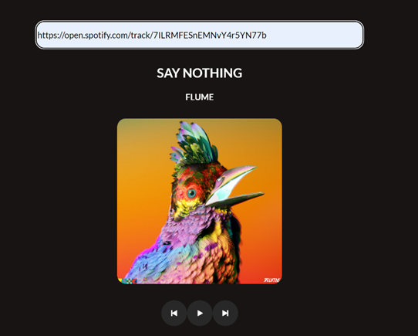

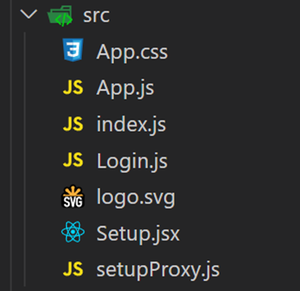
React

Slide 10
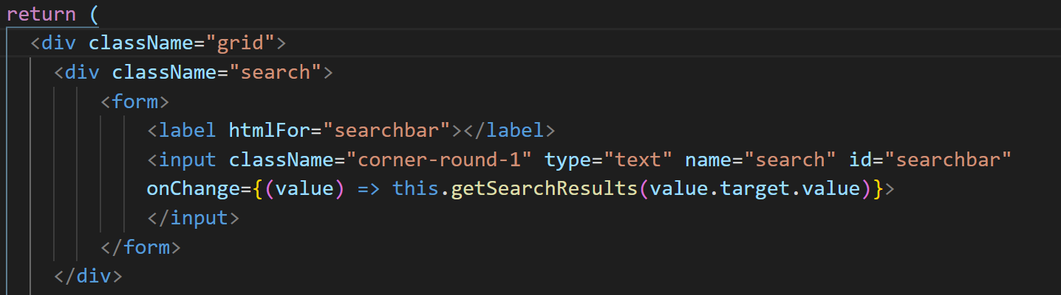
HTML

Slide 11
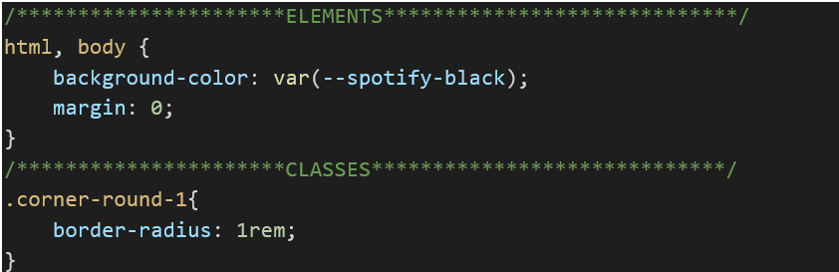
CSS
Content in the stylesheet
Content in the HTML

Slide 12
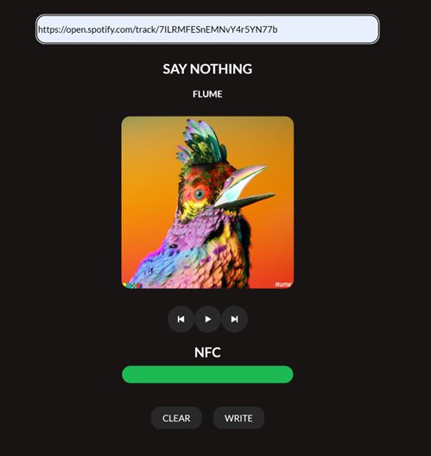
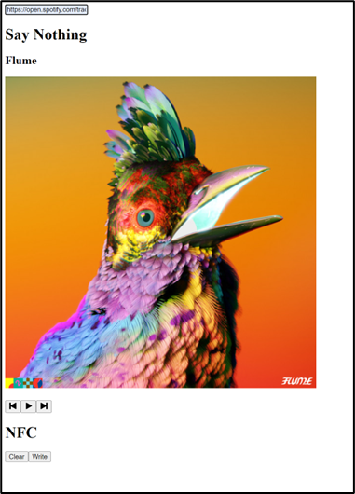
Finished Frontend

Slide 13
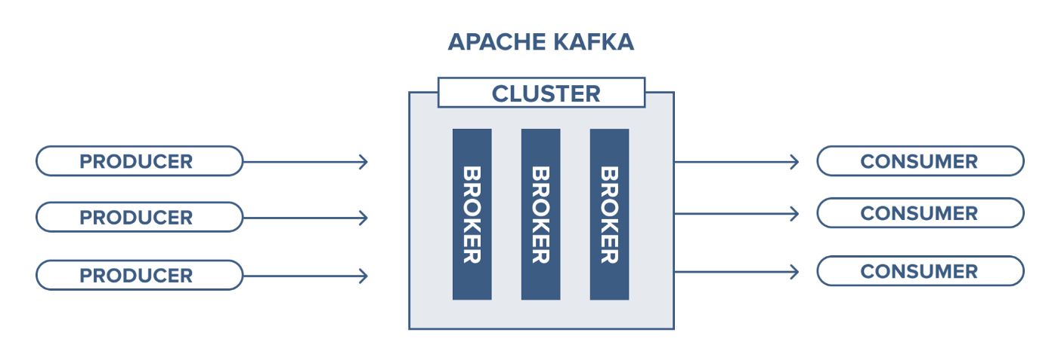
Apache Kafka
Python Thread listens to Kafka Topic
On write Button press
Server writes the ID to the Topic
Python writes the Song ID

