Slide 1
Kiro
Justin Ho

Slide 2
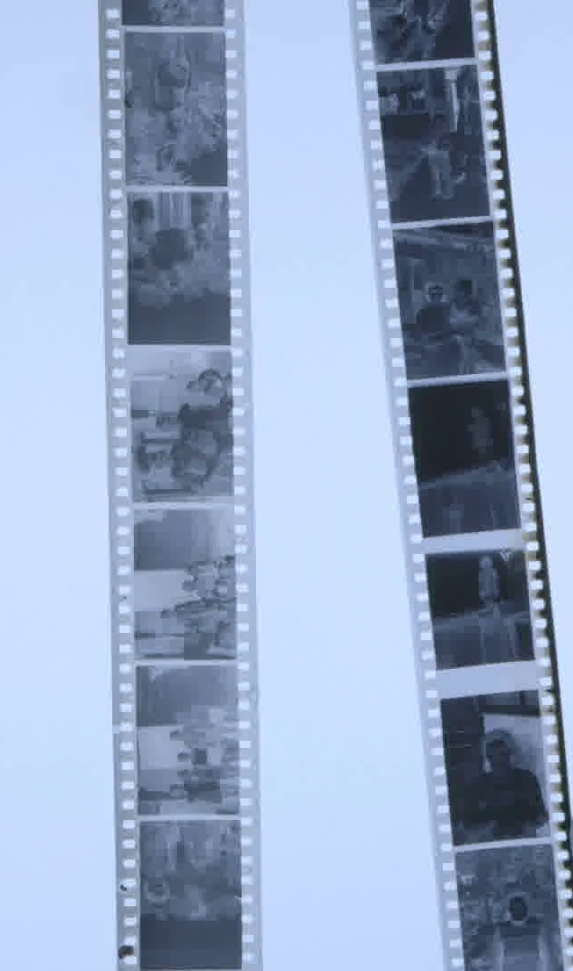

Kiro
Video Summarization Tool
Utilizes Open Source and AWS Technology
Youtube Link Summarized Video

Slide 3
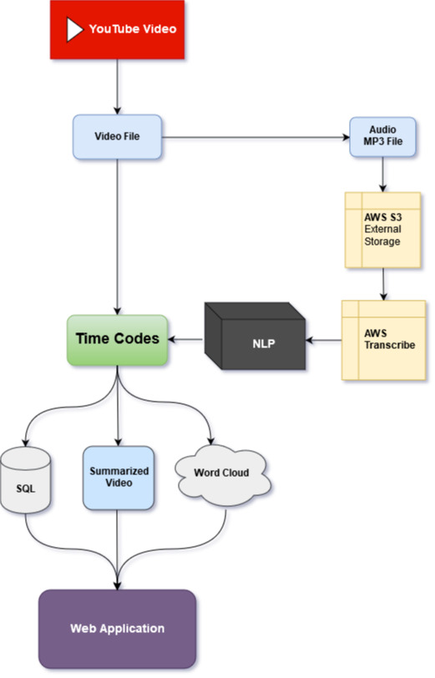
Pipeline
Process Duration
Short Form Videos:
Less than 5 minutes
Long Form Videos:
Less than 20-25 minutes

Slide 4

Video Demo

Slide 5
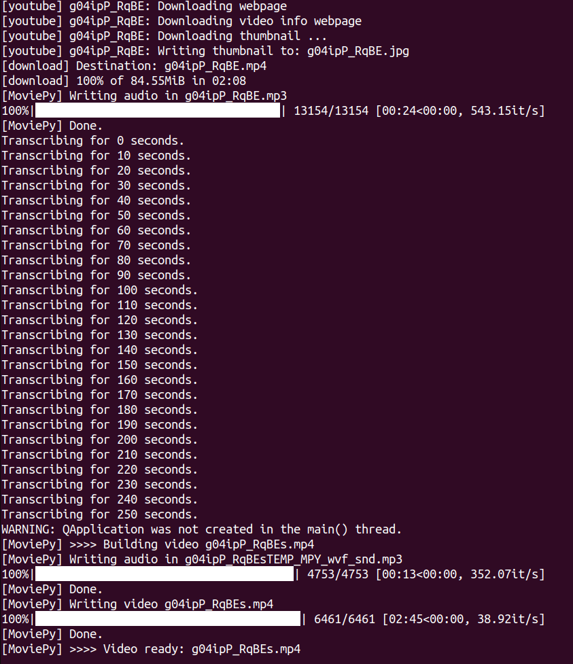

Slide 6


Slide 7
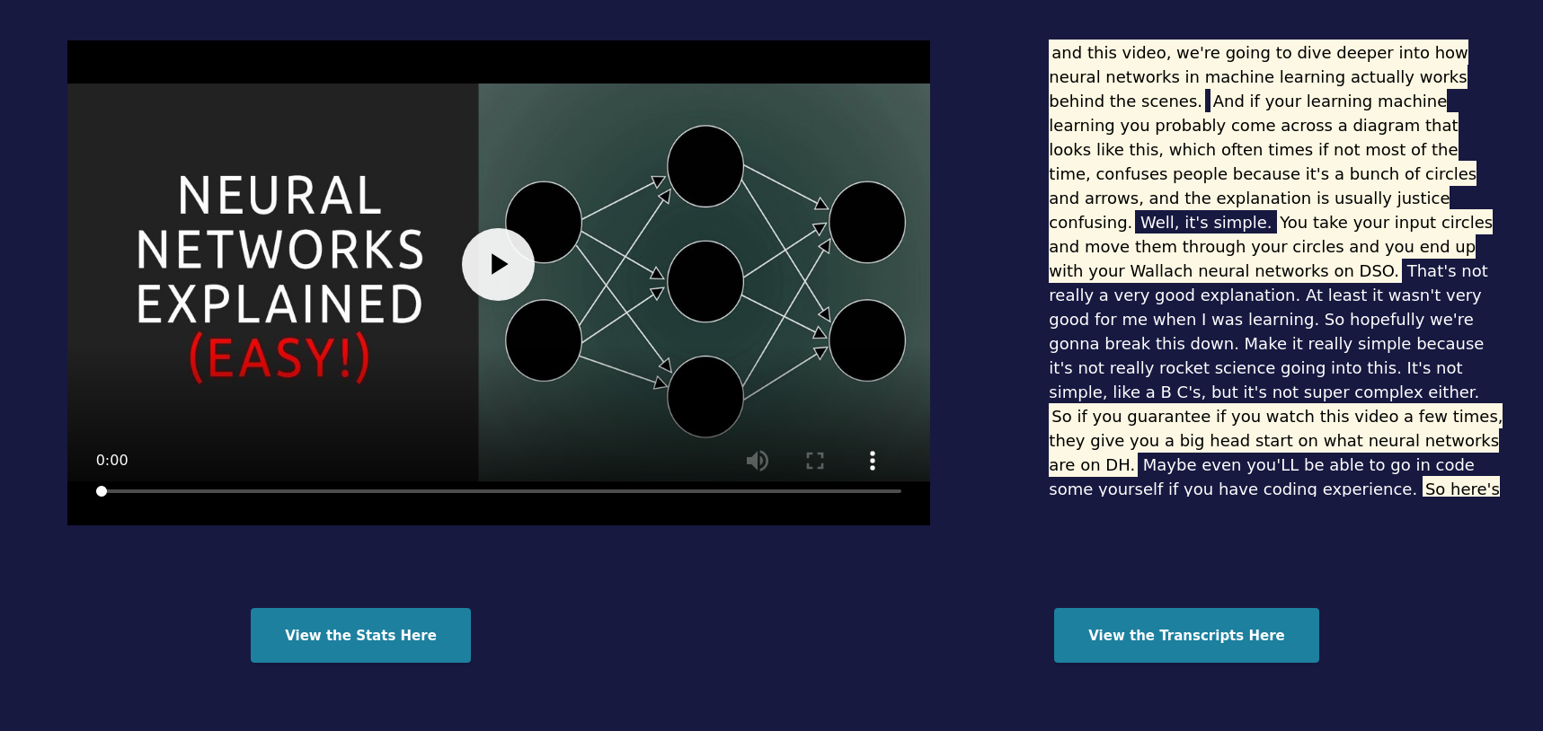

Slide 8
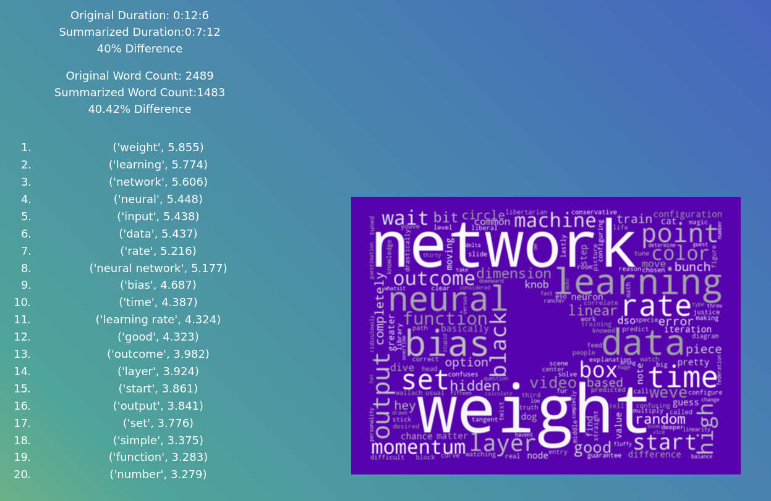

Slide 9
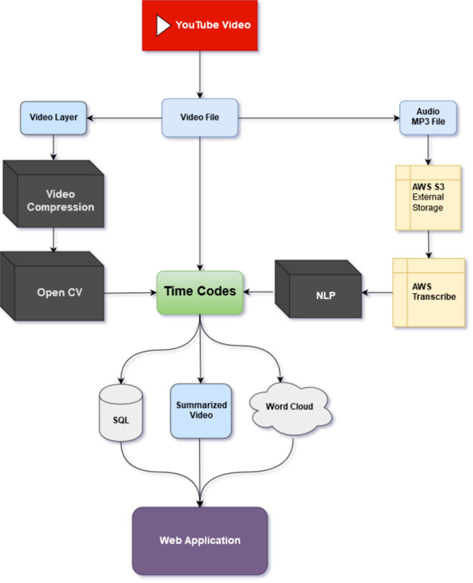

Slide 10
Contact
Email: gujh816@gmail.com
LinkedIn: www.linkedin.com/in/justin-ho-0816/

