Slide 1
Data Analytics Graduate Capstone 2024
Justin Huynh
M.S. Data Analytics
Western Governors University

Slide 2

About Me
Professional digital marketer for over 7 years
Attended a coding bootcamp prior to starting MSDA at WGU
Career change into Data Analytics/Science

Slide 3
Problem and Hypothesis
Given the research dataset from Digital Marketing Company from Kaggle, we need to identify which customers are most likely to convert from these campaigns.
Hypothesis: Certain marketing channels (i.e. Social Media, Email, PPC) significantly influence conversion rates.
Null Hypothesis: There is no significant difference in the conversion rates across different marketing channels.
Alternate Hypothesis: There is a significant difference in the conversion rates across different marketing channels.

Slide 4
Data Analysis Process
Exploratory Data Analysis (EDA)
Examine patterns in customer behaviors, ad spend, and click-through rates (CTR)
Statistical Test (One-Way ANOVA)
Test whether marketing channels impact conversion rates
Predictive Model
Build a logistic regression model to predict customer conversions
Address class imbalance using SMOTE (Synthetic Minority Over-Sampling Technique)

Slide 5
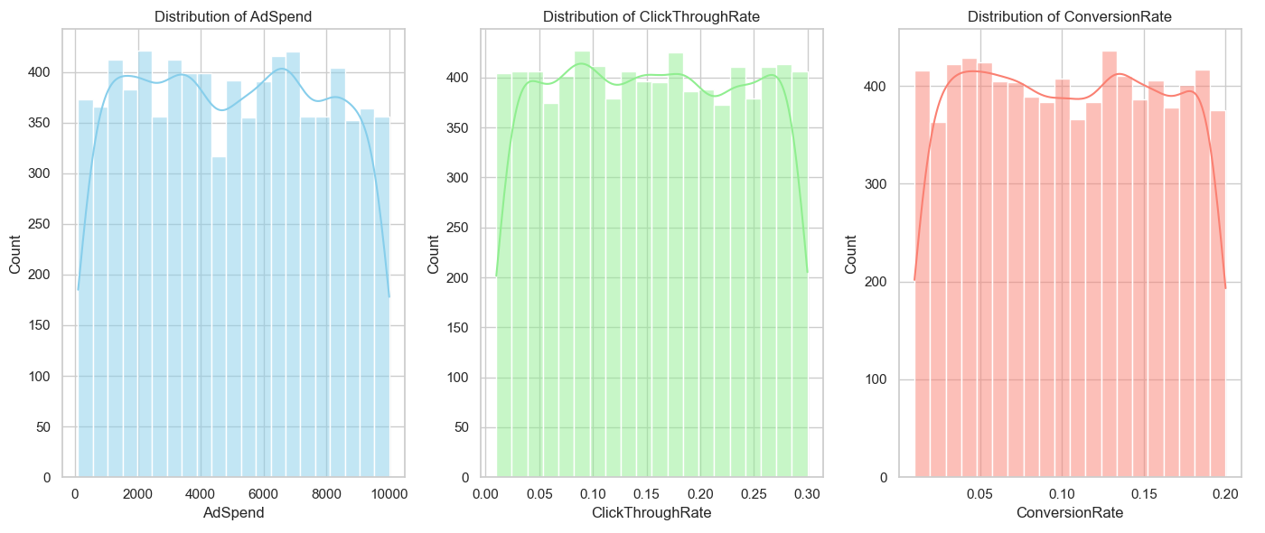
Exploratory Data Analysis
Ad spend, CTR, and Conversion rate were relatively uniform across all channels in terms of distribution

Slide 6
Statistical Test (ANOVA)
Analysis of Variance to compare the mean of multiple groups to determine if there are significant differences (i.e. marketing channels)
Looking at the average conversion rates to see if there are real differences vs. random chance
P-value: 0.59
Shows the likelihood of the data occurring under the null hypothesis
The lower the p-value, the greater the statistical significance of the observed difference

Slide 7
Predictive Model
Logistic regression using SMOTE to improve the model
This technique generated synthetic examples of non-conversions to balance the dataset
Original model had an accuracy of 88% because it was heavily biased towards predicting conversions
More conversions than non-conversions in the dataset

Slide 8
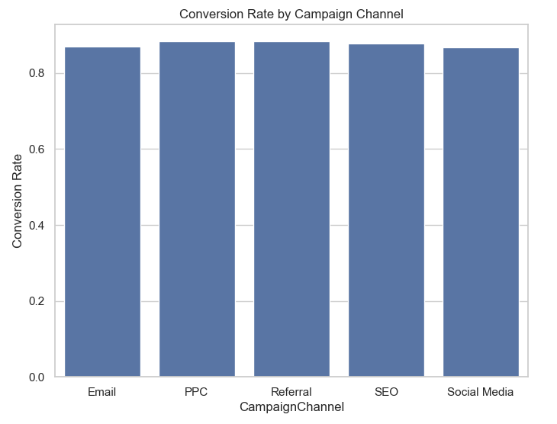
Outline of Findings
With a typical significance level of 0.05, we fail to reject the null hypothesis due to the P-value of 0.59 being > 0.05
Predictive model with SMOTE has an accuracy of 62% for predicting customer conversions

Slide 9
Limitations
Logistic regression assumes simple relationships, but customer behavior may be more complex
People don’t always follow simple patterns
SMOTE introduces synthetic data, which may not fully represent real-world behavior
Artificial data can be uncertain since they’re not from real people

Slide 10
Proposed Actions
Target high-probability customers
Use the model to focus marketing efforts on customers more likely to convert by highlighting behaviors
Move away from targeting based solely on marketing channels
Optimize marketing spend
Allocate resources more efficiently by prioritizing high-converting customers to achieve a better ROI

Slide 11
Expected Benefits
Increased conversion rates
Finalized model can help improve conversion rates by 5-10%
Reduce inefficient ad spend
Focusing on customers with high conversion probability will reduce unnecessary spending
Data-driven decision making
Use the model to guide marketing efforts to make more informed decisions
(i.e. which customers to go after, what type of ads to show, which channel to invest more into, etc.)

Slide 12
Thank You

