Slide 1
ALCF HW 7 AI Testbeds

Slide 2
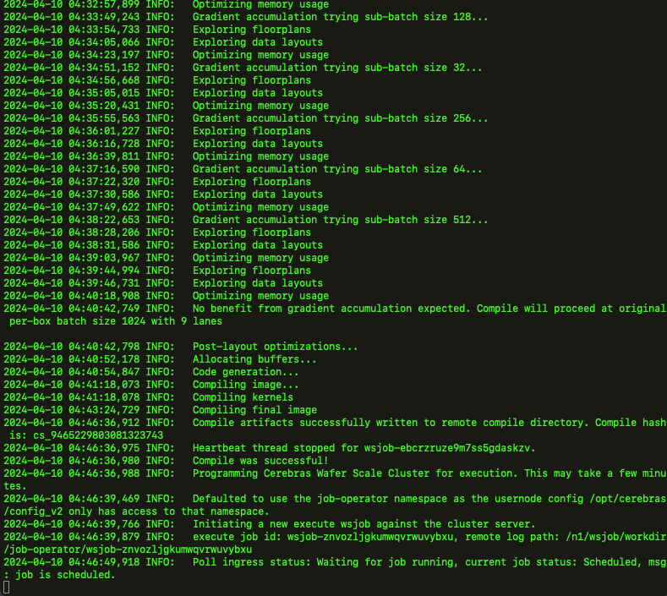
Cerebras

Slide 3
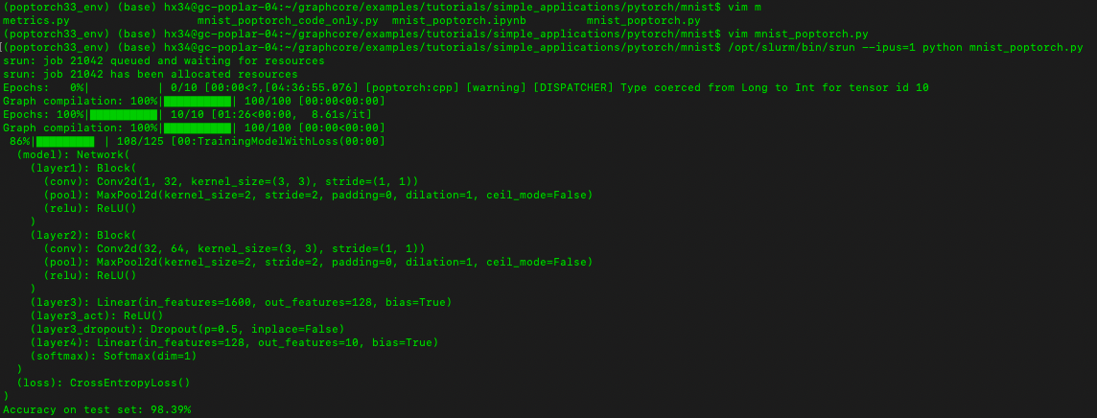
Graphcore

Slide 4
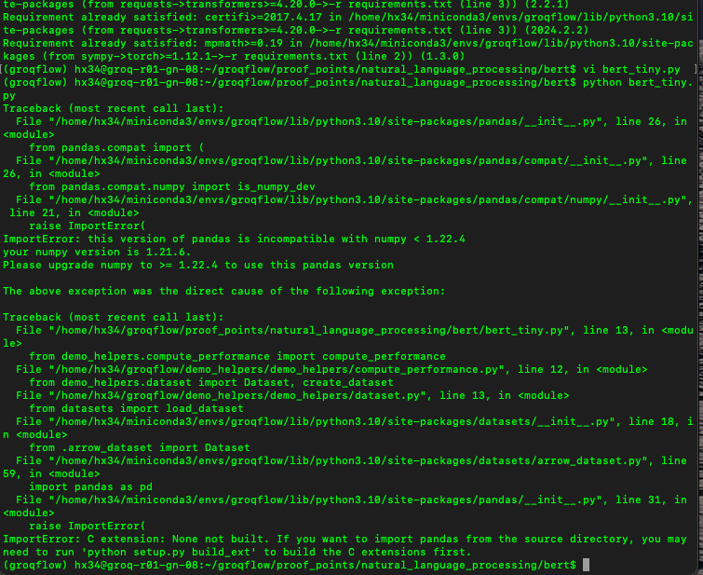
Grop

Slide 5
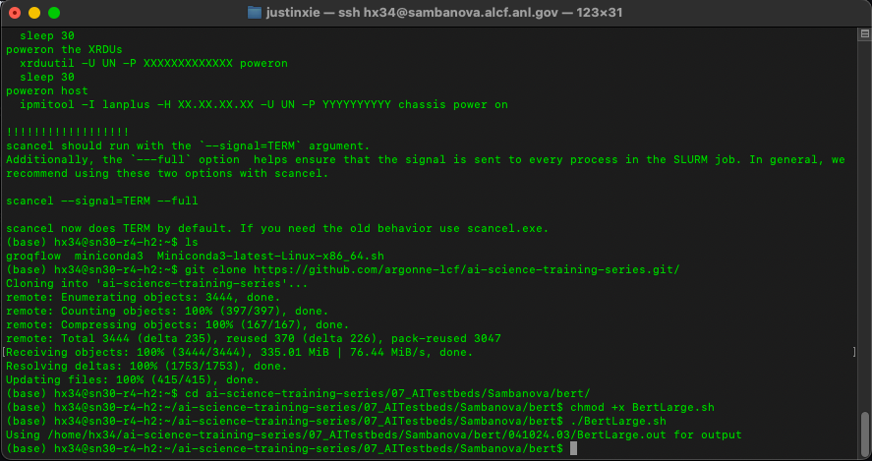
Sambanova

