Slide 1
QSU R Coding Workshop

Slide 2
Session 1: Coding Best Practices | Friday March 1
Session 2: Basic R | Friday March 15
“Off-week” open conference room | Friday March 22
Session 3: Advanced R | Friday March 29
“Off-week” open conference room | Friday April 5
Session 4: Quarto/RMarkdown | Friday April 12
“Off-week” open conference room | Friday April 19
Session 5: Favorite R packages | Friday April 26
Notes:
A lot of this will be based on my own workflow but please jump in if any of you have suggestions on what works better for you – because what works for me maybe helpful for XXX but not for XXX
I feel like there’s so many ways to go with this especially when it comes to the R coding part…soooo I’m going to try to be as efficient and practical as possible and have this be like:
Starting a project, how do we start, what are the typical things we have to do (read data, clean data, create table1, create some figures, fit a model), and then output as a single document that contains all our results (Quarto)
somewhere in there we’ll throw in some advanced things like writing for loops, if clauses, creating our own functions, parallel computing, Shiny dashboards
In the end I’m hoping we’ll have a nice Quarto document with everything we’ve done…maybe with a Shiny app that everyone can take home along with the code to create them
JL need to find some data to play with…baseball stats?

Slide 3
Where/What/How I save files
 | QSU server | Box | GitHub
Code | x | x | x
Data | x | x | x
PHI data | x | x*
Other documents | x | x | x
Version control |  | x | x
Other places to store files?
Sherlock
GCP/BigQuery
Carina?

Slide 4
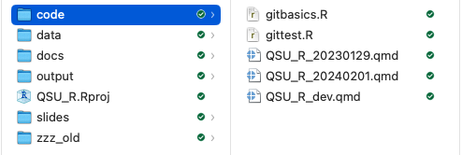
How I save files (self version-control)
I usually save after I’ve written a ton of code that I don’t want to lose (and maybe will need to go back to)
I usually save things as _YYYYMMDD so when the list of files is sorted alphabetically the latest version will sit at the bottom
In general I have a _dev.R file that is my current version then _YYYYMMDD.R are my self-version controlling files and when I’m done with an analysis I’ll drop the _dev.R so its just filename.R or sometimes filename_fin.R if I’m feeling fancy

Slide 5
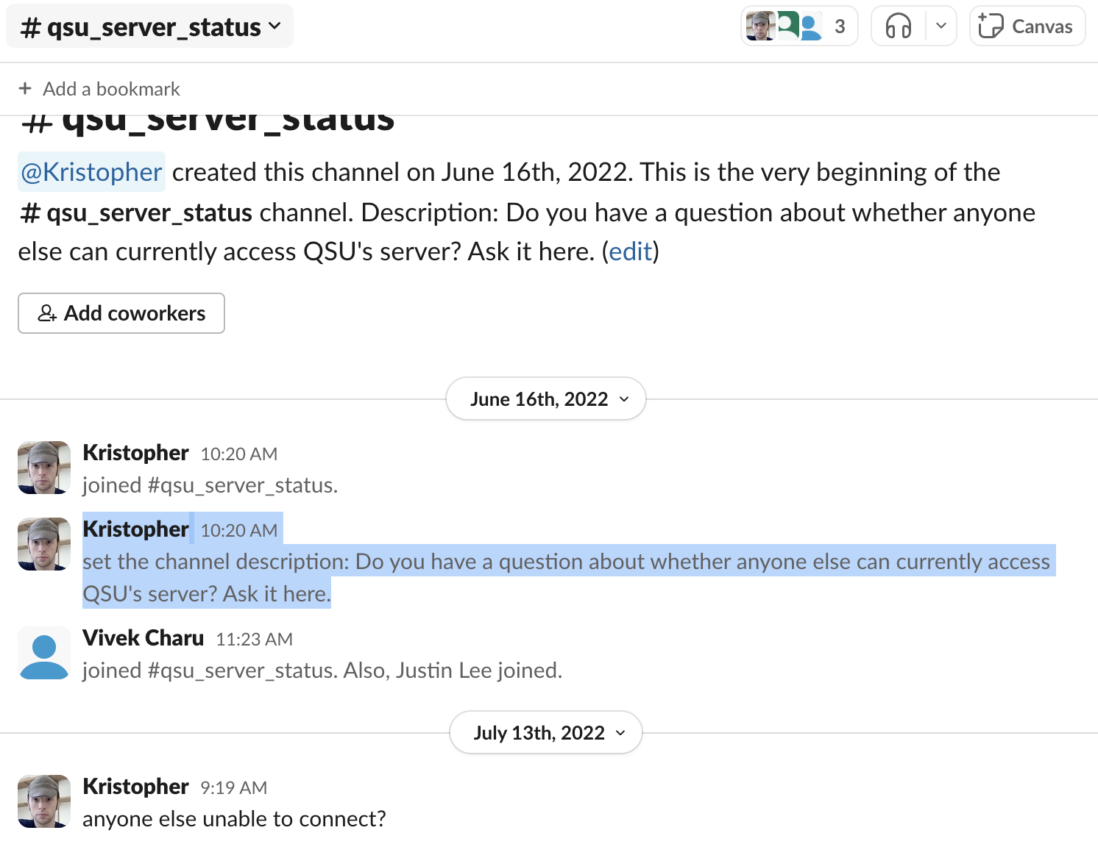
QSU server
Actual physical server that lives at SLAC and managed by Jeff Melton
Only QSU has access
No built-in version control –
Its down…a lot – maybe not so much lately, but it got to a point where Kris made Slack channel dedicated to asking if the server is down:
Sometimes files go missing. I think Jeff has solved this problem now, but he’s “solved it” before

Slide 6
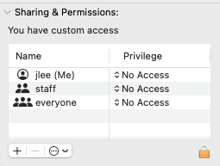
QSU server
How to log in – I think everyone already knows this, but can do a quick demo if not
Sometimes we don’t all have access to files saved on the QSU server…
Granting access to everyone (on a mac)
Go to Get Info for the file, at the bottom change Privilege to Read Only or Read & Write
Or we have to ask Jeff to do it

Slide 7
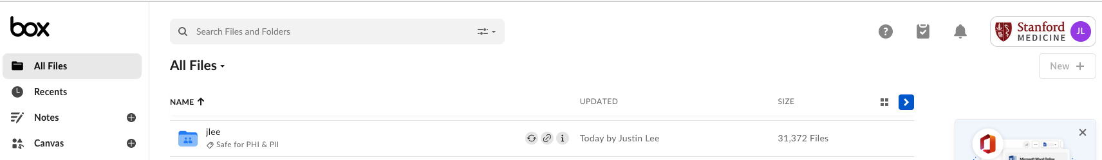
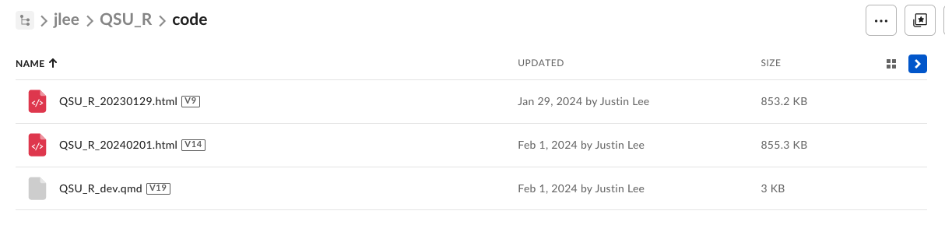
Box
Stored in the cloud
*Some folders are safe for PHI
Owners of the Box folder can grant access to anyone (within Stanford Medicine?)
Version control

Slide 8
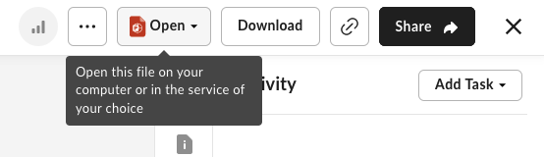
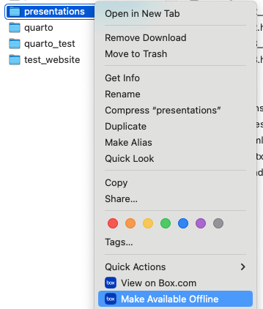
Box
Open, Edit, Save directly from Box
Download Box Drive/Sync (https://www.box.com/drive) – syncs to your computer to have easy access through Finder (mac) then when you save something back here it gets synced to the cloud but doesn’t live on your computer unless you ask it to

Slide 9
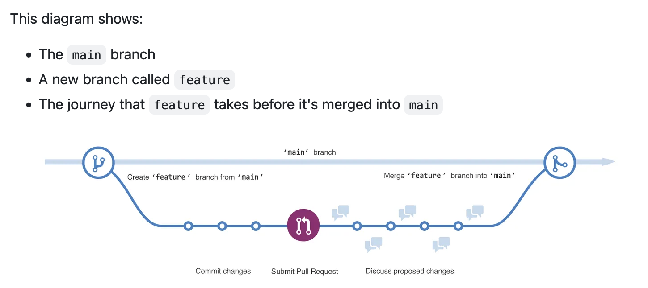
GitHub - https://github.com/justinhylee/QSU_RWorkshop
GitHub can be its own workshop all together so just covering the basics
Good version control for coding
Easily visualize what has changed between documents
Allows multiple branches in the same repository
Tutorial from GitHub: https://docs.github.com/en/get-started/start-your-journey/hello-world

Slide 10
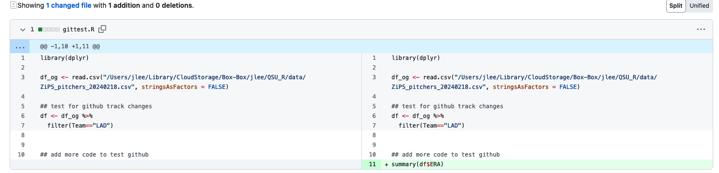
GitHub - https://github.com/justinhylee/QSU_RWorkshop
Good version control for coding
Easily visualize what has changed between documents
Tutorial from GitHub: https://docs.github.com/en/get-started/start-your-journey/hello-world

Slide 11
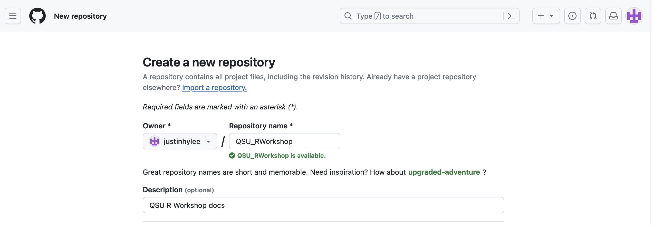
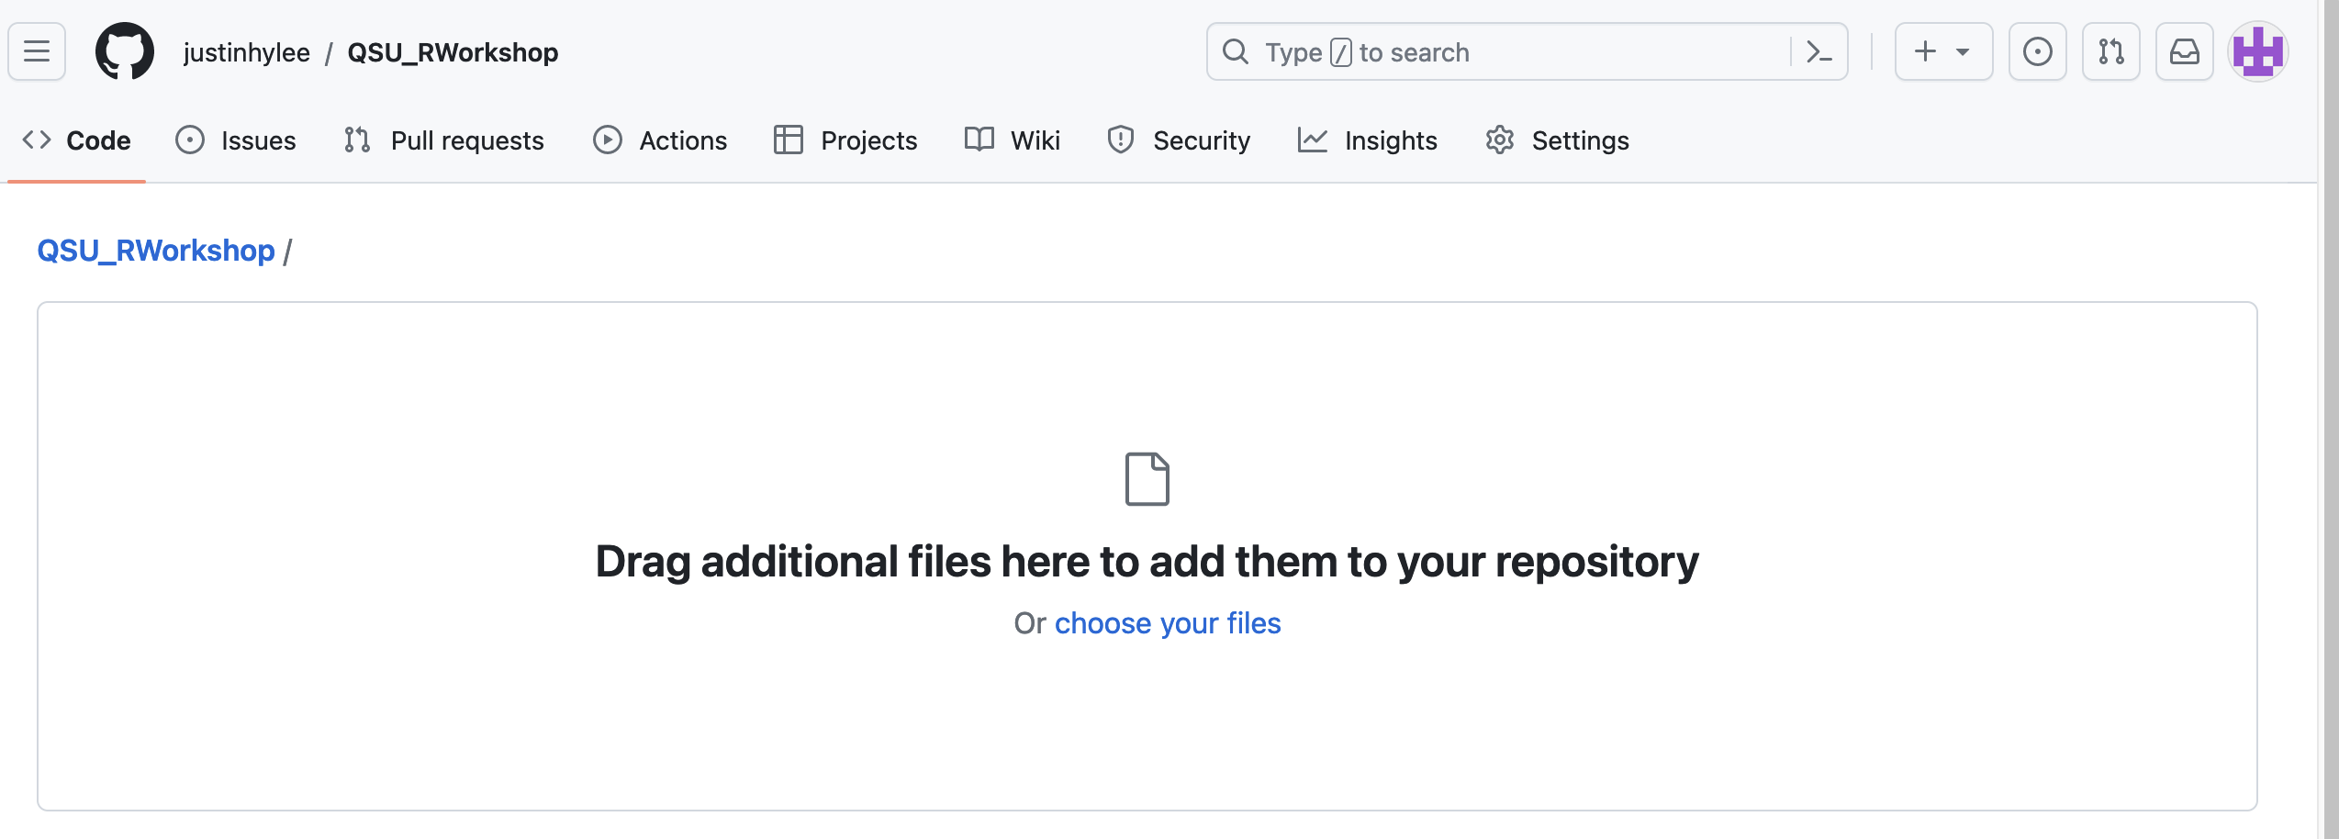
GitHub – using the GUI

Slide 12
GitHub – using the terminal
Quick intro to RStudio: we’ll get more into this in the next Session 2: Basic R – but one of my favorite things they added in the last few years is direct access to the Terminal (gitbasics.R)
Cloning repo
git clone https://github.com/justinhylee/QSU_RWorkshop
Adding files
git add .
Checking status
git status
Committing any changes
git commit -m 'jl commit test’
Push to repo
git push
Pull from repo
git pull

Slide 13
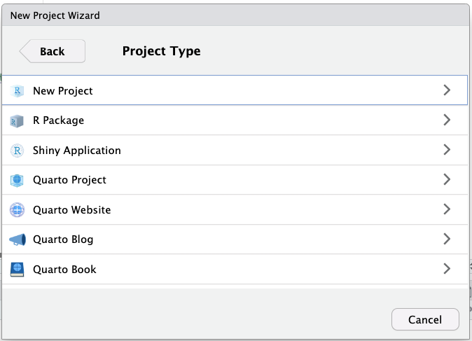
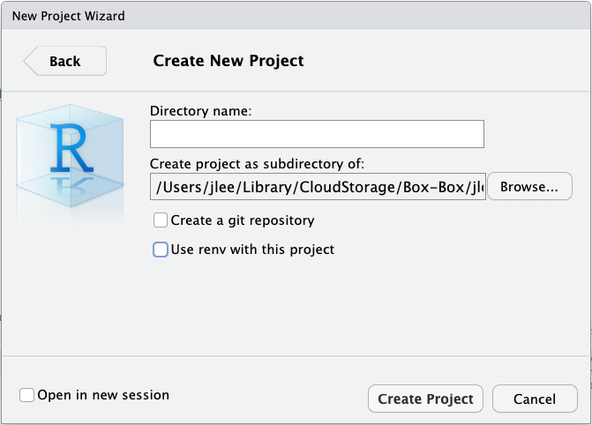
RStudio-specific good practices
Create separate RStudio projects

Slide 14
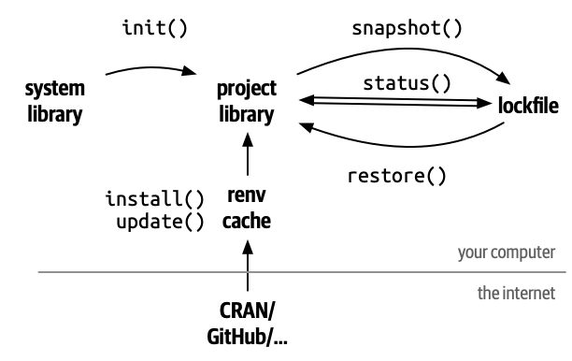
RStudio-specific good practices
The problem: if you’ve ever had to go back to a piece of R code you wrote many years ago (or look at someone else’s code) and rerun something…there’s a very good chance some of the R package versions have changed. Usually its not an issue, but sometimes everything just breaks. You can try to guess which version you were using based on when you did it but from experience you’ll never figure it out
Use “renv” (or “slushy” or “docker”) to freeze your R package versions
https://rstudio.github.io/renv/articles/renv.html

Slide 15
Tasks for next time
Create a directory wherever you want (or clone my github repo)
Install R and RStudio
https://www.r-project.org/
https://posit.co/products/open-source/rstudio/

