Slide 1

The O.C.
Navi: A Company-Wide Organizational Chart
(Justin) Hyobin You, Preston Ragonese,
Lauren Brown, Mohammed Miah, & Vincent Ding
The Intern Challenge – Summer 2017
July 19, 2017

Slide 2
Table of Contents
Section 1 Project Logistics 2
Section 2 Current System vs. New System 5
Section 3 Risk Analysis 9
Section 4 Future Deliverables 11
Section 5 Lessons Learned 13

Slide 3
Section 1
Project Logistics

Slide 4
The O.C. Team
Team Description
Name | Role | Responsibilities
Vincent Ding | Project Manager | Planning and Execution
Mohammed Miah | Business Analyst | HR Recruiting Job Board Data Access
(Justin) Hyobin You | Software Developer | GEDULD, WFP, technical design, web dev, software dev, System Testing, UAT
Lauren Brown | Business Analyst | HRi Data Access, Requirement and Scope Check
Preston Ragonese | Business Analyst | UBS Connections Data Access
SMEs
Dominic Cerchio (AO)
SteFan PremDas (AD)
Radoslaw Czyrnek (DI)
Notes:
Remove department column, replace with responsibilities
Discuss layout of team and key businesses we spoke to

Slide 5
Section 2
Current System vs. New System
Notes:
Add reasoning behind inception of idea
Stay away from neagtives → talk about positives

Slide 6
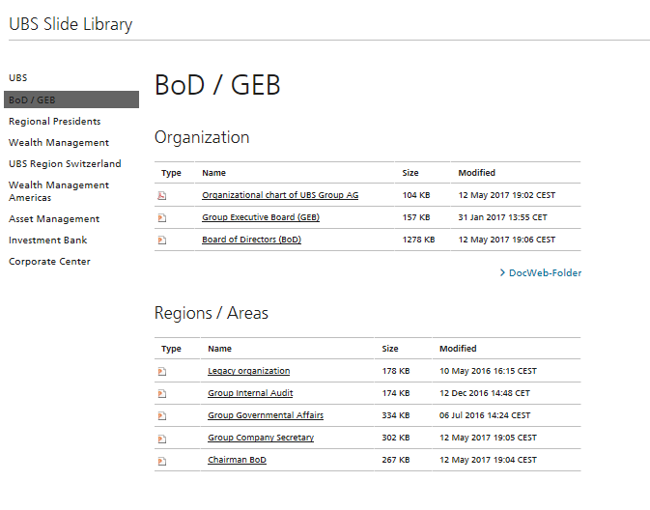
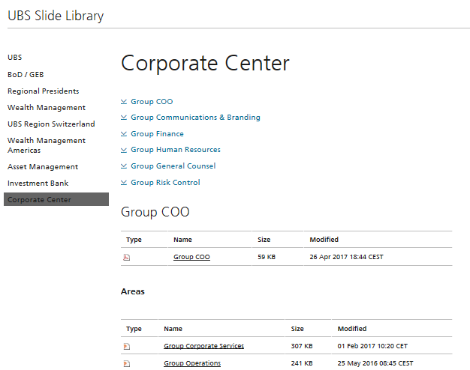
Current System
Potential Improvements:
One universal location
Easier maintenance
Interactive
Search and filter function
Detailed profile

Slide 7
Project Timeline
July 5th – July 19th
Gathering database access to HRi, Connections, WFP, GEDULD, and Job Board
Public access link, System Testing, and UAT
Inception
Data Collection
Review/Test
Product Development
Deciphering all issues present from employee feedback
Designing and creating sunburst diagram in a navigable web platform

Slide 8
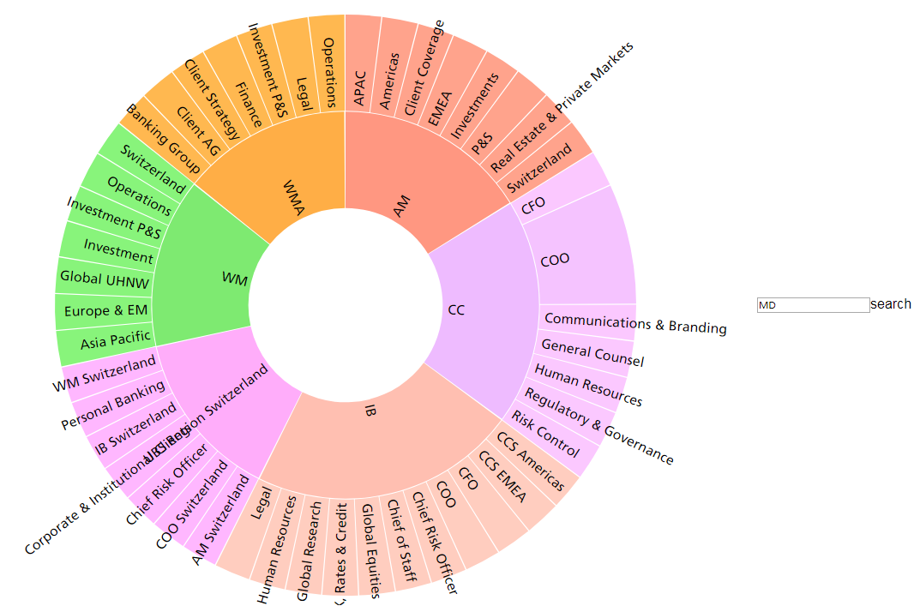
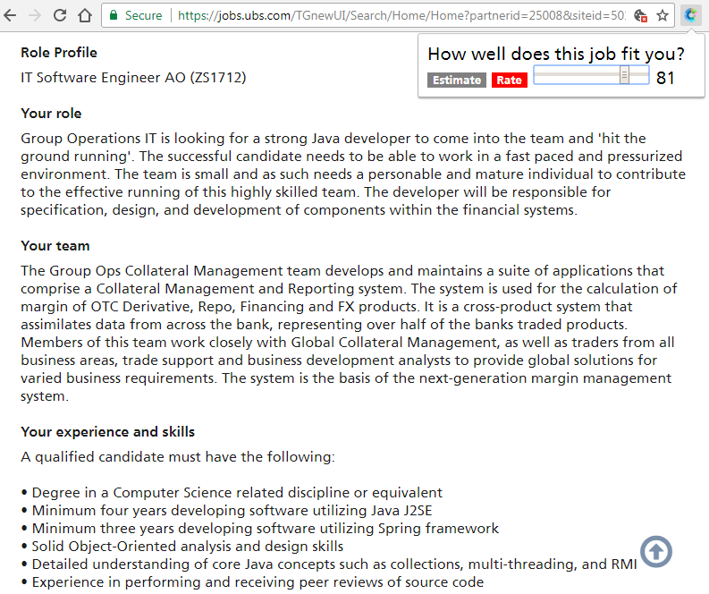
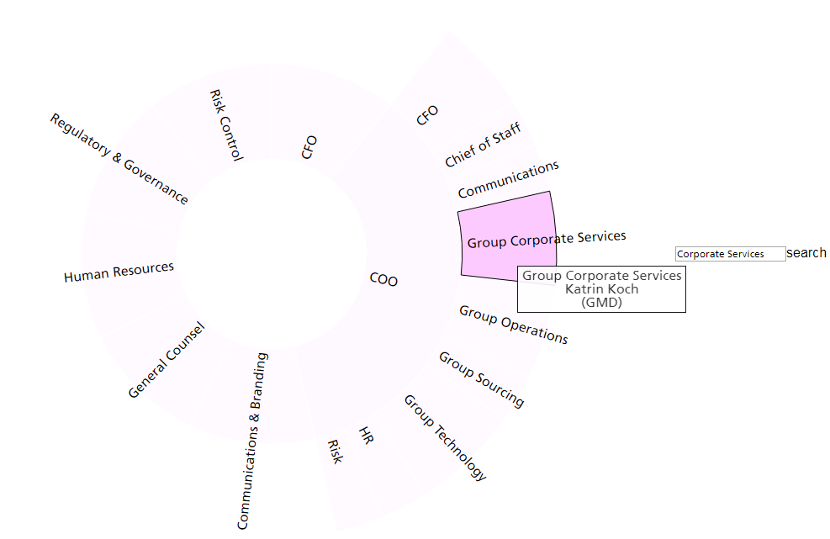
New System and Demo
Together. Interactive. Searchable.
goto/navi
Notes:
Potential to add pdf export

Slide 9
Value Added
Simplicity
Interactive, user-friendly GUI
Efficiency
Optimize resource allocation
Opportunity
Standard template for the business
Notes:
Simplicity – easy to use navigation will keep users satisfied
Efficiency – minimal resources after initial implementation, automation process opens up new opportunities for employees who are currently tasked with updating the org charts
Opportunity – standard template to consolidate information

Slide 10
Section 3
Risk Analysis

Slide 11
Risk Analysis
Risk
Data Quality
System Maintenance
Product Marketability
Mitigation
Build safeguards in script
Establish development team
Incorporate with onboarding
Erroneous data i.e. name field containing $%&!
Changes in data flow
Bad turnout from users
Field validations
Regular releases
Links on other goto sites and intranet home page
Notes:
Data quality – disconnect of data owners and product developers
System integration – integrating our product into UBS friendly environment
Product marketability – similar systems
Safeguards in script – ensure that all data being fed in has proper validations
Goto/link – standard platform in UBS, easiest for users to access
Onboarding – using current goto links and incorporate into training program

Slide 12
Section 4
Future Deliverables

Slide 13
Future Deliverables
Social
Profile with connection to LinkedIn and Skype
More personal details pulled from Jive Social (Connections)
Technical
Editing capabilities to reflect organizational changes
PDF exporting ability, replacing all current PDFs instantaneously
Professional
Mentorship and networking opportunities
Record of roles and projects within the firm

Slide 14
Section 5
Lessons Learned

Slide 15
Lessons Learned
Inception Phase
Pinpointed issues faced by the overall business
Data Collection Phase
Gained database accesses
Development Phase
Gained broad scope of departments and divisions throughout UBS
Manually retrieved updated organizational charts
Streamlined various sources across the company
HRi, Connections, HR Recruiting, Geduld, WFP
Researched and discovered tools/sources relating to the project
Notes:
Be more positive

Slide 16
Thank you.

