Slide 1

Crypto Curious Blockchain Investment Group (CCBIG)
By: Christopher Larson, Collin Holben, Camillo D’Orazio, Benjamin Cifuentes & Justin John

Slide 2









Purpose & Tools We used
The purpose is to build prototype ER20 and ERC721 tokens for an Investment Community Group.
Once the coins are created, we created a liquidity pool on Uniswap.
Tools:

Slide 3

VISIT OUR WEBSITE FOR MORE INFORMATION:
https://ccbigcrypto.com/

Slide 4
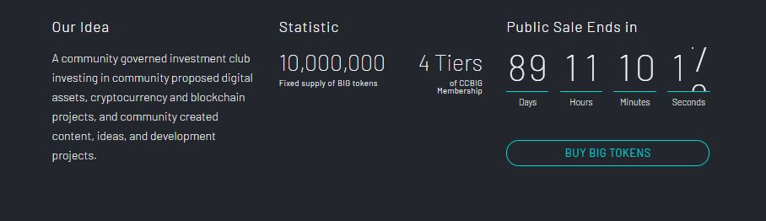
Idea

Slide 5
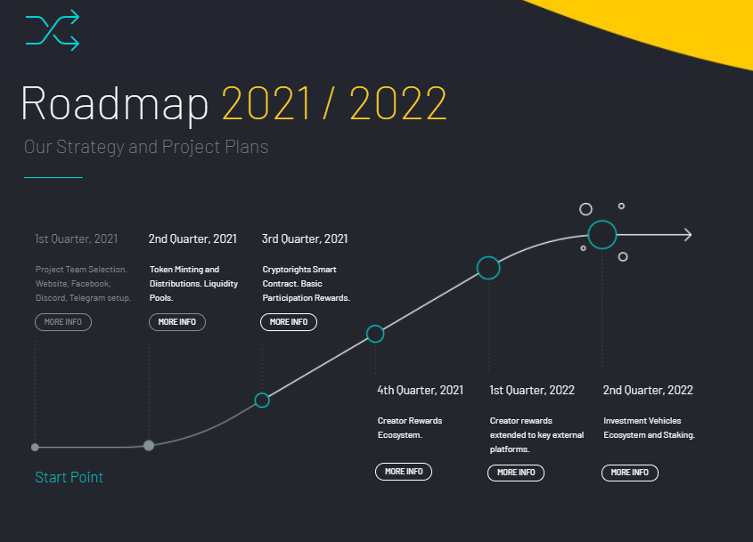
Roadmap & strategy

Slide 6
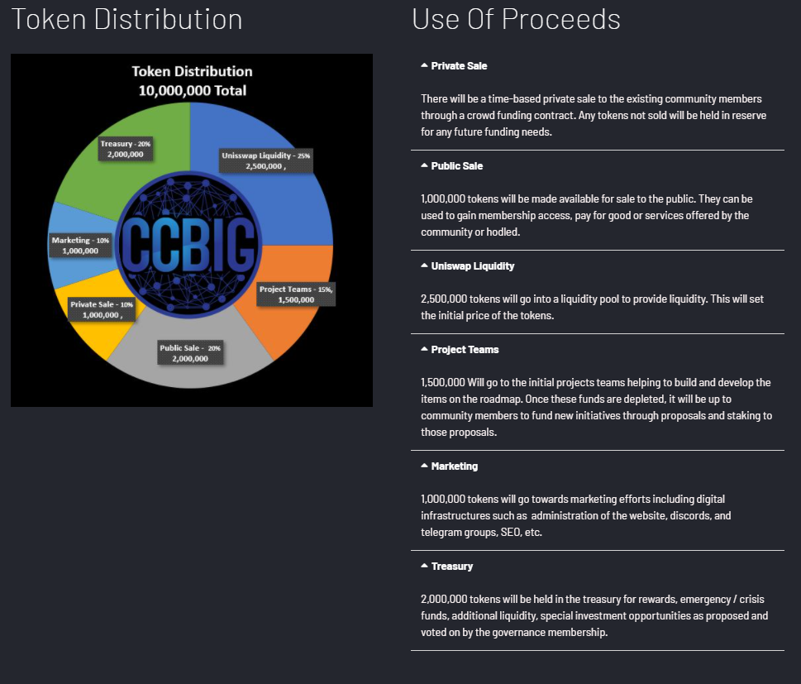
Token Distribution Method & Use of proceeds

Slide 7
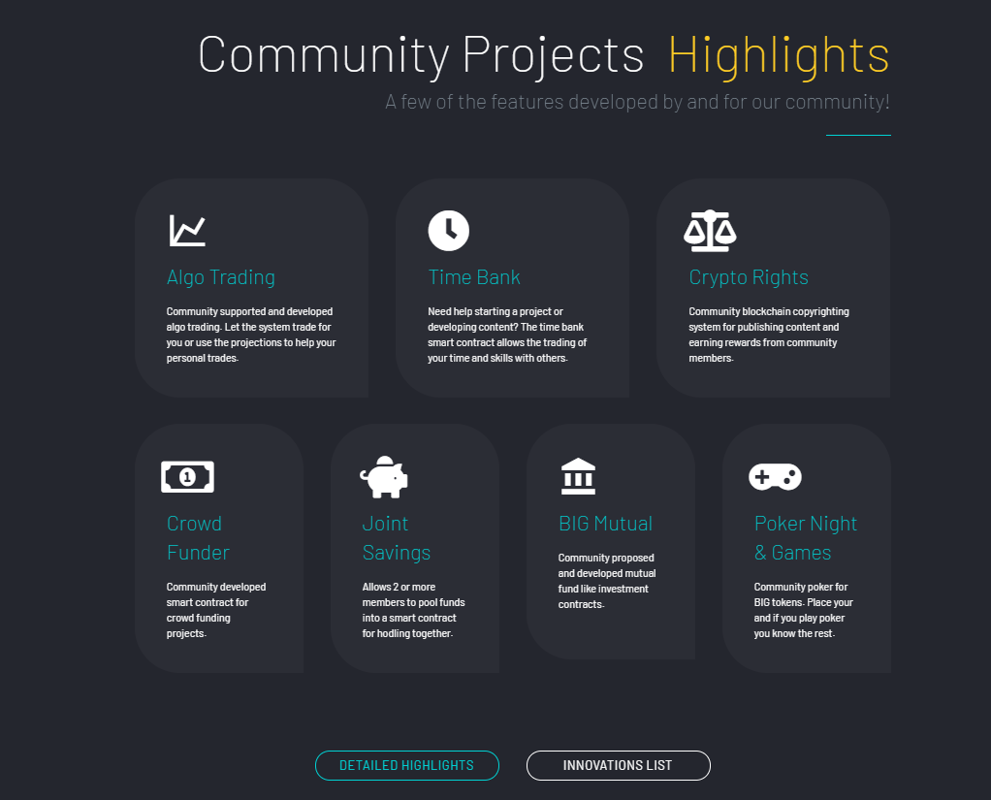
Community Highlights/features

Slide 8
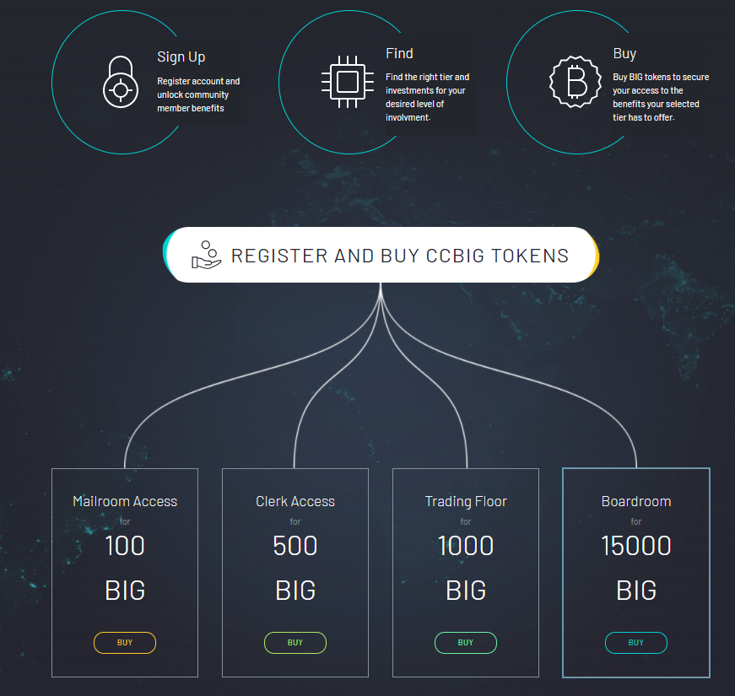
BUY OUR TOKENS!!

Slide 9

Any Questions?

