Slide 1
South Wales Meetup Group
Data Analysis using Power BI for Beginners
©datavibe

Slide 2
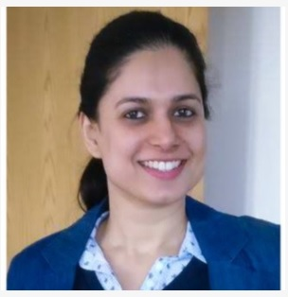






Pragati Jain
Microsoft Data Platform MVP
Superuser at Microsoft Power BI Community
10+ years of industry experience
Total 5 years experience as a database developer
Senior Data Analyst at Trustpilot, London
Fun Fact About Me:
I am a painter and proudly call myself ‘TechieArtist’ 😊
©datavibe

Slide 3
One Slide All Demo Session
Overview of Microsoft Power BI Desktop Tool – 10 minutes
Page options, available themes, page settings
Different type of filters
Multiple data source connectors
Report, Data and Model view
Basic visual charts
Visual interactions
Power Query quick overview
Analysis of Travel Insurance Data – 30 minutes
Load travel insurance data to Power BI
View data in Power Query
Analyse data by generating basic visual charts
Identify Top 5 key insights in the data
Demonstrate full report in the end – 5 minutes
To show additional capabilities that can be added to a Power BI report to make it more interactive
Q&A Session – 5 minutes
©datavibe

Slide 4
Power BI Resources
https://docs.microsoft.com/en-us/power-bi/
https://community.powerbi.com/
https://community.powerbi.com/t5/Community-Blog/bg-p/community_blog
https://www.sqlbi.com/topics/power-bi/#
https://www.udemy.com/course/power-query-m-language-programming-part-1/
https://exceleratorbi.com.au/
The Definitive Guide to DAX by Marco Russo & Alberto Ferrari
https://radacad.com/
https://www.youtube.com/channel/UCFp1vaKzpfvoGai0vE5VJ0w
https://www.tutorialspoint.com/power_bi/dax_basics_in_power_bi.htm
©datavibe

Slide 5
Datasets Used
Travel Insurance Data: https://www.kaggle.com/mhdzahier/travel-insurance
Plane Accidents Data: https://www.airfleets.net/crash/stat_country.htm
©datavibe

Slide 6

THANK YOU
©datavibe

