Slide 1
PETROL PRICE FORECASTING

Slide 2
OBJECTIVE
The objective of this project is to perform the price trend forecast of petrol for time series.
INTODUCTION
Using machine/deep learning we forecast the price of petrol based on time series. With help neural network algorithm we predict the price of petrol for future. Data which used in model is collected from the source provide by ineuron.
Data Description:
The data set consist of price of petrol with corresponding week. Dimension of this dataset is 2*814.

Slide 3
PROCESS METHODOLOGY:
Start
Data import
Data processing
Model building
End
Streamlit
Output

Slide 4
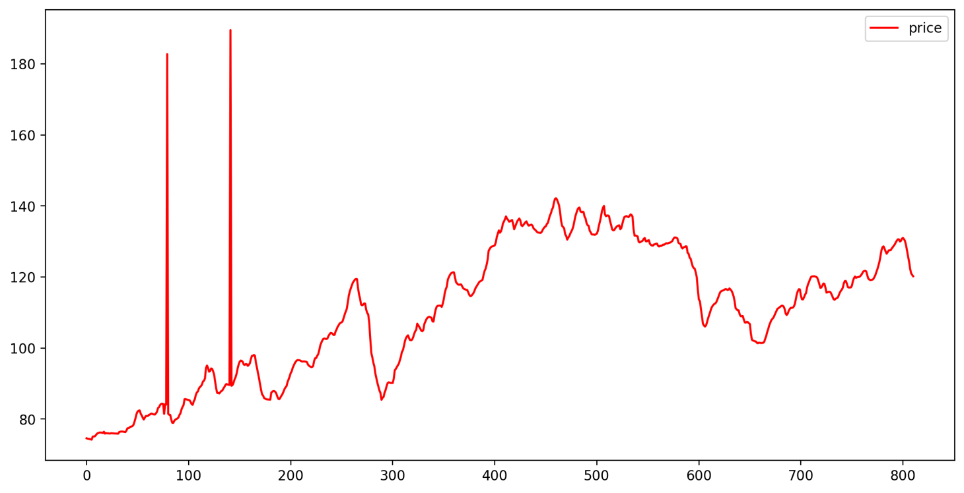
Petrol Price vs Time Series

Slide 5
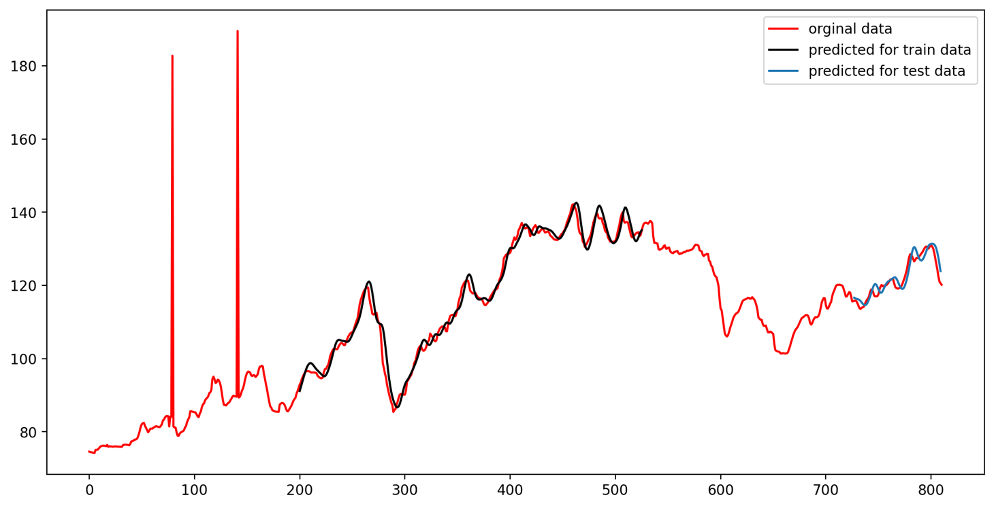
Petrol Price Baseline and Predictions

Slide 6
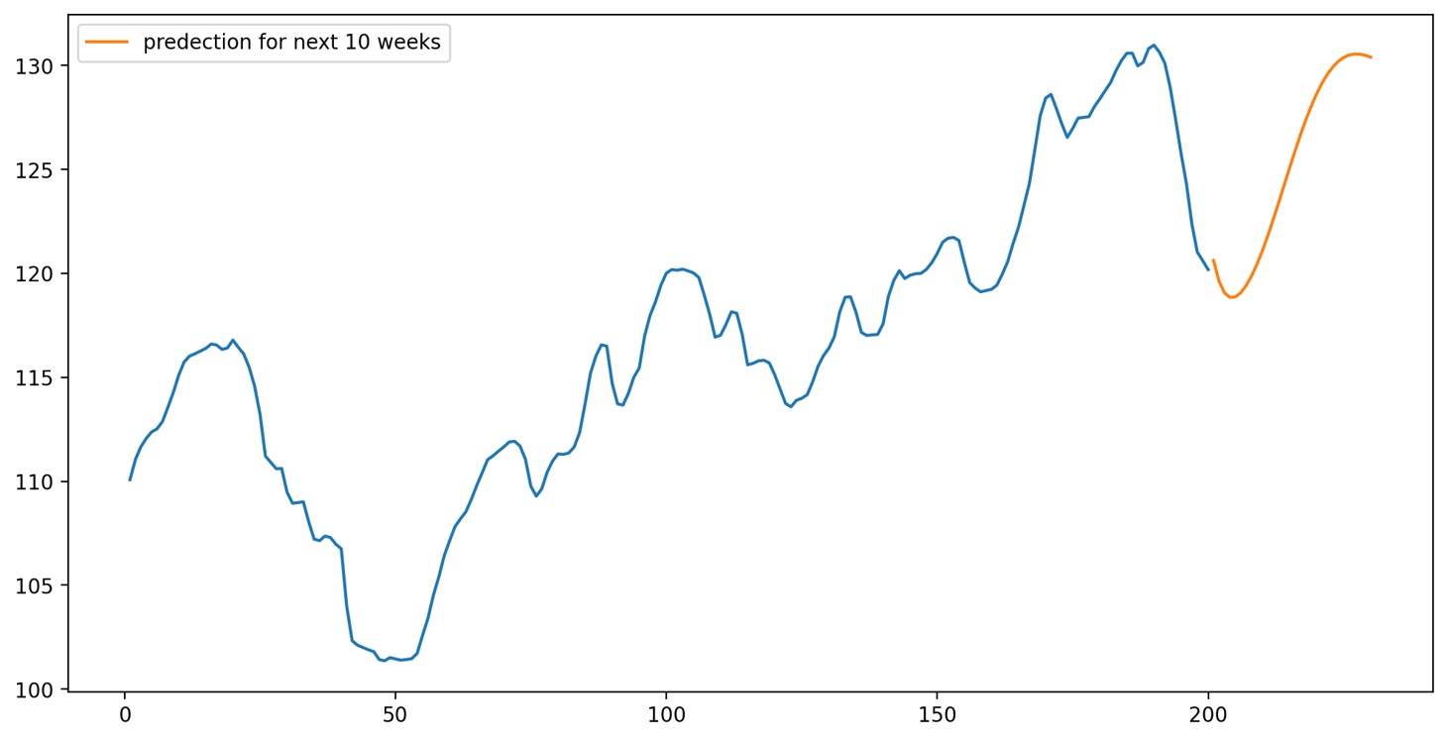
Petrol Price Trend Prediction For Next 10 Weeks

Slide 7
CONCLUSION
Using the deep learning model , we predict that price trend of petrol increases for next 10 weeks.

