Slide 1

EEOGs CS 491-591: Brain-Computer Interface Elliott Miller | Logan Skinner | Justin Lukas

Slide 2

Itinerary
Introduction
Previous Work
Our Approach
System Design
Challenges
Future Work
Demo

Slide 3
Introduction
Problem: Dangers of operating motor vehicles while drowsy
Goal: Stimulate brain activity to combat drowsiness
Importance: 72,000 accidents per year that are the result of drowsy driving including up to 6,000 fatalities

Slide 4
PREVIOUS WORKS

Slide 5
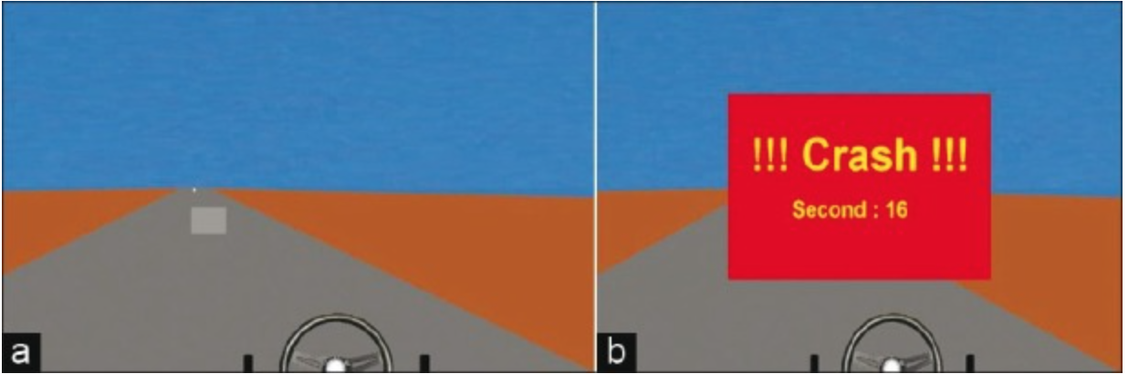
EEG-based Drowsiness Detection for Safe Driving Using Chaotic Features and Statistical Tests
Mardi, Z., Ashtiani, S. N. M., & Mikaili, M. (2011)
Notes:
distinguish the significance level of difference between the alertness and drowsiness.
removed stress by creating virtual driving environment that does not have real consequences for crashing

Slide 6
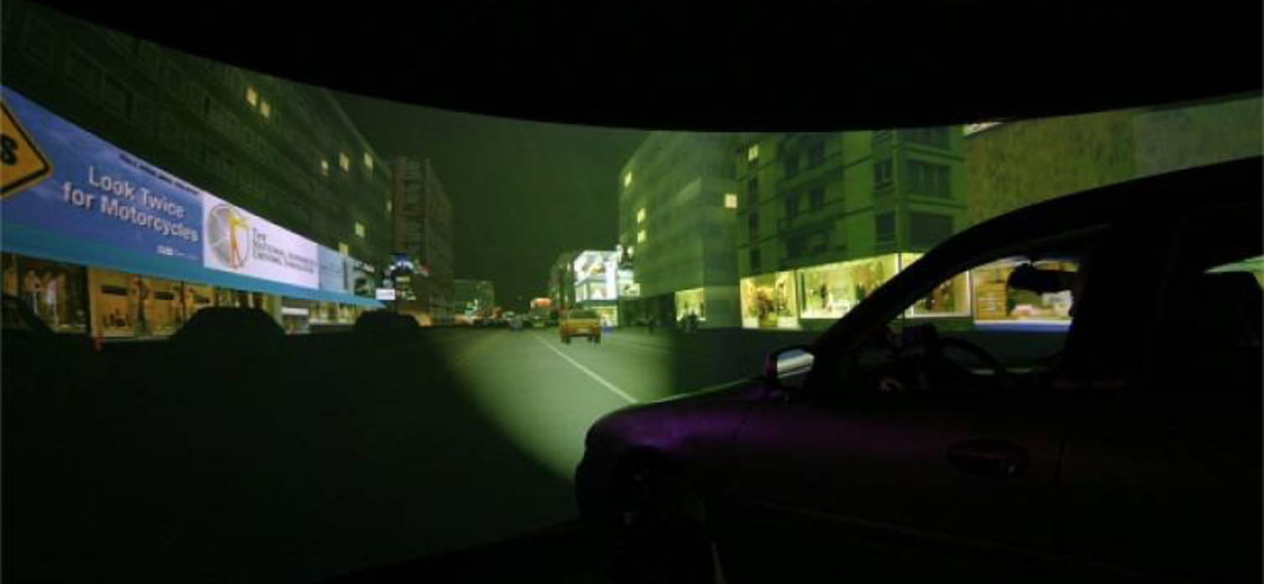
Identifying Periods of Drowsy Driving Using EEG
Brown, T., Johnson, R., & Milavetz, G. (2013)
Notes:
The overall purpose of this line of research was to investigate ways to identify degraded driving performance associated with drowsy driving within an overall program to identify driver inattention and impairment.

Slide 7
OUR APPROACH

Slide 8
Neurophysiological Features
Enhance?
Passive
EEG
Theta 4 – 8 Hz → Drowsiness
Beta 14 – 30 Hz → Highly alert / focused
FP1, FP2, A1, and A2 on the 10-20 InternationalSystem

Slide 9
Feedback and Goals
Trivia questions
Beeps
Other stimulants (future)
Show how feedback can trigger heightened alertness

Slide 10
SYSTEM DESIGN

Slide 11
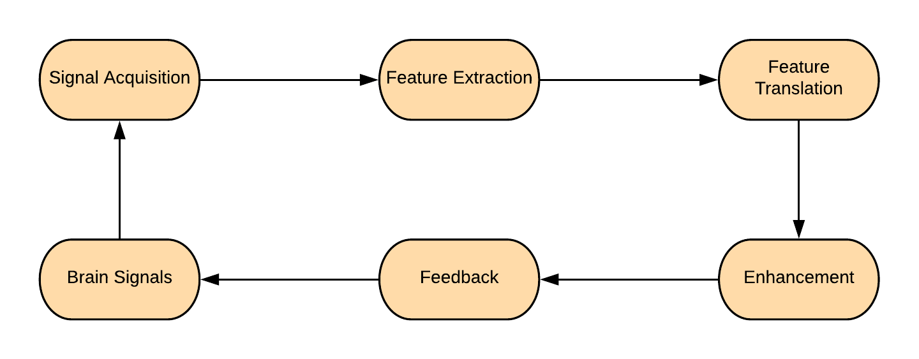
BCI Cycle

Slide 12
Tools Used
Android Studio
Node.js
OpenBCI Ganglion Board and Software
Android Studio
Firebase
Google Sheets

Slide 13
Challenges
Connectivity Issues
Hardware limitations
Time constraints

Slide 14
Future Work
Weight system for stimulations / triggers
Research into tailored responses
Less bulky connections
Outside applications

