Slide 1
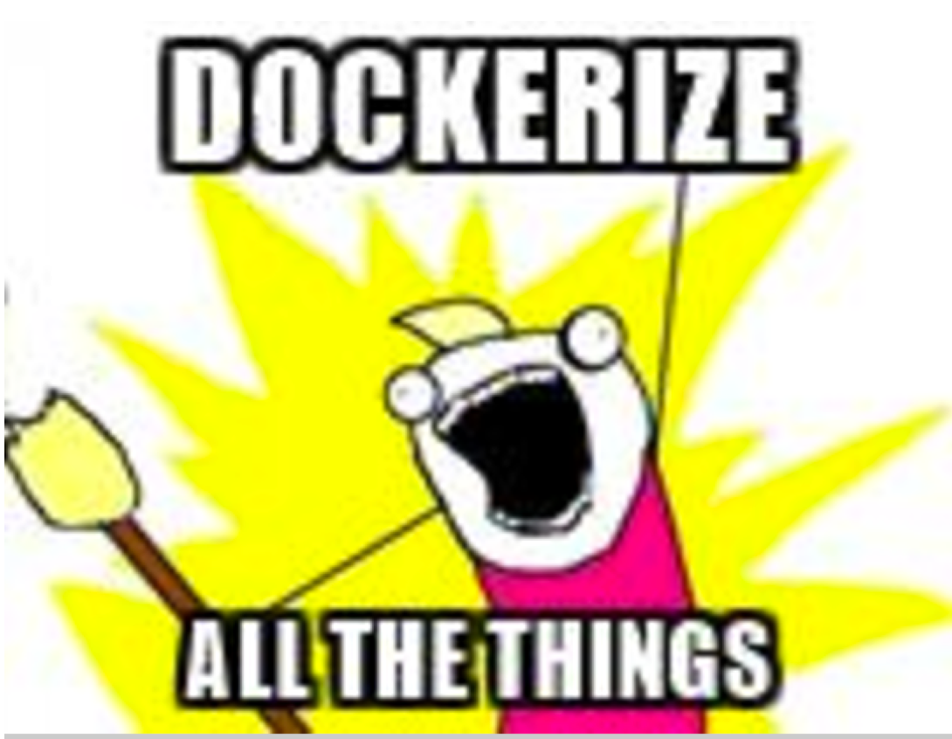
Speaker: Justin Montgomery
LinkedIn: jmontgomeryinit
Github: justinjohn83
Twitter: justinjohn83
Email: jmontgomery@gamesalutes.com

Slide 2


What is Docker?
Software Container Platform
Run applications inside of containers instead of web application servers
Wait…I have VMs why do I need Docker?
VMs are heavier weight in both storage and runtime resources
Docker containers only contain libraries and code resources needed to run stuff
System calls are performed directly by the host OS kernel so there is virtual no CPU and memory access overhead
Do I have to use Microservices too?
No, Docker is an infrastructure architecture pattern and Microservices are a software architecture pattern. They are independent.

Slide 3
Why do we need it?
Helps eliminate the “Works on my Machine” problem
Standard versions of libraries, code, and settings across environments
Share the same OS kernel
Easier to manage deployment of new code
Isolate apps from each other
Works on major Linux Distros, Mac OSX, Windows

Slide 4
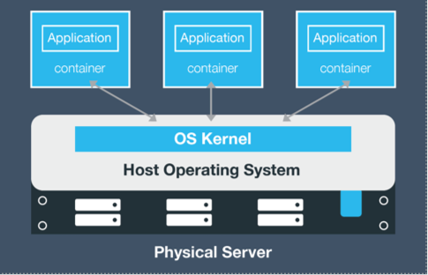
What is a Container?
A Docker container wraps up a piece of software in a complete filesystem that contains everything it needs to run: code, runtime, system tools, system libraries – anything you can install on a server. ​
​
By encapsulating and isolating everything in a container, this guarantees that the container will always run the same, regardless of the environment it is running in.​

Slide 5
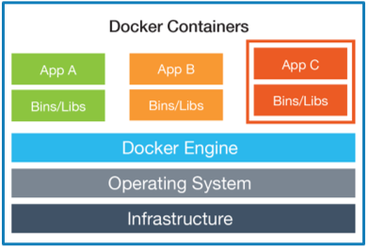
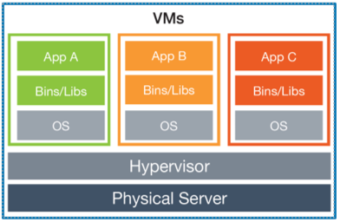
Containers vs. VMs
Docker containers share the OS kernel on the host, while with virtualization each VM has a full copy of an OS inside the VM.​
These two models are NOT mutually exclusive. Containers run anywhere a Docker Engine is installed, i.e on bare metal, in VMs (vSphere, Hyper-V) and clouds (AWS, Azure, Google and more). ​ ​
Docker containers are portable from any environment to the another without having to recode the application.​

Slide 6
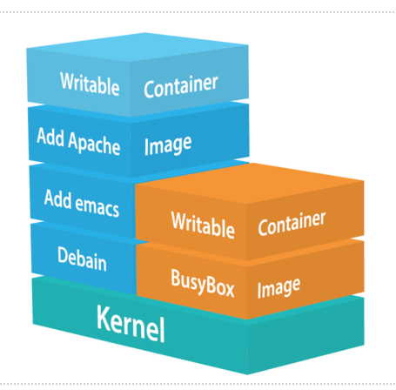
Docker Images
Layered
Each image has a “base image” that defines first layer
Built using dockerfile
Each command in docker file creates a new layer
Each layer is its own intermediate unique image
Images are immutable
Images created with “docker build” command
Containers are the running instances of images
Created with “docker run” command
Containers can have mutable state

Slide 7


How can we use it?
Install Docker
Visit Docker Hub to search for base images of favorite stack
Steps to Dockerizing
Get your code working first!
Have an automated build process
Identify dependent tools (Java, node.js, .NET core, Selenium, Nginx, Ruby, Python, etc)
These typically act as your base images or you can start with an OS image (such as CentOS) or you can start with a blank “scratch” image
Work on automating your tool set up process with scripts

Slide 8
How can we use it?
Create your Dockerfile
Test building your Dockerfile
Test your running container
Use “docker exec –i –t <container> sh to inspect running container
Use “docker run –i –t –entrypoint /bin/sh <imageHash> to inspect failed docker builds or failed start ups
Publish your containers to a registry
Jfrog Artifactory
Docker Trusted Registry (DTR)

Slide 9
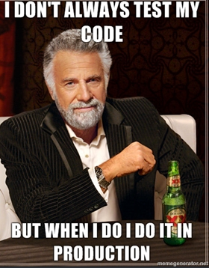
Productionize
Choose a Container platform
Docker Data Center (Docker’s solution)
Openshift Origins (based on Kubernetes)
Mantl (Might be a dead project)
Service Discovery & Networking
Rely on your container platform solution (built into Docker Data Center)
Have a solid versioning strategy

Slide 10
Demo and Code Walkthrough
https://github.com/justinjohn83/DockerizeAllTheThings

