Slide 1
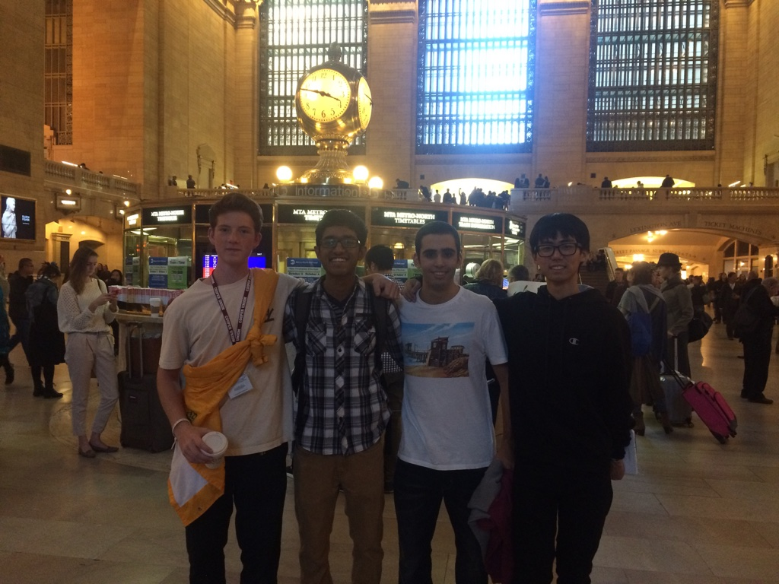
Traveler
EID101D: Smart Connected Device
Nikola
Varouzan
Justin
Dongkyu

Slide 2
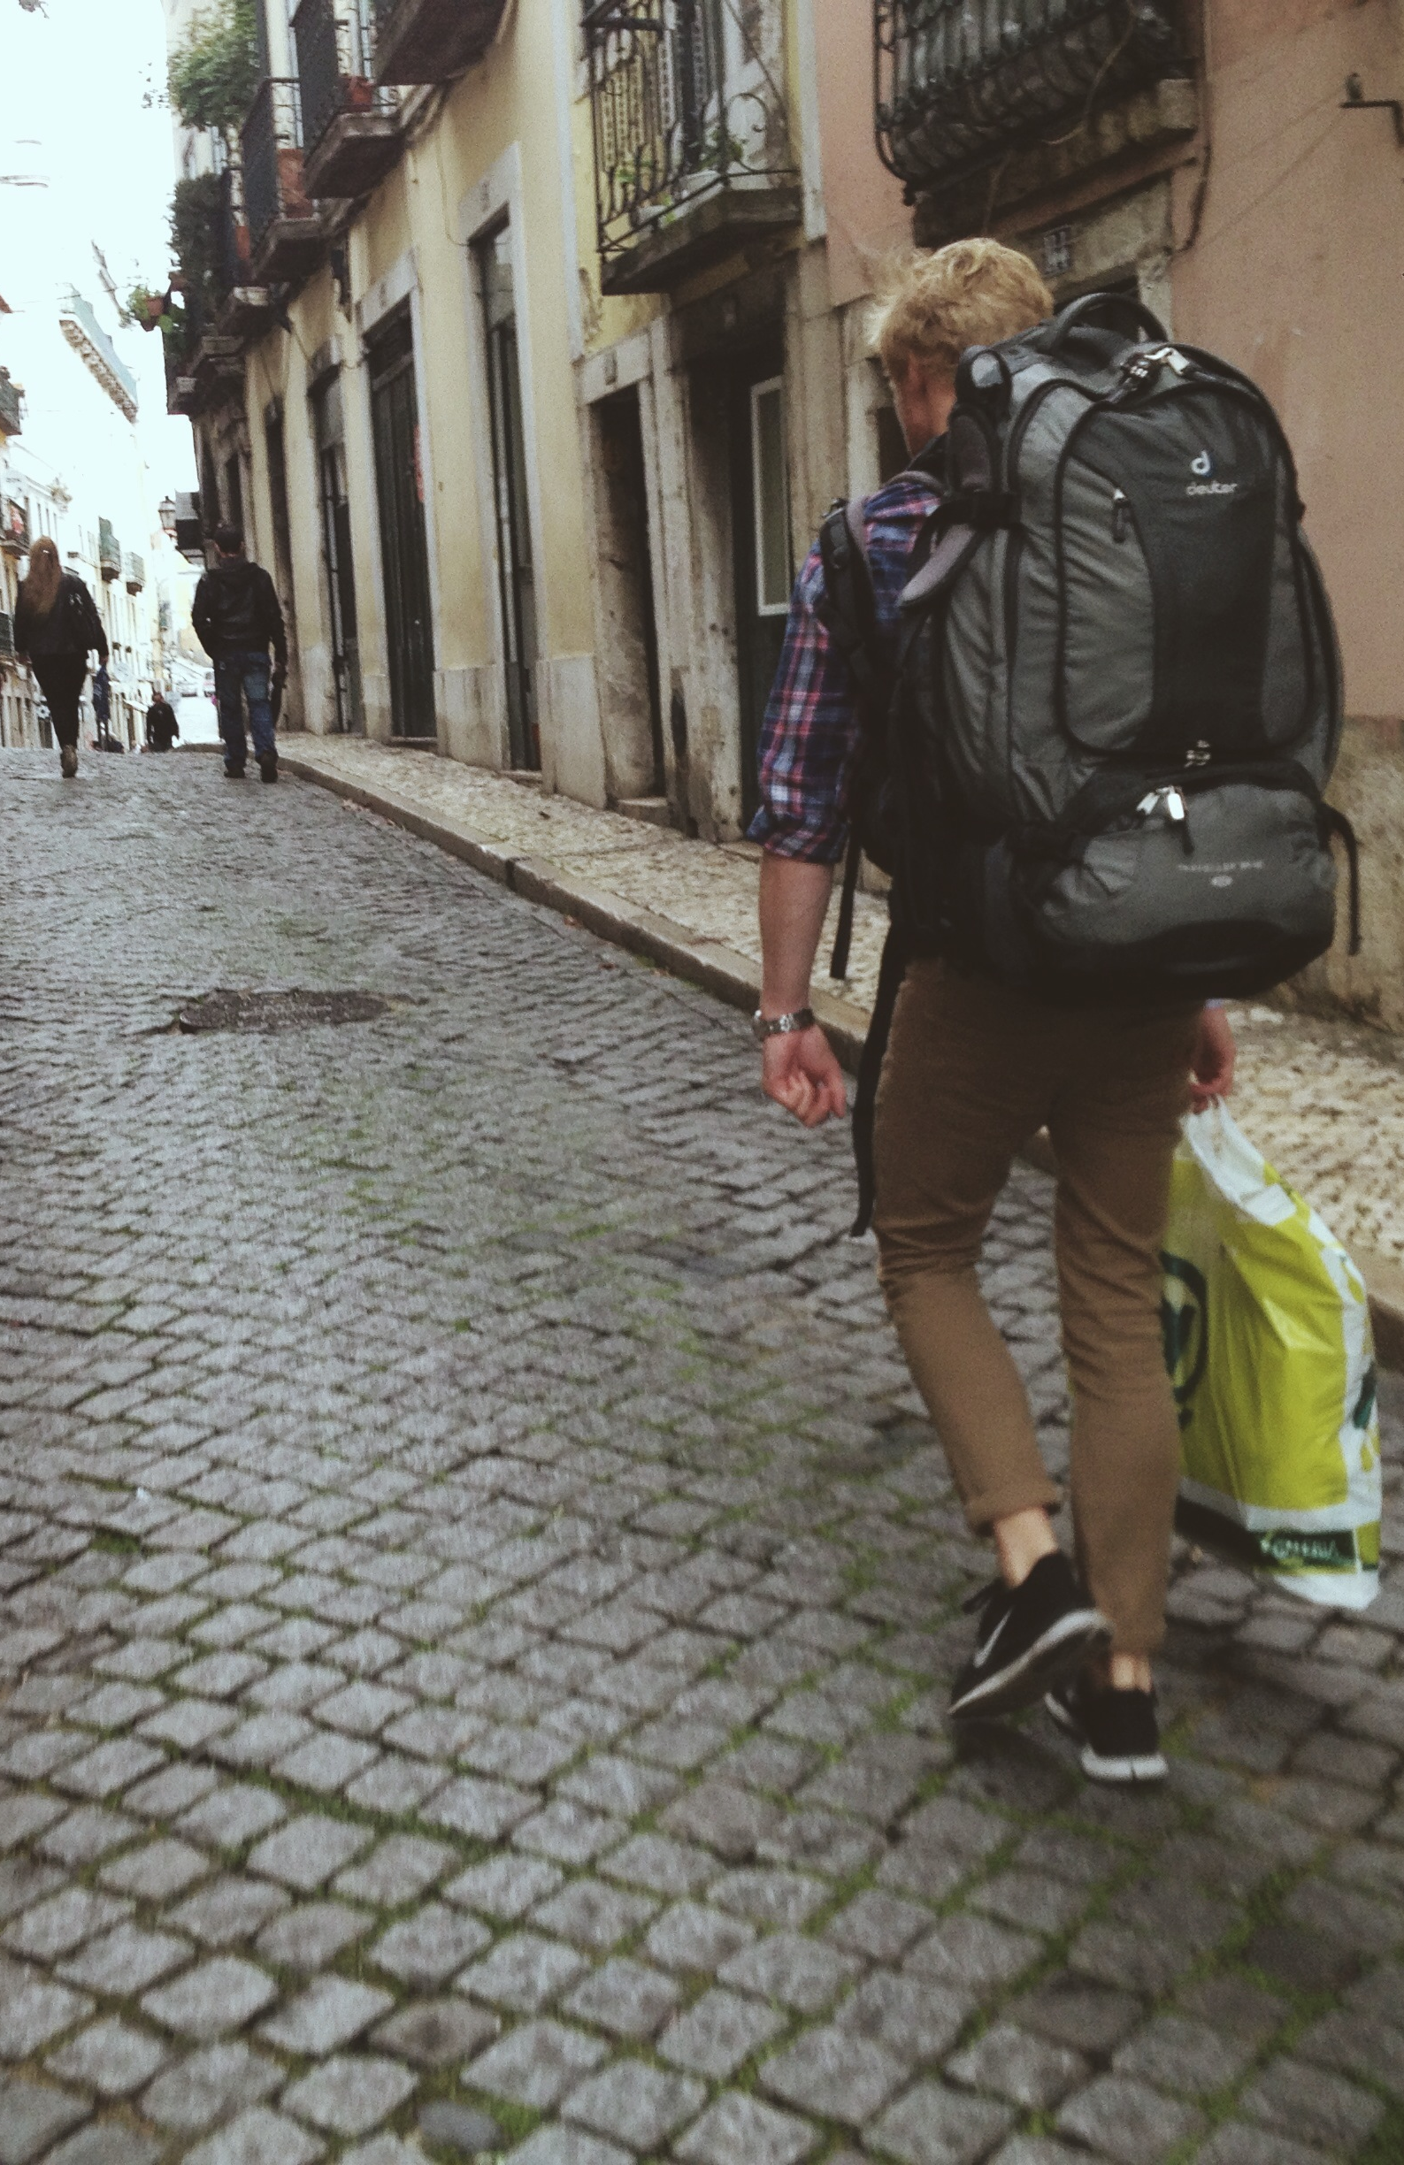
Customer Segment
18-30yr Old Backpackers

Slide 3
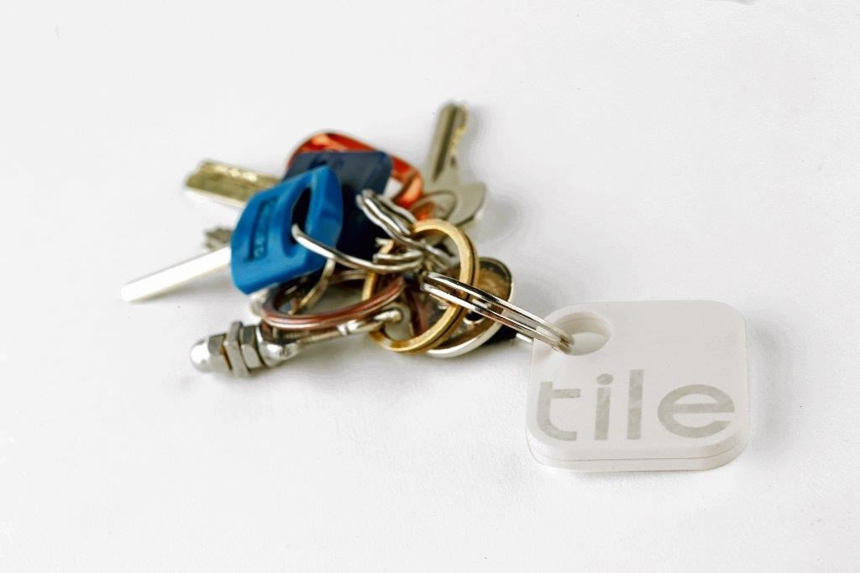
Initial Value Proposition

Slide 4
1st Interviews

Slide 5
1st Interviews

Slide 6
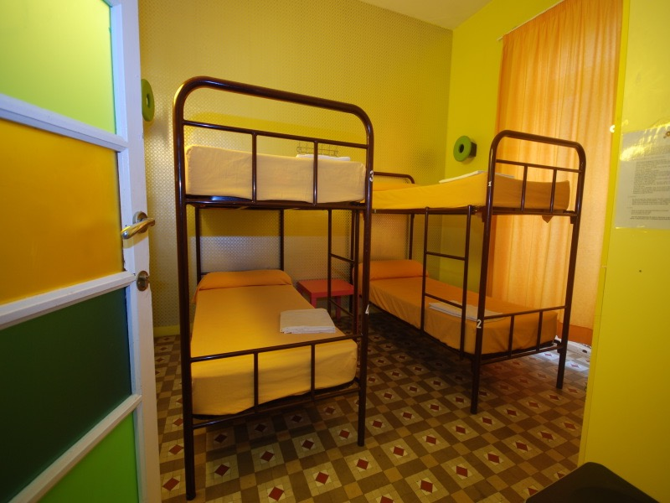
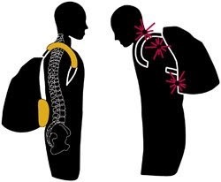
Possibilities

Slide 7
2nd Interviews

Slide 8
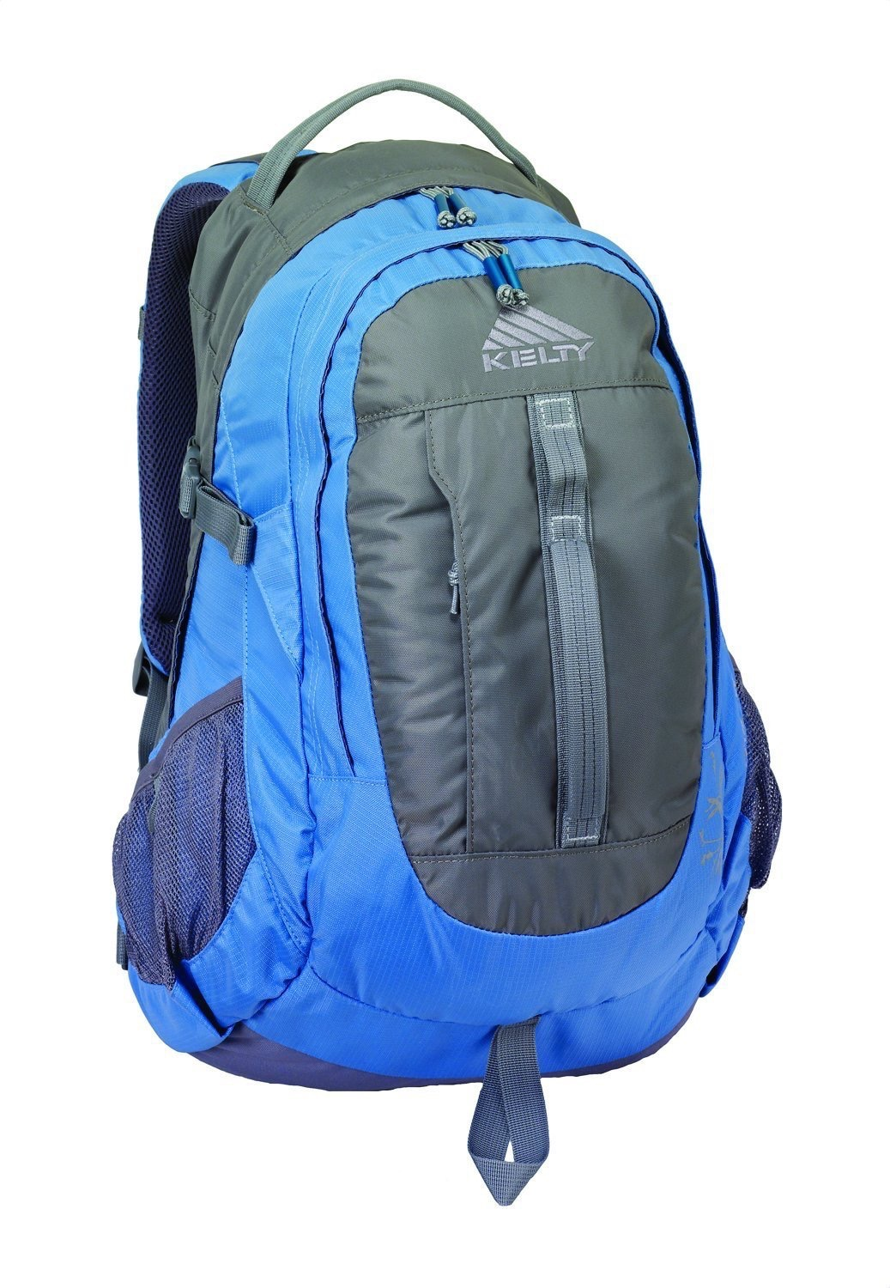
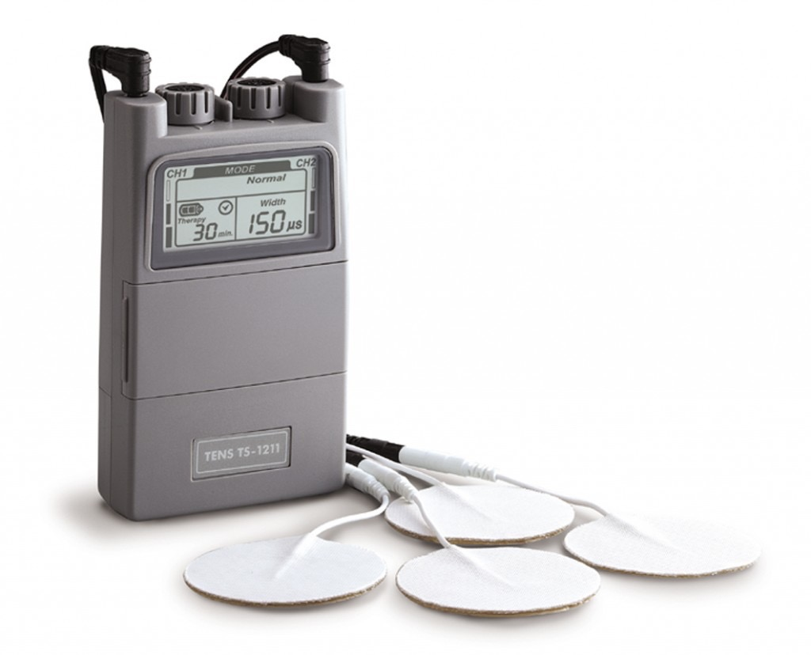
Current Value Proposition
+

