Slide 1
Node.js&Koa Share
2016/12
Justin

Slide 2
Build a Web application
Front-end
HTML: The content of webpage
CSS: The appearance of webpage
JavaScript: The functionality of webpage
Back-end
Node.js: A platform Built on JavaScript
Express: Web framework for Node.js
Koa: Next generation web framework for Node.js

Slide 3
Node.js: A JavaScript runtime
What
Build on JavaScript
Event loop and Asynchronous I/O (demo 1)
Why
Lightweight and Efficient
Designed for DIRTy (data-intensive real-time) application
How
Demo 2
Problem
Callback hell (demo 3)

Slide 4
Connect: A middleware layer
Middleware
Middleware functions are functions that have access to the request object (req), the response object and the next middleware function in the application’s request-response cycle.
Demo 4
How
Demo5

Slide 5
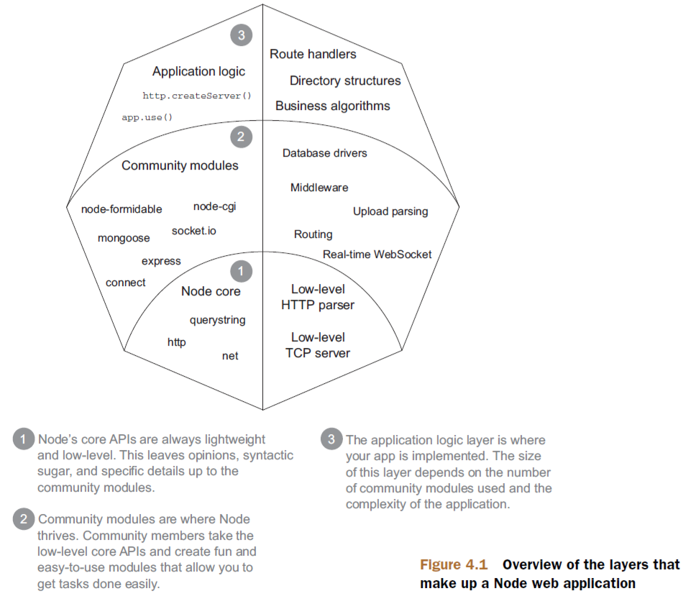
Express: Web framework
More powerful
All api of Connect
Routing
Templating
Sending Files
…
Advantages
Most popular
Most stable
Most documents

Slide 6
Co
Generator
Generators are functions which can be exited and later re-entered
Demo 6
Co
Generator based flow-control goodness
Demo 7
Generator => Co => Koa

Slide 7
Koa: Next generation web framework
What
Expressive middleware for node.js (demo 8)
Yields "downstream", then control flows back "upstream“ (?)
Why
No callback hell (thanks to co)
Better error handling through try/catch (demo 9)
How
Build a simple ‘Koa’ (demo 10)

Slide 8
Koa vs Express
Koa aims to "fix and replace node", whereas Express "augments node".
Differences
Generator-based control flow
Koa is barebones
Koa abstracts node's request/response
Features | Koa | Express | Connect
Middleware Kernel | ✓ | ✓ | ✓
Routing |  | ✓
Templating |  | ✓
Sending Files |  | ✓
JSONP |  | ✓

Slide 9
Thank You!

