Slide 1

Justin Kamerman
Machine Learning Evaluation Methods Beyond Accuracy

Slide 2
Why Measure ?
Relatively new field. Low hanging fruit has been picked
Comprehensibility
Empirical Science
Searching the hypothesis space
Advancing the state of the art
Convincing others

Slide 3
What's Right With Accuracy ?
Simple and intuitive
Most widely used measure in machine learning
Proportion of examples that were correctly classified
Robust measure of overall performance
Insensitive to performance on a specific class

Slide 4
What's Wrong With Accuracy ?
Does not distinguish between the types of errors made
Acceptable if class distribution is balanced
Acceptable if misclassification costs are balanced
In real world, previous two points generally don't apply

Slide 5
The Confusion Matrix
Actual vs Predicted
Captures raw performance data
Invariance analysis of composite metrics
T_{p} | F_{p}
F_{n} | T_{n}

Slide 6
Scalar Performance Measures
Single value
Easy to compare – hill climbing, pruning
Represent a single operating point
Various composite measures used, depending on application

Slide 7
Precision and Recall
Precision
Proportion of predicted positives examples that were actually positive
Recall
Proportion of positive examples that were correctly identified

Slide 8
Precision and Recall
Focus on one particular class
Invariant to changes in T_{n} i.e. do not recognise the specificity of a classifier
Suitable for applications with weak negative class
Used in text classification, information extraction, and natural language processing
F-score: harmonic mean of precision and recall

Slide 9
Sensitivity and Specificity
Sensitivity = Recall
Proportion of positive examples that were correctly identified
Specificity
Proportion of negative examples that were correctly identified

Slide 10
Sensitivity and Specificity
Estimate performance classifying positive and negative examples respectively
Employed in medical and biomedical applications and studies involving visual data
Youden's Index: evaluates ability to avoid failure, weighting both classes equally
Likelihood: combines into two measures
Discriminant Power: summarizes both; used for feature selection

Slide 11
Non Scalar Measures
Misclassification costs and class skew define a classifier operating point
Non scalar measures consider a range of operating points
Misclassification costs related to class distribution
Direct comparisons not easy, however, given operating point, more likely to pick best classifier for the job

Slide 12
ROC Curves
Used by radar engineers during WWII
Plots sensitivity vs (1 – specificity) for binary classifier as decision threshold is varied
Invariant with respect to operating conditions
If operating conditions change, curve does not, only the point of interest
Good for domains with skewed class distributions and unequal misclassification costs

Slide 13
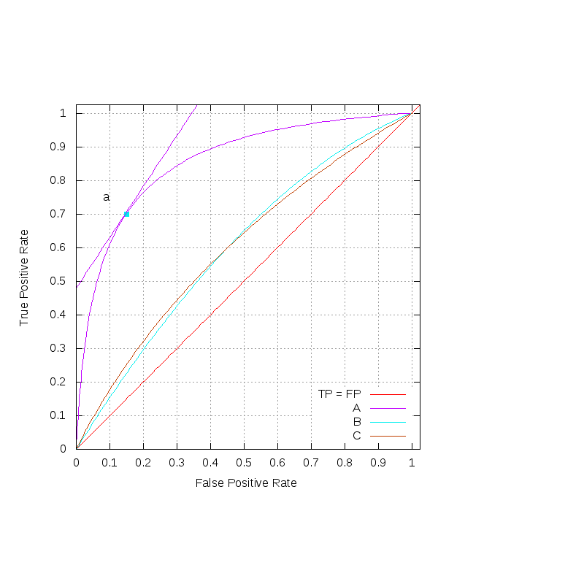
ROC Curves

Slide 14
ROC: Comparing Classifiers
ROC curves can be overlaid for comparison.
Northwest points are better
Dominant classifiers better for all operating conditions
Probability scores are not calibrated, should not be compared across models or decision thresholds

Slide 15
ROC: Iso-performance Lines
[Provost & Fawcett 1989]
A particular operating point translates to the gradient of a family of iso-performance lines
Points on each line have same expected cost
Lines with higher TP intercept have lower expected cost
Example: class distribution 3/2, equal miscalssification cost

Slide 16
ROC: Convex Hull
[Provost & Fawcett 1989]
Convex hull of a set of points – potentially optimal classifiers
Intuitively, marks the nothwest boundary
Points not on convex hull are not optimal for any operating condition
Maximal iso-performance lines are tangent to convex hull

Slide 17
ROC: Area Under the Curve
Summarizes ROC curve into a single metric
Statistically consistent and more discriminating than accuracy [Ling et al 2003]
Also, classifiers optimizing AUC, are more accurate than those optimizing accuracy
AUC:acc shown formally to be consistent with and finer than mesures it combines [Huang & Ling 2007]
Strong predictor of performance

Slide 18
Statistical Techniques
Measuring classifier performance is essentially making an estimate based on a sample
Researchers should use statistical methods to qualify results – confidence, variance
Widespread in more mature scientific fields
Convince others
Convince ourselves

Slide 19
Stats: Sub-sampling
Single train and test partitions are not reliable estimators of true error rate
Use cross-validation
Scalar metrics are easily aggregated
Need to be careful when aggregating non-scalar metrics
[Bradley 1997] found that averaging raw data depressed combined estimates of AUC and accuracy

Slide 20
Stats: Analysis of Variance
Determine whether difference between classifiers is random or statisitcally significant
T-test: assumes normal distribution
Wilcoxon Test: alternative to t-test that does not assume a normal distribution
Bootstrapping: computationally intensive resampling

Slide 21
Real World
Few machine learning systems deployed and used for a sizable period of time
Domain experts and users need to be convinced – comprehensibility, confidence
Real data is surprisingly dirty
Training data may have been cleaned
Benchmark data sets are useful but should not be leaned upon too heavily

Slide 22
Conclusions
No one-size-fits-all for performance measures.
Selection of metric as important as selection of algorithm.
Machine learning researchers must learn to use formal experimentation methods to convince others.
If we cannot discriminate, we cannot improve.

Slide 24
Caveats
Studies show that 56.34 % of all statistics are inaccurate
;-)

