Slide 1
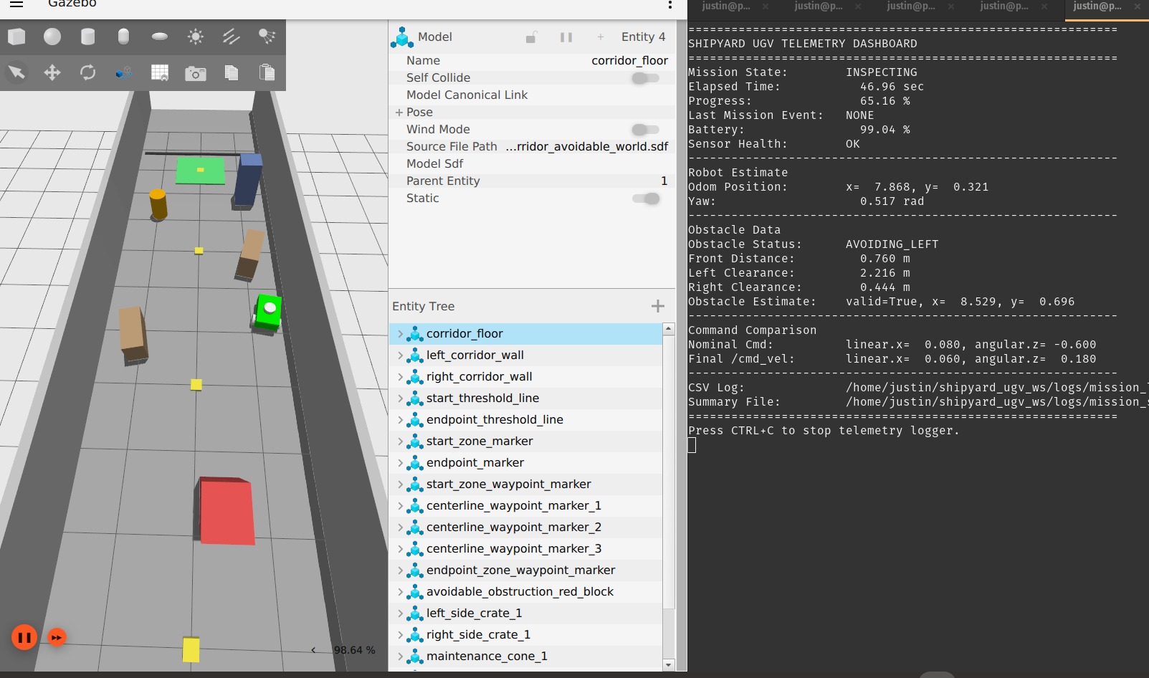
Simulation-Based Autonomous UGV for Indoor Shipyard Corridor Inspection
Predefined waypoint route, 2D LiDAR safety layer, and mission telemetry in ROS 2 + Gazebo
Final Design Presentation | EEL 5606 Introduction to Mobile Robotics and Unmanned Systems
PLACEHOLDER: replace image with 10–15 sec intro clip of Gazebo robot launching
EEL 5606 | Simulation-Based Autonomous UGV | Justin Kwarteng
1

Slide 2
Project Summary
Purpose + stakeholders
MISSION NEED
STAKEHOLDERS
Send a simulated UGV into a known indoor shipyard or port maintenance corridor after a suspected obstruction, alarm, or hazard so personnel get a first-look status without entering first.
Primary user
Operator or maintenance lead reviewing a corridor before sending personnel.
Beneficiaries
Simulation-only prototype using ROS 2 Humble, Gazebo/Ignition, and optional RViz.
2WD differential-drive rover with caster, odometry, IMU, 2D LiDAR/range sensing, and simulated health/battery data.
Mission behaviors: start on command, follow predefined route, respond to obstacles, safe-stop if blocked, log mission outcome.
Shipyard/port maintenance crews, safety managers, emergency response coordinators, and operations supervisors.
CLEAR
AVOIDABLE
COMPLETE
COMPLETE
BLOCKED
PLACEHOLDER: 20 sec mission montage video
SAFE_STOP
EEL 5606 | Simulation-Based Autonomous UGV | Justin Kwarteng
2

Slide 3
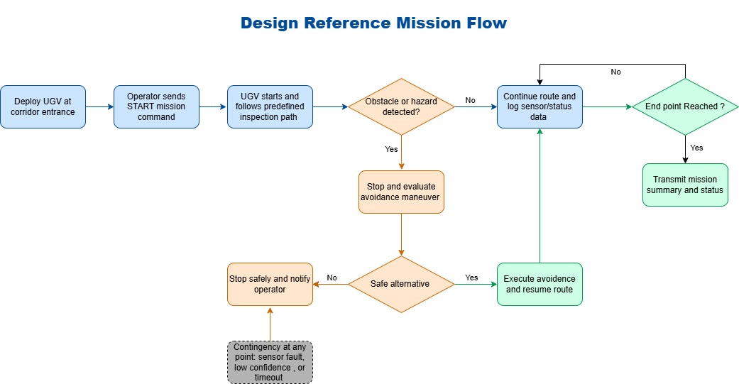
Design Reference Mission & Key Requirements
DRM + MOEs/MOPs
CORE MEASURES
≤ 6 min
0.20–0.35 m/s
Mission duration target
Rover cruise speed
≥ 0.75 m
≤ 0.35 m
Obstacle detection threshold
Stop-distance target
≥ 1 Hz
0.50 m
Telemetry / status output
Endpoint tolerance
MISSION ACCEPTANCE SCENARIOS
PLACEHOLDER: insert final requirements traceability table or one-page MOE/MOP snapshot
Nominal route, avoidable obstacle, blocked route safe-stop, and sensor/timeout contingency provide requirement-traceable verification coverage.
EEL 5606 | Simulation-Based Autonomous UGV | Justin Kwarteng
3

Slide 4
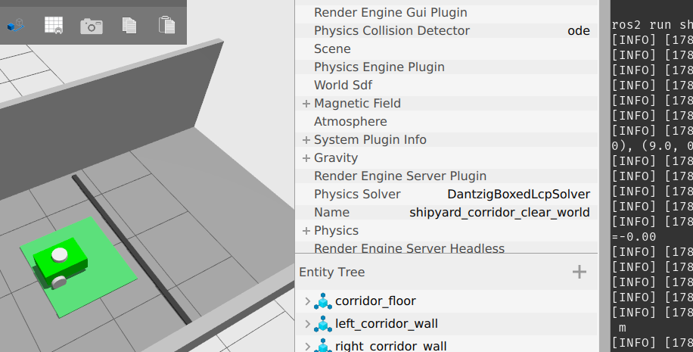
Hardware Overview
Simulation model + physical concept
ROVER CONFIGURATION
2-wheel differential-drive rover with passive caster support.
Encoder-style odometry from drivetrain simulation.
2D LiDAR mounted above chassis; IMU mounted near base frame.
Simulation-only: no physical build or hardware procurement in baseline.
SUBSYSTEM BASELINE
Mobility
Differential drive + caster
PLACEHOLDER: insert URDF/SDF link diagram or Gazebo model tree screenshot
Sensing
2D LiDAR, IMU, odometry
Autonomy
Waypoint follower + safety gate
Reporting
Mission state, health, logs
EEL 5606 | Simulation-Based Autonomous UGV | Justin Kwarteng
4

Slide 5
Sensing & Navigation Approach
Trade study outcome
SELECTED SENSING OPTION
/scan
LaserScan
2D scanning LiDAR selected as the primary obstacle sensing approach
Route + Safety
Logic
/cmd_vel
Final command
Matches indoor corridor geometry: obstacles and walls are primarily in a horizontal scan plane.
Lower integration complexity than camera/3D perception for the course prototype.
Pairs cleanly with IMU and odometry for rules-based waypoint navigation.
SLAM/camera vision reserved as future work.
/odom
Odometry
/imu
IMU
PLACEHOLDER: RViz LaserScan view
PLACEHOLDER: TF tree / frame view
PLACEHOLDER: LiDAR echo + rate screenshot
EEL 5606 | Simulation-Based Autonomous UGV | Justin Kwarteng
5

Slide 6
Autonomy & Software Overview
ROS 2 node architecture
FOUR-NODE AUTONOMY ARCHITECTURE
/start_mission
Trigger service
mission_manager_node
/state + events
route_follower_node
/nominal_cmd_vel
obstacle_avoidance_node
final /cmd_vel
Gazebo rover
Diff-drive
telemetry_logger_node
status + CSV + summary
Key design choice
Final obstacle logic
The route follower produces route intent. The obstacle node owns final motion and acts as the safety gate.
Stateful behavior: CLEAR → AVOIDING → RECOVERING → CLEAR, with BLOCKED safe-stop if no path clears.
PLACEHOLDER: rqt_graph screenshot showing active topics
PLACEHOLDER: node terminal panes or launch output
EEL 5606 | Simulation-Based Autonomous UGV | Justin Kwarteng
6

Slide 7
Human Interface & Mission Planning
Operator workflow
OPERATOR FLOW
PLACEHOLDER: terminal dashboard / telemetry_logger live output
1
Select world
clear / avoidable / blocked
2
Start stack
Gazebo + spawn + bridges
3
Launch nodes
manager, route, safety, logger
4
Send START
/start_mission Trigger
MISSION PLANNING MODES
5
Review status
clear
avoidable
blocked
dashboard + summary log
nominal completion
avoid + recover
safe-stop
PLACEHOLDER: insert short screen recording of operator start command + dashboard
EEL 5606 | Simulation-Based Autonomous UGV | Justin Kwarteng
7

Slide 8
Demonstration & Verification Plan
Scenario evidence
TEST MATRIX
Scenario
World
Expected outcome
Evidence
Video
SCN-1
clear
COMPLETE
summary + progress
clip A
SCN-2
avoidable
AVOID + COMPLETE
status history
clip B
SCN-3
blocked
BLOCKED + SAFE_STOP
event + final cmd=0
clip C
SCN-4
sensor/timeout
SENSOR_INVALID or TIMEOUT
optional log
clip D
VIDEO PLACEHOLDER A
Clear route completion
VIDEO PLACEHOLDER B
Avoidable obstacle + recovery
VIDEO PLACEHOLDER C
Blocked route SAFE_STOP
VIDEO PLACEHOLDER D
Sensor/timeout contingency
Record each run with Gazebo view + telemetry terminal visible. Keep clips short: 20–40 sec each, then show mission summary line item.
EEL 5606 | Simulation-Based Autonomous UGV | Justin Kwarteng
8

Slide 9
Mission Evidence: Clear + Avoidable
Results from simulation
CLEAR ROUTE RESULT
COMPLETE
100%
54.14 s
Final state
Progress
Elapsed
AVOIDABLE OBSTACLE RESULT
COMPLETE
100%
60.61 s
Final state
Progress
Elapsed
Obstacle status sequence proved: CLEAR_PASS_THROUGH → AVOIDING_LEFT → AVOIDANCE_CLEAR_RECOVERING → RECOVERING_TO_ROUTE → RECOVERY_COMPLETE → CLEAR_PASS_THROUGH → COMPLETE.
PLACEHOLDER: paste final avoidable video or replace screenshot
PLACEHOLDER: paste mission_summary lines
Final state / progress / status history
EEL 5606 | Simulation-Based Autonomous UGV | Justin Kwarteng
9

Slide 10
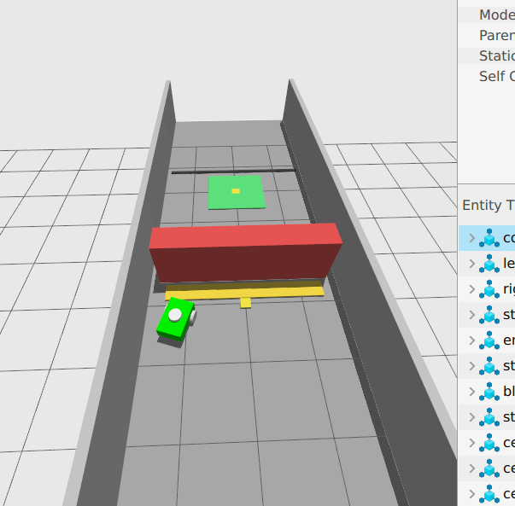
Mission Evidence: Blocked Route + Contingency
Safe-stop behavior
BLOCKED ROUTE RESULT
SAFE_STOP
BLOCKED
75%
Final state
Last mission event
Progress before stop
Obstacle history showed repeated avoidance/recovery attempts, then BLOCKED_SAFE_STOP after the path did not clear. Final /cmd_vel was zero.
PLACEHOLDER: blocked-world video clip
PLACEHOLDER: sensor/timeout contingency screenshot
(e.g., stale /scan → SENSOR_INVALID → SAFE_STOP)
PLACEHOLDER: final log lines / event history
EEL 5606 | Simulation-Based Autonomous UGV | Justin Kwarteng
10

Slide 11
Cost, Maturity, and Major Risks
Risk management + production readiness
COST POSTURE
MAJOR RISKS AND MITIGATIONS
Baseline course product is software-only; physical production cost remains a future prototype estimate.
Obstacle oscillation
Stateful avoidance + recovery + world scenario separation
False COMPLETE while stuck
Waypoint pass logic + final endpoint strictness + logs
No physical procurement required for baseline demonstration.
Reusable open-source stack: ROS 2 Humble, Gazebo/Ignition, Python rclpy.
Future physical unit would require drivetrain, compute, battery, LiDAR/range sensor, IMU, enclosure, and operator interface.
Blocked route ambiguity
Front blocked timeout → BLOCKED event → SAFE_STOP
Sensor loss
Stale scan/health watchdog → SENSOR_INVALID
MATURITY
Current: simulation prototype / SITL
Next: HITL + physical rover prototype
Future: SLAM/Nav2/camera integration
PLACEHOLDER: optional risk matrix from Assignment 5
EEL 5606 | Simulation-Based Autonomous UGV | Justin Kwarteng
11

Slide 12
Summary, Remaining Work, and Schedule
Decision path
Current result: the simulation now demonstrates the three core mission behaviors required for the final system story.
clear
avoidable
blocked
COMPLETE
COMPLETE
SAFE_STOP
REMAINING WORK BEFORE FINAL SUBMISSION
Record final demo clips for clear, avoidable, blocked, and optional sensor contingency scenarios.
Capture rqt_graph, RViz/TF, Gazebo view, and telemetry dashboard screenshots.
Clean up final report language: rules-based waypoint following, not SLAM/Nav2/A*.
Add final summary logs and screenshots into slides.
JULY 2026 PATH TO PRODUCTION DECISION
Week 1
Week 2
Week 3
Week 4
Finalize tests + evidence
Polish deck + record demo
Contingency + report cleanup
Decision: extend sim / pursue hardware
PLACEHOLDER: final slide can include one short combined demo video or QR/link to repository/video folder
EEL 5606 | Simulation-Based Autonomous UGV | Justin Kwarteng
12

