Slide 1

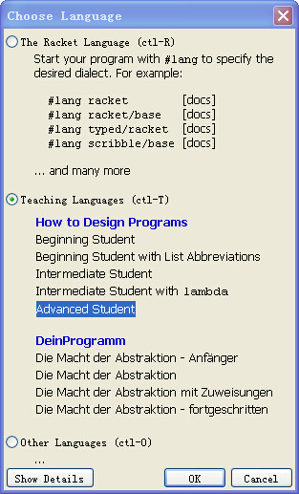
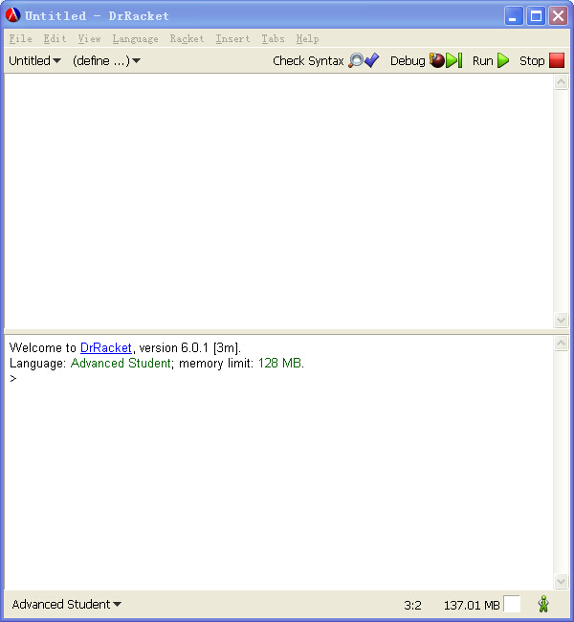
Preparations

Slide 2
Terminology
The top-half of DrRacket is called the definitions area. This area is where you create the programs, which is called editing. As soon as you add a word or change something in the definitions area, the SAVE button shows up in the top-left corner. When you click SAVE for the first time, DrRacket asks you for the name of a file, which is a place on your computer (technically, its disk) where DrRacket stores your program for good. Once your definitions area is associated with a file, clicking SAVE just ensures that the content of the definitions area is stored safely in the file.

Slide 3
Arithmetic

Slide 4
1.1 The Arithmetic Of Numbers
For example
(+ 1 2)= 1+2
(+ 1 (+1 (+ 1 1) 2 ) 3 (+ 2 2) 5)
=1+(1+(1+1)+2)+3+(2+2)+5

Slide 5
The arithmetic of numbers
Not only plus, there some other operations are provided:+, -, *, /, abs, add1, ceiling, denominator, exact->inexact, expt( power), floor, gcd( greatest common divisor), log, max, numerator, quotient, random, remainder, sqr, and tan.

Slide 6
Exercise 1
The direct goal of this exercise is to create an expression that computes the distance of some specific Cartesian point (x,y) from the origin (0,0). The indirect goal is to introduce some basic programming habits, especially the use of the interactions area to develop expressions. The values for x and y are given as definitions in the definitions area (top half) of DrRacket:
(define x 3)
(define y 4)

Slide 7
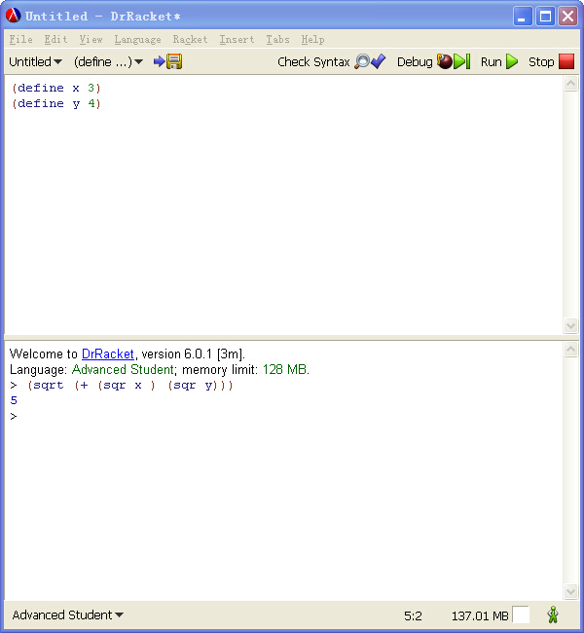

Slide 8
1.2 The Arithmetic Of Strings
Programming languages are about calculating with information, and information comes in all shapes and forms. For example, a program may deal with colors, names, business letters, or conversations between people. Even though we could encode this kind of information as numbers, it would be a horrible idea. Just imagine remembering large tables of codes, such as 0 means “red” and 1 means “hello,” etc.

Slide 9
Better idea？

Slide 10
Strings!
Generally speaking, a String is a sequence of the characters that you can enter on the keyboard enclosed in double quotes, plus a few others, about which we aren’t concerned just yet.
For example: “Hello” , “blue”, “red” or “what a lovely day for learning Racket”

Slide 11
(string-append )
> (string-append "what a " "lovely " "day" " for learning Racket")
>"what a lovely day for learning Racket"

Slide 12
Exercise 2
Add the following two lines to the definitions area:
(define prefix "hello")
(define suffix "world")
Then use string primitives to create an expression that concatenates prefix and suffix and adds "_" between them. When you run this program, you will see "hello_world" in the interactions area.

Slide 13
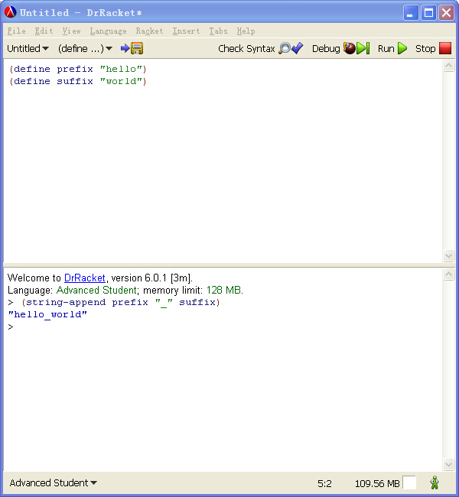

Slide 14
1.3 Mixing It Up
string-length consumes a string and produces a (natural) number
string-ith consumes a string s together with a natural number i and then extracts the one-character substring located at the ith position (counting from 0)
number->string consumes a number and produces a string.
substring consumes a string s together with two natural number i and j then extracts string from i to j

Slide 15
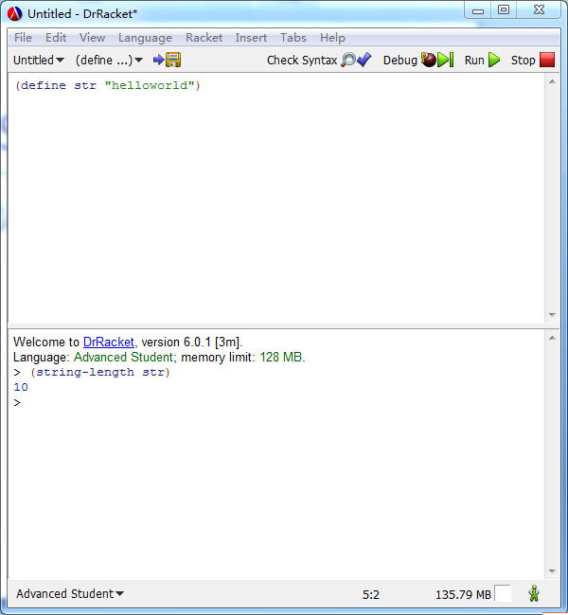
String-length

Slide 16
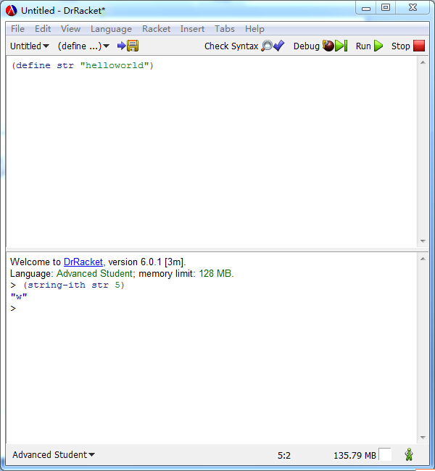
String-ith

Slide 17
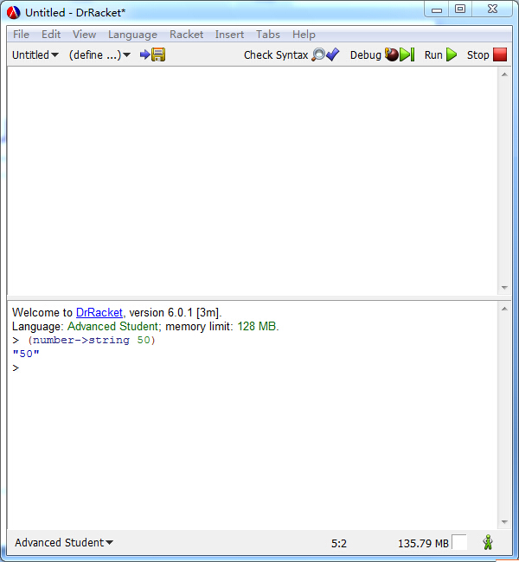
number->string

Slide 18
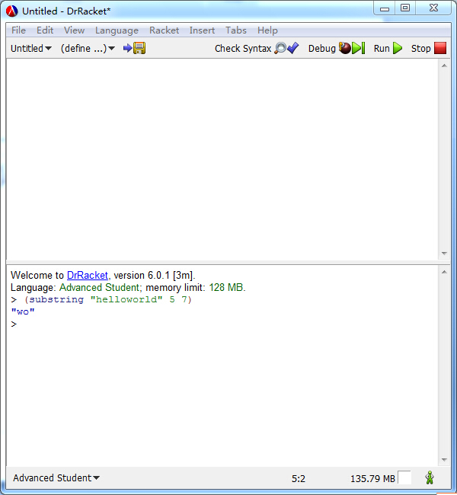
Substring

Slide 19
Exercise 3
Exercise 3. Add the following two lines to the definitions area:
(define str "helloworld")
(define i 5)
Then create an expression using string primitives that adds "_" at position i. In general this means the resulting string is longer than the original one; here the expected result is "hello_world".

Slide 20
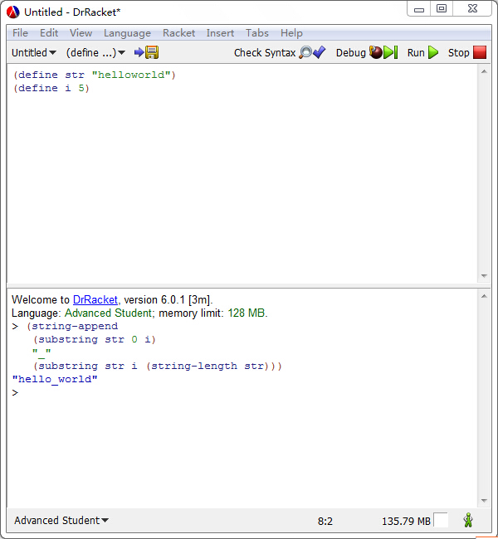

Slide 21
Exercise 4
Exercise 4. Use the same setup as in exercise 3. Then create an expression that deletes the i th position from str. Clearly this expression creates a shorter string than the given one; contemplate which values you may choose for i.

Slide 22
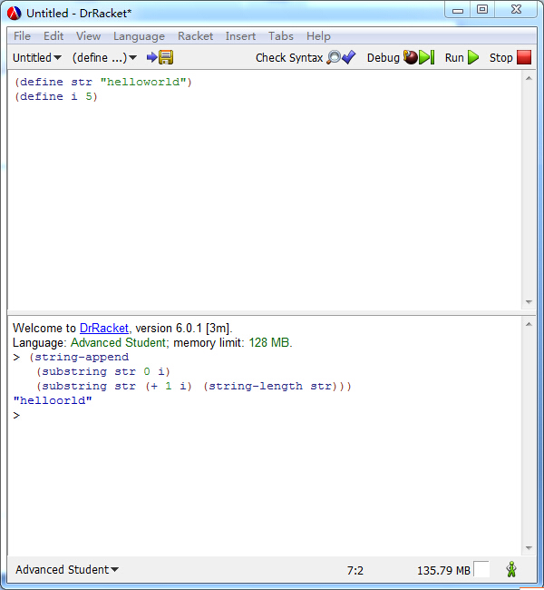

Slide 23
1.4 The Arithmetic Of Images

Slide 24
Creation of basic images
circle produces a circle image from a radius, a mode string, and a color string
ellipse produces an ellipse from two radii, a mode string, and a color string
line produces a line from two points and a color string
rectangle produces a rectangle from a width, a height, a mode string, and a color string
text produces a text image from a string, a font size, and a color string
triangle produces an upward-pointing equilateral triangle from a size, a mode string, and a color string

Slide 25
Image properties
image-width determines the width of a given image in terms of pixels;
image-height determines the height of an image

Slide 26
Functions that compose images
(overlay i1 i2) places all the images to which it is applied on top of each other, using the center as anchor point.
(overlay/align ”str1” “str2”) is like overlay but accepts two strings that shift the anchor point(s) to other parts of the rectangles.

Slide 27
Functions that compose images
(overlay/xy i1 x y i2)is like overlay but accepts two numbers—x and y—between two image arguments. It shifts the second image by x pixels to the right and y pixels down —all with respect to the image’s center; unsurprisingly, a negative x shifts the image to the left and a negative y up.

Slide 28
Creating animated scenes and images for games
(empty-scene x y) creates an framed rectangle of a specified width and height;
(place-image i1 x y i2) places an image into a scene at a specified position. If the image doesn’t fit into the given scene, it is appropriately cropped.

Slide 29
Creating animated scenes and images for games
(add-line image x1 y1 x2 y2 pen-or-color) consumes an scene, four numbers, and a color to draw a line of that color into the given image.

Slide 30

Exercise 5
Add the following line to the definitions area:
(define cat )
Create an expression that counts the number of pixels in the image.

Slide 31
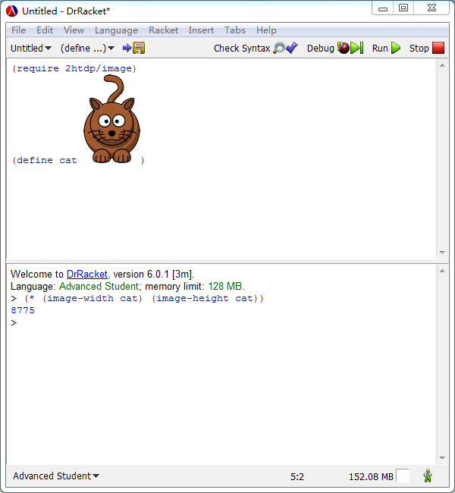

Slide 32
Exercise 6
Use the picture primitives to create the image of a simple automobile.

Slide 33
Exercise 7
Use the picture primitives to create the image of a simple boat.

Slide 34
Exercise 8
Use the picture primitives to create the image of a simple tree.

Slide 35
1.5 The Arithmetic Of Booleans
We need one last kind of primitive data before we can design programs: Boolean values. There are only two kinds of Boolean values: true and false. Programs use Boolean values for representing decisions or the status of switches.

Slide 36
Or
or checks whether any of the given Boolean values is true:
> (or true true)true
> (or true false)true
> (or false true)true
> (or false false)false

Slide 37
And
and checks whether all of the given Boolean values are true
> (and true true)true
> (and true false)false
> (and false true)false
> (and false false)false

Slide 38
Not
not always picks the Boolean that isn’t given:
> (not true)false
> (not false)true

Slide 39
Exercise 9
Add the following two lines to the definitions area of DrRacket:
(define b1 true)
(define b2 false)
Create an expression that computes whether b1 is false or b2 is true. So in this particular case, the answer is false. (Why?)

Slide 40
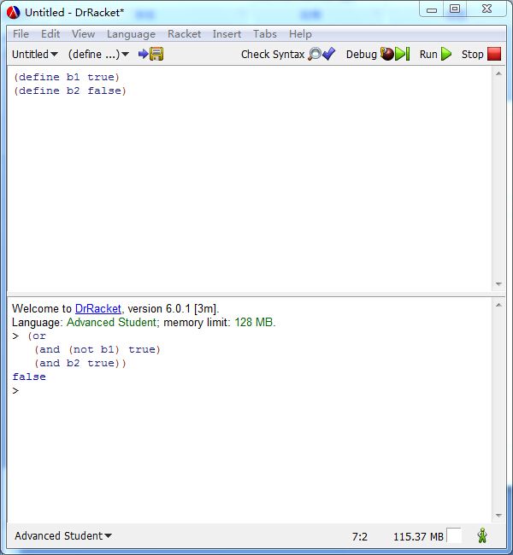

Slide 41
1.6 Mix It Up With Booleans
(define x 2)
(define inverse-of-x (/ 1 x))
This works fine, as long as we don’t edit the program and change x to 0.

Slide 42
(if (= x 0) 0 (/ 1 x))

Slide 43
(if (= x 0) 0 (/ 1 x))
This if expression contains the sub expressions (= x 0), 0, and (/ 1 x). The evaluation of this expression proceeds in two steps:
The first expression is always evaluated. Its result must be a Boolean.
If the result of the first expression is true, then the second expression is evaluated; otherwise the third one. Whatever their results are they are also the result of the entire if expression.

Slide 44
In addition to =, Racket provides <, <=, >, >= to determine about numbers.
Strings aren’t compared with = and its relatives. Instead, you must use string=? or string<=? or string>=? if you are ever in a position where you need to compare strings.

Slide 45
Exercise 10
Add the following line to the definitions area:
(define cat )
Create an expression that computes whether the image is "tall" or "wide". An image should be labeled "tall" if its height is larger or equal to its width; otherwise it is "wide".

Slide 46
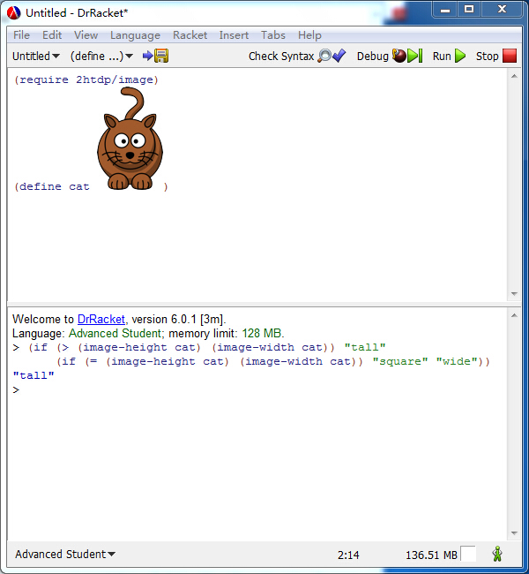

Slide 47
1.7 Predicates: Know Thy Data
Every class of data that we introduced in this chapter comes with a predicate: string?, image?, and boolean?.

Slide 48
1.7 Predicates: Know Thy Data
In addition to predicates that distinguish different forms of data, programming languages also come with predicates that distinguish different kinds of numbers. In BSL, numbers are classified in two ways: by construction and by their exactness. Construction refers to the familiar sets of numbers: integer?, rational?, real?, and complex?.

Slide 49
Exercise 11
Add the following line to the definitions area of DrRacket:
(define in "hello")
Then create an expression that converts whatever in represents to a number. For a string, it determines how long the string is; for an image, it uses the area; for a number, it decrements the number, unless it is already 0 or negative; for true it uses 10 and for false 20.

Slide 50
