Slide 1
BOSTON RED SOX · TRADE DEADLINE 2026
Don't Count Out
The Sox.
The hottest team in baseball was supposed to sell. A lookahead to the trade deadline, now 8 days away.
A data-driven roster case study · July 2026

Slide 2
// THE SETUP
The hottest team in baseball
W13
+41
77%
winning streak
run differential
playoff odds
longest run in the majors this season
outplaying their .515 record all season
10,000 sims of the rest of the season (fig. 12)
A month ago the easy take was sell. The outfield jam, still masked by Roman Anthony's injury, is now a buyer's depth chart: the surplus funds the deadline instead of a teardown.
BOS // OUTFIELD STRATEGY STATCAST / FANGRAPHS / MLB STATS API / SPOTRAC · JULY 2026

Slide 3
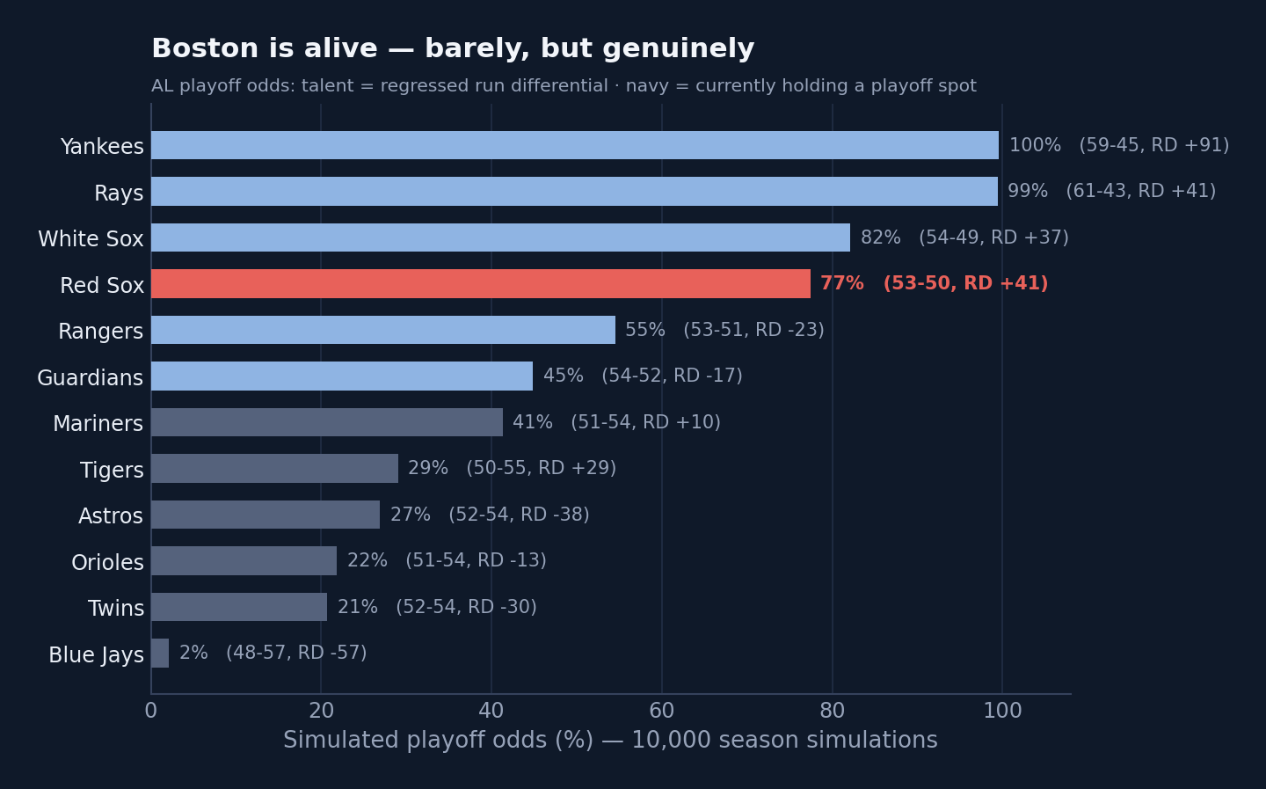
// THE VERDICT
Buy, but keep it small
Hold Duran
Value at its nadir; his July contact (~.35 xwOBA) is already surging. Re-price in winter.
Keep the vets
Gray, Chapman, Contreras are playoff innings now. Sell branch reopens only if the gap blows out by Aug 1.
Add small, without disturbing the room
A reliever first, maybe an infield bat, prospects before big-leaguers, empty spots before hot ones. The catcher tandem stays.
The team is its left fielder: process better than results.
BOS // OUTFIELD STRATEGY STATCAST / FANGRAPHS / MLB STATS API / SPOTRAC · JULY 2026

Slide 4
// KEEP
The young, cheap, controllable core
Roman Anthony
Ceddanne Rafaela
Wilyer Abreu
LF · age 22
CF · age 25
RF · age 27
3.8
3.2
2.8
projected WAR / yr
projected WAR / yr
projected WAR / yr
$2.6M · 8yr/$130M ext
$2.0M · 8yr/$50M
$0.8M · pre-arb → 2029
Franchise bat. Untouchable. On the IL now, back in 2027.
Elite center-field glove + SS/utility flex. Premium position, controlled cheap.
Best surplus on the roster: plus RF glove, above-average LH bat.
Three spots, locked. Everything else flexes around them.
BOS // OUTFIELD STRATEGY STATCAST / FANGRAPHS / MLB STATS API / SPOTRAC · JULY 2026

Slide 5
// MOVE
The two hard cases: a redundant bat and an underwater contract
Jarren Duran
Masataka Yoshida
LF/CF · 29 · $7.7M
DH · 32 · $18.6M
Movable piece. Controllable through 2028; above-average at true talent (~110 wRC+). Redundant behind the core and the priciest of the young group.
The contract, not the bat. He's hitting: above-average wRC+, .340-class OBP, one of MLB's lowest strikeout rates. $18.6M for a DH with below-average pop is still underwater as an asset.
Hold at the deadline. Value at its nadir; xstats say the market under-prices him. Re-price in winter, after the rebound shows (or doesn't).
Keep him in the lineup. Gonzalez covers the tougher lefties. Absorb the deal, let it expire.
BOS // OUTFIELD STRATEGY STATCAST / FANGRAPHS / MLB STATS API / SPOTRAC · JULY 2026

Slide 6
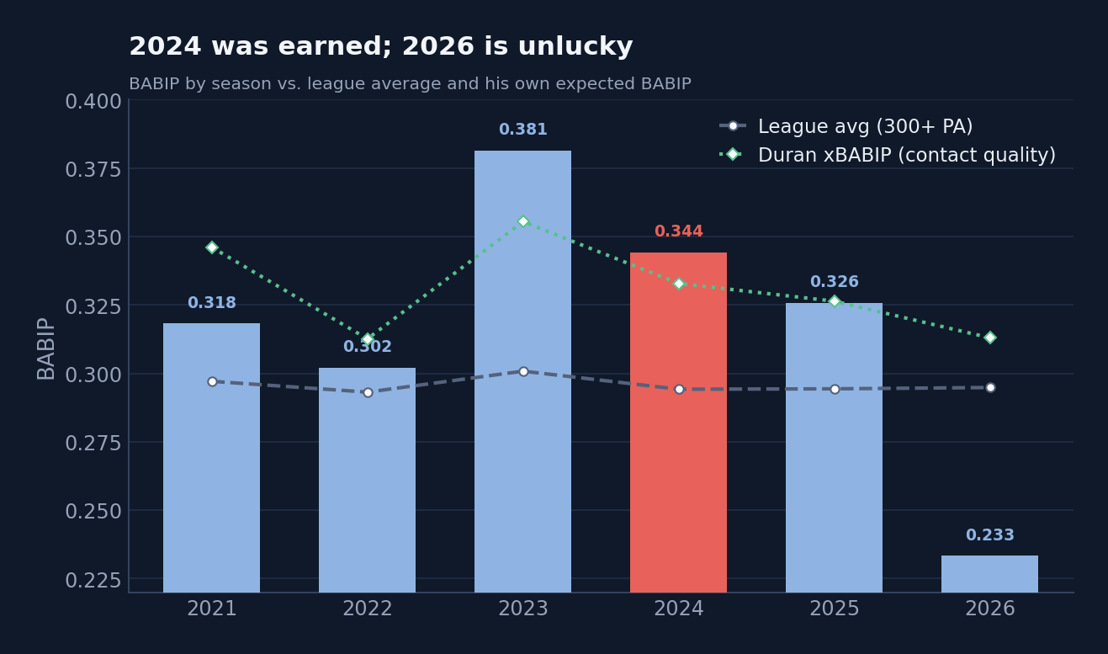
// DON'T SELL LOW
Duran's 2026 is unlucky
2024 was more what we should expect
BABIP .344 vs xBABIP .333; xwOBA .340 legit. Credit his speed's usual edge over xstats and the true luck is only +5 to +14 pts.
2026 is the real anomaly
wOBA .263 BELOW its .293 xwOBA, 34 to 43 pts under his own norm; BABIP .238 vs .309 expected. Erosion real, luck worse.
The legs are fine
Career gap +19 home / +19 road: identical, the skill travels. Speed, baserunning and fielding all still plus. No injury.
True talent ≈ his 2025 (~110 wRC+)
An above-average regular. The 2024 high and 2026 low are tails around that plateau.
Selling now cashes the slump. Value hinges on the rebound.
BOS // OUTFIELD STRATEGY STATCAST / FANGRAPHS / MLB STATS API / SPOTRAC · JULY 2026

Slide 7
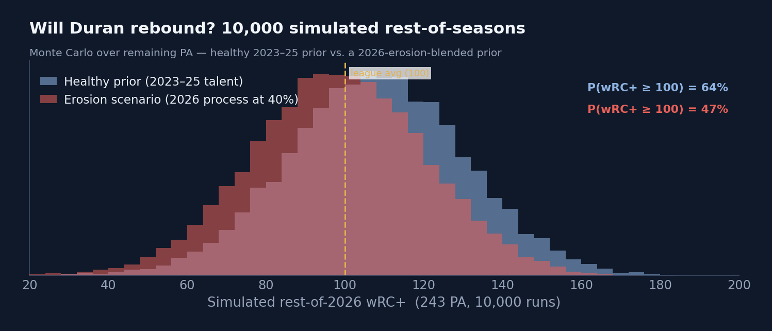
// THE REBOUND MATH
10,000 simulations: the rebound is likely
P(REST-OF-SEASON wRC+ ≥ 100)
69% healthy prior
47% erosion-blended
EXPECTED OFFSEASON TRADE VALUE
$22M vs $18M
either way, well above the ~$10M a July sale fetches
The honest line: the 22-point probability gap is the price of the worse chase / whiff / hard-hit rates. Hold-through-2026 survives the erosion stress test, but with less confidence in the rebound narrative itself.
BOS // OUTFIELD STRATEGY STATCAST / FANGRAPHS / MLB STATS API / SPOTRAC · JULY 2026

Slide 8
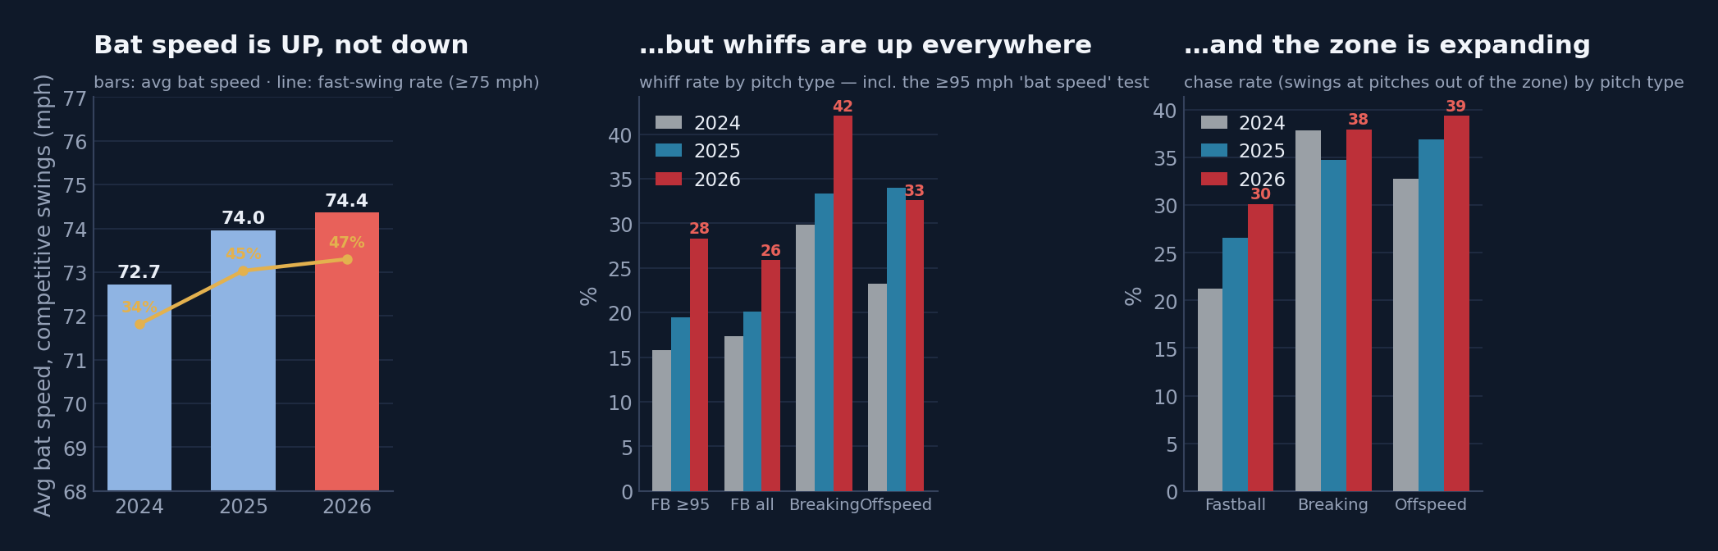
// THE TIEBREAKER
Swing Stats
74.5 mph avg bat speed 2026, up from 72.7 in '24
29% whiff vs 95+ up from 16% in '24
60 / 40 re-weighted scenario odds → 60% rebound
Duran is swinging harder, longer and steeper. That's pressing, not fading.
Whiffs on a rising bat speed = selling out. The chase leak is velo/offspeed; breaking-ball chase actually improved.
Approach is fixable (see his own 2022→23 chase overhaul); the tools a buyer prices are intact.
BOS // OUTFIELD STRATEGY STATCAST / FANGRAPHS / MLB STATS API / SPOTRAC · JULY 2026

Slide 9
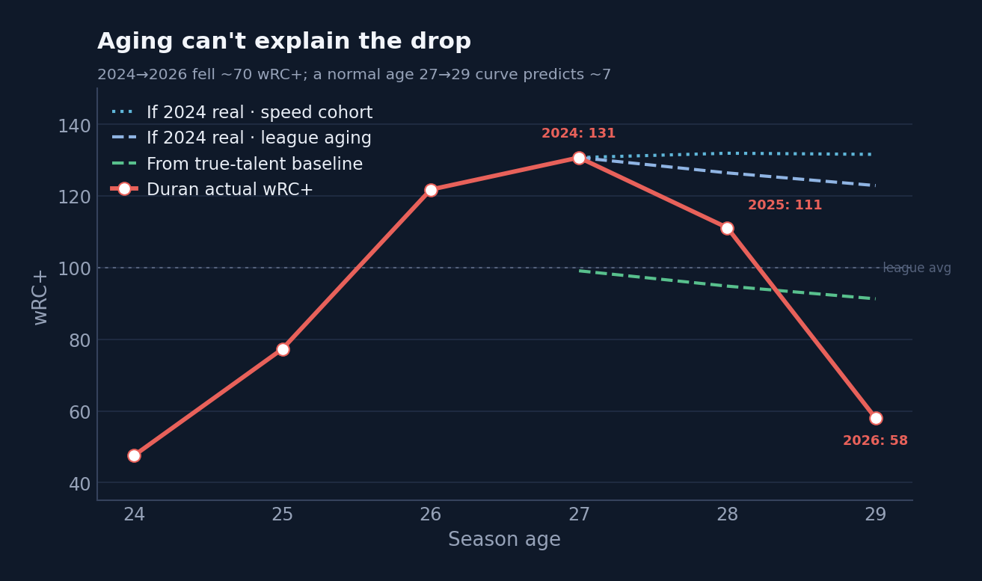
// CONTEXT
Aging doesn't explain the drop
2024 → 2026 wRC+ fell ~70 points; a normal age 27→29 curve predicts only ~7. The gap is mean-reversion from an inflated peak plus a 2026 bad-luck tail, not a skill cliff.
BOS // OUTFIELD STRATEGY STATCAST / FANGRAPHS / MLB STATS API / SPOTRAC · JULY 2026

Slide 10
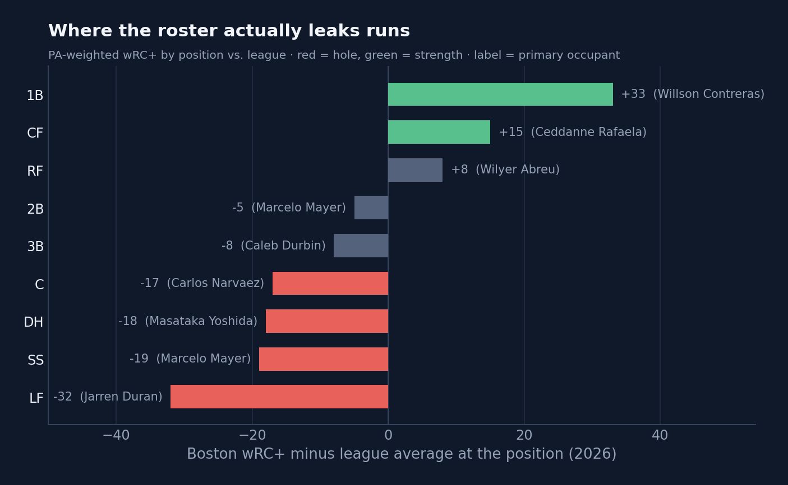
// IF THEY BUY, WHERE?
The roster's biggest hole is the Duran slump itself
LF −31: internal fix
Duran's regression, now sheltered by a Jahmai Jones platoon, plus Anthony's eventual return. Free.
SS −18: the true target
One controllable infield stabilizer is the only lineup trade that fits the odds.
Bullpen: quiet weakness
ERA top-10 but FIP and reliever WAR rank far worse, it will regress without help.
The Contreras twist
The winter's reported sell candidate is now their best hitter. Moving him would be met with outrage.
BOS // OUTFIELD STRATEGY STATCAST / FANGRAPHS / MLB STATS API / SPOTRAC · JULY 2026

Slide 11
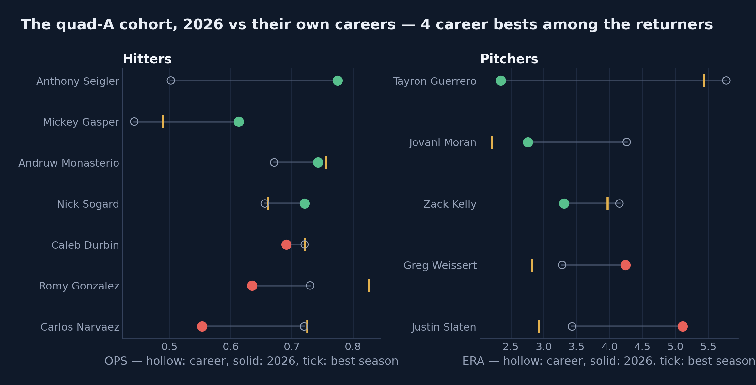
// THE SUPPORTING CAST
Career years everywhere. That's a tailwind, not a foundation
15 quad-A contributors
Waiver claims, up-down arms and career minor-leaguers holding real roles, +3.4 WAR combined.
4 career bests, 4 rookies
Most of the returners are beating every season they've ever had; the rookies have no baseline at all.
The process check
Results sit within a few points of expected, they're earning it. The risk is track record: careers, not heaters, predict August.
So buy substance
Replace borrowed production before August returns it: a real reliever over a career-year one, a real bat over a waiver claim on a heater.
BOS // OUTFIELD STRATEGY STATCAST / FANGRAPHS / MLB STATS API / SPOTRAC · JULY 2026

Slide 12
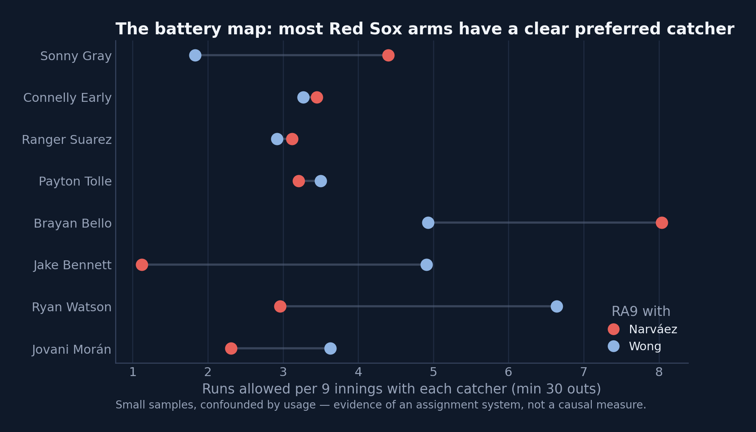
// THE CHEMISTRY VETO
Don't Mess Up The Pitching Staff
The staff works with both
3.42 RA9 with Wong, 4.20 with Narváez, the run-prevention core of the streak.
Every arm has a guy
Raw pairings look dramatic (fig. 14), but small samples shrink hard (fig. 15). What survives: settled, deliberate assignments.
The pen is paired too
Leverage relievers ride with a settled catcher, these innings aren't assigned at random.
So: no catcher trade
The adjusted model (pitcher/opponent/park controls) finds no significant catcher effect: -31 pts, 95% CI [-84, +21]. Nothing here for a trade to fix.
BOS // OUTFIELD STRATEGY STATCAST / FANGRAPHS / MLB STATS API / SPOTRAC · JULY 2026

Slide 13
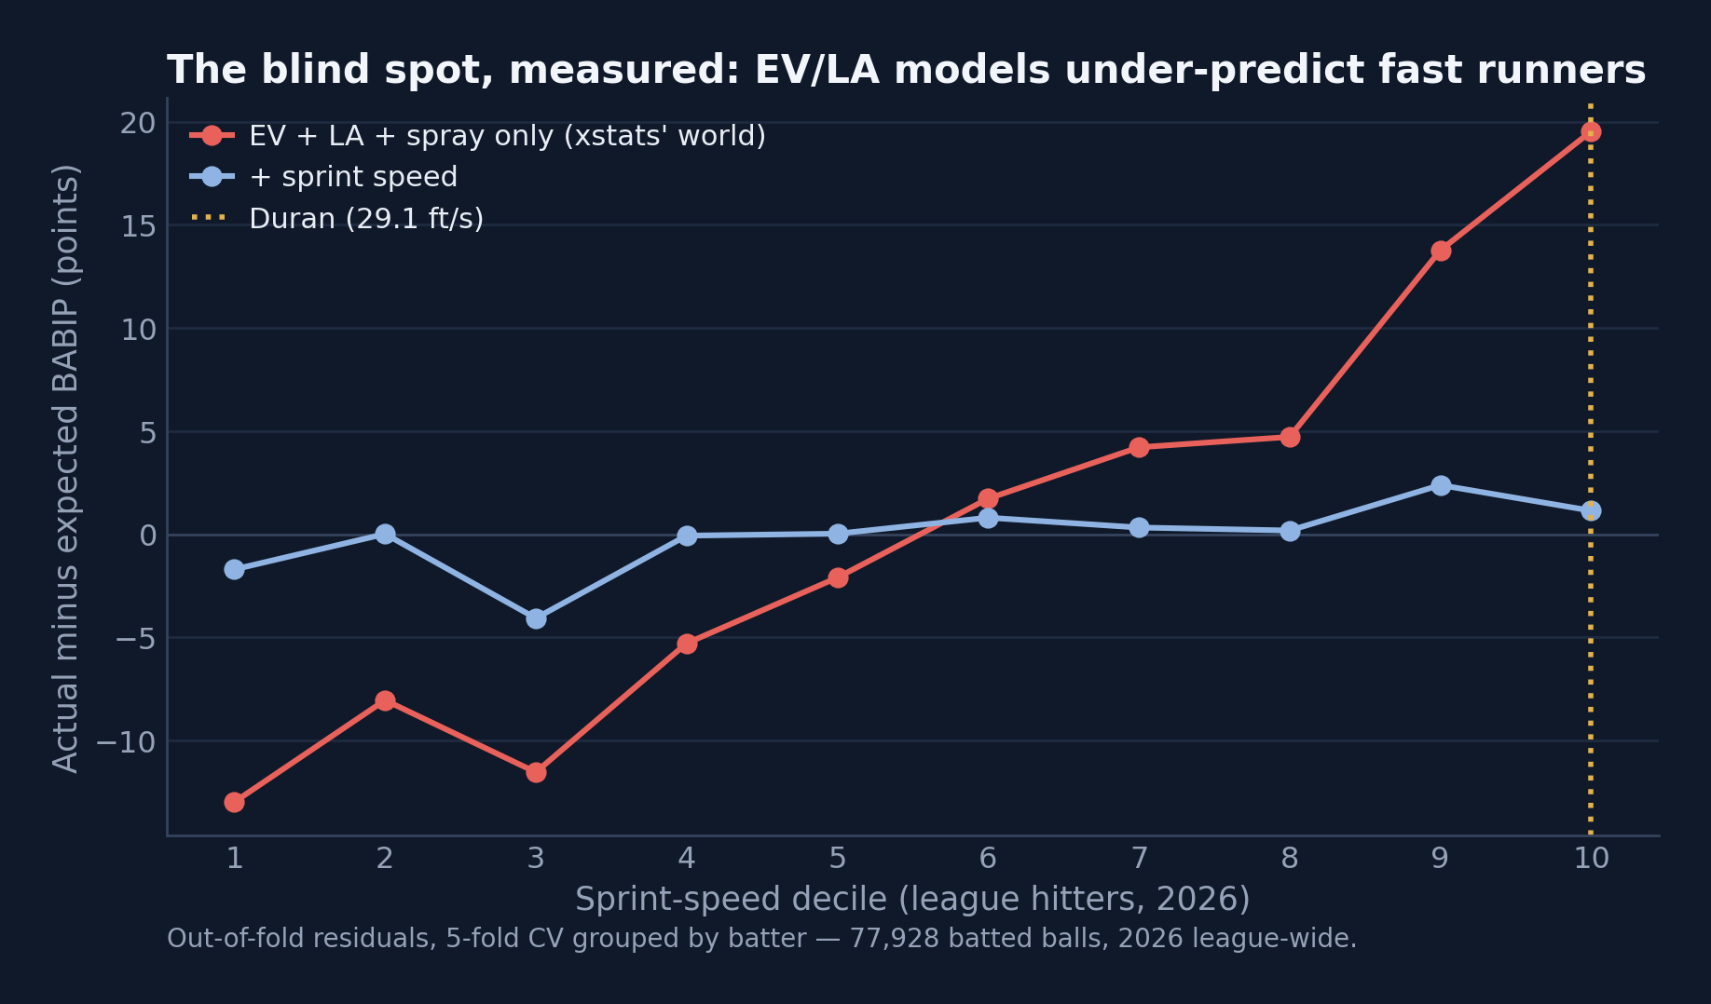
// UNDER THE HOOD
Two custom models behind the calls
Speed-aware xBABIP / xwOBAcon
Gradient boosting on 77,928 league batted balls (EV, LA, spray ± sprint speed), 5-fold CV grouped by batter so every residual is out-of-sample.
The blind spot, measured
Speed-blind xstats under-predict the fastest decile by +20 pts of BABIP. Duran's speed term: +23 pts of wOBA on contact, inside the +5–14 band derived independently.
Adjusted battery model
WOWY + fixed-effects OLS (pitcher/opponent/park), cluster-bootstrap CIs, empirical-Bayes shrinkage (fig. 15): raw splits are mostly noise; no significant catcher effect.
Why it's credible
Out-of-sample everywhere, CIs on every headline, and frozen pre-registered predictions graded in October, flattering or not.
BOS // OUTFIELD STRATEGY STATCAST / FANGRAPHS / MLB STATS API / SPOTRAC · JULY 2026

Slide 14
// THE MENU
Three trades that fit, and one walk-away
1 · THE PEN FIX · DO IT
2 · THE STABILIZER · IF THE PRICE HOLDS
RHP Luke Weaver (NYM)
2B Luis Arraez (SFG)
For a 45 FV + 40 FV, prospects only, nobody loses a job or an inning. Elite relief year, signed through '27. The highest-probability marginal win on the board.
For Brayan Bello, the first deal that touches the active roster. Zero prospect cost; Arraez fills a patchwork platoon spot, not a hot regular's.
3 · THE BIG SWING · PROBABLY WAIT
✗ · THE WALK-AWAY
SS Zach Neto (LAA)
C Shea Langeliers (ATH)
For Tolle + Early + a 45 FV: two arms out of a winning rotation mid-streak. Franchise-window correct, and still there in the winter. Controlled through 2029.
The value math worked; the battery map is the veto. No August bat is worth resetting eight pitcher-catcher pairings in the middle of a streak built on run prevention.
A menu, not a plan, Boston can afford about two. Full value math and verified contracts in the mock-trades memo. Hypotheticals, not reporting.
BOS // OUTFIELD STRATEGY STATCAST / FANGRAPHS / MLB STATS API / SPOTRAC · JULY 2026

Slide 15
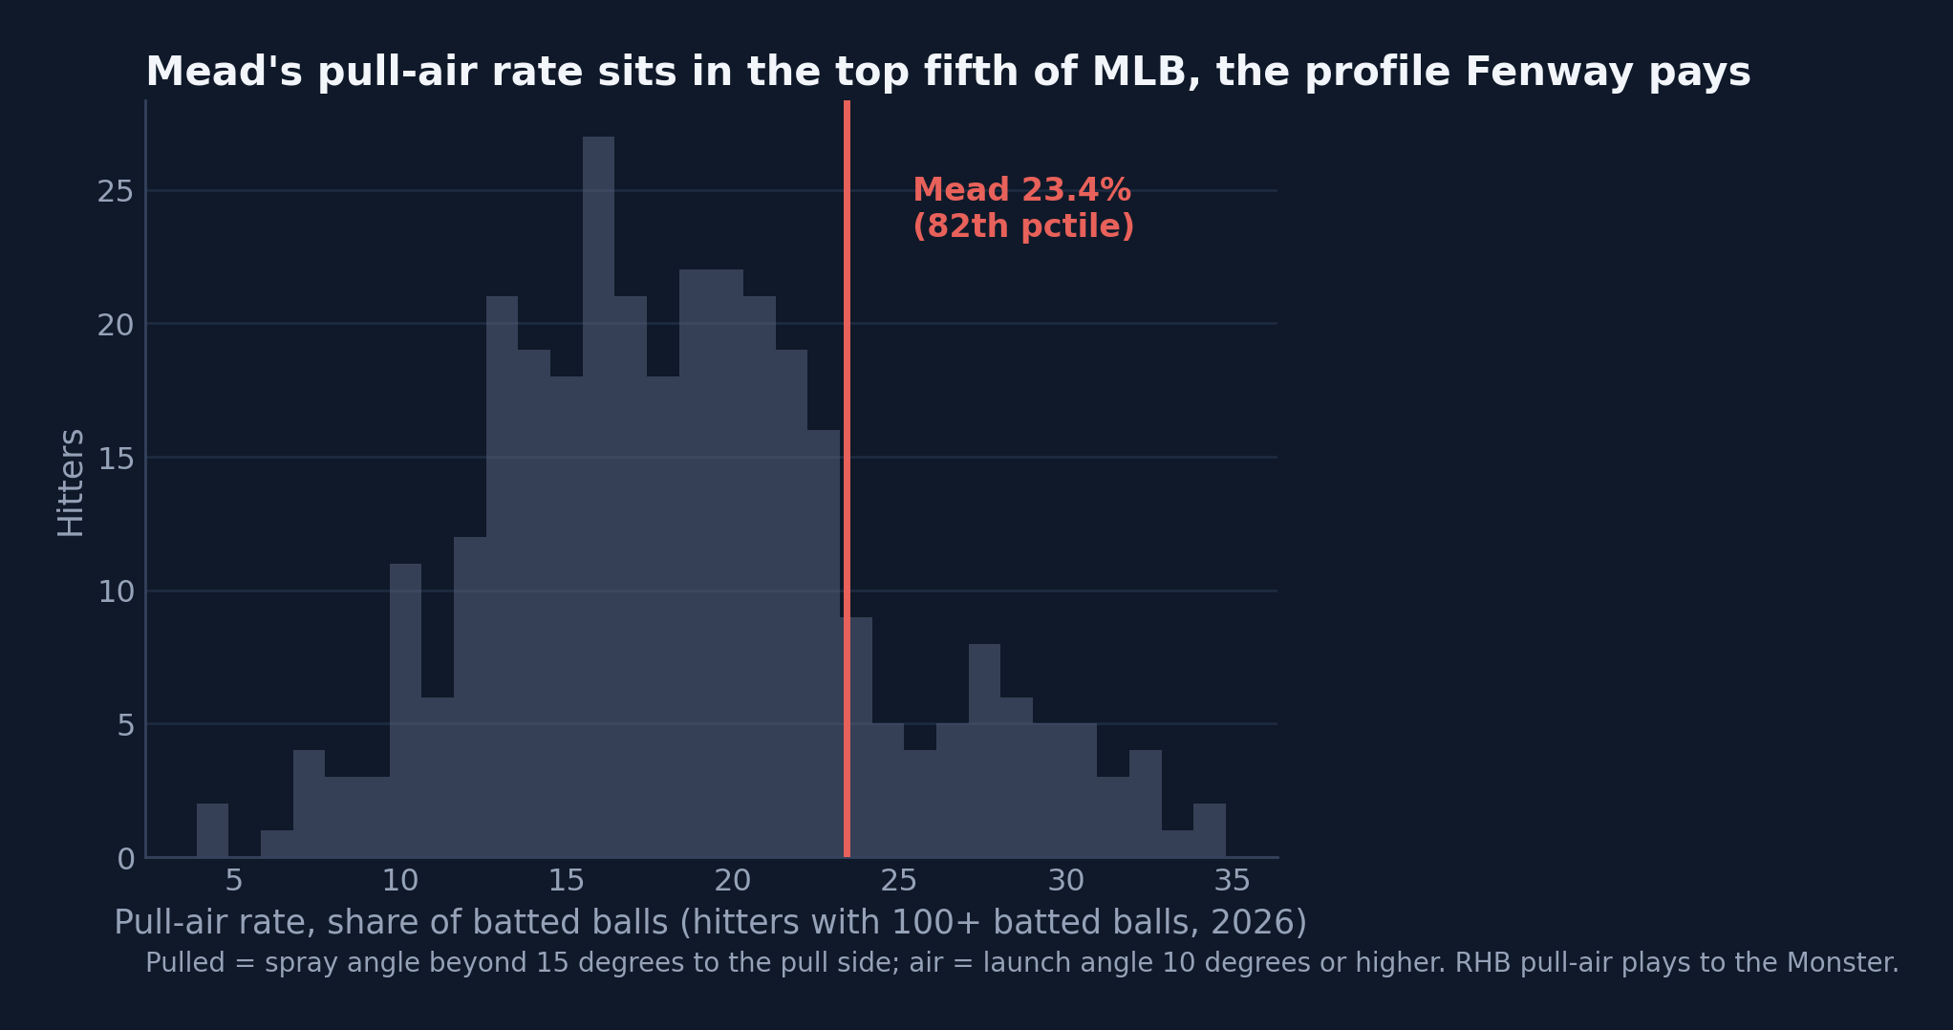
// THE REAL TRADE
They made one: Mead for Early
The deal
Curtis Mead (25) from Washington for Connelly Early: one surplus arm for a 134 wRC+ infield bat with years of club control.
The Fenway fit
23% pull-air rate, 82nd percentile, with a .846 wOBA on pulled air balls. RHB pull-air plays to the Monster.
Earned, mostly
.376 wOBA against a .359 xwOBA, so the breakout has contact quality behind it. The flag: 488 PA of .617 OPS before this year.
Menu grade
The big-swing shape at half the price, and the infield hole filled. The pen fix is still open, 8 days left.
BOS // OUTFIELD STRATEGY STATCAST / FANGRAPHS / MLB STATS API / SPOTRAC · JULY 2026

Slide 16
// THE WINTER PLAN
Spend the pitching surplus on offense
If winter comes and Duran's rebound has shown up, this is what a deal should return. With a top-6 rotation (3.65 ERA) carrying the club, trading bats for arms is backwards, convert the outfield surplus into what's thin:
1
2
3
Controllable bats
Best talent / upside
Salary relief
Young, cost-controlled position players to fix an inconsistent lineup and lengthen it around the core.
In a retool you take the best player, not the positional patch, prospects and MLB-ready youth over rentals.
Attach Yoshida money where possible; free payroll for the 2027 window.
Keep the arms. Cash the outfield. Build the 2027 lineup, don't rent the 2026 one.
BOS // OUTFIELD STRATEGY STATCAST / FANGRAPHS / MLB STATS API / SPOTRAC · JULY 2026

Slide 17
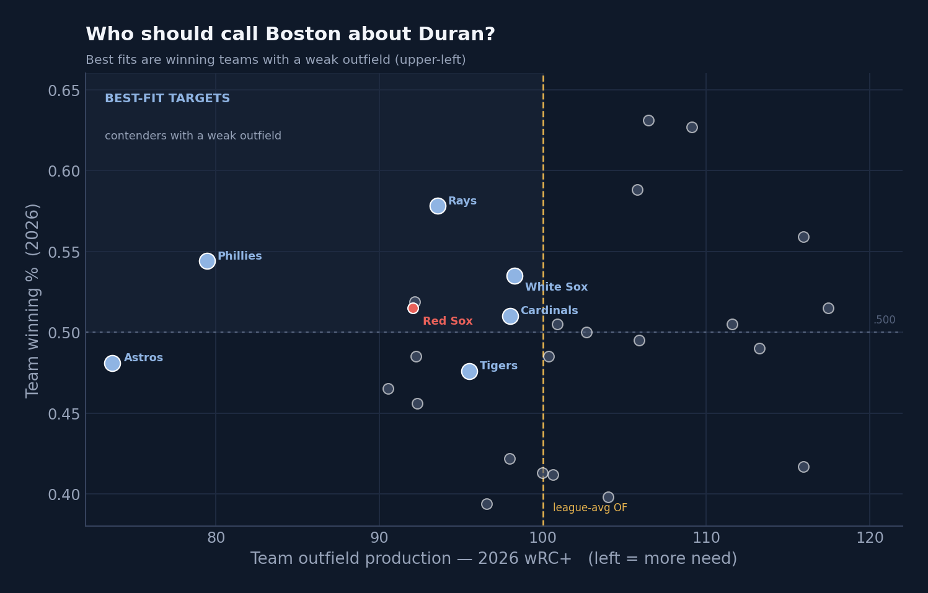
// THE MARKET
Who pays: contenders with a hole in the outfield
Best-fit buyers
Phillies .557, 84 OF wRC+
Rays .596, 88 OF wRC+
Cardinals .526, OF need
Astros fringe, weakest OF
Trade a redundant bat to a team that needs one, and take back the hitting/youth Boston is short on.
BOS // OUTFIELD STRATEGY STATCAST / FANGRAPHS / MLB STATS API / SPOTRAC · JULY 2026

Slide 18
// THE SEQUENCE
Buy now, decide on Duran in the winter
1
At the deadline: buy targeted
A controllable infield bat and a reliever, funded from the pitching surplus. Keep the vets, they're playoff innings now.
THE RETURN
Sell now (nadir)
~$10–15M · a 45-FV bat
2
Hold Duran through August
His value is at its nadir and his July contact quality (~.35 xwOBA) is already surging. Selling now cashes the slump.
Sell after rebound
~$28M · a 50-FV, top-100
controllable talent
3
Winter: re-price, then choose
Anthony healthy, jam returns. Rebound confirmed → extend or trade at full price. Erosion persists → sell at market. Either way, the 2027 OF is Anthony / Rafaela / Abreu.
One grade of return = the reason to wait.
BOS // OUTFIELD STRATEGY STATCAST / FANGRAPHS / MLB STATS API / SPOTRAC · JULY 2026

Slide 19
BOTTOM LINE
Play the hand. 77% playoff odds, +41 run differential, a wild card in hand, buy small (a reliever first), keep the vets, and let the record keep catching up to the process.
Cash the surplus, not the slump. Hold Duran through the deadline; re-price him in winter, extend or trade the 2025 player, never the unlucky 2026 one.
Stop fighting the Yoshida deal. The bat is back to average or better; absorb the contract and let it expire.
Confidence: high that 2024 shouldn't be the anchor and pitching is a strength; the open question is how much of 2026's skill dip (chase, whiff, hard-hit are all worse) persists, the one thing to watch before selling.

