Slide 1
BOSTON RED SOX · TRADE DEADLINE 2026
Red Sox Trade Deadline
Thoughts
After an incredible push, the Sox are in a position to be buyers before this trade deadline. A breakdown of our new acquisition, Curtis Mead, and what else the Sox need to do for a deep playoff run. 8 days to August 3.
A data-driven roster case study · July 2026

Slide 2
// THE SETUP
Red Sox Are Back From The Dead
53-50
+41
78%
record
run differential
playoff odds
holding the final wild card
outplaying their .515 record all season
10,000 sims of the rest of the season (fig. 12)
A month ago the easy take was sell. The outfield jam, still masked by Roman Anthony's injury, is now a buyer's depth chart: the surplus funds the deadline instead of a teardown.
BOS // OUTFIELD STRATEGY STATCAST / FANGRAPHS / MLB STATS API / SPOTRAC · JULY 2026

Slide 3
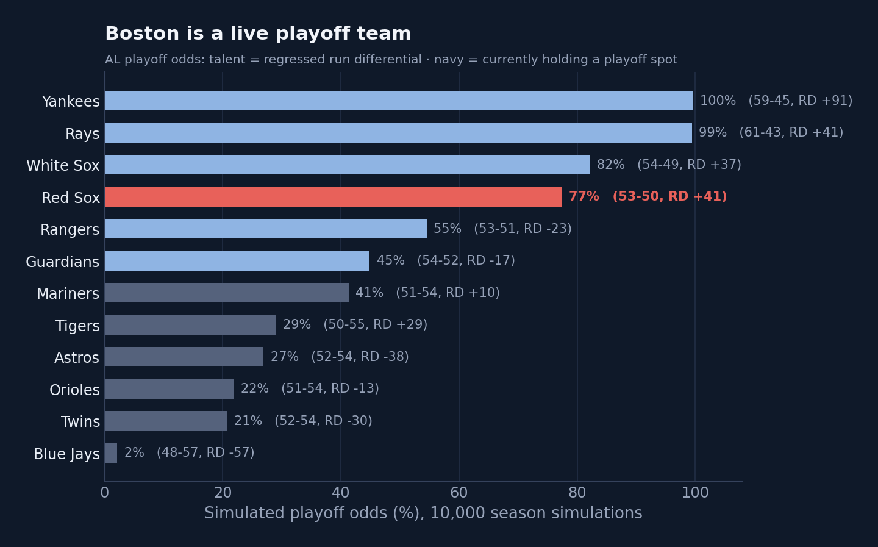
// THE VERDICT
Buy, Nibble At The Edges
Hold Duran
Duran has had a miserable season, but his underlying numbers are better than they seem. Positive regression candidate. Let him build up his value and flip in the offseason.
Keep the vets
Gray, Chapman, Contreras should not be sold now. Sell branch reopens only if the gap blows out by Aug 1.
Don't disturb the clubhouse
Back-end starter, reliever, RHH.
BOS // OUTFIELD STRATEGY STATCAST / FANGRAPHS / MLB STATS API / SPOTRAC · JULY 2026

Slide 4
// KEEP
Young, Controllable Outfield Core
Roman Anthony
Ceddanne Rafaela
Wilyer Abreu
LF · age 22
CF · age 25
RF · age 27
3.8
3.2
2.8
projected WAR / yr
projected WAR / yr
projected WAR / yr
$2.6M · 8yr/$130M ext
$2.0M · 8yr/$50M
$0.8M · pre-arb → 2029
Franchise bat. Untouchable. On the IL now, back in 2027.
Elite center-field glove + SS/utility flex. Premium position, controlled cheap.
Best surplus on the roster: plus RF glove, above-average LH bat.
Three spots, locked. Everything else flexes around them.
BOS // OUTFIELD STRATEGY STATCAST / FANGRAPHS / MLB STATS API / SPOTRAC · JULY 2026

Slide 5
// MOVE
The 4th Outfield Spot
Jarren Duran
Masataka Yoshida
LF/CF · 29 · $7.7M
DH · 32 · $18.6M
Movable piece. Controllable through 2028; above-average at true talent (~110 wRC+). Redundant behind the core and the priciest of the young group.
The contract, not the bat. He's hitting: above-average wRC+, .340-class OBP, one of MLB's lowest strikeout rates. $18.6M for a DH with below-average pop is still underwater as an asset.
Hold at the deadline. Duran has had a miserable season, but his underlying numbers are better than they seem. Positive regression candidate. Let him build up his value and flip in the offseason.
Keep him in the lineup. Gonzalez covers the tougher lefties. Platoon the DH spot and let it ride.
With Roman's status up in the air, hold both outfielders through this season.
BOS // OUTFIELD STRATEGY STATCAST / FANGRAPHS / MLB STATS API / SPOTRAC · JULY 2026

Slide 6
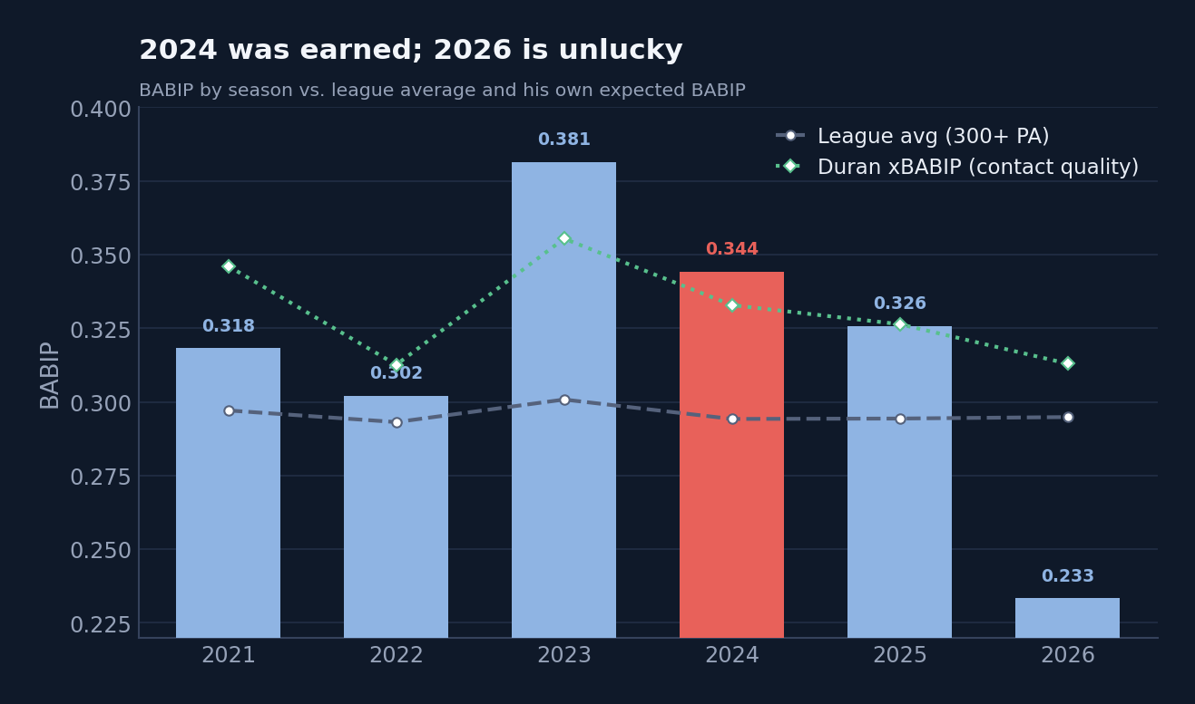
// DON'T SELL LOW
Duran's 2026 Is Unlucky
2024 was more what we should expect
BABIP .344 vs xBABIP .333; xwOBA .340 legit. Legs are still there, and defense is definitely improved.
2026 is the real anomaly
wOBA .263 BELOW its .293 xwOBA, 34 to 43 pts under his own norm; BABIP .238 vs .309 expected.
The legs are fine
Speed, baserunning and fielding all still plus. No injury.
True talent ≈ his 2025 (~110 wRC+)
An above-average regular. The 2024 high and 2026 low are tails around that plateau.
Wait for the rebound.
BOS // OUTFIELD STRATEGY STATCAST / FANGRAPHS / MLB STATS API / SPOTRAC · JULY 2026

Slide 7
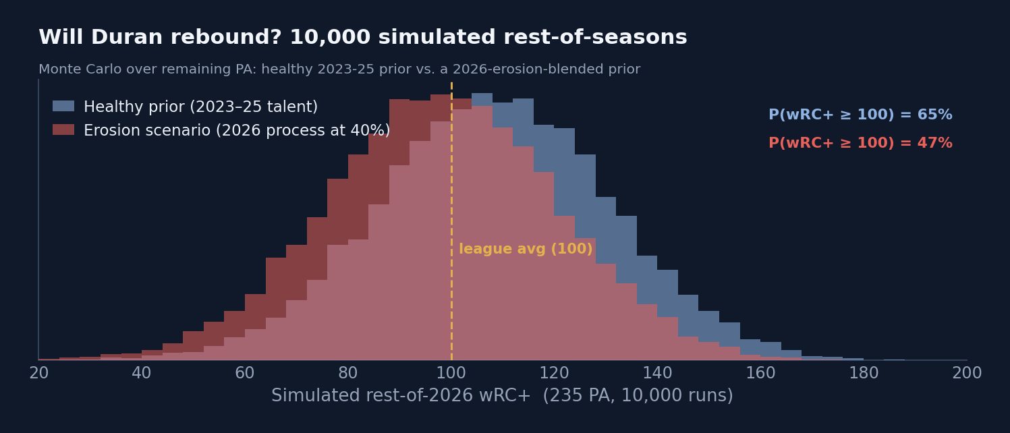
// THE REBOUND MATH
Duran Will Be Back
P(REST-OF-SEASON wRC+ ≥ 100)
69% healthy prior
47% erosion-blended
EXPECTED OFFSEASON TRADE VALUE
$22M vs $18M
either way, well above the ~$10M a July sale fetches
The honest line: the 22-point probability gap is the price of the worse chase / whiff / hard-hit rates. Hold-through-2026 survives the erosion stress test, but with less confidence in the rebound narrative itself.
BOS // OUTFIELD STRATEGY STATCAST / FANGRAPHS / MLB STATS API / SPOTRAC · JULY 2026

Slide 8
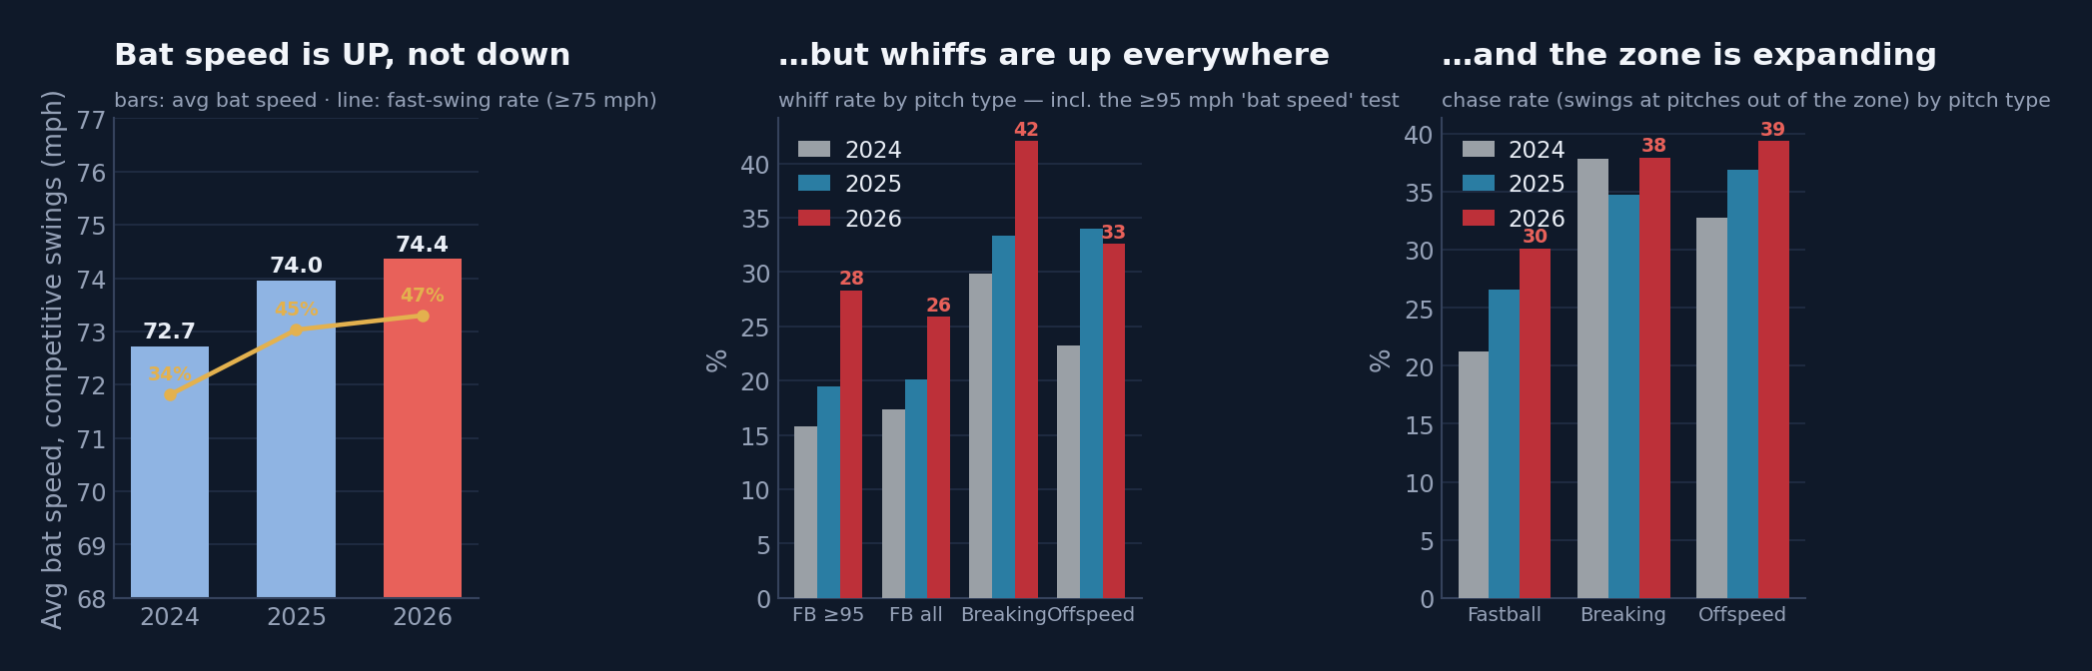
// THE TIEBREAKER
Duran Swing Stats
74.5 mph avg bat speed 2026, up from 72.7 in '24
29% whiff vs 95+ up from 16% in '24
60 / 40 re-weighted scenario odds → 60% rebound
Duran is swinging harder, longer and steeper than ever.
Whiffs on a rising bat speed. Breaking-ball chase actually improved, the problem is on velocity.
Approach is fixable (see his own 2022→23 chase overhaul); the tools a buyer prices are intact.
BOS // OUTFIELD STRATEGY STATCAST / FANGRAPHS / MLB STATS API / SPOTRAC · JULY 2026

Slide 9
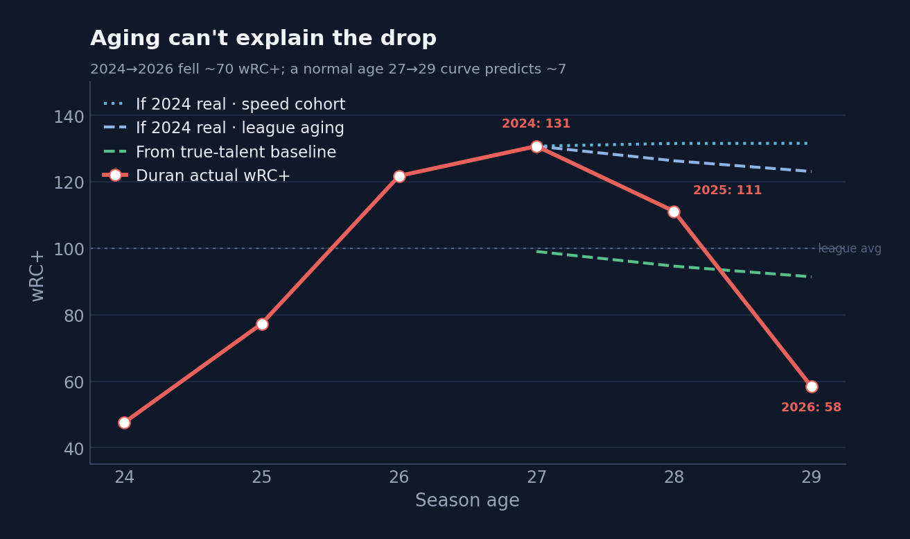
// CONTEXT
Aging Not A Factor For Jarren
2024 → 2026 wRC+ fell ~70 points; a normal age 27→29 curve predicts only ~7. The gap is mean-reversion from an inflated peak plus a 2026 bad-luck tail, not a skill cliff.
BOS // OUTFIELD STRATEGY STATCAST / FANGRAPHS / MLB STATS API / SPOTRAC · JULY 2026

Slide 10
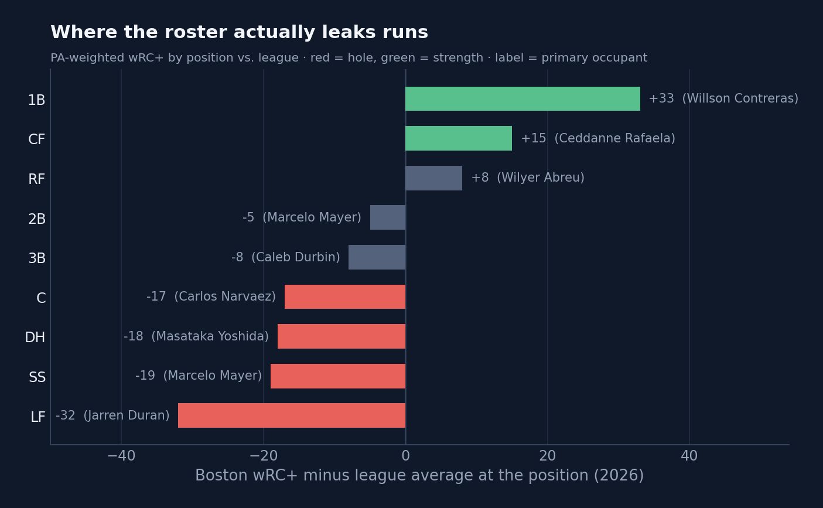
// IF THEY BUY, WHERE?
Left Field Is A Black Hole In 2026
LF −31: internal fix
Duran's regression, now sheltered by a Jahmai Jones platoon, plus Anthony's eventual return. Free.
SS −18: the true target
One controllable infield stabilizer is the only lineup trade that fits the odds.
Bullpen: quiet weakness
ERA top-10 but FIP and reliever WAR rank far worse, it will regress without help.
The Contreras twist
The winter's reported sell candidate is now their best hitter. Moving him would be met with outrage.
BOS // OUTFIELD STRATEGY STATCAST / FANGRAPHS / MLB STATS API / SPOTRAC · JULY 2026

Slide 11
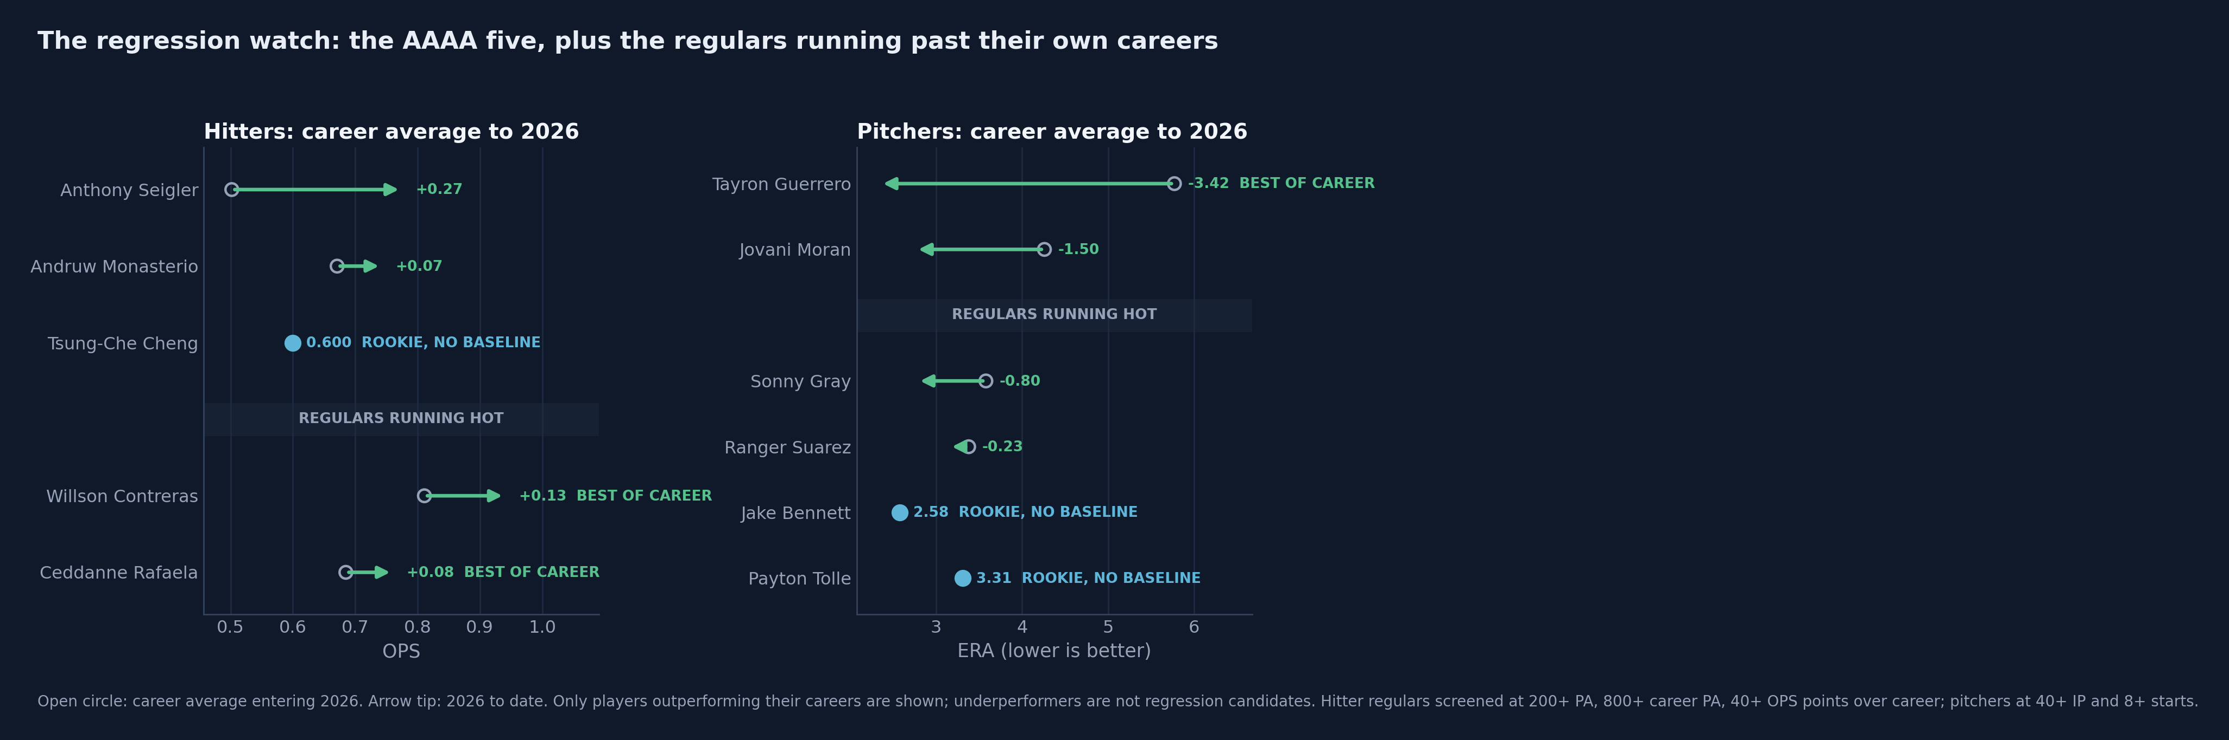
// THE SUPPORTING CAST
Regression Candidates
5 AAAA contributors on the roster
Waiver claims, up-down arms and career minor-leaguers holding real roles, +1.3 WAR combined.
1 career best, 2 rookies
The vets are beating their own track records; the rookies have no baseline at all.
The regulars are hot too
Same screen, lineup and rotation: Contreras +130 OPS pts, Rafaela +76 OPS pts; Gray and Suarez are also under their career ERAs. Expect good, not scorching, from here.
History backs the fade
2016-25, 100 hitter and 198 reliever cases: the median journeyman kept only 39% of a career-best first half (fig. 20).
Buy Buy Buy
Pick up a seasoned reliever and a right-handed hitter.
BOS // OUTFIELD STRATEGY STATCAST / FANGRAPHS / MLB STATS API / SPOTRAC · JULY 2026

Slide 12
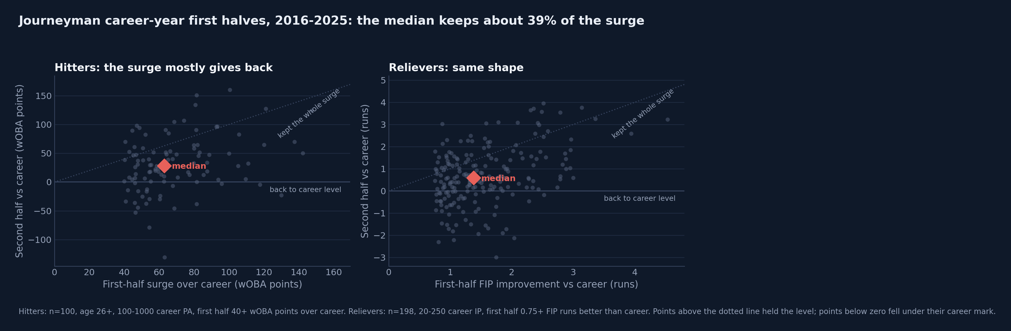
// THE BASE RATE
Career-year First Halves Usually Give Back
298 historical cases
2016-2025: 100 hitters and 198 relievers with the same profile as Boston's AAAA group: thin track record, age 26+, career-best first half.
Median kept 39%
The typical hitter held only 39% of his surge after July; relievers 37%.
A third fell all the way back
34% of hitters and 37% of relievers finished the second half at or below their career level.
So the surge is rented
Plan for the median, not the heater: replace borrowed production before August returns it.
BOS // OUTFIELD STRATEGY STATCAST / FANGRAPHS / MLB STATS API / SPOTRAC · JULY 2026

Slide 13
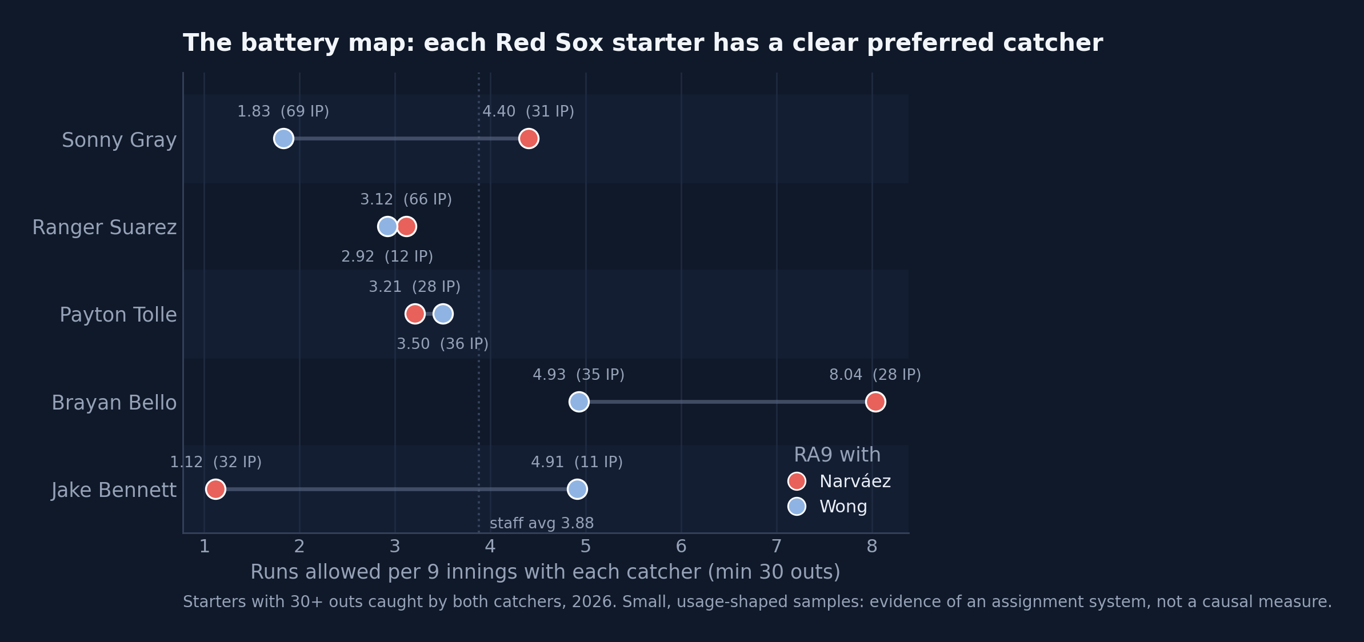
// THE CHEMISTRY VETO
Don't Mess Up The Pitching Staff
The staff works with both
3.42 RA9 with Wong, 4.20 with Narváez, the run-prevention core of the season.
Every arm has a guy. Don't mess with that
Gray / Wong. Bennett / Narvaez. Settled, deliberate assignments across the rotation.
So: no catcher trade
League catchers hit ~90 wRC+ and Wong beats that bar; the gap is all Narvaez's bat, and his value is the glove. The adjusted model agrees: -31 pts, CI [-84, +21], no significant catcher effect. A power bat would cost a top arm to fix a half-time problem.
BOS // OUTFIELD STRATEGY STATCAST / FANGRAPHS / MLB STATS API / SPOTRAC · JULY 2026

Slide 14
// THE MENU
Possible Trades
1 · THE PEN FIX · DO IT
2 · MID LEVEL STARTER
RHP Luke Weaver (NYM)
RHP Michael Wacha (KCR)
For a 45 FV + 40 FV, prospects only, nobody loses a job or an inning. Elite relief year, signed through '27. The highest-probability marginal win on the board.
A 40 FV flier for a veteran back-end starter while Crochet and Sandoval build back. Buy-low alt: Gausman, whose FIP beats his ERA, the mirror of the Early sale.
3 · THE SHORTSTOP · PROBABLY WAIT
✗ · THE WALK-AWAY
SS Zach Neto (LAA)
C Shea Langeliers (ATH) / Hunter Goodman (COL)
For Tolle / Bennett + a 45 FV: two arms out of a winning rotation midseason. Right for the franchise window, and still there in the winter. Blocks Mayer or Arias as well. Controlled through 2029.
Not worth overpaying for either. Langeliers just hit the 10-day IL with a torn meniscus, so Goodman's price shoots through the roof. Boston was right not to pay for a catcher bat it never needed.
A menu, not a plan, Boston can afford about two. Full value math and verified contracts in the mock-trades memo. Hypotheticals, not reporting.
BOS // OUTFIELD STRATEGY STATCAST / FANGRAPHS / MLB STATS API / SPOTRAC · JULY 2026

Slide 15
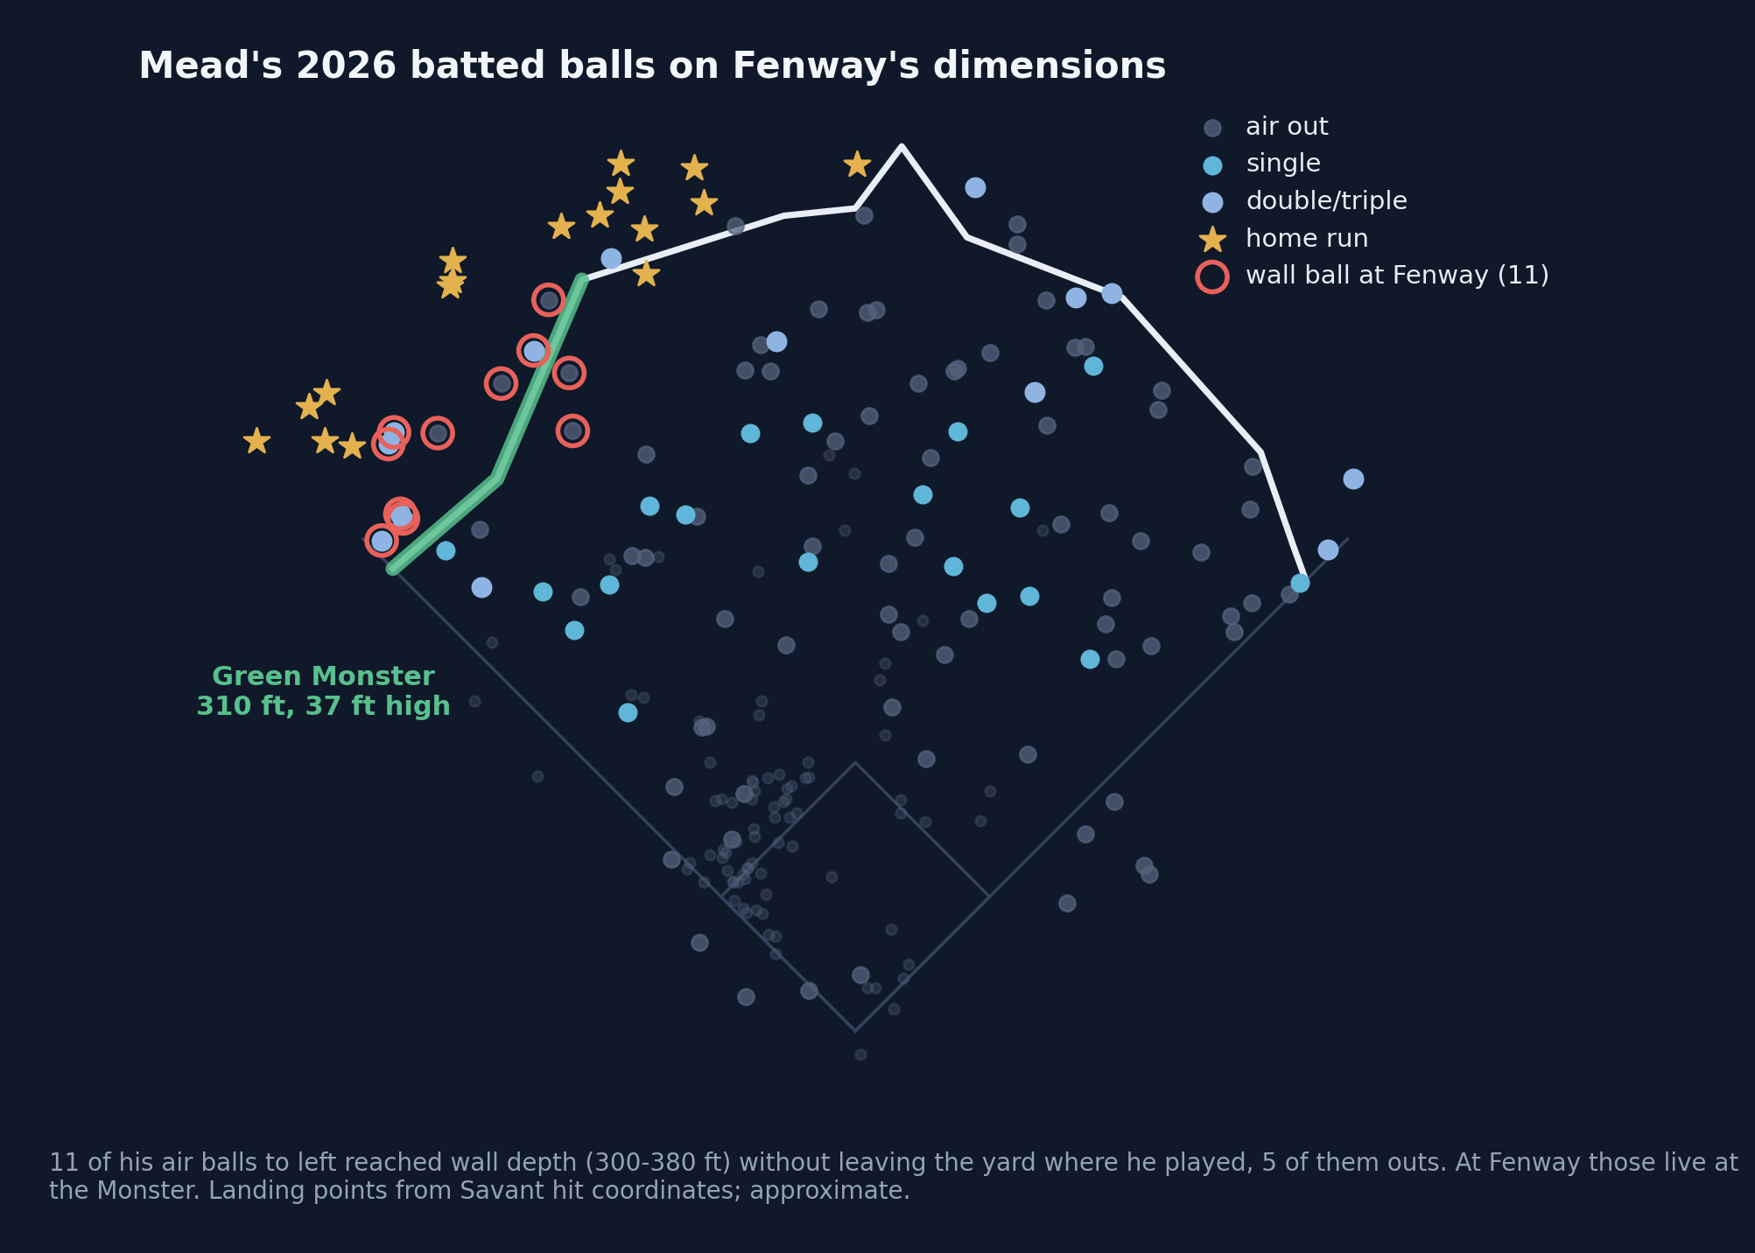
// THE REAL TRADE
New Acquisition: Mead Breakdown
The deal
Curtis Mead (25) from Washington for Connelly Early: one surplus arm for a former top-100 prospect at a 134 wRC+ with years of club control.
The Fenway fit
23% pull-air rate (82nd pctile). Replaying his Monster-zone contact as wall doubles takes him from a .376 wOBA to about .386 on a half-home schedule.
Earned, mostly
.376 wOBA against a .359 xwOBA, so the breakout has contact quality behind it. The flag: 488 PA of .617 OPS before this year.
Menu grade
The big-swing shape at half the price, and the infield hole filled. The pen fix is still open, 8 days left.
BOS // OUTFIELD STRATEGY STATCAST / FANGRAPHS / MLB STATS API / SPOTRAC · JULY 2026

Slide 16
// THE TRADE, GRADED
Why Mead for Early wins for Boston
What they gave: Connelly Early
What they got: Curtis Mead
The ERA flattered him. 3.44 ERA over a 4.61 FIP, a +1.17 gap, the most of any Boston starter. Sold at peak perception.
A controllable, earned bat. Former top-100 prospect, 134 wRC+ at 25, backed by a .359 xwOBA. Years of club control at the position the audit flagged.
The smallest frame in the pipeline. 6' 3", 195 lbs. Durability risk the org's other arms don't carry.
Built for the park. 23% pull-air rate (82nd percentile). RHB pull-air plays to the Monster.
The factory keeps producing: Tolle (6' 6", 250 lbs, 3.31 ERA / 3.24 FIP) and Bennett (6' 6", 234 lbs, 2.58 / 3.12) are bigger, more durable and better by FIP. Boston develops arms; it bought the bat it could not grow.
BOS // OUTFIELD STRATEGY STATCAST / FANGRAPHS / MLB STATS API / SPOTRAC · JULY 2026

Slide 17
BOTTOM LINE
What I'd Do Before August 3
78%
+41
8
39%
PLAYOFF ODDS
RUN DIFF
DAYS LEFT
OF A CAREER-BEST HALF SURVIVES, HISTORICALLY
1
Finish the shopping: a reliever and innings. A Weaver-class arm for prospects and a Wacha-class starter for a flier. Nobody in the room loses a job; two quiet wins get covered.
2
Trust the diagnosis, not the heater. The regression watch says plan for the fade. Mead, the returning injured bats, and Duran's own regression are the real September lineup.
3
Hold Duran. Decide in the winter. His value is at rock bottom while the underlying numbers say rebound. Buyers read xstats too; nobody pays 2024 prices in August 2026.
Every number on these slides regenerates from live data. Predictions frozen July 4 and July 26, graded in October, flattering or not. justinloo12.github.io/red-sox-trade-deadline-thoughts

