Slide 1
BOSTON CELTICS · FIT CHECK
Breaking Down
the Jaylen Brown Trade
On July 1, 2026 Boston traded Brown to Philadelphia for Paul George and picks. This is a breakdown on why the trade might not be all bad news for Boston. In the world of "that boy tuff" and analytical basketball, this is a Celtics fan's version of this trade.
Numbers, not takes · nba_api + Basketball-Reference · unit-tested pipeline

Slide 2
THE SETUP
A $53M wing that shoots long twos, and a live or die by the three pointer system
34.4%
+16%
4
of the salary cap
worse shot diet, YoY
assets back from PHI
$53.1M in 2025-26 — over a third of the sheet on one wing
bad-shot index 0.328 → 0.379 — drifting away from the system
Paul George, a 2028 first, a 2031 unprotected first, two seconds
Boston's edge is shooting more threes than opponents. The question this deck answers with data: did Brown's game pull with that identity or against it, and was the return worth it?
Fit Check · Jaylen Brown Trade Audit Data: nba_api / Basketball-Reference · 2024-25 & 2025-26 · July 2026

Slide 3
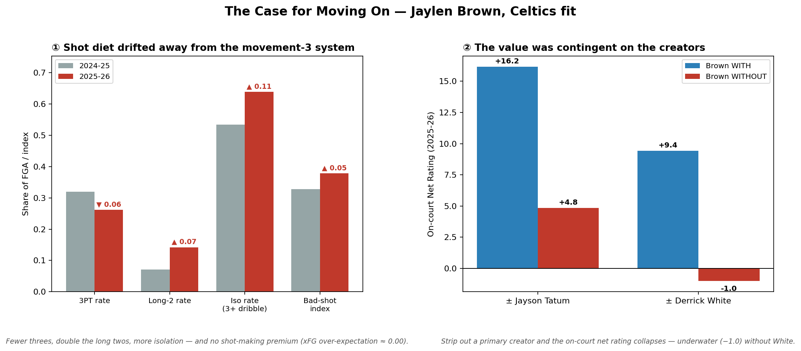
THE SHOT DIET
The shot profile was drifting away from what Boston wins with
Fewer threes, doubled long twos
3PT rate fell 0.32 → 0.26; long-two rate doubled 0.07 → 0.14 — the one shot the system exists to kill.
Two-thirds self-created
Iso / 3+ dribble rate rose 0.53 → 0.64, with more late-clock bailouts (0.18 → 0.22).
No tough-shot premium
The xFG model (2,661 shots) scores his shot-making at expectation — ≈ 0 both years. The difficulty is self-inflicted.
Brown's own shot selection drifted far away from what the system is built on, and his "tough" shot making isn't good enough to excuse it.
Fit Check · Jaylen Brown Trade Audit Data: nba_api / Basketball-Reference · 2024-25 & 2025-26 · July 2026

Slide 4
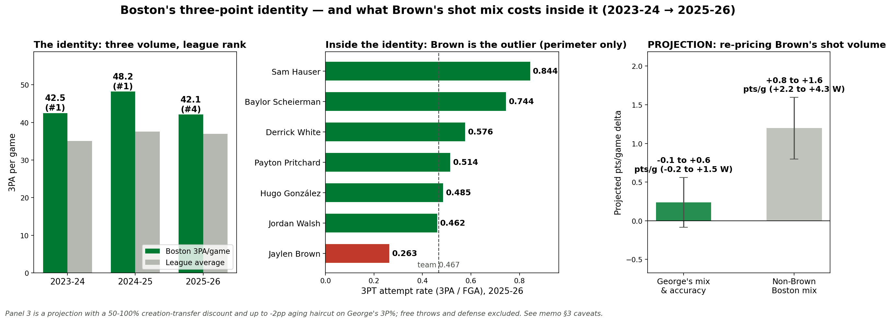
THE GAME PLAN
Boston's identity is math and Brown ruins it
#1 · #1 · #4 in three-point volume and a top-2 offense all three years. Threes returned 1.10 points per shot vs 0.97 for twos. Brown: last of 7 perimeter players in 3PT rate (.263 vs team .467), first in long twos. A shot-mix problem, not a finishing one (his 1.046 PPS vs 1.101).
Fit Check · Jaylen Brown Trade Audit Data: nba_api / Basketball-Reference · 2024-25 & 2025-26 · July 2026

Slide 5
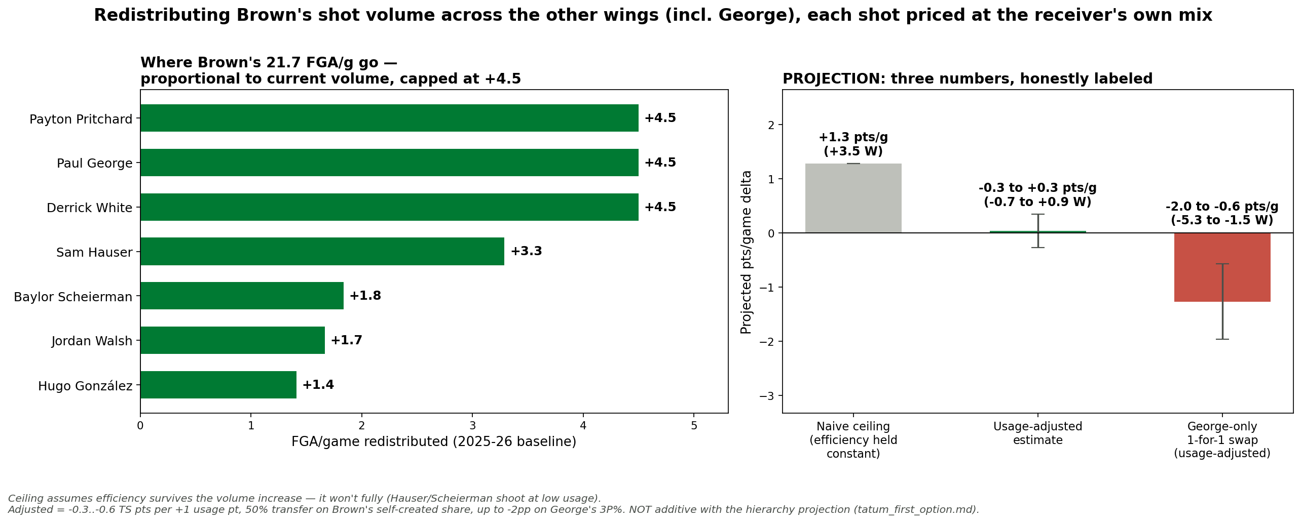
WHERE THE SHOTS GO
Redistribute Brown's 21.7 shots to the wings
Ceiling: +1.3 pts/g (~3.5 wins) if every wing's efficiency survived the extra volume — it won't. Usage-adjusted: roughly a wash (−0.7 to +0.9 wins). And the George-only 1-for-1 is negative for the Celtics. The real upside is Tatum's creation (5.7-6.1 ast, .498 3PT-rate gravity) upgrading the shots these wings get, and that effect is already measured in the +11.9 Tatum-led lineups. Combined honest range: ~+4 to +8 wins (without Brown this year).
Fit Check · Jaylen Brown Trade Audit Data: nba_api / Basketball-Reference · 2024-25 & 2025-26 · July 2026

Slide 6
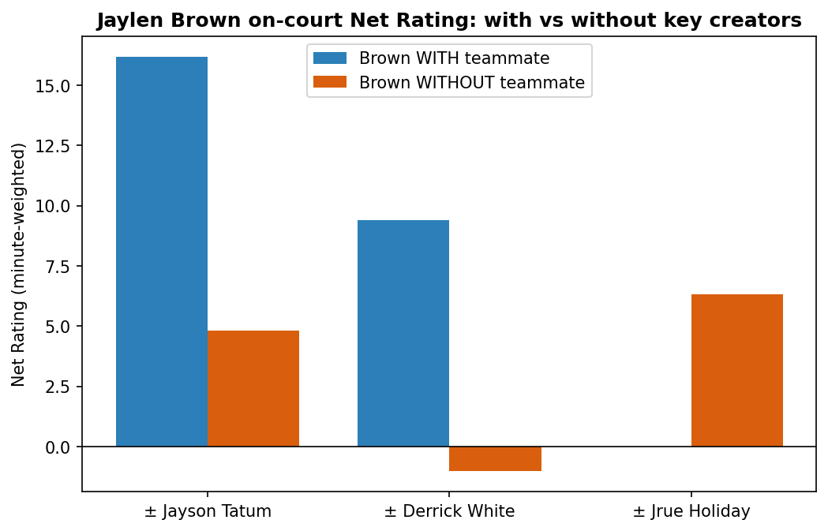
CONTINGENT VALUE
The production needed Tatum and White to prop it up
With Tatum: +16.2 · without: +4.8
An 11.3-point swing in 2025-26. Brown's lineups won when the infrastructure was on the floor.
With White: +9.4 · without: −1.0
Same story with the other connector — Brown-led lineups without White were underwater.
The honest caveat
Tatum's injury contaminates the 2025-26 split; the confound is documented, not hidden. It softens — but doesn't reverse — the pattern.
A $53M player whose value is contingent on his co-stars is a fit problem, not a star.
Fit Check · Jaylen Brown Trade Audit Data: nba_api / Basketball-Reference · 2024-25 & 2025-26 · July 2026

Slide 7
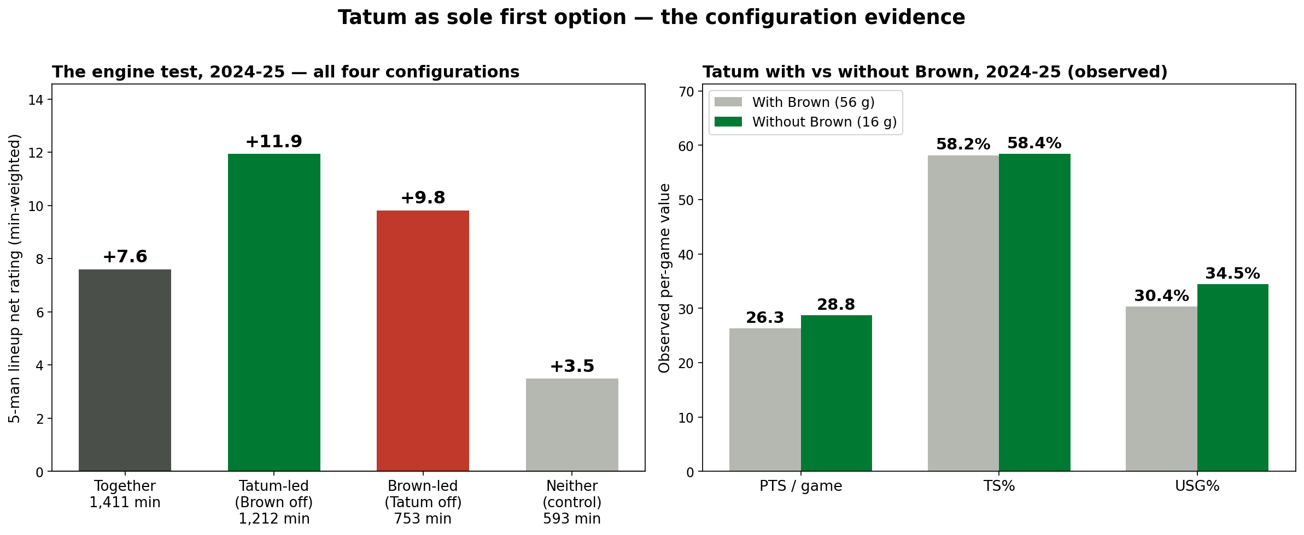
THE HIERARCHY TEST
First-option Tatum will be a problem (in a good way)
25-4 (86.2%) when Brown sat
29 games, 2023-present, +13.3/game — including 10-0 in the title year. Both healthy: 73.7%. Lineups: Tatum-led +11.9 > together +7.6 > neither +3.5 (control).
Usage up, efficiency mostly holds
Pooled: 28.0/7.9/5.7 at 34.6% usage (+4.7 pts of usage), TS .593 → .572 — a modest efficiency dip, printed, not hidden.
Worth ~5-7 wins a season
Projection, not observation: the +4.3 lineup gap, shrunk 40-60% for bench/garbage contamination → +1.7-2.6 team net → +4.7-7.0 wins.
Tatum's projected solo season: 27.2-28.8 pts · 7.8-8.9 reb · 5.1-6.2 ast · .566-.584 TS
Fit Check · Jaylen Brown Trade Audit Data: nba_api / Basketball-Reference · 2024-25 & 2025-26 · July 2026

Slide 8
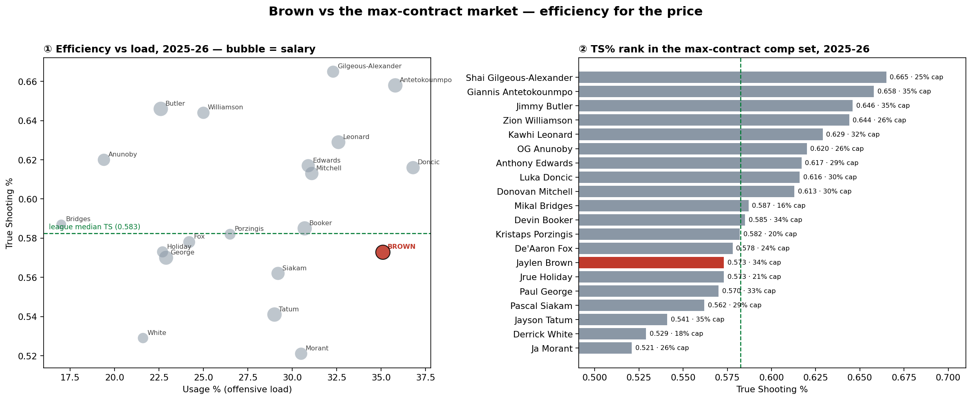
THE CONTRACT
Max-contract price, below-median-efficiency production
6.9 WS on $53.1M = $7.7M per win share at 34% of the cap, with a 0.573 TS%, below the max-wing median. Picks 15-30 buy the same wins at ~$2.1M/WS on rookie deals.
Fit Check · Jaylen Brown Trade Audit Data: nba_api / Basketball-Reference · 2024-25 & 2025-26 · July 2026

Slide 9
THE RETURN
George is the cleaner fit for the Celtics system, and new lottery odds
2025-26 shot profile
PLUS THE PICKS
BROWN
GEORGE
2028 first + 2031
unprotected first
3PT rate
0.262
0.497
Catch-&-shoot rate
0.163
0.409
Under the post-2019 flattened lottery exact odds enumerated across all 24,024 seed permutations, late-lottery firsts convey materially more top-4 equity than the old system.
Iso / 3+ dribble rate
0.639
0.404
Contested-shot rate
0.517
0.370
Bad-shot index
0.379
0.273
George takes the shots the system is built to generate. He plugs in instead of stopping it.
Cheap, controllable, tradeable — the assets a capped-out roster can't otherwise get.
Fit Check · Jaylen Brown Trade Audit Data: nba_api / Basketball-Reference · 2024-25 & 2025-26 · July 2026

Slide 10
WHERE THE CASE IS WEAKEST
The counter-evidence, on the record
1
2
3
Brown could carry
The defense is a real loss
The turnover tax wasn't his
His 7-game solo cell was the best in the 2024-25 matrix (6-1, +15.8), and he carried 58 games alone in 2025-26 at 28.9 ppg (36-22, +5.7). The man can be a first option — just not here.
Brown took 19% of his defended possessions against opponents' #1 options (Tatum: 8%) at better points-allowed, with -4.2/-5.7 defended-FG% margins. Boston traded its toughest assignment.
Play-by-play says Brown's live-ball TO rate (1.75/36) was LOWER than Tatum's (1.84) in 2024-25. That angle exonerates him — and the media consensus graded the trade for Philadelphia.
Brown as an individual is a remarkable basketball player, there is no denying that. But he was just an expensive player that didn't quite fit what the Celtics are trying to do. The data says the best version of this team was always Tatum at the top.
Fit Check · Jaylen Brown Trade Audit Data: nba_api / Basketball-Reference · 2024-25 & 2025-26 · July 2026

Slide 11
BOTTOM LINE
The fit was real and it was drifting. Fewer threes, doubled long twos, two-thirds self-created — with no shot-making premium to pay for it.
The value was contingent. Brown-led lineups needed Tatum and White on the floor; at 34% of the cap, contingent is expensive.
The return buys identity and optionality. George takes the system's shots; two firsts add the cheap, controllable assets a capped roster can't otherwise acquire.

