Slide 1
Couchbase and Spark
Notes:
Welcome
Introduction

Slide 2
Agenda
Couchbase Overview
Couchbase Data Pipeline
Spark
Demo
Q&A

Slide 3
















What is Couchbase?
Couchbase is the company behind Couchbase Server & Couchbase Mobile
Open source JSON database
Founded 2010
400+ enterprise customers globally
Some of our customers:
Couchbase Server can be deployed as:
Document database
Key-value store
Distributed cache

Slide 4
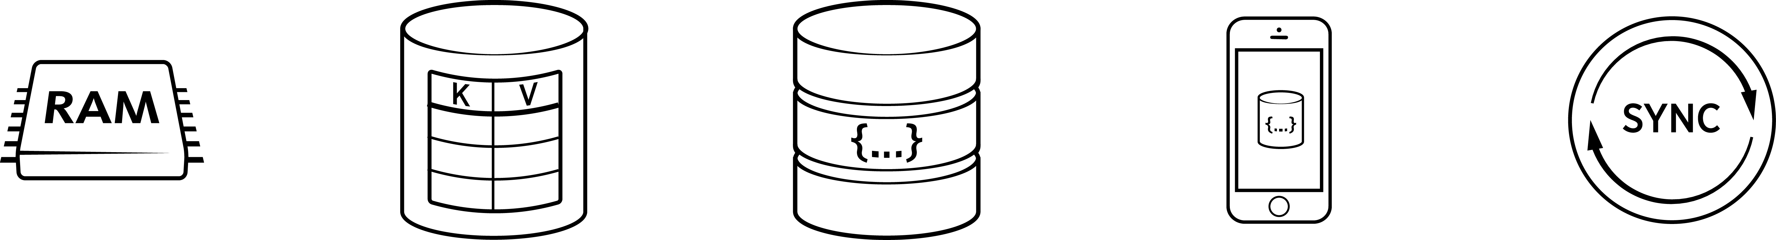
Couchbase Server Defined
The first NoSQL database that enables you to develop with agility and operate at any scale.
Managed Cache
Key-Value Store
Document Database
Embedded Database
Sync Management
Notes:
KEY POINT: COUCHBASE HAS YOU COVERED FOR YOUR GENERAL PURPOSE DB NEEDS. FROM CACHING TO KV STORE, TO JSON DOCUMENT STORE, TO MOBILE APPS. NO OTHER NOSQL DB VENDOR HAS THIS BREADTH AND DEPTH OF TECHNOLOGY
The purpose of this slide is to discuss the high level concepts of Couchbase, and if the SE wants to discuss what parts of Couchbase make up each concept. It is not to go over specific technologies like N1QL, ODBC, etc

Slide 5
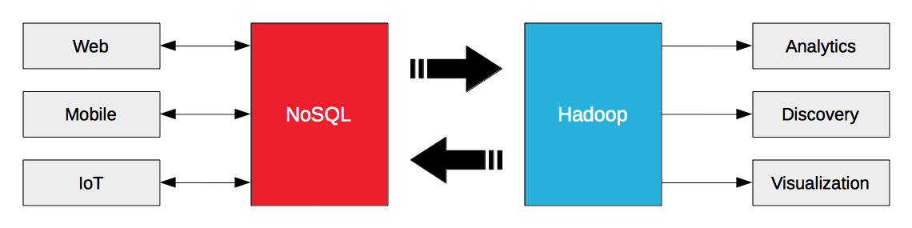
Couchbase and Hadoop
Couchbase is primarily online operational NoSQL datastore, low latency, scalable
Data Source
Example: Pulling user profiles into Hadoop for deep analytics
Data Sink
Example: training machine learning models that are then cached / served from Couchbase

Slide 6





At a Glance
 | Couchbase | Spark | Hadoop (Hive)
Use cases | Operational Web / Mobile | Analytics Machine Learning | Analytics Machine Learning
Processing mode | Online Ad Hoc | Ad Hoc Batch Streaming (+/-) | Batch Ad Hoc (+/-)
Low latency = | < 1ms ops | Seconds | Minutes
Performance | Highly predictable | Variable | Variable
Users are typically… | Millions of customers | 100’s of analysts or data scientists | 100’s of analysts or data scientists
 | Memory-centric | Memory-centric | Disk-centric
Big data = | 10s of Terabytes | Petabytes (?) | Petabytes
OPERATIONAL
ANALYTICAL
Notes:
Use cases are totally different – Spark is an execution engine, not a database.
A prime use case for Hadoop is as a low cost data warehouse, which is not a good use case for Couchbase or Spark
Latency - Everyone says real time, but what do mean?
For an operational system, this means:
Extremely fast (in-memory) reads
Extremely fast (log append) writes
For Couchbase, complete millions of ops / second (these are gets / sets) at latencies of under 1ms, compare LinkedIn figures from Jerry Franz’s session
Tuned to LinkedIn’s specific workload: 75% writes (sets + incr) / 25% reads – 13 byte values, 25 byte keys on average
2.5 billion items (+ 1 replica)
600 Gbytes of RAM / 3 Tbytes of disk in use on average
Average store latency ~ 0.4 milliseconds
99th percentile store latency ~ 2.5 milliseconds
Average get latency ~ 0.8 milliseconds
99th percentile get latency ~ 8 milliseconds
In general, Spark is just better at Hadoop’s core use cases than Hadoop (note, I’m not talking about HDFS)
Spark is much better for highly iterative algorithms and interactive queries – which is important, given that the majority of jobs work on 100GB or less of data (small big data)
Spark scale – less than Map Reduce based solutions on Hadoop, but that’s OK – “[T]he majority of real-world analytics jobs process less than 100GB of input, but popular infrastructures such as Hadoop/MapReduce were originally designed for petascale processing.” http://www.msr-waypoint.com/pubs/204499/a20-appuswamy.pdf
This is especially convenient for people with development background who like to run "stuff" (ad-hoc queries) on data in hadoop/hdfs. This remove the need to know about the underlying hadoop layer and just think of it as data.

Slide 7


Why are they needed?
Operational
Analytical
Velocity
Volume

Slide 8




How do they help?
Operational
Velocity
Analytical
Velocity
Analytical
Volume

Slide 9



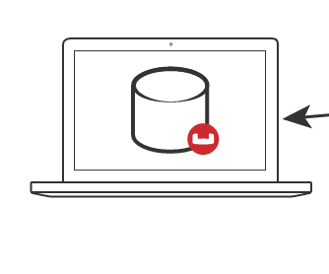
Connectors - Overview
unknown application users
analyst/data scientist/engineers
Spark
NoSQL Database
DCP
Kafka
Hadoop
Sqoop
XDCR v1
Storm
Elasticsearch
Notes:
Work people do in these systems -
Training ML models
ETL / Data wrangling
Aggregations
Reporting / BI
Kafka is a data multiplexer – some people are still going to want to do this, but it’s designed for higher latency applications with a known high complexity (e.g. ebay – many different consumers for information)
Traditional data warehouse – definitely will be a different programming language – how do you make sense of the data feed? You get into the problems that making changes on one side introduces tons of complexity on the other
Downsides – maturity is not 100% on the Spark side, still in active development in the Couchbase side
KV / N1QL

Slide 10
Couchbase Spark Connector

Slide 11
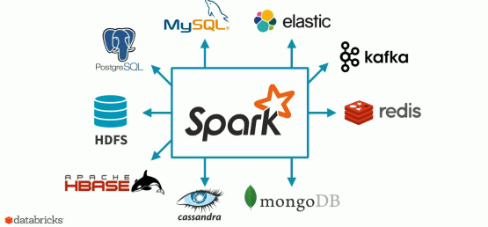


Connects to everything…
Source: Databricks https://www.brighttalk.com/webcast/12891/196891
DCP
KV
N1QL
Views

Slide 12
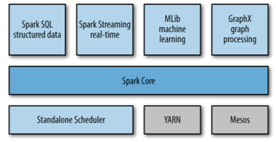
Spark
Fast and general engine for big data processing with libraries for advanced analytics
Spark Core:
task scheduling
memory management
fault recovery
interacting with storage systems
Notes:
Spark Core
Automatic Cluster and Resource Management
Creating and Persisting RDDs
Java, Scala APIs
Spark SQL
Easy JSON handling and querying
Tight N1QL Integration
Spark Streaming
Persisting DStreams
DCP source (experimental)

Slide 13
Anatomy of a Spark Application
Driver Program
Cluster Manager
SparkContext
Spark Worker
Data Node
Data Node
Executor
Task
Couchbase
Couchbase
Couchbase
Notes:
Spark Application = a user program built on Spark. It includes the driver program and the executors on the cluster.
Application jar – a jar containing the users application along with its dependencies.
Driver program – The process running the main() function of the application and creating the SparkContext
Executor - A process launched for an application on a worker node, that runs tasks and keeps data in memory or disk storage across them. Each application has its own executors.

Slide 14
Couchbase Spark Connector
Operational
Data Store
XDCR
Separate cluster for workload isolation
Results streamed back as needed to support applications

Slide 15
For Spark / Hadoop – Couchbase to Operationalize Spark
Fast (memory – centric)
Flexible
Scalable
Operations
Analysis
Notes:
Analyze other

Slide 16
Couchbase Spark Connector
application users
data scientists &
data engineers
DCP
Features
Automatic cluster & resource management
Create RDDs from KV, N1QL, Views
Create DStreams from DCP feeds
Persist RDDs and Dstreams
Support for DataFrames and SparkSQL
Notes:
Analyze other

Slide 17
Couchbase Spark Use Case #1: Data Integration
Data scientists / data engineers run queries across data in many systems using one language & runtime
Store results where needed for further use (like Couchbase)
Late binding of schemas
DCP
hdfs
s3
RDBMS
Elasticsearch
Notes:
Analyze other

Slide 18
Couchbase Spark Use Case #2: Machine Learning
Data scientists train machine learning models
Load results into Couchbase so end users can interact with them online
Examples including recommendations for content and products, flagging fraud or spam
DCP
Machine Learning Models
Data Warehouse
Hadoop
Historical Data
Notes:
Analyze other

Slide 19
Couchbase Spark Connector
Available Now: 1.1 GA
Spark Core
Create RDDs from Documents, Views and N1QL Queries
Write RDDs into Couchbase
Automatic cluster and resource management
Predicate pushdown
Spark SQL – Data frames based on N1QL
Spark Streaming
Persist DStreams
Experimental support: create Spark streams use DCP feeds
Possible Future Releases
Maintenance releases most months
Support for Spark 1.6
Spark R
N1QL & view on RDDs
Hints for views & queries
Databricks certification
Schema inference on random docs
github.com/couchbaselabs/couchbase-spark-connector
https://issues.couchbase.com/projects/SPARKC
Notes:
Fully transparent cluster and bucket management, including direct access if needed

Slide 20
Learn More - Couchbase Spark Connector
Github Repo
https://github.com/couchbaselabs/couchbase-spark-connector
Spark with Couchbase to Electrify your Data Processing
https://youtu.be/sBnAf7gAfLc
Docs
http://developer.couchbase.com/documentation/server/4.0/connectors/spark-1.0/spark-intro.html
Avalon Consulting blog and Github repo (Market Basket Analysis)
http://blogs.avalonconsult.com/blog/big-data/combining-operational-and-analytical-big-data-using-couchbase-and-spark-a-market-basket-analysis-example/
https://github.com/Avalon-Consulting-LLC/couchbase-spark-mba
Notes:
Fully transparent cluster and bucket management, including direct access if needed

Slide 21
Spark (ElephantScale)

