Slide 1
Introduction to Spark
Notes:
Session 2: Introduction to Spark

Slide 2

HI, I’m Sujee Maniyam
Founder / Principal @ Elephant Scale
Consulting & Training in Big Data
Spark / Hadoop / NoSQL / Data Science
Author
“Hadoop illuminated” open source book
“HBase Design Patterns”
Open Source contributor: github.com/sujee
sujee@elephantscale.com
www.ElephantScale.com
Checkout our trainings !

Slide 3
Current Big Data Processing Challenges
Processing needs outpacing 1st generation tools
MapReduce (MR) / Hadoop has major limitations
MR performance bottlenecks
Batch processing doesn't fit needs
Programming can be difficult and verbose
Scheduling is sensitive to Slave/worker nodes processing speed and can impact execution time by 25% to %35.
Spark is a 2nd generation tool addressing these needs
One of the premier next generation technologies
Let's look at it
Session 2: Introduction to Spark
Notes:
MapReduce / Hadoop has become a primary tool in the big data processing arena
It does some things extremely well
It grabbed mind and market share early on, along with organizations that supported it
As a result, it plays a dominant role in the big data processing landscape
The limitations of Hadoop are becoming apparent
As big data technologies become more common, the range of tasks they need to deal with are growing
Organizations are no longer willing to live with the shortcomings of existing technology just because they brought capabilities that didn't exist before
As a result, new technologies and products are emerging to augment, and in some cases replace, existing technology
Session 2: Introduction to Spark

Slide 4
What is Spark?
Open source cluster computing engine
Very fast: In-memory ops 100x faster than MR
On-disk ops 10x faster than MR
General purpose: MR, SQL, streaming, machine learning, analytics
Compatible: Runs over Hadoop, Mesos, Yarn, standalone
Works with HDFS, S3, Cassandra, HBase, …
Easier to code: Word count in 2 lines
Spark's roots:
Came out of Berkeley AMP Lab
Now top-level Apache project
Ver 1.6 in Jan 2015
“First Big Data platform to integrate batch, streaming and interactive computations in a unified framework” – stratio.com
Session 2: Introduction to Spark
Notes:
Understanding Spark execution model is vital for writing good spark programming.
Built using Scala – a functional programming and supports Java, Scala and Python
List of companies and orgs that are using and supporting Spark - https://cwiki.apache.org/confluence/display/SPARK/Powered+By+Spark
Session 2: Introduction to Spark

Slide 5
Spark Eco-System
Apache top level project
Very active, fast growing community ⁽¹⁾
Databricks: supporting / developing Spark
Founded by Spark's creators
Employs the most active committers
Hadoop vendors (Cloudera / Horton Works)
Include Spark in their distributions
Spark packages repository: Community index of Spark add-ons
http://spark-packages.org/
Session 2: Introduction to Spark
Notes:
(1) Spark had over 465 contributors in 2014 and 822 in 2015
This made it the most active Apache project, as well as the most active Big Data open source project
[http://en.wikipedia.org/wiki/Apache_Spark and https://www.openhub.net/p/apache-spark]
Session 2: Introduction to Spark

Slide 6
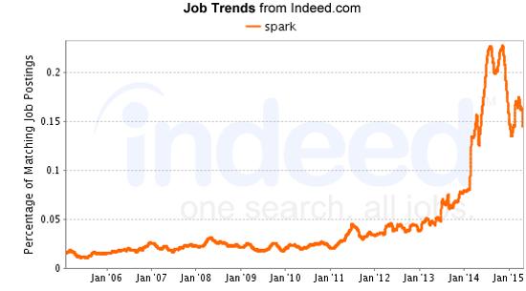
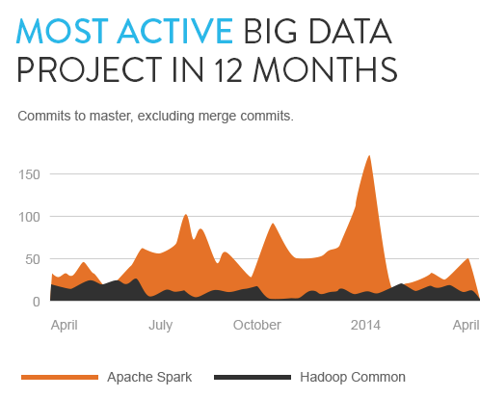
Used More and More
Source : stratio.com
Session 2: Introduction to Spark
Notes:
See https://www.openhub.net/p/apache-spark for some current usage stats
Session 2: Introduction to Spark

Slide 7
Spark Illustrated
Schema / SQL
Real Time
Machine Learning
Graph Processing
Spark
SQL
Spark
Streaming
ML lib
Graph
Spark Core
Cluster
managers
Standalone
YARN
MESOS
Data Storage
S3
HDFS
Cassandra
Couchbase
Session 2: Introduction to Spark
Notes:
See the next slide for a brief explanation of each component
Session 2: Introduction to Spark

Slide 8
Spark Structure
Data Storage: Pluggable data storage systems
Integrates with HDFS, S3, Cassandra DB and more
Cluster Manager: Manages distributed node clusters
Provides the distributed execution environment
Works with Mesos, Yarn, and it's own standalone manager
Spark Core: Distributed Compute Engine
Spark Components: Modules layered on top of core
Specialized functionality - e.g. Spark SQL for SQL-based querying
Session 2: Introduction to Spark
Notes:
We will get into much more detail on how each of these components works and how they integrate together
Standalone manager is called Scheduler
Along with SQL, it also support HQL – Hive Query Language.
Session 2: Introduction to Spark

Slide 9
Spark Core
Basic building blocks for distributed compute engine
Task schedulers and memory management
Fault recovery (recovers missing pieces on node failure)
Storage system interfaces
Defines Spark API and data model
Data Model: RDD (Resilient Distributed Dataset)
Distributed collection of items
Can be worked on in parallel
Easily created from many data sources (Any HDFS InputSource)
Spark API: Scala, Python, and Java
Compact API for working with RDD and interacting with Spark
Much easier to use than MapReduce API
Session 2: Introduction to Spark
Notes:
We will get into much more detail on how each of these components works and how they integrate together
RDD – is akin to a table in a database. It can hold any type of data.
RDD helps in computation and optimization of data processing.
RDD is also fault tolerance – it can recreate itself.
Session 2: Introduction to Spark

Slide 10
Spark Components
Spark SQL: Structured data
Supports SQL and HQL (Hive Query Language)
Data sources include Hive tables, JSON, CSV, Parquet ⁽¹⁾
Spark Streaming: Live streams of data in real-time
Low latency, high throughput (1000s events / sec)
Log files, stock ticks, sensor data / IOT (Internet of Things) …
ML Lib: Machine Learning at scale
Classification/regression, collaborative filtering …
Model evaluation and data import
GraphX: Graph manipulation, graph-parallel computation
Social network friendships, link data, …
Graph manipulation and operations and common algorithms
Session 2: Introduction to Spark
Notes:
(1) Parquet is an on disk columnar format that is heavily compressed
Spark Streaming – user activity, user updates, etc.
Session 2: Introduction to Spark

Slide 11
Spark Use Case Examples
Ooyala (video content)
Personalized video recommendations
Spark & Cassandra
Open sourced Spark Job Server
https://github.com/spark-jobserver/spark-jobserver
http://engineering.ooyala.com/blog/fast-spark-queries-memory-datasets
Spark at Yahoo ⁽¹⁾
News personalization
120 line Scala program with MLlib replaced 15,000 lines of C++
Took 30 min to run on 100 million data set of samples
Session 2: Introduction to Spark
Notes:
(1) http://www.datanami.com/2014/03/06/apache_spark_3_real-world_use_cases/
Session 2: Introduction to Spark

Slide 12
Spark Use Cases Contd…
Alibaba
Discover e-commerce communities (forming around a product)
Netflix
Analyze streaming events (450 Billion events / day)
Personalization / Recommendations

Slide 13



Spark @ Large Scale
Cluster
8000 nodes
400 TB+ data
@ Tencent (Social network in China)
Single job
1 PB
Image processing @ Alibaba
Streaming
1 TB / hour
Analyze medical images @ Jenelia farm
2014 Sort record (next slide)
Notes:
Source : Matei Zaharia (Databricks) @ Spark Summit 2015 (https://www.youtube.com/watch?v=Zy84w4BLOR8&index=1&list=PL-x35fyliRwgdKsaLFMwl-Q-vSd7-X6mi)
Logo credits : to their companies

Slide 14
Spark New and Noteworthy
Data Science
Dataframes (inspired by R / Python) [Spark 1.3]
Machine Learning pipelines (inspired by SciKit Learn) [Spark 1.4]
R language (!) [Spark 1.4]
Platform
Unified access across multiple data sources (HDFS / noSQL ..etc)
Spark packages : community libraries
http://spark-packages.org
Core / Engine
Tungsten : off-heap memory
Visualization / debugging tools

Slide 15
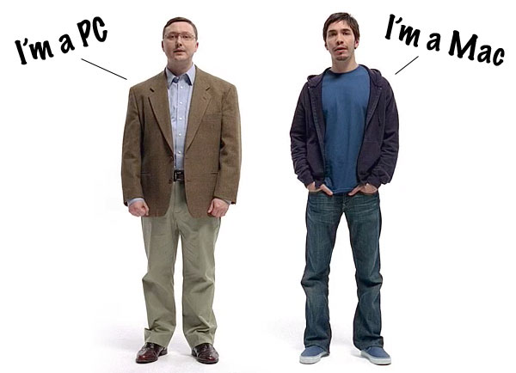
Hadoop Vs. Spark
Spark - New kid on the block
Hadoop V1.0 in 2011, Spark V1 in 2014
Spark is fast and leverages current knowledge and infrastructure
Hadoop
Spark
Session 2: Introduction to Spark
Notes:
Session 2: Introduction to Spark

Slide 16
Comparison With Hadoop
Hadoop | Spark
Distributed Storage + Distributed Compute | Distributed Compute Only
MapReduce framework | Generalized computation
Usually data on disk (HDFS) | On disk / in memory (Tachyon)
Not ideal for iterative work | Great at Iterative workloads (machine learning ..etc)
Batch process | - Up to 2x - 10x faster for data on disk - Up to 100x faster for data in memory
Java supported fully. Other language support possible | Compact code Java, Python, Scala supported
No equivalent of shell | Shell for ad-hoc exploration
Session 2: Introduction to Spark
Notes:
Since in Spark, we can store in memory, disk performance issues are reduced dramatically, iterative workloads are possible.
Session 2: Introduction to Spark

Slide 17
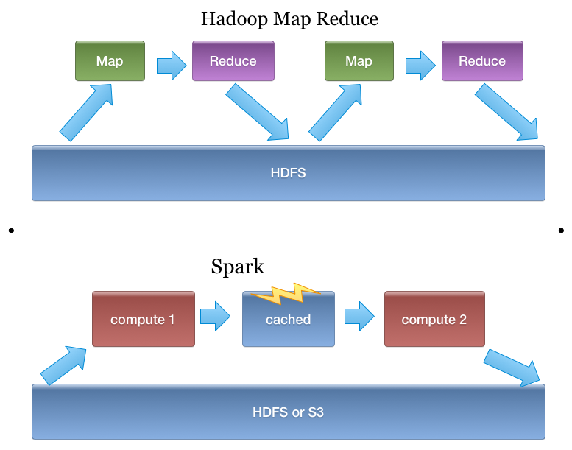
Spark Is Better Fit for Iterative Workloads
Session 2: Introduction to Spark
Notes:
Power of storing in the memory is evident here.
Session 2: Introduction to Spark

Slide 18
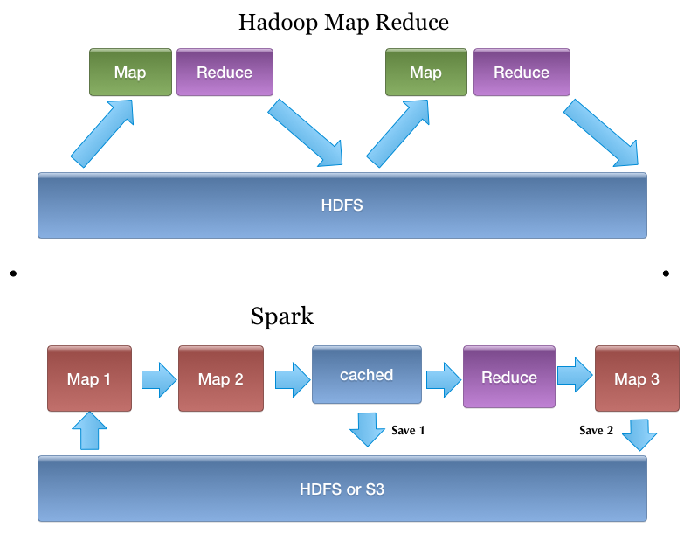
Spark - More Generic Programming Model
Reducing dependency on the Disk
Session 2: Introduction to Spark
Notes:
Session 2: Introduction to Spark

Slide 19
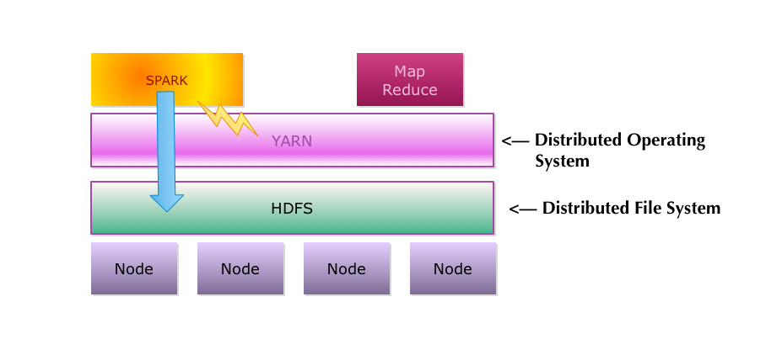
Is Spark Replacing Hadoop?
Spark currently runs on Hadoop / YARN
Can be an alternative to classic MapReduce
Spark can access HDFS data natively
HDFS is a very stable / mature distributed file system
Spark is a fantastic compliment to Hadoop
Session 2: Introduction to Spark
Notes:
Companies have already invested millions of $ to build their Hadoop infrastructure – for the time being Spark looks like a better hitter on the Hadoop team. Future will tell if it replaces Hadoop or not.
Session 2: Introduction to Spark

Slide 20
RDD Concepts
Notes:
Session 3: RDDs and Spark Architecture

Slide 21
What is an RDD?
Resilient Distributed Dataset: Core Spark data abstraction
Distributed collection of elements
Partitioned - usually across different nodes
Read-only (immutable)
Operations execute in parallel on the partitions
Fault tolerant: Can recover from loss of a partition
The "Resiliency"
Efficiently - Re-computed, not stored ⁽¹⁾
Two operation types
Transformation: Lazy operation creating new RDD
e.g. map(), filter()
Action: Return a result or save it
e.g. take(), save()
Session 3: RDDs and Spark Architecture
Notes:
(1) The main challenge in designing RDDs is defining a programming interface that can provide fault tolerance efficiently. Existing abstractions for in-memory storage on clusters, such as distributed shared memory, keyvalue stores, databases offer an interface based on fine-grained updates to mutable state (e.g., cells in a table). With this interface, the only ways to provide fault tolerance are to replicate the data across machines or to log updates across machines. Both approaches are expensive for data-intensive workloads, as they require copying large amounts of data over the cluster network, whose bandwidth is far lower than that of RAM, and they incur substantial storage overhead.
In contrast to these systems, RDDs provide an interface based on coarse-grained transformations (e.g., map, filter and join) that apply the same operation to many data items. This allows them to efficiently provide fault tolerance by logging the transformations used to build a dataset (its lineage) rather than the actual data.1 If a partition of an RDD is lost, the RDD has enough information about how it was derived from other RDDs to recompute just that partition. Thus, lost data can be recovered, often quite quickly, without requiring costly replication.
[Matei Zaharia, et. al, Resilient Distributed Datasets: A Fault-Tolerant Abstraction for In-Memory Cluster Computing, at: https://www.cs.berkeley.edu/~matei/papers/2012/nsdi_spark.pdf]
Session 3: RDDs and Spark Architecture

Slide 22
RDD Lifecycle
RDD is created by either:
Loading an external dataset
Distributing a collection
RDD is transformed:
e.g. filter out elements
Result: A new RDD ⁽¹⁾
Often have a sequence of transformations
Data is eventually extracted
By an action on an RDD
e.g. save the data
At right, we read/transform a log file, then save the result
Create: Read a log file (e.g. from HDFS) sc.textFile(“server.log”)
RDD 1
Filter: Keep lines starting with "ERROR"
RDD 2
Filter: Keep lines containing "mysql"
RDD 3
Action: Write result to storage
Session 3: RDDs and Spark Architecture
Notes:
(1) Transformations are operations on an RDD that create a new RDD
The new RDD contains the result of the transformation on the old RDD(s)
Recall that an RDD is read-only, so is never affected by a transformation - it's just the input to creating a new RDD
An action is an operation that externalizes a value
Either returning a value to the driver program, or storing something in external storage
Session 3: RDDs and Spark Architecture

Slide 23
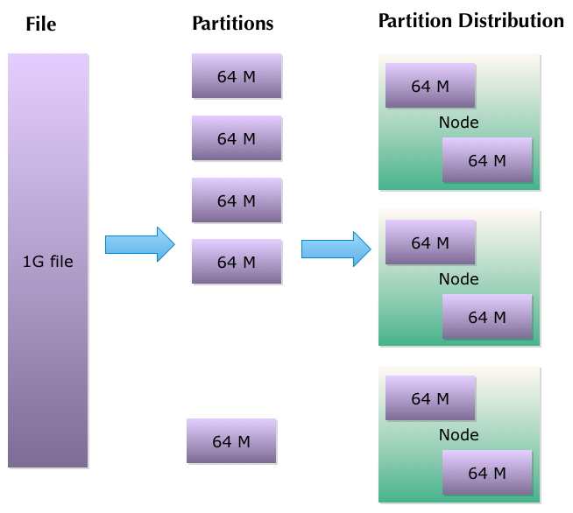
RDD Partitioning
Data in an RDD is partitioned around the cluster
e.g. With HDFS, Spark creates RDD partitions from HDFS blocks
Partitions are distributed
Session 3: RDDs and Spark Architecture
Notes:
HDFS will store the file in blocks (64M - 128M) on data nodes that live in the cluster
These data nodes can also be Spark workers, a common situation when using HDFS with Spark
Spark will partition its RDD in the same blocks as HDFS stores it, as this is the most efficient
Session 3: RDDs and Spark Architecture

Slide 24
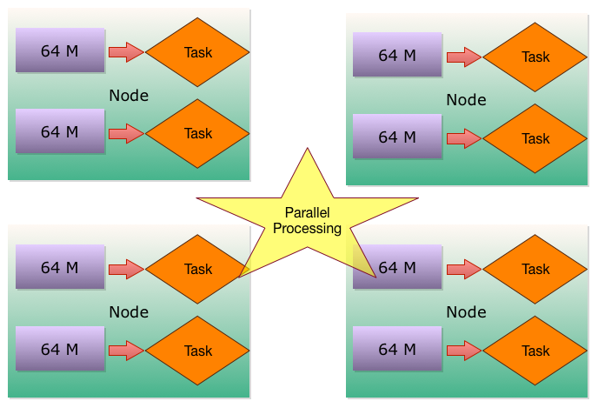
RDD Partitions and Parallel Processing
Nodes execute tasks in parallel on the partitions
Spark will co-locate tasks with their data (HDFS block if HDFS)
Session 3: RDDs and Spark Architecture
Notes:
If you have a series of transformations running on an RDD, then Spark will keep using the same data
Session 3: RDDs and Spark Architecture

Slide 25
Spark SQL / Dataframes
Notes:
Session 6: Spark SQL

Slide 26
Spark Illustrated
Spark
SQL
Spark
Streaming
ML lib
GraphX
Spark Core
Standalone
YARN
MESOS
Session 2: Introduction to Spark
Notes:
See the next slide for a brief explanation of each component
Session 2: Introduction to Spark

Slide 27
Why Spark SQL?
Spark API is still fairly complex
Easier to code than Hadoop/MR, but still a large API
Difficult to model some areas via the standard Spark API
It is hard to do specific optimizations
The objects and transformation functions are opaque to Spark
So Spark does mainly generalized optimizations
Many data pipelines require both relational and procedural querying capabilities
The lack of SQL capabilities limits Spark
SQL and relational querying are well known
And there is a lot of data in a format to a relational interface
Session 6: Spark SQL
Notes:
Can load structured and unstructured data sources – JSON, Hive, and Parquet
Allows you query data within a Spark Program as well as via External tools that connect via ODBC/JDBC connectors - such as Tableau
You can join RDDS and SQL Tables using spark programming languages such as Python/Java/Scala.
Session 6: Spark SQL

Slide 28
Goals for Spark SQL?
Support relational processing
On DataFrames & RDDs
On external data sources with an easy-to-use API
Provide high performance
Building from established relational DB techniques
Easy extensibility
Support new data sources
Support new data types
Integrate with advanced analytics
GraphX
MLlib
Session 6: Spark SQL
Notes:
Session 6: Spark SQL

Slide 29
What is Spark SQL
Bridges the gap between relational and procedural methods
Consists of the following pieces
DataFrame API (new, available from spark v1.3)
Provides relational operations on data
Through DSL functions and through SQL ⁽¹⁾
Supports RDDs and external data sources
Integrate with existing libraries (e.g. MLlib)
Catalyst Optimizer
Query optimizer for relational querying
Automatically transforms SQL queries to execute more efficiently
Easily extensible to support new data types and optimizations
Session 6: Spark SQL
Notes:
(1) DataFrame and its associated classes provide a domain-specific language (DSL) for operations
The DSL works at the RDD level, and is sometimes more convenient and expressive than using SQL
It also supports querying via SQL
From release 1.3, SchemaRDD has been renamed as DataFrame – as DataFrame is no longer inherited from RDD.
DataFrames can still be converted to RDD by calling a method .rdd.
Catalyst Optimizer – at its core uses advanced programming language features from Scala such as – Pattern Matching and Quasiquotes
Catalyst supports both rule-based and cost-based optimization.
Quasiquote example
Scala> val tree =q”I am{ a quasiquote }”
Tree: universe.Tree = i.am(a.quasiquote)
Session 6: Spark SQL

Slide 30
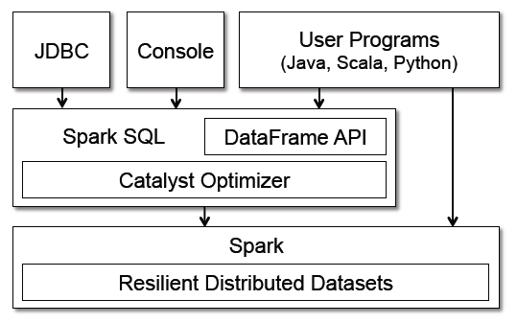
Spark SQL within Spark
Runs as Library over Spark
Exposed to Spark via DataFrame API
Provides external SQL interfaces via JDBC/ODBC and a console
Session 6: Spark SQL
Notes:
Image from "Spark SQL: Relational Data Processing in Spark" by Michael Armbrust, et. al
Session 6: Spark SQL

Slide 31
DataFrames
DataFrame: Distributed collection of data organized into named columns
Equivalent to relational table or data frame in R/Python
Can be built from many data sources
RDDs, structured data files, Hive tables, external databases …
Supports standard Spark API (map, filter, etc.)
Adds new relational API
Supports more optimizations (via Catalyst)
More accessible to developers
More expressive in many situations
e.g. computing multiple aggregates in one SQL statement
Usable via both procedural DSL and SQL interfaces
Session 6: Spark SQL
Notes:
Session 6: Spark SQL

Slide 32
Dataframes Vs. RDDs
RDDs have data
DataFrames also have schema
Dataframes Used to be called ‘schemaRDD’
Unified way to load / save data in multiple formats
Provides high level operations
Count / sum / average
Select columns & filter them
// load json data
df = sqlContext.read
.format(“json”)
.load(“/data/data.json”)
// save as parquet (faster queries)
df.write
.format(“parquet”)
.saveAsTable(“/data/datap/”)

Slide 33
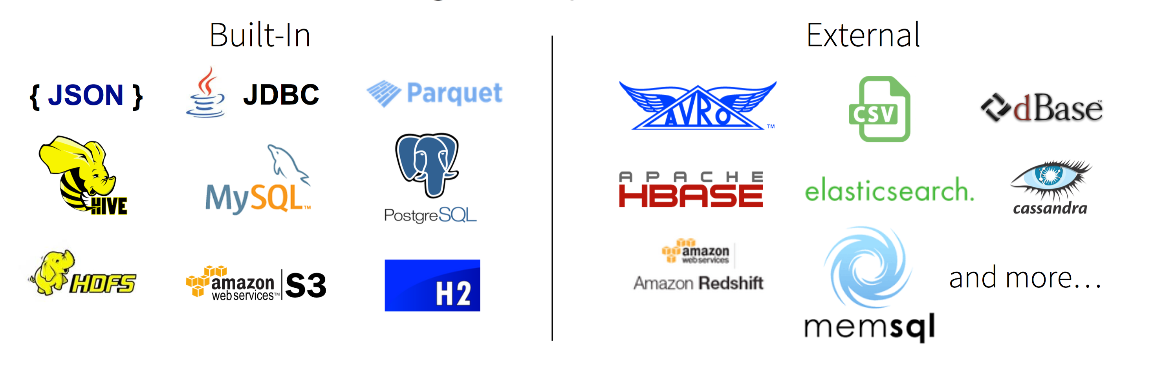
Supported Formats
Notes:
Image from “Spark Data Frames " by Michael Armbrust @ Spark summit 2015 (https://www.youtube.com/watch?v=xWkJCUcD55w&list=PL-x35fyliRwgfhffEpywn4q23ykotgQJ6&index=14)

Slide 34
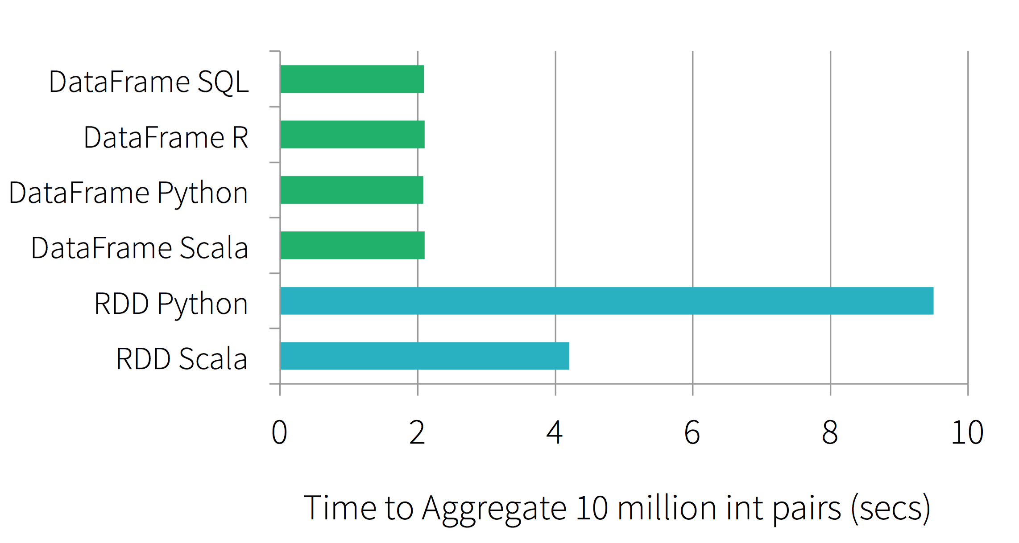
Performance
Generally performs very well - often better than vanilla Spark
Below, we illustrate the performance of running group-by aggregation on 10 million integer pairs on one machine
Spark SQL (the DF lines) outperforms their vanilla counterparts
Session 6: Spark SQL
Notes:
Image and example from “Spark Data Frames " by Michael Armbrust @ Spark summit 2015 (https://www.youtube.com/watch?v=xWkJCUcD55w&list=PL-x35fyliRwgfhffEpywn4q23ykotgQJ6&index=14)
Session 6: Spark SQL

Slide 35
Dataframes Demo
Notes:
~/Documents/Hive-spark.mov

Slide 36
Thanks and questions?
Sujee Maniyam
Founder / Principal @ Elephant Scale
Expert Consulting + Training in Big Data technologies
sujee@elephantscale.com
Elephantscale.com

