Slide 1
Couchbase and Spark
Notes:
Welcome
Introduction

Slide 2
Agenda
Couchbase Overview
Couchbase Data Pipeline
Spark
Demo
Q&A

Slide 3
















What is Couchbase?
Couchbase is the company behind Couchbase Server & Couchbase Mobile
Open source JSON database
Founded 2010
400+ enterprise customers globally
Some of our customers:
Couchbase Server can be deployed as:
Document database
Key-value store
Distributed cache

Slide 4
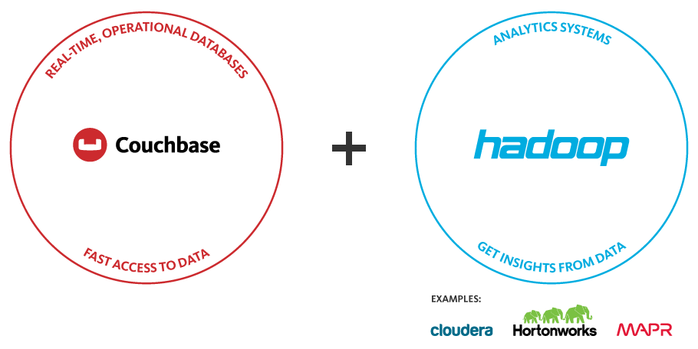
How Does Couchbase Fit In Big Data?
Couchbase and Hadoop are complementary.
Notes:
KEY POINTS: BIG DATA IS NOT ONE THING – IT’S A COMBINATION OF OPERATIONAL (NOSQL) AND ANALYTICAL SYSTEMS. YOU NEED BOTH. COUCHBASE PROVIDES THE OPERATIONAL SOLUTION.
Big data has two major pieces: Operational and Analytical
Operational is about:
Real time
Online, interactive
Customer/consumer facing
Processing data at high velocity
Analytical is about:
Offline analytics
Often batch oriented
Takes time processing
Directly touches relatively few users (business analysts)
These two pieces together form “Big Data”
There’s some overlap
NoSQL can deliver some analytics
Hadoop can deliver some operational
But in general each technology designed for separate purposes
Couchbase fits on the operational side, Hadoop on the analytics side

Slide 5
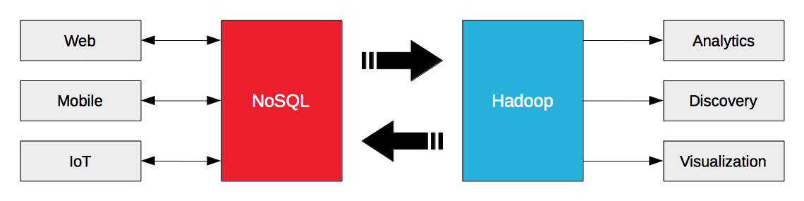
Couchbase and Hadoop
Couchbase is primarily online operational NoSQL datastore, low latency, scalable
Data Source
Example: Pulling user profiles into Hadoop for deep analytics
Data Sink
Example: training machine learning models that are then cached / served from Couchbase

Slide 6



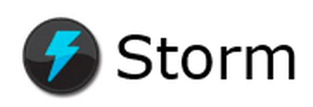

Couchbase and Hadoop
All Data
Precompute Views (Map Reduce)
Batch Layer
Batch
Recompute
Couchbase Hadoop Connector (Sqoop)
Partial Aggregate
Partial Aggregate
Partial Aggregate
Serving Layer
New Data Stream
Batch Views
Merged View
Merge
Real-Time Views
Real-Time Data
Process
Stream
Incremental Views
Speed Layer
Real-Time
Increment
Notes:
- Improve the animation for data handling – refresh existing sales deck and deep dives.

Slide 7
Couchbase and Hadoop
All Data
Precompute Views (Map Reduce)
Batch Layer
Batch
Recompute
Couchbase Hadoop Connector (Sqoop)
Partial Aggregate
Partial Aggregate
Partial Aggregate
Serving Layer
Stream / Data Ingestion
Store
Serving merged results / responses
New Data Stream
Batch Views
Merged View
Merge
Real-Time Views
Real-Time Data
Incremental Data / Stream processing
Process
Stream
Incremental Views
Speed Layer
Real-Time
Increment
Notes:
Using Couchbase as the high performance, low latency, scalable data store to support personalized interactions
Couchbase, as real-time operational database may be generating real-time data to feed into both the batch and real-time layers
In some use cases, Couchbase is used to perform real-time processing and analytics – M/R views
Some customers are using Couchbase as the data store to for stream processing
Email from Michael on streaming data from CB to Spark via Kafka:
well, Kafka is one way but it also uses DCP under the covers. I actually need to make some changes to the DCP implementation in the java client and my plan is to have DCP support in dp2 (a month later or so). So once we are GA, there will be a 100% way to stream data directly into a DStream (spark streaming).
And of course you can easily implement simple polling of let’s say a view, and grab the full docs that match for example a time interval.

Slide 8



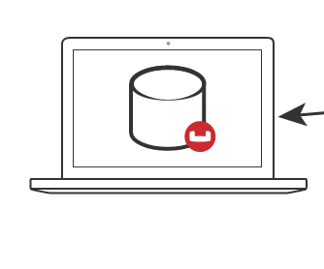
Connectors - Overview
unknown application users
analyst/data scientist/engineers
Spark
NoSQL Database
DCP
Kafka
Hadoop
Sqoop
XDCR v1
Storm
Elasticsearch
Notes:
Work people do in these systems -
Training ML models
ETL / Data wrangling
Aggregations
Reporting / BI
Kafka is a data multiplexer – some people are still going to want to do this, but it’s designed for higher latency applications with a known high complexity (e.g. ebay – many different consumers for information)
Traditional data warehouse – definitely will be a different programming language – how do you make sense of the data feed? You get into the problems that making changes on one side introduces tons of complexity on the other
Downsides – maturity is not 100% on the Spark side, still in active development in the Couchbase side
KV / N1QL

Slide 9
Connector Overview (DCP)
Spark & Kafka Connectors leverage Java SDK (JVM Core Library for DCP)
Maintenance release around 3rd Tuesday most months
Spark & Kafka release later in the month to take advantage of Java SDK
QE validation for Elasticsearch, Kafka & Spark
Notes:
Streams Data
Inserts, Updates, Deletes
Ordered (Sequence)
Checkpoints
Replay / Restart
Internal
Node to Node (Replication and XDCR)
External
Kafka, Spark, and more

Slide 10
Database Change Protocol (DCP)
Innovative protocol for data sync in Couchbase Server
Increases data sync efficiency with massive data footprints
Removes slower disk-IO from the data sync path
Improves latencies to replication for data durability
Powers many critical functions
Data replication
XDCR (Cross Datacenter Replication) for HA / DR
Maintains indexes
Connectors
Spark & Kafka connectors use standard Java SDK Core IO library for DCP
Notes:
Streams Data
Inserts, Updates, Deletes
Ordered (Sequence)
Checkpoints
Replay / Restart
Internal
Node to Node (Replication and XDCR)
External
Kafka, Spark, and more
Data replication – one node connecting to another node and making a replica (in CB, there is one active version of any piece of data. A replica is exactly that – a copy that is ready to take over if something goes wrong)
XDCR – moving data to another cluster

Slide 11
Couchbase – Database Change Protocol
Streams data
Mutations (Inserts, Updates, Deletes)
Ordered (Sequences) > Replay / Restart
Checkpoints (Snapshots)
Memory-based
Distributed
Internal (Intra-cluster replication, inter-cluster replication)
External (Spark, Kafka, Hadoop, Storm)
http://www.couchbase.com/connect/agenda/deep-dive-dcp-streaming-protocol-cluster-communication/

Slide 12





What are tools?
Operational: Database
Analytical: File System + Batch Processing (MR)
Analytical: Stream Processing (DAG)
Infrastructure: Messaging
Analytical: In-Memory Batch & Stream Processing (DAG)

Slide 13




Why are they needed?
Operational
Analytical
Velocity
Volume

Slide 14
How do they help?
Operational
Velocity
Analytical
Velocity
Analytical
Volume

Slide 15
Couchbase Spark Connector

Slide 16
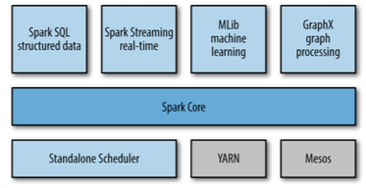
Spark
Fast and general engine for big data processing with libraries for advanced analytics
Spark Core:
task scheduling
memory management
fault recovery
interacting with storage systems
Notes:
Spark Core
Automatic Cluster and Resource Management
Creating and Persisting RDDs
Java, Scala APIs
Spark SQL
Easy JSON handling and querying
Tight N1QL Integration
Spark Streaming
Persisting DStreams
DCP source (experimental)

Slide 17
Why is Spark popular?
In-memory compute engine for Hadoop & other platforms (e.g. SAP HANA)
Fast
Claims 100x better than MapReduce when in-memory, 10x on disk
Sophisticated
can run most advanced algorithms
Easy to develop
Well designed APIs in Java, Scala, Python, now R
Supports SQL, Dataframes, and many other formats
Interactive shell
Unified Lambda architecture (mostly)
Same code for streaming and batch
Notes:
Spark is much better for highly iterative algorithms and interactive queries – which is important, given that the majority of jobs work on 100GB or less of data (small big data)
There’s not much that Hadoop MR is better at performance-wise, possibly if data set is orders of magnitude larger than cluster RAM, but that’s speculation

Slide 18
Couchbase Spark Connector
application users
data scientists &
data engineers
DCP
Features
Automatic cluster & resource management
Create RDDs from KV, N1QL, Views
Create DStreams from DCP feeds
Persist RDDs and Dstreams
Support for DataFrames and SparkSQL
Notes:
Analyze other

Slide 19
Couchbase Spark Connector
Operational
Data Store
XDCR
Separate cluster for workload isolation
Results streamed back as needed to support applications

Slide 20
Couchbase Spark Connector
Available Now: 1.0 GA
Spark Core
Create RDDs from Documents, Views and N1QL Queries
Write RDDs into Couchbase
Automatic cluster and resource management
Spark SQL – Data frames based on N1QL
Spark Streaming
Persisting DStreams
Experimental support: use DCP feeds to create Spark streams
Future Releases
Maintenance releases most months
Support for Spark 1.5
Spark R
N1QL & view on RDDs
Hints for views & queries
Databricks certification
Schema inference on random docs
github.com/couchbaselabs/couchbase-spark-connector
https://issues.couchbase.com/projects/SPARKC
Notes:
Fully transparent cluster and bucket management, including direct access if needed

Slide 21
Spark

Slide 22
How can we use Spark – instead of Hadoop
Output
Couchbase
Spark
Input

Slide 23
How can we use Spark – with Hadoop
Output
Couchbase
Spark
Hadoop
Input
Input

Slide 24
How can we use Spark – instead of Storm
Output
Couchbase
Spark
Stream

Slide 25
Couchbase to Spark: Parallel Import/Export
Couchbase Server 1
Server 1
Spark 1
vBucket 1
Task
vBucket 2
Task
Couchbase Server 1
Server 2
Spark 2
vBucket 3
Task
vBucket 4
Task
Couchbase Server n
Server 3
Spark n
vBucket 1023
Task
vBucket 1024
Task

Slide 26
Using the Spark connector – RDDs (Core)
val cfg = new SparkConf()
.setAppName("couchbaseQuickstart") // give your app a name
.setMaster("local[*]") // set the master to local for easy experimenting
.set("com.couchbase.bucket.travel-sample", "”) // open the travel-sample bucket
val sc = new SparkContext(cfg)
sc.couchbaseGet[JsonDocument](Seq("airline_10123", "airline_10748")).collect().foreach(println)
sc.couchbaseView(ViewQuery.from("airlines", "by_name").limit(10)).collect().foreach(println)
val query = "SELECT name FROM `travel-sample` WHERE type = 'airline' ORDER BY name ASC LIMIT 10”
sc.couchbaseQuery(Query.simple(query)).collect().foreach(println)
// sc.something().saveToCouchbase()
http://developer.couchbase.com/documentation/server/4.1/connectors/spark-1.0/working-with-rdds.html

Slide 27
Using the Spark connector – DataFrames (SQL)
val sql = new SQLContext(sc);
// Load Airports from Couchbase
val airports = sql.read.couchbase(schemaFilter = EqualTo("type", "airport"))
// find all landmarks in the same city as the given FAA code
val toFind = "SFO" // try SFO or LAX
airports
.join(landmarks, airports("city") === landmarks("city"))
.select(airports("faa"), landmarks("name"), landmarks("url"))
.where(airports("faa") === toFind and landmarks("url").isNotNull)
.orderBy(landmarks("name").asc)
.show(20)
http://developer.couchbase.com/documentation/server/4.1/connectors/spark-1.0/spark-sql.html

Slide 28
Using the Spark connector – DStreams (Streaming)
val ssc = new StreamingContext(cfg, Seconds(2))
val stream = TwitterUtils.createStream(ssc, None, Seq())
val hashTags = stream
hashTags.foreachRDD(rdd => {
rdd.map(status =>
JsonDocument.create(status.getId.toString, JsonObject.create().put("text", status.getText)))
.saveToCouchbase()
})
ssc.start()
ssc.awaitTermination()
http://developer.couchbase.com/documentation/server/4.1/connectors/spark-1.0/spark-streaming.html

