Slide 1
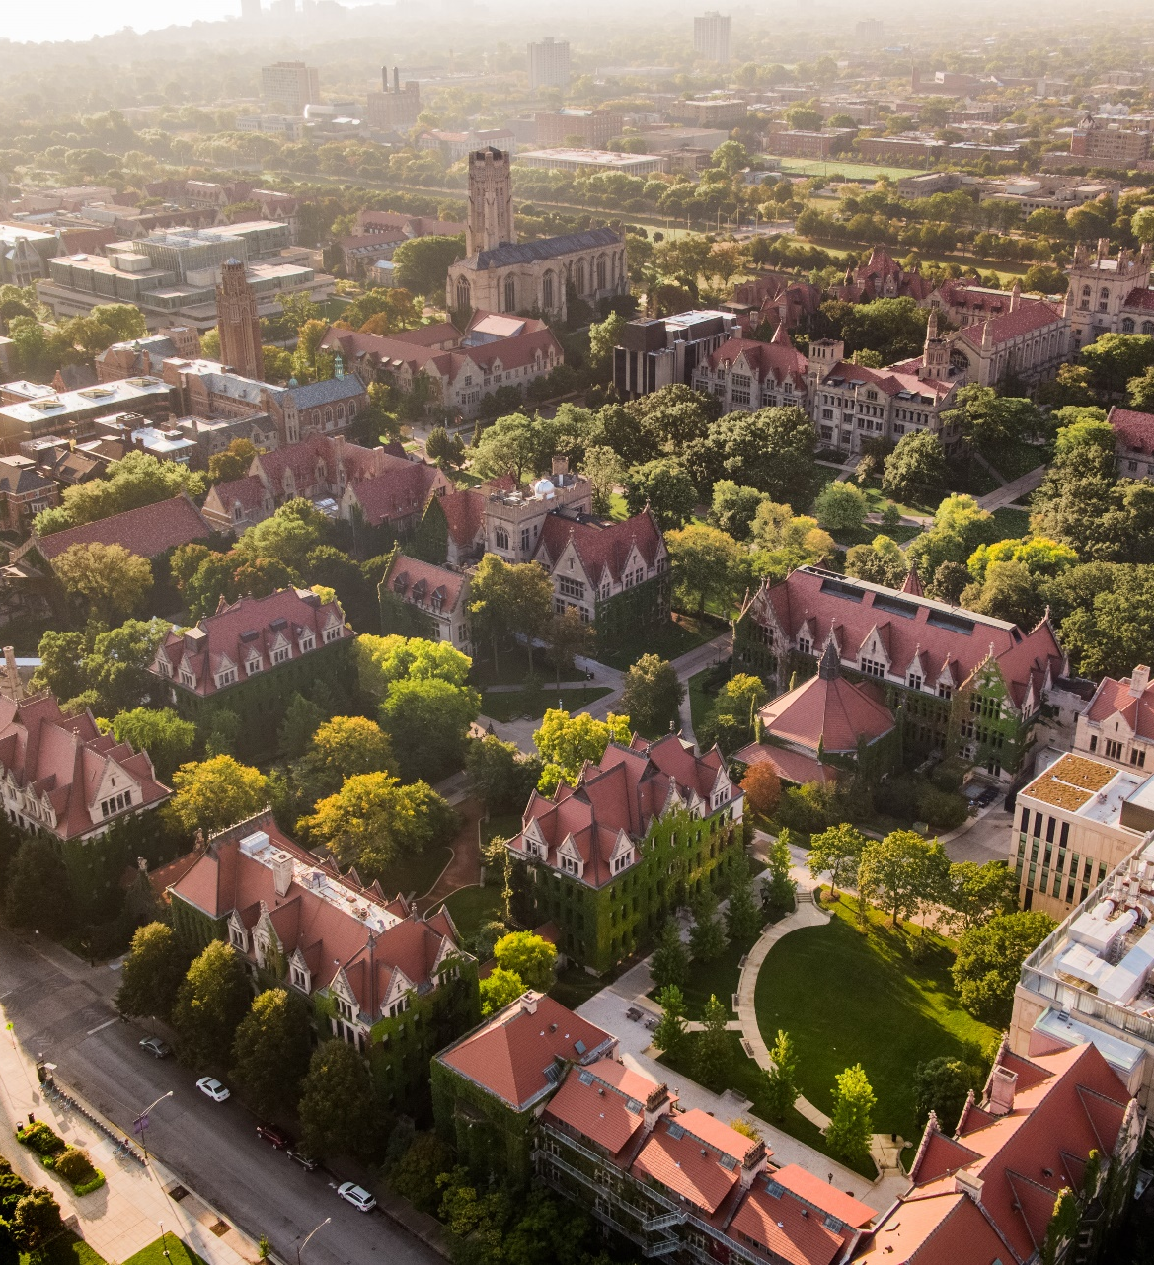
The interesting parts of being a data scientist
By Jonathan Williams
July 2026

Slide 2
When I was your age, I wanted to study statistics.
And so I did.
But back then, there was no way to study data science.
This presentation highlights the difference – no statistics needed!

Slide 3
Introductions
What is data science?
The data science life cycle
Case study: Chicago restaurant inspections
Demonstration

Slide 4
1. Introductions

Slide 5
I’m Jonathan. I’ve bummed around a few different jobs and industries, as a statistician and as a data scientist.
High School
Tallahassee, FL
College
University of Chicago
National security
DHS-funded summer scholarship positions
First masters
University of Chicago
Litigation consulting (expert witness)
10 years
Lawrence Livermore N.L.
Economics with a statistical focus
Second masters
University of Chicago
M.Sc. Analytics ->
MS Applied Data Science
Data science consulting
Manager/team lead
Local governmental clients
Teaching
4 years
University of Chicago
Full-time 4 years
Teach statistics, data science, and consulting
Oak Ridge N.L.
A.B. Statistics
S.M. Statistics
Part-time 4 years
First job: clerk/runner for a law firm

Slide 6
I’m about 24 years older than you. In 2050, I might be retiring. What will you be doing/what will you have done?
“I don’t know” is a perfectly fine answer.
So is, “I don’t care”! You don’t have to have it all figured out.

Slide 7
2. What is data science?

Slide 8
It’s a surprisingly tricky question, even for a professional. Let’s try to answer this by analogy:
Most professionals make goods or provide services
If I were a sculptor, how would you be able to tell? What would convince you that I’m a good sculptor?
If I were an architect, how would you be able to tell? What would convince you that I’m a good architect?
Okay, now what about data scientist?

Slide 9
Data science is not a hobby or an activity: it’s a trade. Data science without a “client” is just a way to pass time.
A civil engineer does not design bridges for fun
Where would they get the labor and materials?
Who would pay for those?
What infrastructure would the bridge connect to?
What bank did this civil engineer rob to spend months designing bridges for their own amusement?
This is actually a pretty close analogy to data science
A “client” can be internal or external

Slide 10
“Data science” means the profession or tradecraft which helps organizations to better reach their goals through the rigorous collection, study, and summarization of first- and third-party data.

Slide 11
Statistics and data science share some knowledge bases and skill sets, but they are not interchangeable terms.
 | Statisticians | Data Scientists
Education | Graduate degree in statistics, mathematics, biostatistics, etc. | Undergrad or graduate degree in any quantitative field + industry experience
Focus | Theoretical: building better tools, proving new results | Applied: using the best tools to solve old and new problems
Sample questions | How do I construct the best confidence intervals? | How often will my insurer suffer a loss large enough to require reinsurance?
 | How do I design experiments to account for confounding variables? | Does this new drug treat the disease better than the old drug?
 | Why did high-education voters change parties from 2008 to 2016? | Where should we spend our budget during the 2028 election cycle?

Slide 12
Data science helps organizations to make decisions and reach their goals. However, organizational goals vary:
Corporate
Non-profit
Political
Governmental
Examples
Boeing
Anthropic
Alinea
Examples
Examples
Greenpeace
University of Chicago
Legal Aid Chicago
Examples
Examples
Dem Nat’l Committee
Sen. Duckworth ‘28
ERA Caucus
Examples
Examples
City of Chicago
lL State Treasurer
FTC Antitrust division
Examples
Goals
Profit
Growth
Risk mitigation
Goals
Goals
Revenue
Mission fulfillment
Risk mitigation
Goals
Goals
Election wins
Legislative wins
Funding (sometimes)
Goals
Goals
Goals
Service delivery
Efficiency
Equity

Slide 13
Data science work typically occurs within the framework of projects, product launches, consulting contracts, etc.
A park ranger, a pastry chef, or a day trader’s work is operational: a continuous flow of maintenance
By contrast, an architect or a data scientist usually takes discretized project-based work:
Build a recommendation engine for an e-commerce website
Optimize product placement in a grocery store
Plan the 2030 Decennial Census
Nota bene: Everything is in flux! AI is changing the field.

Slide 14
Each individual project can be viewed in several stages, called the data science “lifecycle” or “pipeline”:
Understand the problem
Data discovery
Analysis and modeling
Evaluation
Deployment and impact
Sizing the problem
Talking with SMEs
Research
Choosing target function
Gaining access
Augmenting w/ 3rd-party data
Reviewing documentation
EDA
Pitching solution
Choosing candidate models
Creating features
Checking against assumptions
Iterating to final model
Finding point estimates
Measuring uncertainty
Identifying weaknesses
Performing robustness tests
Reporting
Presenting
Change management
Implementation
Maintenance
Offloading

Slide 15
4. Case study: Chicago restaurant inspections

Slide 16
What are City of Chicago restaurant inspections? Let’s briefly talk about them, and then run our own simulation.
City employs about 50 “sanitarians” who inspect facilities with food licenses
Sanitarians run inspections for:
New licenses
Responding to complaints
“Canvassing” (random check)
Follow-ups after failures for any of the above
About 16,000 licensed facilities

Slide 17
What are City of Chicago restaurant inspections? Let’s briefly talk about them, and then run our own simulation.
Two of you will be “sanitarians”, performing canvass inspections of everyone else, the “restaurant owners”
Everyone starts by standing up
Sanitarians visit anyone in any order. To conduct an inspection, they play a game of rock-paper-scissors with the restaurant owner. When the sanitarian wins, the restaurant owner hands over their ticket and sits down.
A ticket marked with an “F” represents a critical violation of the health code, resulting in a failed inspection.

Slide 18
Let’s apply the steps of the data science lifecycle to help improve Chicago’s restaurant inspection process.
Discussion questions:
Who should we talk to in order to think of ways to improve the restaurant inspections?
What are some of the possible problems with this process, and are we likely to solve them?
How could we define and measure what it would mean to perform the inspections “better”?
Cheaper?
More efficient?
Fairer?
Understand the problem
Sizing the problem
Talking with SMEs
Research
Choosing target function

Slide 19
The problems we can solve are limited both by the data collection process as well as by our own access issues.
Discussion questions:
What sort of data do we need?
Where is it likely to be found?
Would we benefit from any outside datasets?
Are the data clean / usable / fully understood by us?
Data discovery
Gaining access
Augmenting w/ 3rd-party data
Reviewing documentation
EDA
Pitching solution

Slide 20
Many aspiring data scientists are most excited by the modeling and analysis step – the hardest one to demo!
Discussion questions:
What variable should our model predict?
What variable(s) should it use as predictors?
Are there any reasons that the historical data would mislead us about future inspection results?
Would our model upset or harm anyone?
Analysis and modeling
Choosing candidate models
Creating features
Checking against assumptions
Iterating to final model

Slide 21
Instead of delivering a solution which grows stale over time, can we create a report which updates over time?
Discussion questions:
Who will see our work?
Will they be open to our conclusions? If not, how can we make our work seem more valuable to them?
What happens to our work after our direct involvement?
Deployment and impact
Reporting
Presenting
Change management
Implementation
Maintenance
Offloading

Slide 22
Models provide answers. But are they good or bad answers? Sensitive or sturdy? This is why we evaluate.
Discussion questions:
What is our main conclusion?
Why are we confident in this answer (or are we not?)
If we were wrong, what would be a typical error size?
How might we test whether our model really explains the world around us?
Evaluation
Finding point estimates
Measuring uncertainty
Identifying weaknesses
Performing robustness tests

Slide 23
5. Demonstration

