Slide 1
PAYAJO
Save Together.
Grow Together.
A smarter way to run your Ajo or Esusu with friends, family, coworkers, and communities — built end-to-end across mobile, web, and backend.
Flutter mobile app
Next.js web app
FastAPI backend

Slide 2
THE PROBLEM
Traditional Ajo is built on trust.
Trust isn't always enough.
Treasurer disappears
Missed contributions
No payment reminders
One person holds everyone's money, and everyone's trust.
No system to catch who's behind until it's too late.
People forget, and the group quietly falls apart.
Manual record keeping
Money disputes
No transparency
A notebook or a chat thread isn't a ledger.
“I paid already” becomes a fight with no proof either way.
Members can't see the pool, the order, or where things stand.
PayAjo
02

Slide 3
THE SOLUTION
Meet PayAjo.
Every group gets a dedicated reserved account. Every member gets a personal wallet. Every contribution is tracked automatically — so trust is backed by a system, not just a promise.
GROUP POOL
₦2,400,000
12 members · Round 5 of 12
Reserved accounts
Amara O.
Paid
Personal wallets
Every group gets its own dedicated bank account via Monnify.
Deposit once, pay contributions instantly from your balance.
Chidi E.
Paid
Ngozi K.
Pending
Automatic tracking
BVN verification
Every contribution is logged and matched the moment it lands.
Every member is identity-verified before they can join.
PayAjo
03

Slide 4
HOW IT WORKS
Six steps to your first payout.
1
Create your account
2
Verify your identity
3
Create or join a group
Sign up in minutes with your email and phone number.
Quick BVN verification keeps every group member accountable.
Start your own circle or join one with an invite code.
4
Fund your wallet
5
Track contributions
6
Receive your payout
Top up your wallet, or pay a contribution straight from your bank.
See who's paid, who's pending, and where the pool stands — live.
When it's your turn, funds land straight in your bank account.
PayAjo
04

Slide 5
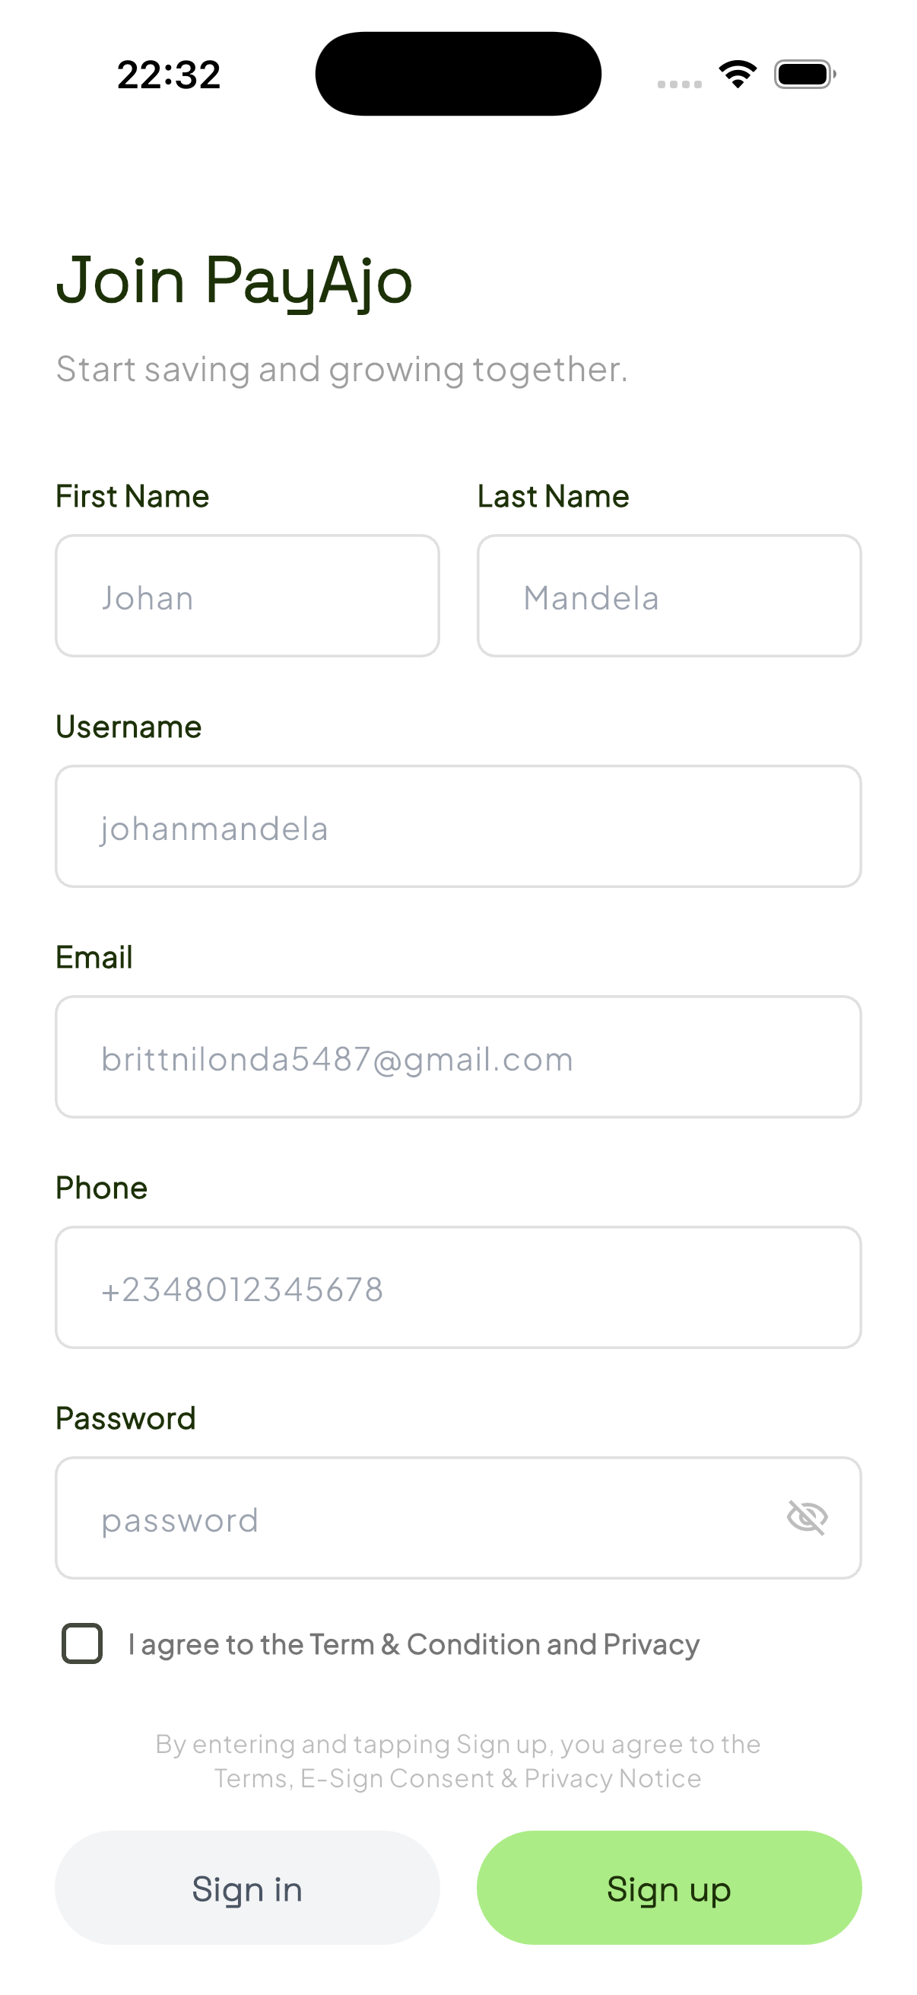
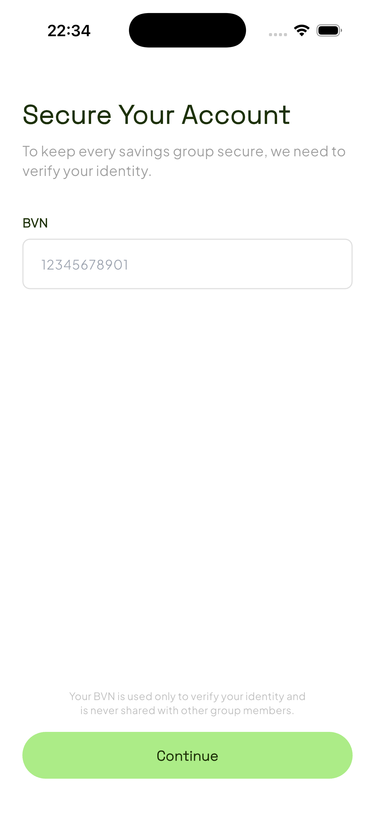
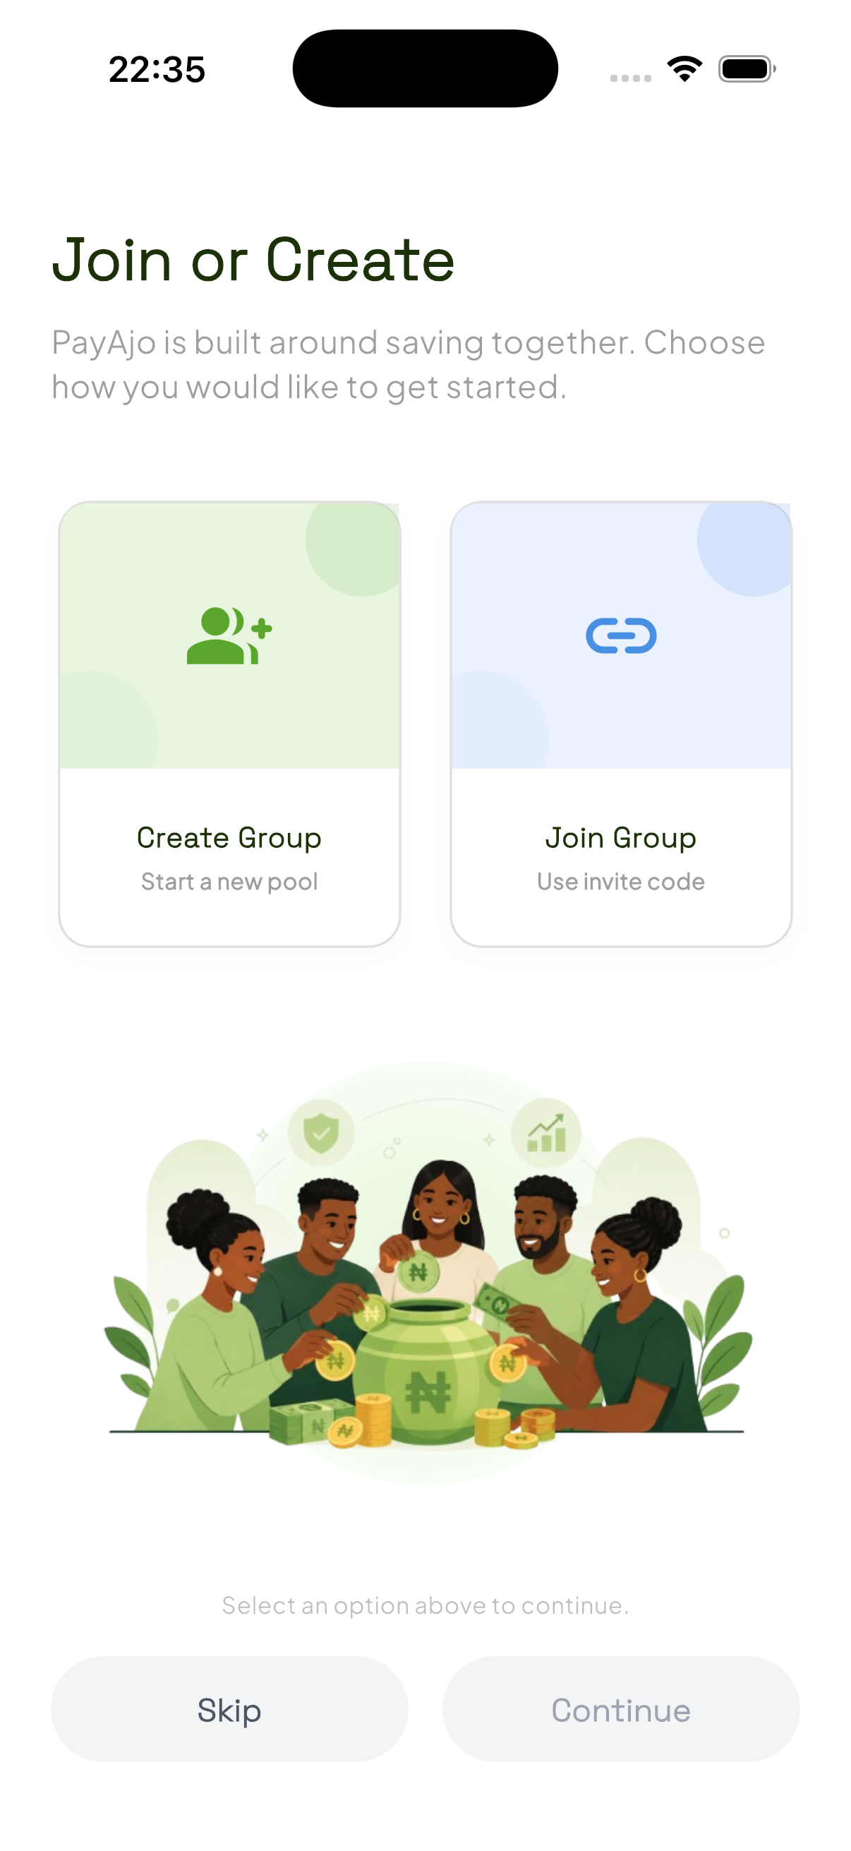
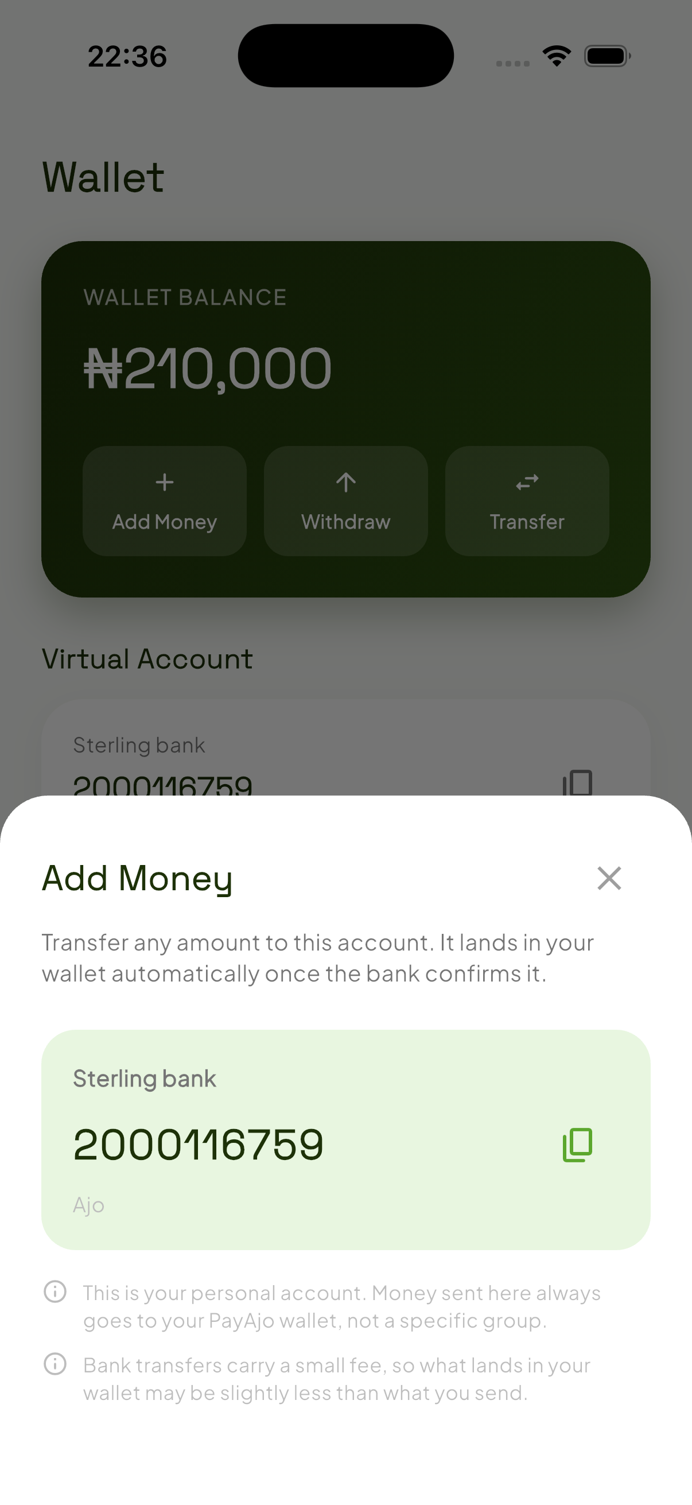
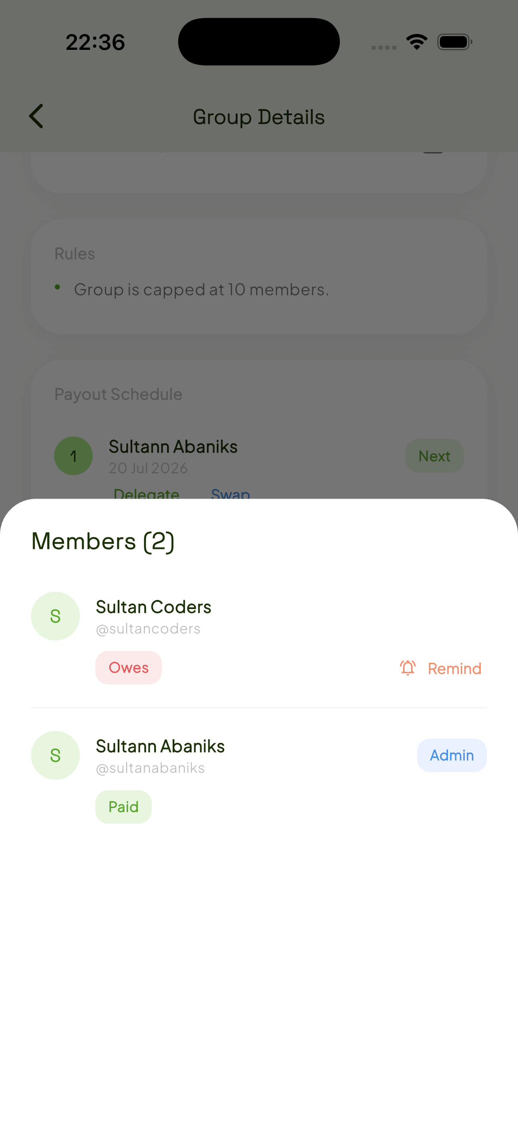
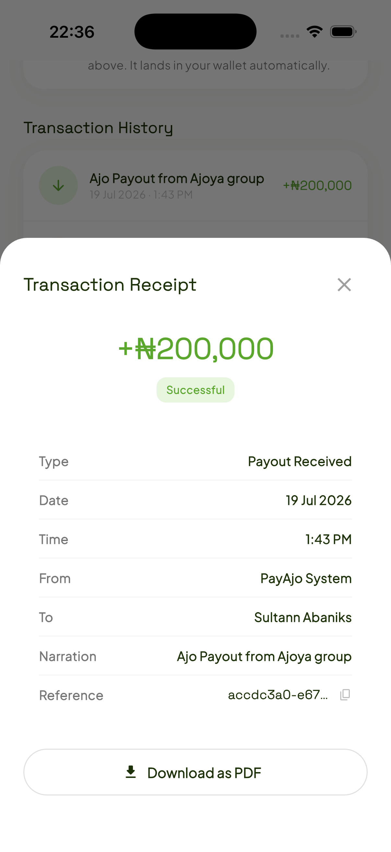
THE PRODUCT
What it actually looks like.
Create account
Verify identity
Join or create
Wallet
Group details
Transactions
PayAjo
05

Slide 6
EVERYTHING YOU NEED
One app, every part of your Ajo.
1
2
3
4
Reserved Virtual Accounts
Personal Wallet
Group Chat
Smart Reminders
Every savings group gets its own dedicated account.
Deposit once. Pay contributions instantly.
Real-time messaging and image sharing, right inside the app.
Automated nudges before a contribution deadline.
5
6
7
8
BVN Verification
Transaction History
Invite Codes
Push Notifications
Only verified members can join a group.
Every payment recorded, timestamped, and visible.
Join groups instantly with a simple shareable code.
Real-time alerts on payments, requests, and payouts.
PayAjo
06

Slide 7
TRUST, ENGINEERED IN
Control stays with the group admin.
PIN-confirmed actions
Configurable approvals
Auto-debit, cycle swaps, delegations, and payouts all require the member's transaction PIN — nothing moves silently.
Admins choose whether cycle swaps and payout delegations need their sign-off, or auto-approve.
Auto-debit, on your terms
Automated backend jobs
Members opt in to automatic contributions, choosing how many days ahead of payout to pull from their wallet.
A scheduler evaluates payouts, reminders, and auto-debits on a continuous cycle — no manual admin work required.
PayAjo
07

Slide 8
UNDER THE HOOD
A real, working full stack.
MOBILE
WEB
BACKEND
PAYMENTS
Flutter + Riverpod
Next.js + Tailwind
FastAPI + PostgreSQL
Monnify
Native iOS & Android app
Full-featured browser app
Async Python API
Reserved accounts, transfers, payouts
MEDIA
PUSH
EMAIL
AUTOMATION
Cloudinary
Firebase Cloud Messaging
Brevo
APScheduler
Avatar & chat image storage
Real-time push notifications
Transactional email delivery
Payout, reminder & auto-debit jobs
PayAjo
08

Slide 9
ONE PRODUCT, TWO PLATFORMS
Built for both, in step.
Capability
Mobile
Web
Auth, KYC & PIN security
✓
✓
Wallet, transfers & receipts
✓
✓
Create, join & manage groups
✓
✓
Cycle swaps & delegations
✓
✓
Real-time group chat + images
✓
✓
In-app & push notifications
✓
✓
PayAjo
09

Slide 10
WHAT'S NEXT
Where we're taking it.
Time-of-day auto-debit
iOS push rollout
Move beyond day-level scheduling to a precise deduction time members can set themselves.
Enable the Push Notifications capability and APNs key to bring parity to iOS delivery.
Richer group analytics
Deeper notification links
Contribution trends and payout history, visualized per group over time.
Tapping a notification jumps straight to the exact group and action that triggered it.
PayAjo
10

Slide 11
PAYAJO
Save Together.
Grow Together.
No more chasing payments. No more missing records. No more disappearing treasurers.
Thank you.

