Slide 1

A Method for Optimizing Pitch Targets
Justin Choi

Slide 2
Motivation
Where should you throw?
Seems easy enough…
Different factors we need to consider:
Count
Command
Stuff
Batter at plate

Slide 3
Initial Steps
How valuable is a pitch?
Frameworks from stuff/location models
Things get tricky with batter, count, etc.
ML doesn’t work here – need alternative!

Slide 4
Modeling Pitch Value
Breaking down the components:
Swing / Take
Whiff / Foul / In-Play
Out / Single / Double / Triple / Home Run
Bayesian hierarchical models with batter random effects
Bambi package in Python
Count, movement, location, etc.
Bayesian approach allows for stable estimation of BBE outcome dist.

Slide 5
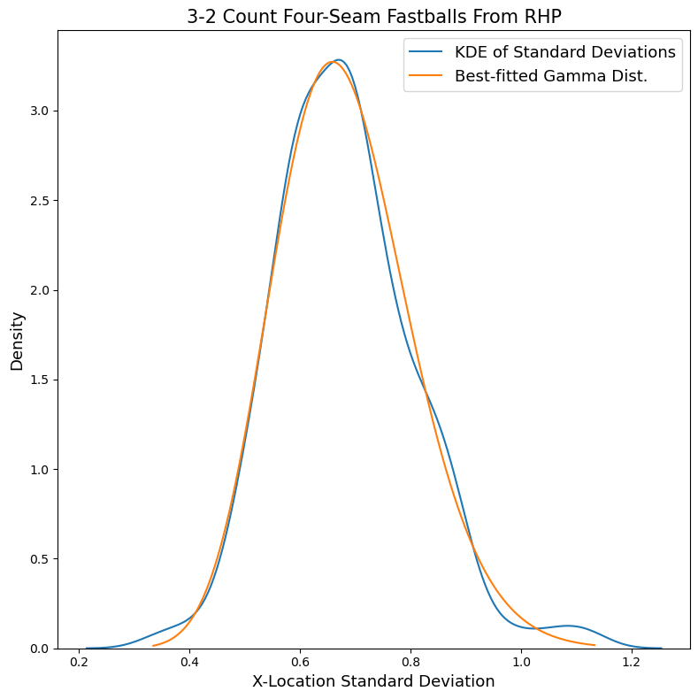
Modeling Pitcher Command
Goal: Estimate covariance matrix of pitcher’s pitch locations
Good command = Less variance
Gamma prior determined by league-wide data
For each pitch type + count, assume bivariate normal dist.
Notes:
Need visual of gamma distribution

Slide 6
Putting It All Together
Initialize: Pitcher, batter, pitch type, count, list of candidate targets
Targets on 5 x 5 rectangular grid (25 targets)
Pitcher, pitch type, and count for covariance matrix estimation
For each target, do:
Simulate pitch locations, with target as mean and estimated covariance matrix
Calculate expected value of each pitch, then average
Return target with best average EV
Notes:
Need visual of candidate targets

Slide 7
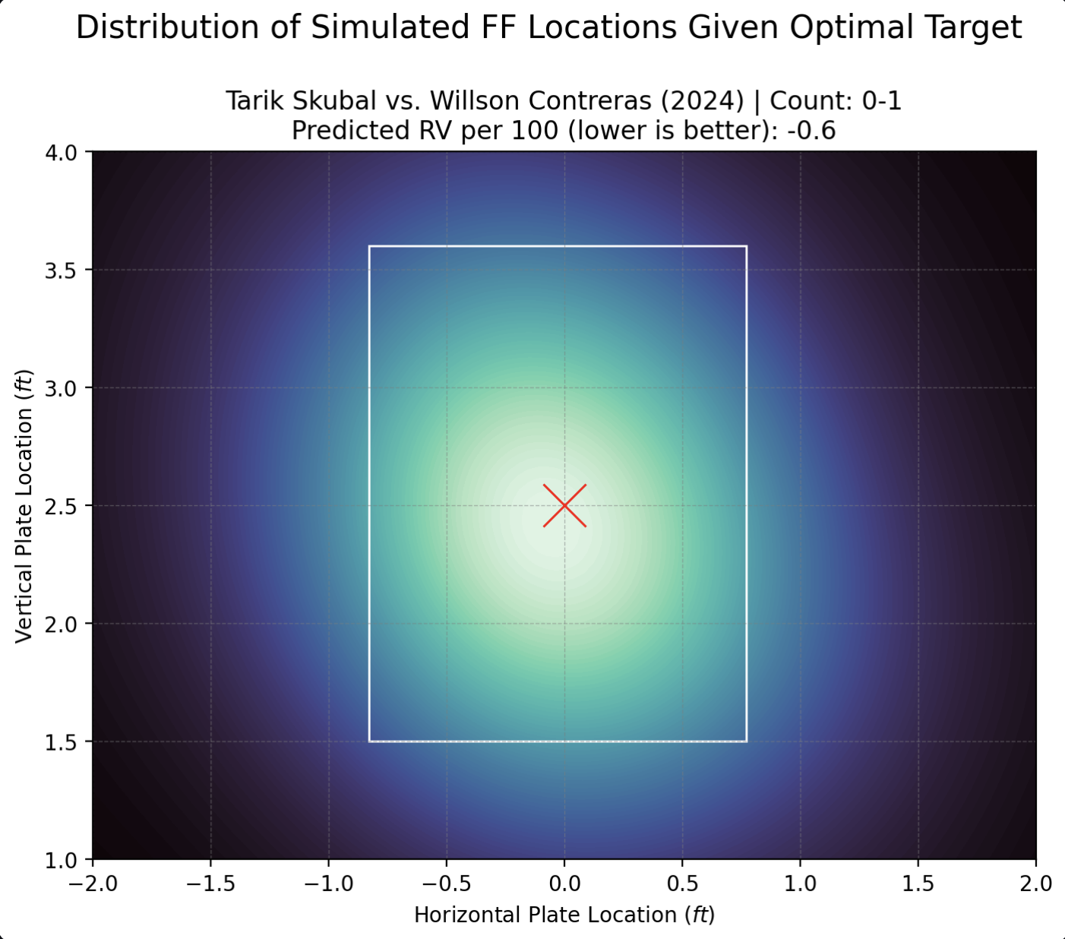

Slide 8
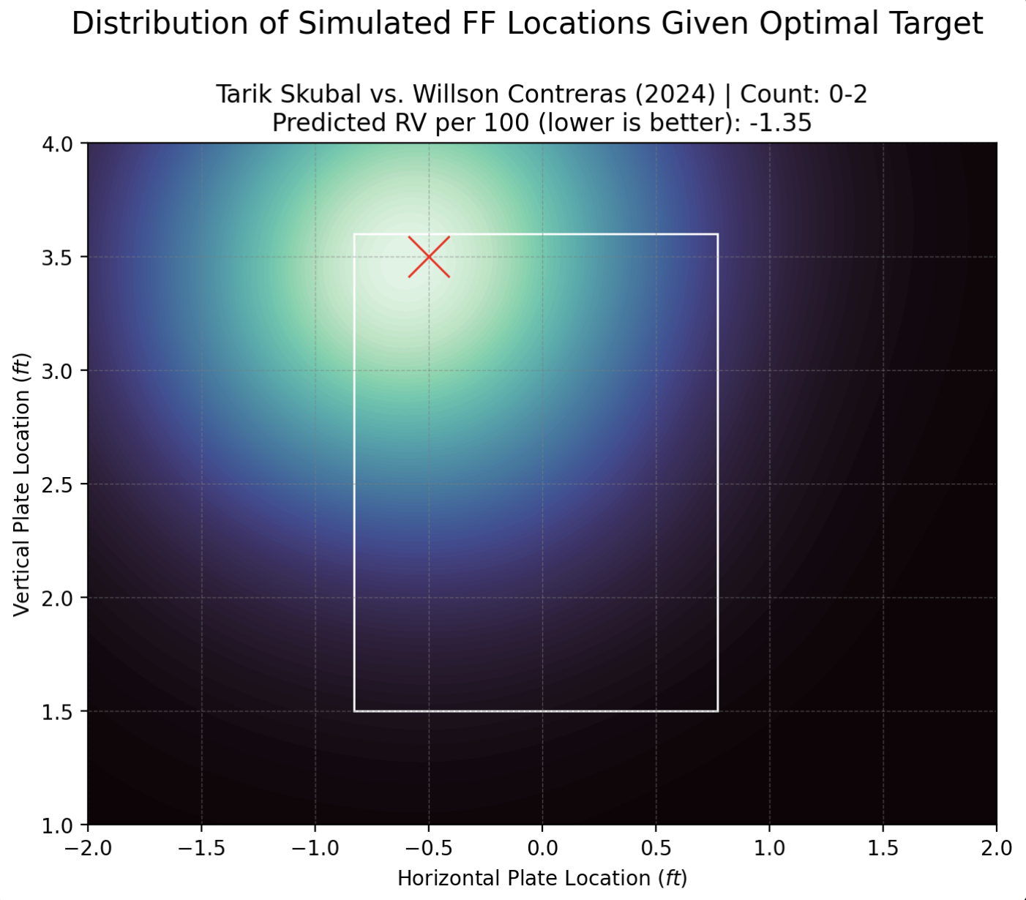
Results
Optimal targets almost always in-zone, except for two-strike counts

Slide 9
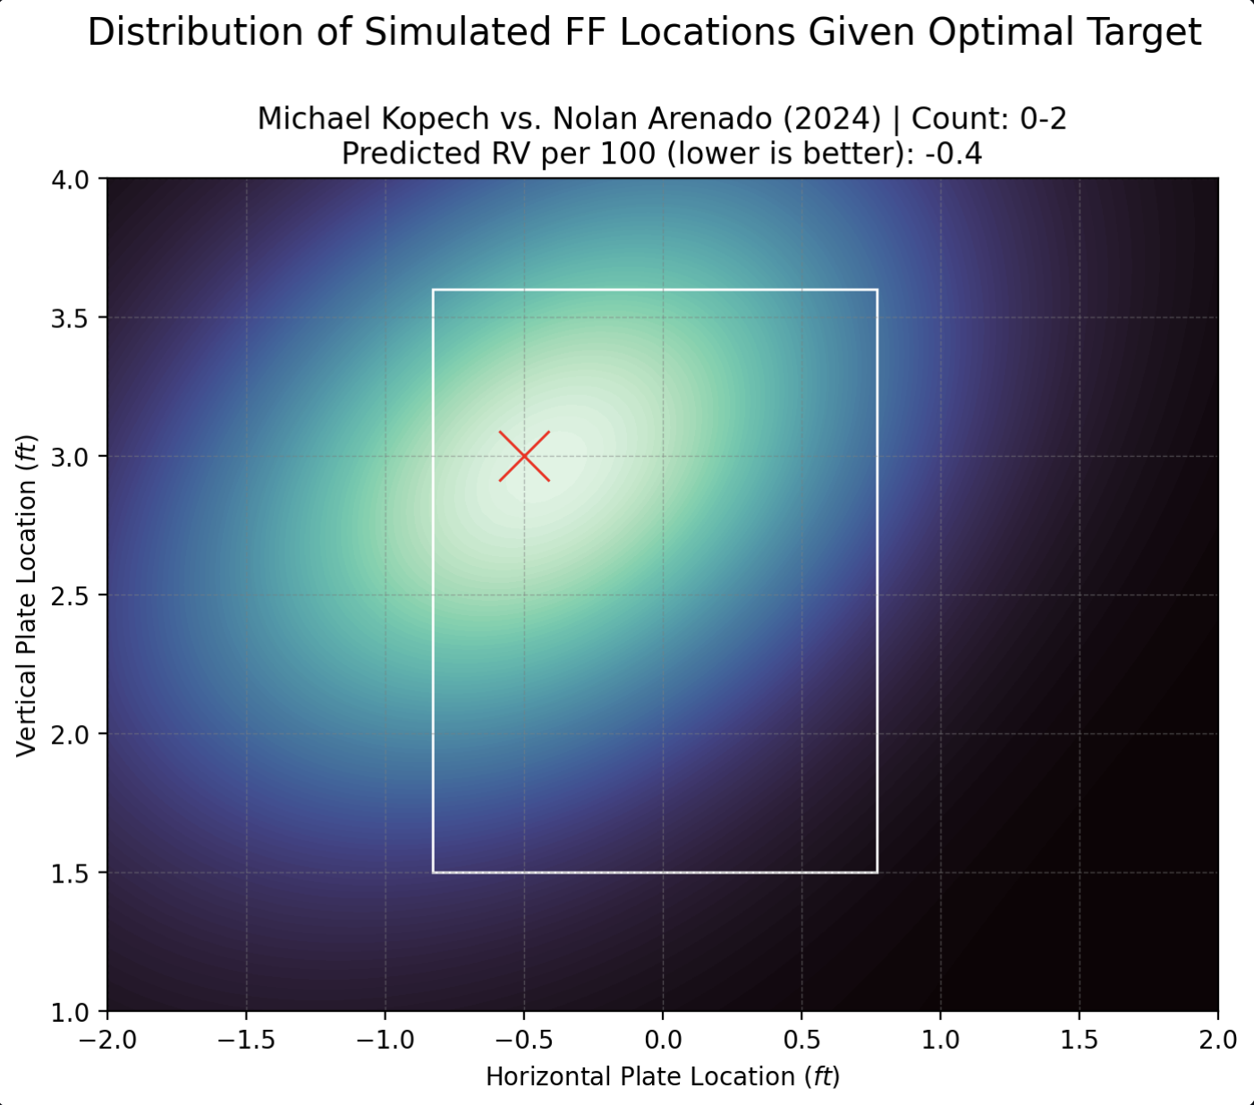
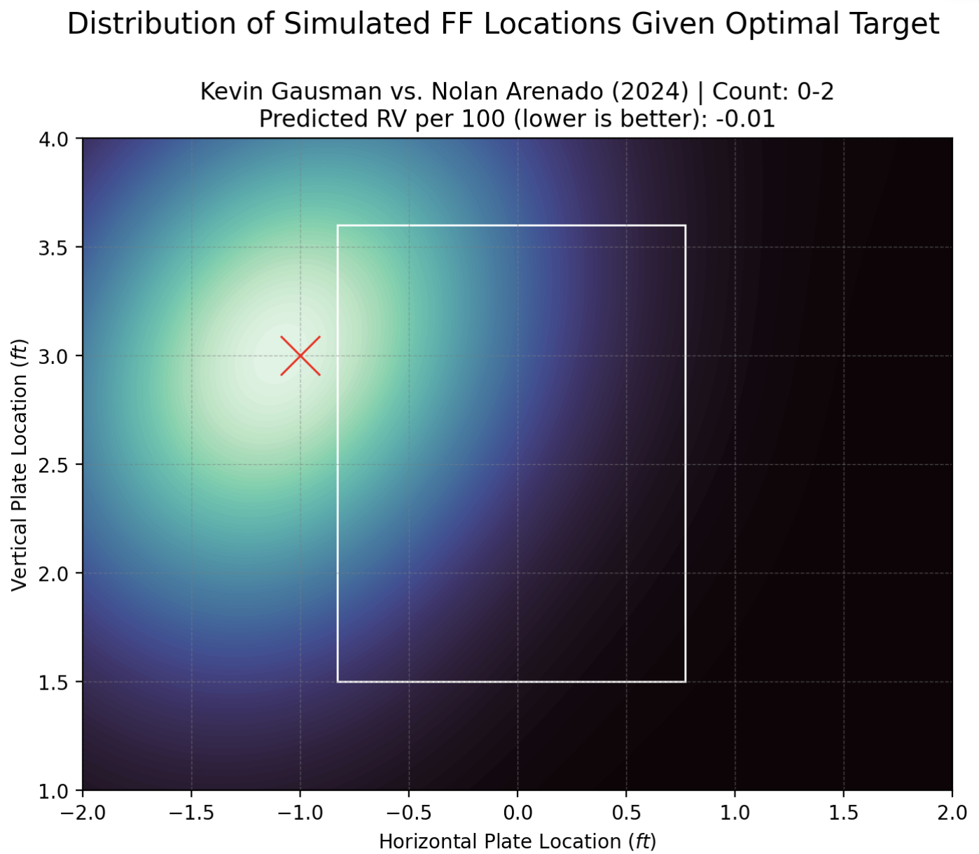
Results
Stuff+: 108
Location+: 90
Stuff+: 94
Location+: 103
Changes to command/stuff can change optimal target and RV

Slide 10
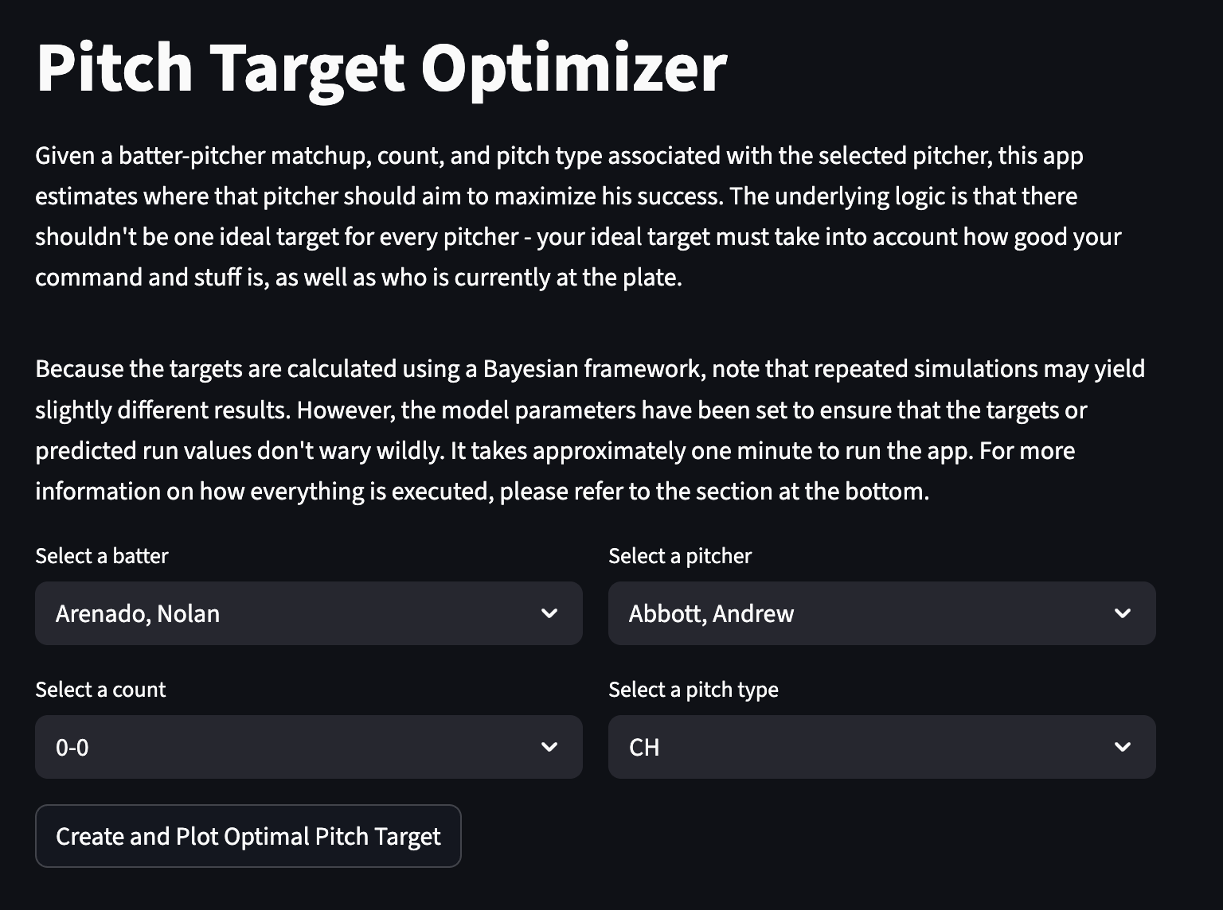
Streamlit App
pitch-target-optimizer.streamlit.app

Slide 11
Conclusion / Next Steps
Takeaways:
Pitcher + batter essential
Locations vary – a lot!
Rush to two strikes
Future:
Take previous pitch(es) into account
Expand customization (movement profiles, targets)

Slide 12
Thank You!
github.com/justinochoi/SaberSeminar2025
Saberseminar for hosting
MLB for pitch-level data

